Slide 1
Uncovering Impact: Bibliometric Approaches to Assessing Library Collections
Jack Young – McMaster University
jkyoung@mcmaster.ca

Slide 2
Use-Based Indicators for Collections Analysis
Journal Impact Factor
The average number of citations received by articles within a given journal over the past 2 years.
Total Institutional Publications
How often authors from your institution publish in a given journal.
Total Institutional Citations
How often authors from your institution cite a given journal.

Slide 3
Bibliometric Indicators for Collections Analysis
Use-Based Indicators
 | BMJ – British Medical Journal | Canadian Medical Association Journal | Astronomy & Astrophysics
Journal Impact Factor¹ | 105.7 | 14.6 | 6.5
Total McMaster Publications (2020-22)² | 62 | 111 | 16
Total McMaster Citations (2020-22)³ | 1407 | 743 | 1014
¹ Journal Citation Reports
² Web of Science
³ InCites Benchmarking & Analytics

Slide 4
Impact-Based Indicators for Collections Analysis
Category Normalized Citation Impact (CNCI)
This metric normalizes an article’s citation count based on the year and subject area in which it was published.
CNCI allows for journal impact comparisons across disciplines (globally & within the institution).
CNCI Example Scores
0.5 = The article has been cited half as many times as expected based on its year and subject area.
1 = The article has been cited exactly as many times as expected based on its year and subject area.
2 = The article has been cited twice as many times as expected based on its year and subject area.

Slide 5
Bibliometric Indicators for Collections Analysis
Use-Based Indicators
 | BMJ – British Medical Journal | Canadian Medical Association Journal | Astronomy & Astrophysics
Journal Impact Factor¹ | 105.7 | 14.6 | 6.5
Total McMaster Publications (2020-22)² | 62 | 111 | 16
Total McMaster Citations (2020-22)³ | 1407 | 743 | 1014
Impact-Based Indicators
Journal CNCI (2020-22)³ | 1.76 | 0.96 | 1.37
McMaster CNCI When Publishing (2020-22)³ | 16.95 | 2.09 | 1.59
¹ Journal Citation Reports
² Web of Science
³ InCites Benchmarking & Analytics

Slide 6
Projecting the Impact of Journal Use
Research Impact “Flows” Through the Library Collection

Slide 7
Projecting the Impact of Journal Use
Research Impact “Flows” Through the Library Collection

Slide 8
Bibliometric Indicators for Collections Analysis
Use-Based Indicators
 | BMJ – British Medical Journal | Canadian Medical Association Journal | Astronomy & Astrophysics
Journal Impact Factor¹ | 105.7 | 14.6 | 6.5
Total McMaster Publications (2020-22)² | 62 | 111 | 16
Total McMaster Citations (2020-22)³ | 1407 | 743 | 1014
Impact-Based Indicators
Journal CNCI (2020-22)³ | 1.76 | 0.96 | 1.37
McMaster CNCI When Publishing (2020-22)³ | 16.95 | 2.09 | 1.59
McMaster CNCI When Citing (2020-22)²⁺³ | 3.35 | 2.33 | 1.75
¹ Journal Citation Reports
² Web of Science
³ InCites Benchmarking & Analytics

Slide 9
Impact-Based Visualizations

Slide 10
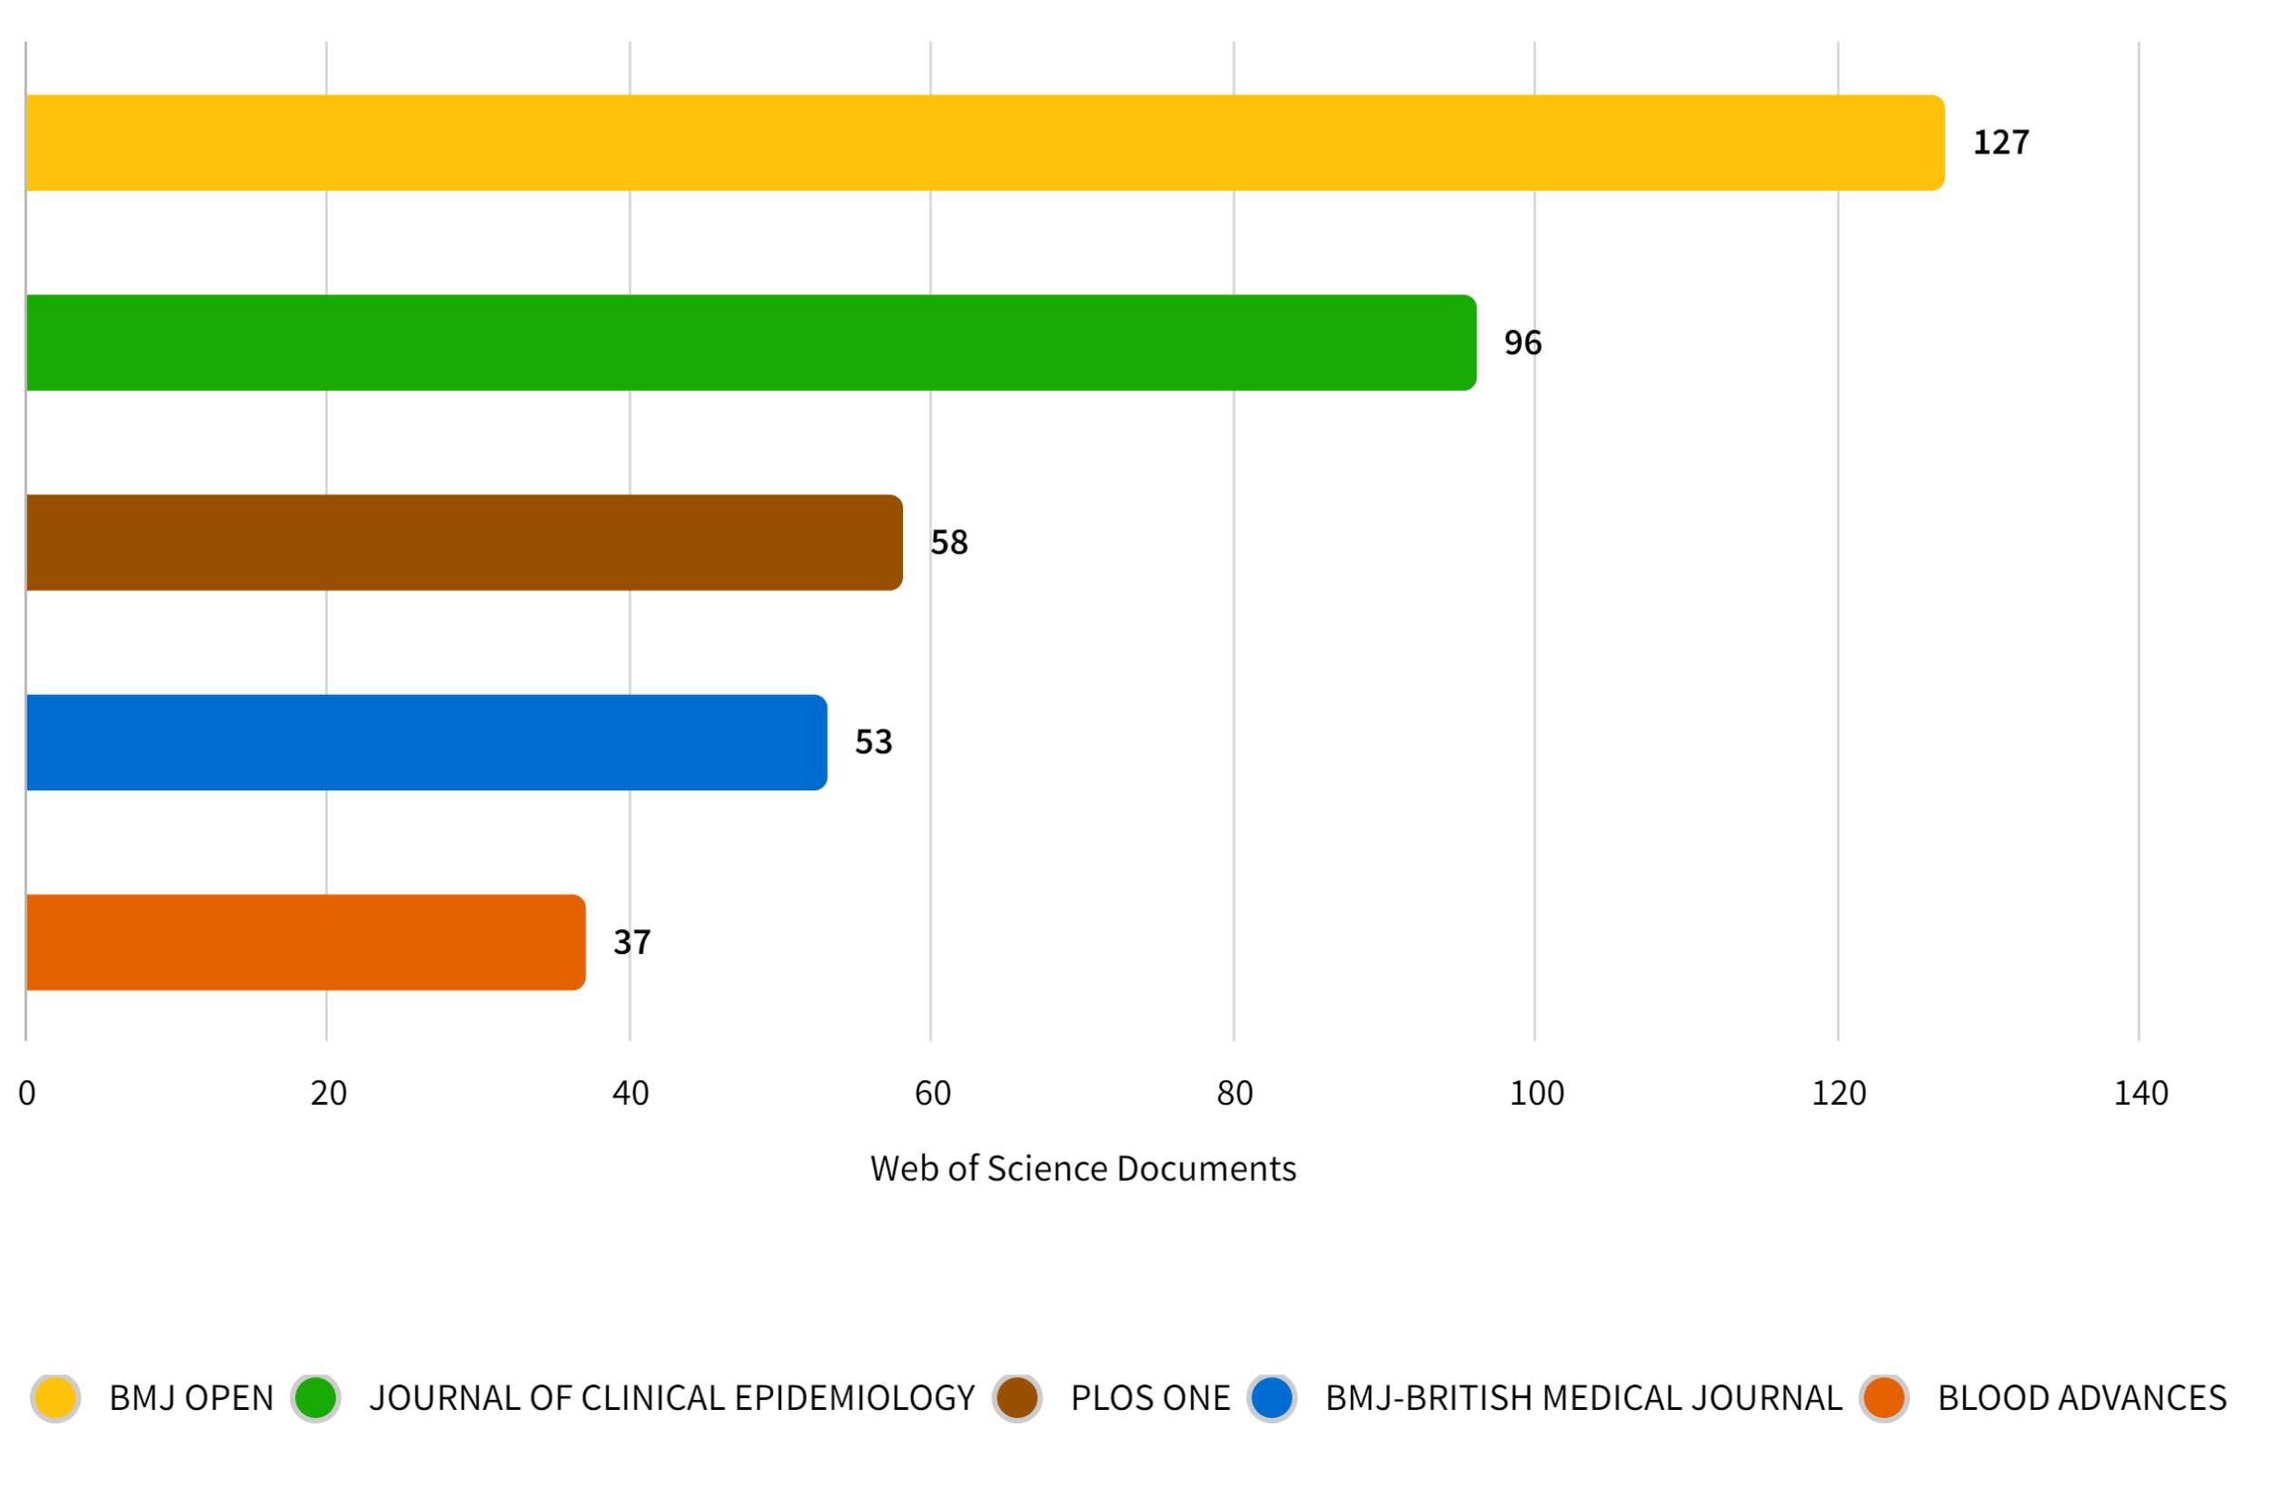
Access to BMJ at McMaster Leads To Publications in….

Slide 11
Access to Astronomy & Astrophysics at McMaster Leads To Collaborations with…
*Network visualization created in VOSviewer

Slide 12
Uncovering Impact: Bibliometric Approaches to Assessing Library Collections
Jack Young – McMaster University
jkyoung@mcmaster.ca

