Slide 1
Assessing the Value of Transformative Agreements
An Automated Approach to Estimating Article Processing Charge (APC) Discounts
Jack Young, Bibliometrics & Research Impact Librarian
Kelvin Lee, Research Software Developer
June 5, 2025

Slide 2
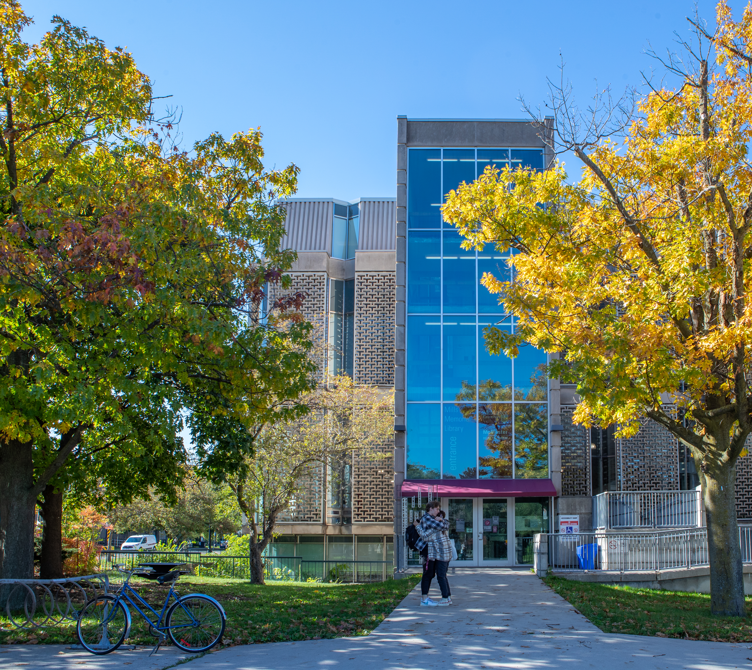
Land
Acknowledgement
McMaster University is located on the traditional Territories of the Mississauga and Haudenosaunee Nations, and within the lands protected by the “Dish With One Spoon” wampum agreement.

Slide 3
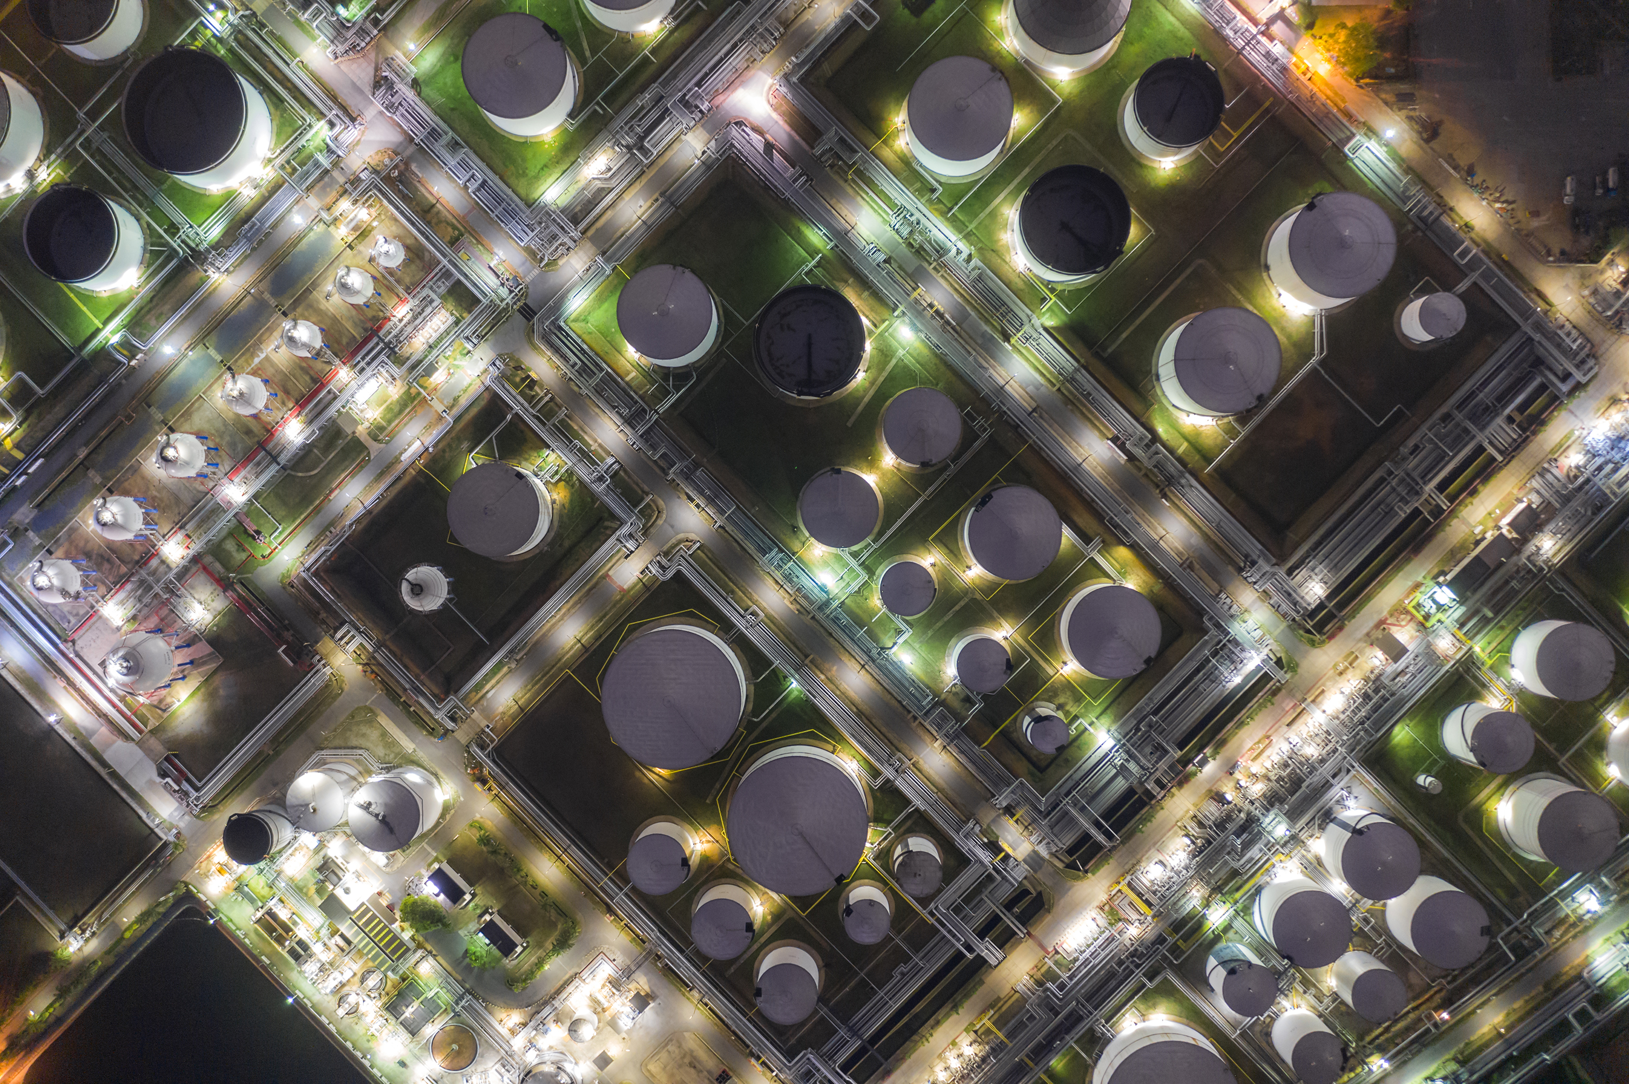
Session Overview
Context
Methodology
Results
Challenges/Limitations
Next Steps
Questions/Feedback
scds.ca
scds@mcmaster.ca

Slide 4
Context
scds.ca
scds@mcmaster.ca

Slide 5
AskResearch at McMaster
AskResearch is a library-hosted service that brings digital research support teams at McMaster together under a single service point. Component teams include:
Research Data Management
Information Security
High-Performance Computing
Research Software Development and Support
Research Impact
Helps simplify navigation for researchers and fosters collaboration between teams (e.g. Software Development + Research Impact)
scds.ca
scds@mcmaster.ca
Notes:
AskResearch is a library-hosted service that brings digital research support teams at McMaster together under a single service point (includes Research Data Management, Information Security, High Performance Computing, Research Software Development, and Research Impact Services).
Part of this is to help researchers more easily navigate the various support offerings at the University.
But it’s also an opportunity for discrete support teams to learn from eachother, increase accurate referral rates, and identify opportunities for collaboration.
Support for a partner hospital in pulling publication/citation metrics for their researchers.
Couldn’t use McMaster’s subscriptions and wasn’t something we wanted to be regularly pulling on their behalf, so we looked to automate the approach with a free resource, in this case OpenAlex.
OpenAlex’s UI

Slide 6
Transformative Agreements
Transformative (read-publish) agreements offer waived or discounted article processing charges (APCs) when authors from the participating organization publish open access.
In 2024, McMaster was part of the Canadian Research Knowledge Network’s (CRKN) consortia-led transformative agreement with 20 publishers.
Being able to confidently assess and express the value of such agreements is important for today’s research libraries, especially as Universities tighten their budgets.
Although some publishers provide transparent APC discount data to libraries, there is still significant value in libraries keeping their own records of this data.
scds.ca
scds@mcmaster.ca
Notes:
Assessing and Expressing the value of transformative agreements
From a Collections perspective to make sure we have sufficient data to negotiate with publishers and advocate for sustainable approaches to open science.
From a Library Leadership perspective to make sure they costs/value of these agreements are being adequately understood by University leadership around budgeting and communications with researchers / department

Slide 7
Methodology
scds.ca
scds@mcmaster.ca

Slide 8
OpenAlex
OpenAlex is an open bibliographic database of over 240m scholarly outputs.
Free to use (both UI and API).
Well integrated with other open data sources (e.g. DOAJ, CrossRef, RoR)
“Corresponding Institution” and “APC” fields made it uniquely suited to this project.

Slide 9
Computational Notebooks
What they are, why we used them?
An interactive, document-based environment
Write and execute (data querying and analysis) code
Document steps and rationales
Visualize results
Notable examples include Jupyter Notebook and Google Colab
Notes:
We use something called computational notebook to do our analysis. What are they? And why did we use them?
Computational notebook is an interactive, document-based environment that allows us to write and execute code, include all the steps, narrative text and visualize our results – all in one single package.
We want to share our results and help building the bibliometric community. Computation notebooks, such as Jupyter Notebook and Google Colab, allow others to easily reproduce our results, as well as replicating the analysis for different organizations and context. Users can simply clone all the contents from our GitHub repository, which we will share at the end of this presentation, and update the parameter code block in the notebook, in order to run the own analysis.

Slide 10
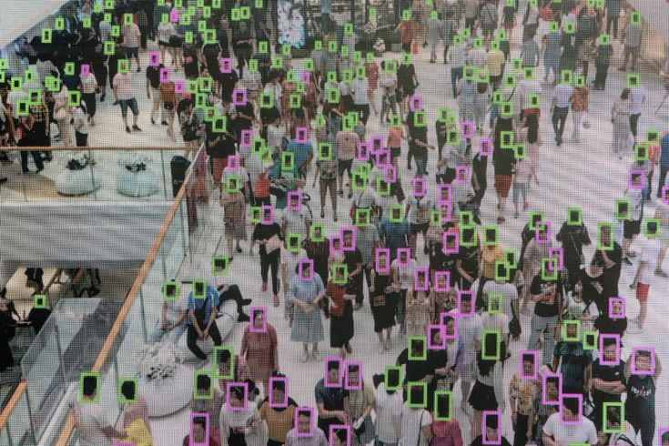
Parameters
corresponding_institution_ids (McMaster’s OpenAlex ID - dervied from ROR)
publication_year (2024)
type (article or review)
oa_status (gold or hybrid)
Code Snippet
ror_id = "https://ror.org/02fa3aq29" publication_year = 2024 publication_types = ["article", "review"] publication_oa_statuses = ["gold", "hybrid"]
Notes:
Let's start talking about our analysis. But before we start working on the analysis, we have to define which types of works are subject to APC.
As Jack mentioned previously, the corresponding authorship information from OpenAlex is crucial to this project. While a work may include contributions from a number of different institutions, APC is typically the responsibility of the work's corresponding author. Hence, we will filter publications which the corresponding authors are from McMaster, using the corresponding institution ID field. The ID is an OpenAlex-defined identifiers. But we've written code to retrieve this ID using a more commonly-used ROR ID.
In addition, open access works published in Gold and Hybrid open access journals are subject to APCs, while those published in Green, Diamond and Bronze access journals are not. We will filter publications that have gold or hybrid OA status flag.
Finally, since APCs are not typically charged for editorial content submitted to an open access journal, we will filter publications that are either original articles or reviews using the work type field.

Slide 11
Query Publications from OpenAlex
def get_works_by_corresponding_institution(institution_id, publication_year, publication_types, page=1, items_per_page=50): url = f""" https://api.openalex.org/works?filter= corresponding_institution_ids:{institution_id}, publication_year:{publication_year}, type:{'|'.join(publication_types)}, oa_status:{'|'.join(publication_oa_statuses)}& page={page}&per-page={items_per_page} """ response = requests.get(url) json_data = response.json() df_works = pd.DataFrame.from_dict(json_data["results"]) next_page = True if df_works.empty: next_page = False
Notes:
With the parameters defined, we can now start querying the necessary data from OpenAlex. Here we construct the API URL with the given institution ID, which we had a separate function to compute the OpenAlex institution ID from ROR ID, publication year, publication types, as well as the page number and records per page to do a recursive query. And eventually concatenate all the query results.

Slide 12
Query Publications from OpenAlex (Cont'd)
if next_page: df_works_next_page = get_works_by_institution( institution_id, publication_year, publication_types, page=page+1, items_per_page=items_per_page ) df_works = pd.concat([df_works, df_works_next_page]) return df_works
Notes:
With the parameters defined, we can now start querying the necessary data from OpenAlex. Here we construct the API URL with the given institution ID, which we had a separate function to compute the OpenAlex institution ID from ROR ID, publication year, publication types, as well as the page number and records per page to do a recursive query. And eventually concatenate all the query results.

Slide 13
Apply Necessary Transformation and Clean Up
# extract 'value_usd' from 'apc_list' if it is a dictionary (i.e. 'apc_list' exists in the work record); otherwise, set to null df_works["apc_usd"] = df_works["apc_list"].apply(lambda apc_list: apc_list["value_usd"] if isinstance(apc_list, dict) else np.nan) # extract 'issn' and 'issn_l' from 'source' within 'primary_location' if 'source' exists; otherwise, set to null df_works["source_issn"] = df_works["primary_location"].apply(lambda location: location["source"]["issn"] if location["source"] else np.nan) df_works["source_issn_l"] = df_works["primary_location"].apply(lambda location: location["source"]["issn_l"] if location["source"] else np.nan) # calculate the average apc where 'apc_list_usd' is not null apc_mean = df_works[df_works["apc_list_usd"].notnull()]["apc_list_usd"].mean() # fill null values in 'apc_list_usd' with the calculated average df_works["apc_list_usd"] = df_works["apc_list_usd"].fillna(apc_mean)
Notes:
After we have all the publications data from OpenAlex, we will apply some necessary transformation and clean up to help us analyzing the data in the next steps.
Mainly, we need to unpack APC USD and the journal ISSN. The ISSN lies within the primary location object of each publication. This primary location object is where OpenAlex describes the location of the best copy of the work.
Despite OpenAlex has records of the works, sometimes it does not have record of the work's location. Hence, we have to clean those records by assigning "unknown source" to them.
We also compute an APC mean from publications with known APC data. Currently, the Directory of Open Access Journals (DOAJ) is the OpenAlex's primary source of APC data. We found that it could not provide the APC information for some publications.
And what we do is to apply the APC mean we calculated to all other publications without APC information.

Slide 14
Apply Known Discount to OpenAlex Data
def get_discount(issn: typing.List[str] | str, apc: float) -> float: if isinstance(issn, str): issn = [issn] discount_rows = df_discount[df_discount["issn"].isin(issn)] if discount_rows.empty: return apc discount_row = discount_rows.iloc[0] if discount_row["is_flatrate"]: return apc - discount_row["discount"] else: return apc * (1 - discount_row["discount"]) df_works["discounted_apc_usd"] = df_works.apply(lambda x: get_discount(issn=x["source_issn"], apc=x["apc_usd"]), axis=1)
Notes:
Now, let's apply the known discount to all the publications data we've queried.
In our analysis, we use a list of journal discounts provided by our collection librarians, which has ISSN of the journal and amount of applicable discount. We manually cleaned up this information and added a Boolean flag to indicate whether the discount is a flat rate discount or percentage discount. We included a template of this discount information in our project repository along with all the project source code.
Next, we read the discount information into a dataframe, df_discount. Here we create a function to get the discount information from the discount dataframe using ISSN, and returned the APC cost after discount.
We then apply the function to every single publications we previously queried.

Slide 15
Results
scds.ca
scds@mcmaster.ca

Slide 16
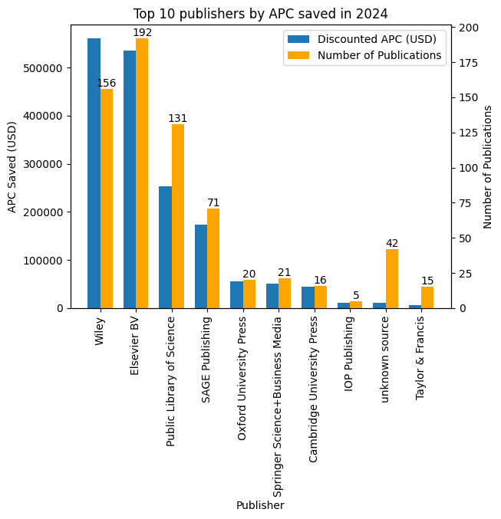
2024 APC Estimates (McMaster University)
Total APC Cost (Before Discount):
USD $2,741,692.01
Total APC Cost (After Discount):
USD $1,020,350.09
Total APC Savings:
USD $1,721,341.92
scds.ca
scds@mcmaster.ca
Notes:
In 2024, our institution would've paid about 2.74 millions dollars in APC. But after the discount given from the transformative agreement, we only paid about 1 million and 20 thousand. We saved about 1.72 million dollars in APC because of the transformative agreement.
As you can see in the graph on the right side, we saved most APC in Wiley, Elsevier, PLoS and SAGE.

Slide 17
Challenges / Limitations
scds.ca
scds@mcmaster.ca

Slide 18
2024 APC Estimates vs. Publisher-Reported
Significant variation in the total articles and APC savings reported by publishers and those gathered using our automated approach.
In total, our approach reported ~30% less eligible articles and discounts than publisher supplied lists.
Publisher | # of McMaster OA Articles (Known v. Estimate) | APC Saved in USD (Known v. Estimate)
Cambridge University Press | 6 | $21,395.00
Elsevier - Hybrid | 107 | $380,961.00
Elsevier - Gold | -7 | -$1,194.00
IOP Publishing - Gold | 5 | $12,615.00
IOP Publishing - Hybrid | 3 | $9,500.00
Oxford University Press - Hybrid | 22 | -$51,519.00
Oxford University Press - Gold | -10 | -$3,128.00
SAGE Publications - Hybrid | 8 | $83,550.00
SAGE Publications - Gold | 7 | $9,622.00
Wiley | 39 | $195,523.00
Combined Difference | 180 | $657,325.00
Combined Difference (as %) | 28.48% | 30.96%
scds.ca
scds@mcmaster.ca

Slide 19
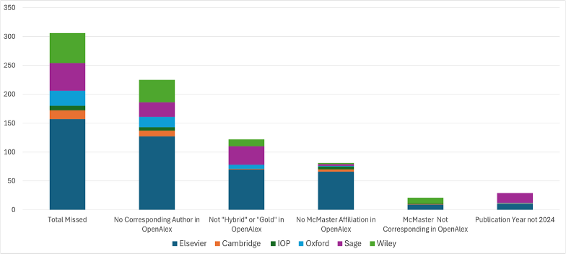
Why Did our Approach Miss Publications from Publisher-Supplied Lists?
scds.ca
scds@mcmaster.ca
Notes:
Techincal Documentation page updated 10 months ago states (regarding corresponding institution): This is a new feature, and the information may be missing for many works. We are working on this, and coverage will improve soon.

Slide 20
APC Data
17% of the retrieved records lacked APC data (mean value of all known APCs was used in these cases).
List APC prices found on publisher websites may not represent the actual amount paid (e.g. promotional rates).
APC data is only available for the most recent year, meaning we are unable to apply this approach retroactively.
Notes:
The difficulties associated with tracking APC costs more generally.

Slide 21
Next Steps
scds.ca
scds@mcmaster.ca

Slide 22
Next Steps
Meeting with Eric Schares, Leigh-Ann Butler, and Stefanie Haustein to discuss insights from their projects^{1,2} tracking APC costs at six major publishers over time. They had some great ideas to workaround some of the challenges we faced:
When McMaster is the only institution on a publication, consider them corresponding.
If no corresponding author is listed, consider first author corresponding.
For unknown APCs, calculate median APC for each publisher / OA type (as opposed to a global mean APC).
¹ Butler, L., Hare, M., Schönfelder, N., Schares, E., Alperin, J. P., & Haustein, S. (2024). An open dataset of article processing charges from six large scholarly publishers (2019-2023). arXiv [Cs.DL]. Retrieved from http://arxiv.org/abs/2406.08356
² P., Hare, M., Butler, L.-A., & Schönfelder, N. (2024). Estimating global article processing charges paid to six publishers for open access between 2019 and 2023. arXiv [Cs.DL]. Retrieved from http://arxiv.org/abs/2407.16551
scds.ca
scds@mcmaster.ca
Notes:
We met with Eric Schares, Leigh-Ann Butler and Stefanie Haustein from Iowa State University and University of Ottawa, to discuss insights from their projects tracking APC costs at six major publishers over time. They gave us some great ideas to work around some of the challenges we faced.
For some publications, which OpenAlex does not have corresponding authorship information, we will consider the first author listed to be the corresponding author. If McMaster is the only institution on the publication, we will consider it corresponding as well.
For publications, which DOAJ and OpenAlex cannot provide APC data, instead of using the mean of all publications, with known APC data, we will use a median of APC calculated using other publications with the same publisher and OA type.
<We haven't implemented these changes>

Slide 23
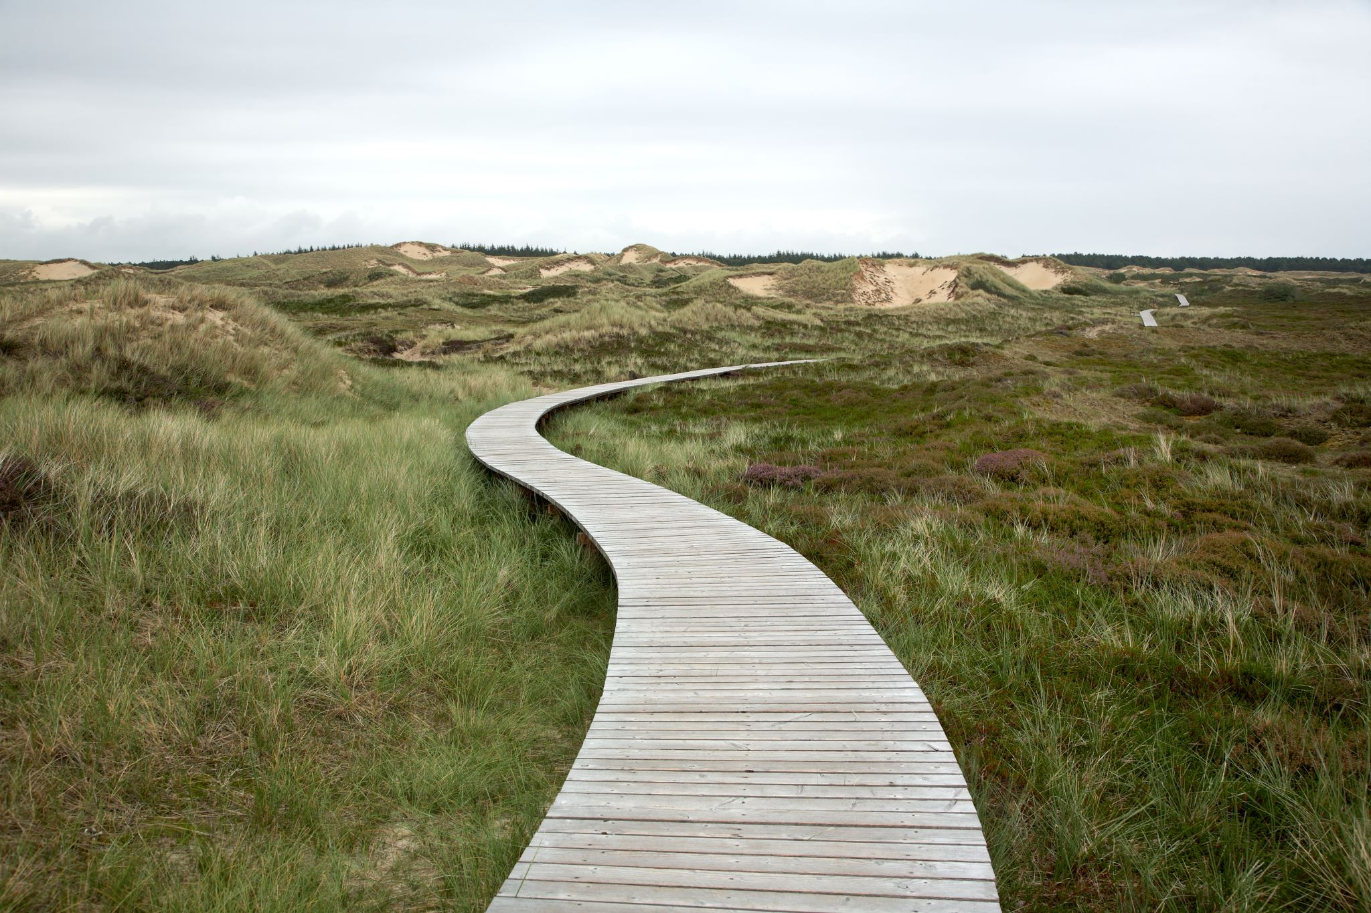
Next Steps (cont.)
Share results of this analysis with OpenAlex to identify, and hopefully improve, some of the issues with corresponding authorship information in the database.
Our estimates turned up publications not included in publishers’ lists, suggesting that some authors are not taking advantage of discounts. This could lead to interventions increasing awareness / use of McMaster’s discounted rates.
Integrating these estimates into library collections’ data. Exploring the feasibility of a dashboard tracking APC discounts at McMaster.
scds.ca
scds@mcmaster.ca

Slide 24
Questions?
Source code: https://doi.org/10.5281/zenodo.15640545
APC notebook source: https://github.com/McMasterRS/research-impact-analysis/blob/main/apc.ipynb
Contact:
Jack Young – jkyoung@mcmaster.ca
Kelvin Lee – lee887@mcmaster.ca

