Slide 1


Academic Conference
19 June 2018

Slide 2
Welcome
Daniele Zanotti
President & CEO, United Way Greater Toronto
Dr. Wayne Lewchuk
Professor, School of Labour Studies and Department of Economics McMaster University

Slide 3
Rising Tides Only Lift Some Boats: the differential impacts of precarious employment
Moderated by:
Tasleem Thawar, United Way Greater Toronto
Presenters:
Dr. Wayne Lewchuk, McMaster University
Stephanie Procyk, United Way Greater Toronto
Simran Dhunna, Access Alliance Multicultural Health and Community Services
Ricardo Tranjan, Canadian Centre for Policy Alternatives Ontario

Slide 4
Academic Conference
19 June 2018

Slide 5
Getting Left Behind – Findings & Recommendations from the Third PEPSO survey report
Dr. Wayne Lewchuk
McMaster University
Stephanie Procyk
United Way Greater Toronto

Slide 6
Wayne Lewchuk, Professor, School of Labour Studies and Department of Economics, McMaster University
Stephanie Procyk, Manager, Research, Public Policy & Evaluation, United Way Greater Toronto
Notes:
Wayne Lewchuk (McMaster University)
Stephanie Procyk (United Way Greater Toronto)
Michelynn Laflèche (United Way Greater Toronto)
Diane Dyson (WoodGreen Community Services)
Luin Goldring (York University)
John Shields (Ryerson University)
Peter Viducis (City of Toronto)

Slide 7
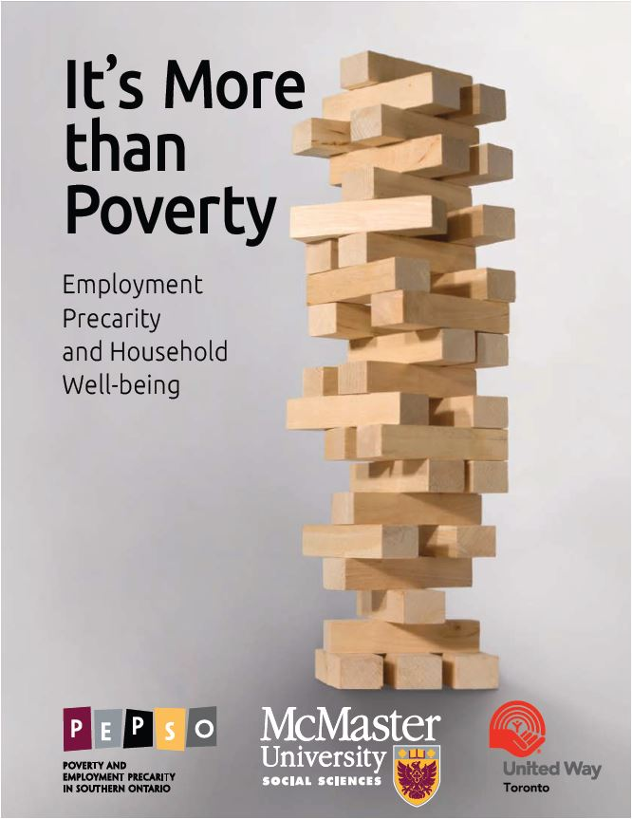
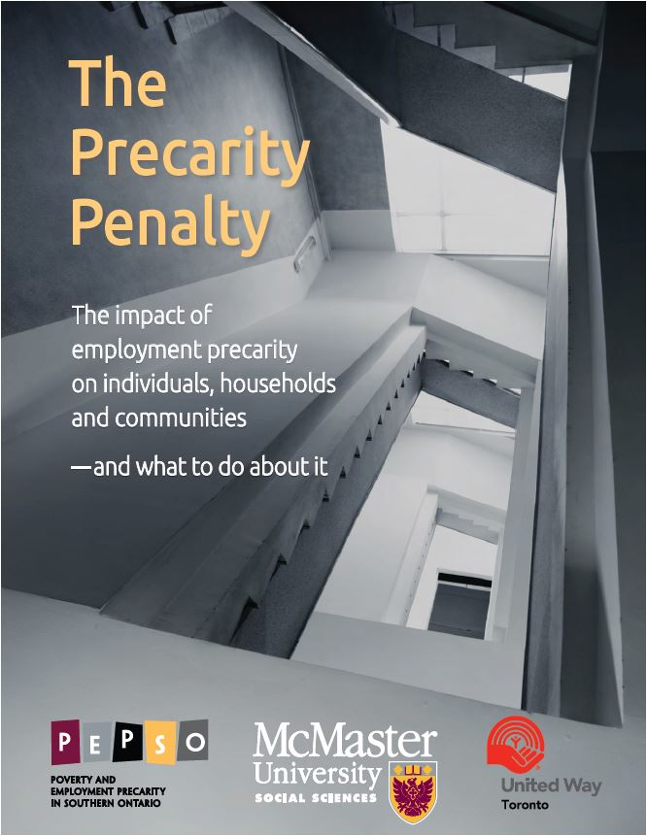
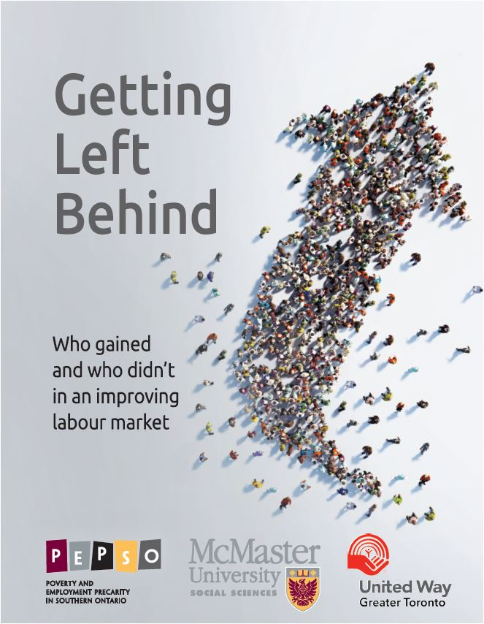
2013 2015 2018
PEPSO Reports
Notes:
This is the third in a series of three reports on precarious employment in the Greater Toronto and Hamilton Area amongst workers aged 25-65.
It’s More than Poverty was published in 2013 and used 2011 data to look at the prevalence of precarious employment and the harmful impact it was having on the wellbeing of individuals, families and communities.
The Precarity Penalty went further to unpack how those in precarious employment often get trapped this type of work, and that your race, gender and where you were born can make the impacts of precarious employment even worse.

Slide 8
What is different this time?
Understand trends in precarious employment during a period of substantial job growth?
Does everyone benefit equally from economic growth?
Notes:
Getting Left Behind looks at precarious employment and the labour market since the publication of It’s More than Poverty to examine the trends that have occurred between 2011 and 2017 and the impacts on 8 different categories of workers.
To understand trends in precarious employment during a period of substantial job growth?

Slide 9
What did we do this time?
Compared the 2011 and 2017 PEPSO surveys of individuals aged 25-65 in the Greater Toronto Hamilton Area
Use two measures of employment security:
  Standard Employment Relationship
  Employment Precarity Index

Slide 10
The Employment Precarity Index
What is included?
Not paid if miss work
Not in standard employment relationship
Weekly income not stable
Hours worked not stable
Work on-call
Don’t know work schedule in advance
Paid in cash
Temporary employment
No benefits
Weak voice at work
What is not included?
Income
Online Employment Precarity Index
Pepso.ca/jobprecarityscore
Notes:
If you want to look at whether you are working in precarious employment, you can go to pepso.ca/jobprecarityscore

Slide 11
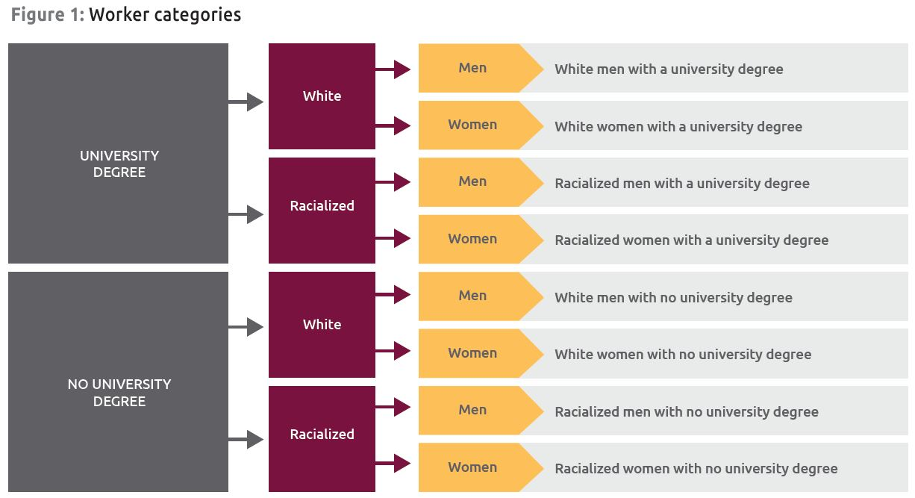
Eight categories of workers

Slide 12
Between 2011 and 2017 the labour market improved
Employment grew 12.4%, twice as fast as the Ontario average
GTHA unemployment fell from 8.2% to 6.3%
Temporary employment grew almost double the rate of permanent employment (18.8% vs. 10.4)
Notes:
Full-time employment grew 11.9%\
Permanent employment grew 10.4%
Temporary employment grew 18.8%
Self-employment grew 17.2%
Self-employment with out employees grew 18.3%

Slide 13
We aren’t seeing the changes we’d expect to see in an improving labour market
Real average weekly wage in the GTHA was only about 1% higher between 2011 and 2017
Canadian real GDP per hour worked increased by 7.2%.
Notes:
Full-time employment grew 11.9%
Permanent employment grew 10.4%
Temporary employment grew 18.8%
Self-employment grew 17.2%
Self-employment with out employees grew 18.3%

Slide 14
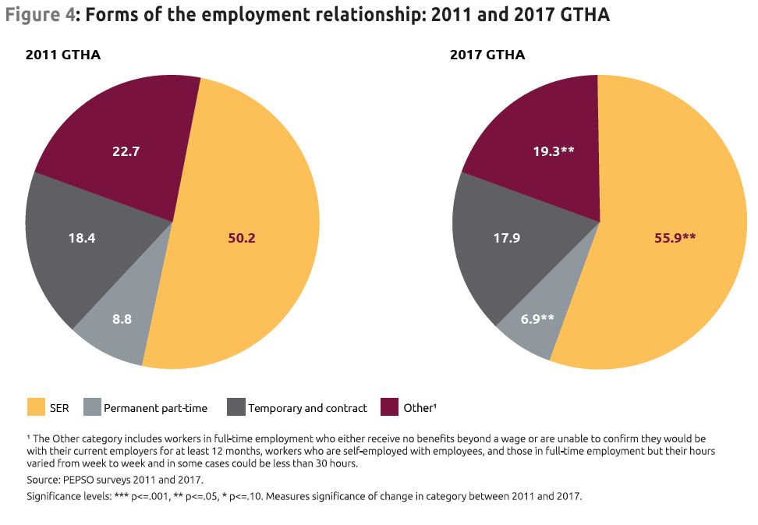
Precarious employment has imprinted itself on the GTHA labour market
Notes:
Despite the overall increase in secure jobs, 37.2% of workers are still working in some degree of precarious employment and the amount of workers who are the most precarious has barely changed – 18.4% were firmly in precarious employment in 2011 and 17.9% in 2017.
We found the same patterns as in previous years:
People who are precariously employed can’t get ahead and can’t plan for their future.
If you’re precariously employed, you’re three times as likely to pay for your own training.
Of the precarious employed, 90% still don’t have access to employer benefits, and over 80% still don’t have an employer-provided pension plan.
People who are precariously employed continue to struggle with making ends meet.

Slide 15
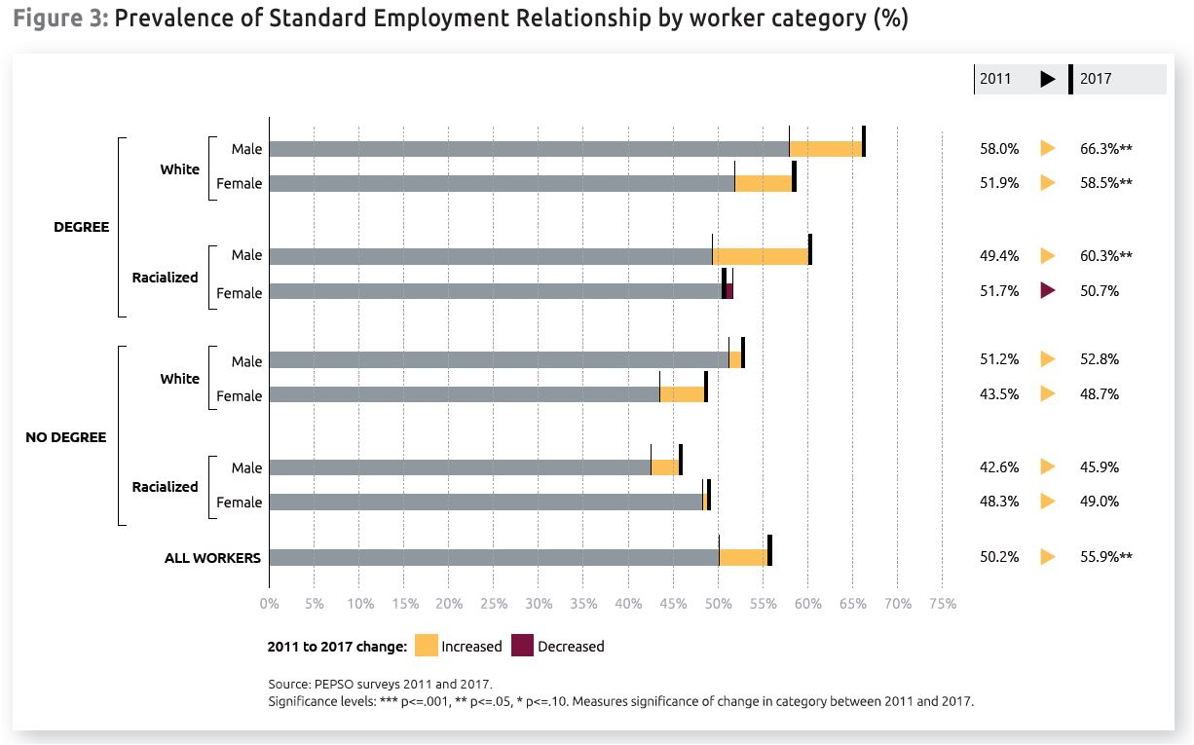
When it comes to landing a secure job in a growing economy, gender, race and university degree determine whether or not you’ll get left behind
Notes:
Intersectionality is at play. It’s not just race, gender or having a university degree that matter alone – it’s the compounding effect of these things that impacts people:
Only white men and women with a university degree, and racialized men with a university degree gained more access to secure jobs.
For racialized women, having a university degree wasn’t enough to keep them from being left behind: they were the only group with a degree to not increase their share of secure jobs
Without a university degree, you were left behind. Workers without university degrees didn’t gain any job security between 2011 and 2017.

Slide 16
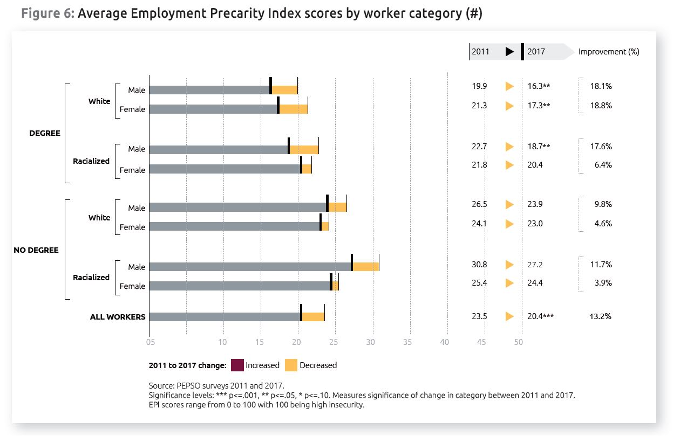
Notes:
We see this same pattern emerge with the Employment Precarity Index

Slide 17
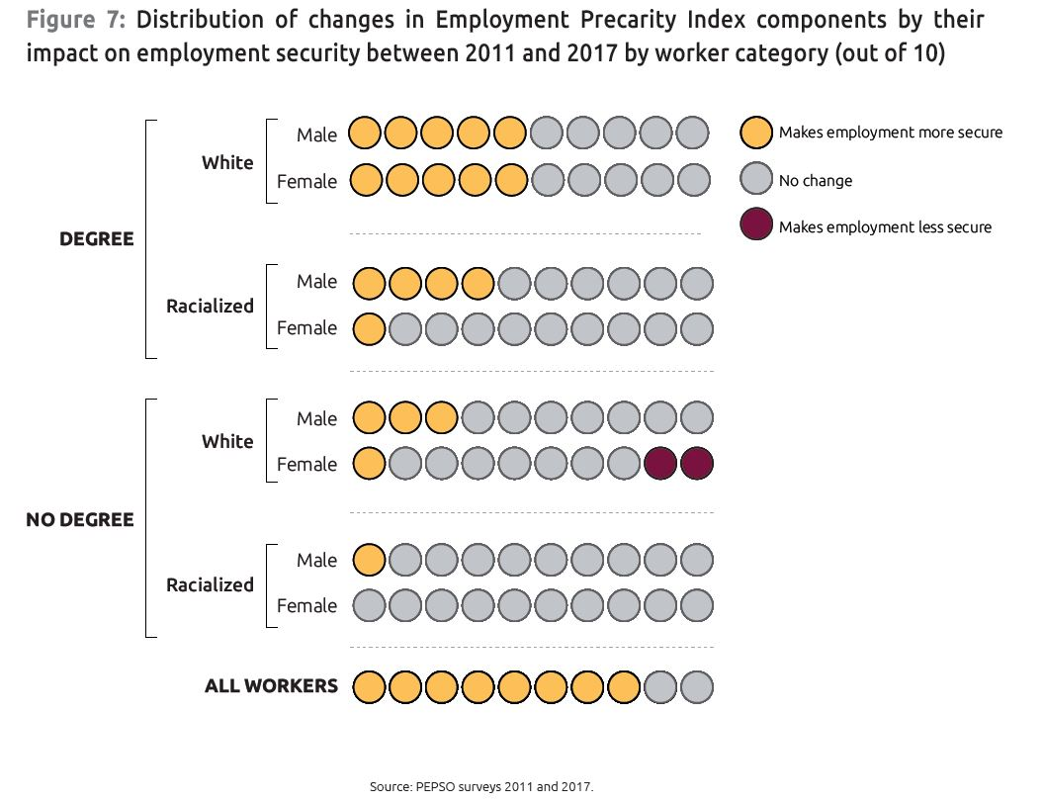
Those without a university degree and racialized women with a degree got left behind
Notes:
Highlight the multiple changes for the top three groups

Slide 18
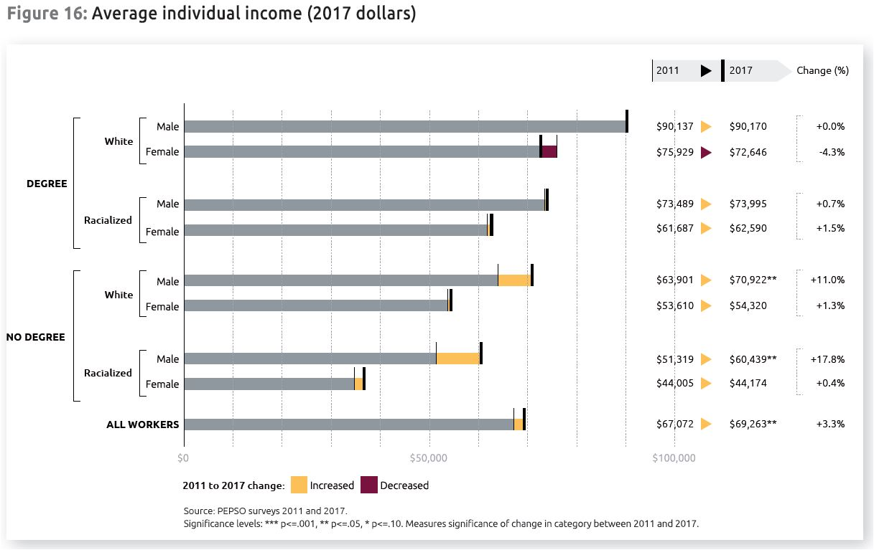
Improved economic conditions can lead to improved economic outcomes, but only for some
Notes:
Some income improvements, but not all
Today a racialized woman without a degree is six times more likely to be low-income than a white man with a degree. In 2011, racialized women without a degree were about four times more likely to be low-income than a white man with a degree.
Improved economic conditions can lead to improved economic outcomes for some. Those who had access to stable, secure jobs in 2011 gained even more access in 2017. And those who didn’t, were left behind.

Slide 19
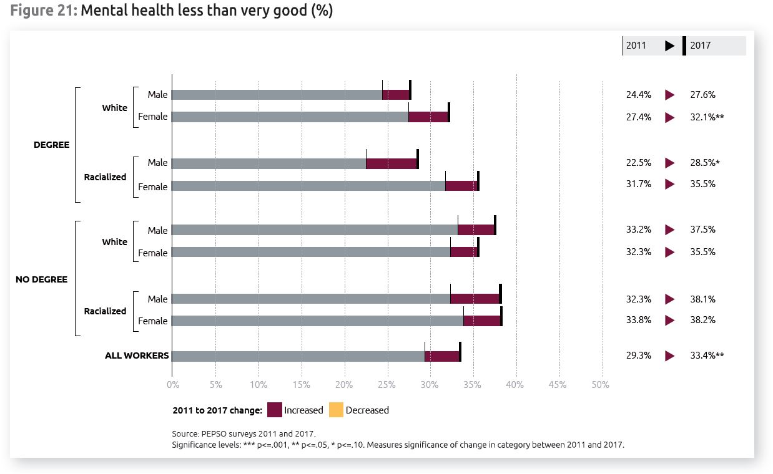
Workers’ wellbeing hasn’t improved with the growing economy
Notes:
For all workers, people’s wellbeing hasn’t improved with the growing economy.
One third of all workers still report poorer mental health.
Rates of anxiety related to employment remain unchanged. Almost 40% of all workers report that anxiety about employment interferes with personal and family life.
People are still putting their life on hold because of their work situation: one out of five workers aged 25-35 are still delaying having children.
20% of workers don’t always know their work schedule one day in advance.

Slide 20
What can be done?
Expand decent work through employment standards and ladders to opportunity
Create a floor of basic income and social supports available to precarious workers
Ensure background and circumstances are not a barrier to the labour market

Slide 21
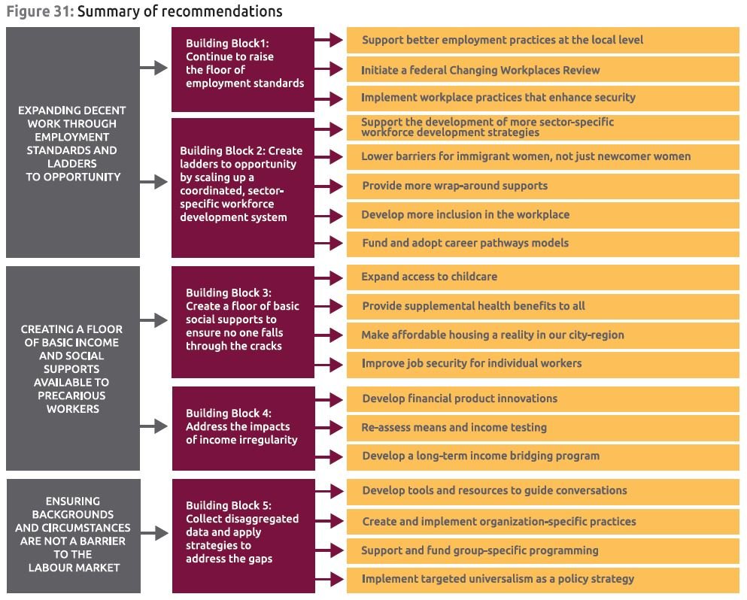
Expand decent work through employment standards and ladders to opportunity

Slide 22
Create a floor of basic income and social supports available to precarious workers

Slide 23
Ensure background and circumstances are not a barrier to the labour market

Slide 24
Promoting decent work for racialized women
Simran Dhunna
Access Alliance Multicultural Health and Community Services

Slide 25
Like Wonder Women, Goddesses, and Robots
How Racialized Immigrant Women in Toronto are impacted by and respond to Employment Precarity
Simran Dhunna, Young Insight Scholar
PEPSO Conference
Working Precarious: Causes and Consequences
June 19, 2018

Slide 26
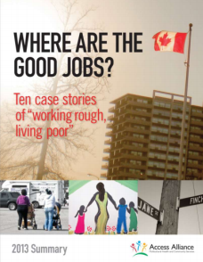
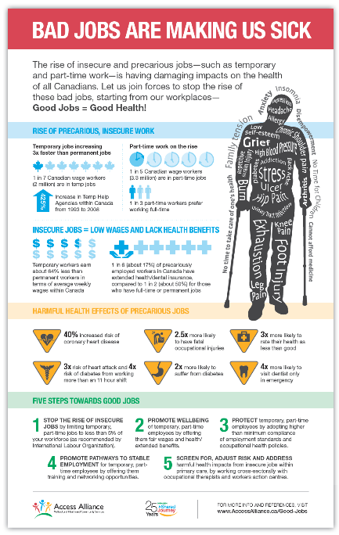
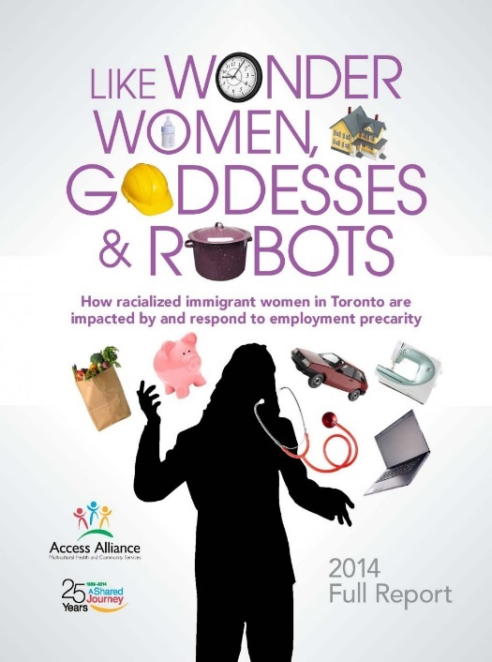
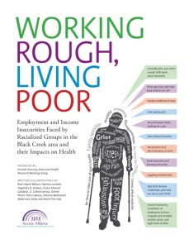
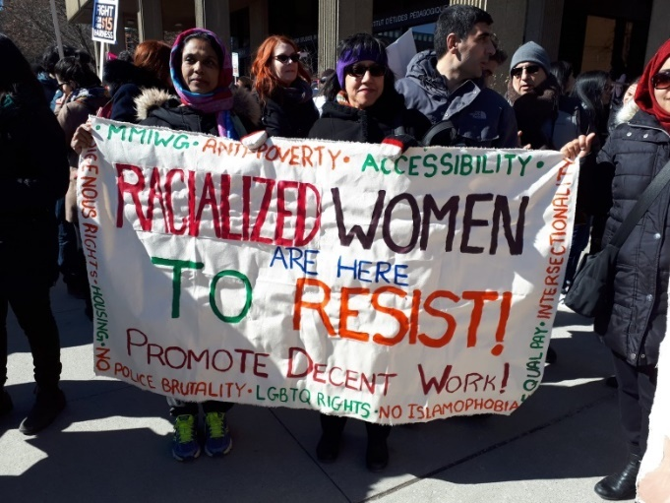
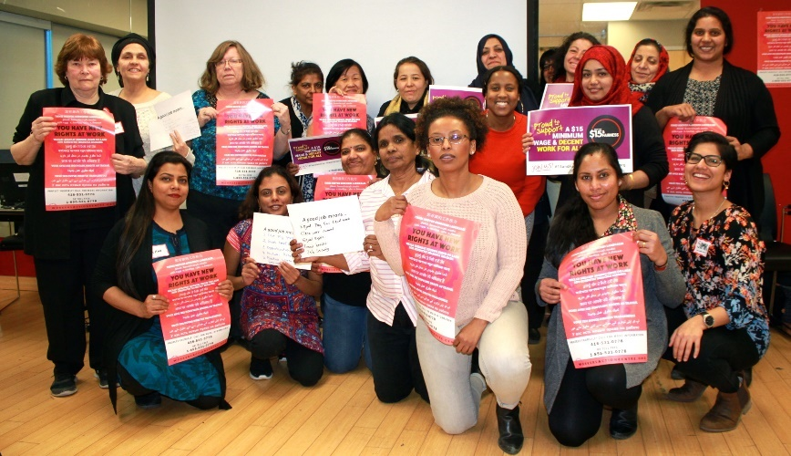
Research + Advocacy at Access Alliance

Slide 27
What do we know about
Precarious employment?

Slide 28
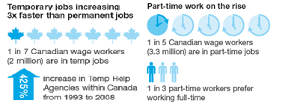
Precarious Employment is Rising
Precarious forms of employment are increasing 3 times faster than permanent, full-time jobs.
From 1993-2006, Canada has seen a 425% increase in Temp Work Agencies
According to Ontario Ministry of Labour (2016), 26.6% of Ontario’s workforce in 2015 constituted non-standard employment
The PEPSO Research group found that less than half of workers (48.1%) in the Greater Toronto-Hamilton Area had “permanent, full-time jobs with some benefits beyond a wage.”
Sources: 1) “Bad Jobs are Making us Sick” Infographic, Access Alliance, 2) Noack, A.M and L.F. Vosko (2009). Precarious Jobs in Ontario. Mapping Dimensions of Labour Market Insecurity by Workers’ Social Location and Context. Toronto, Commissioned report by Law Commission of Ontario.

Slide 29
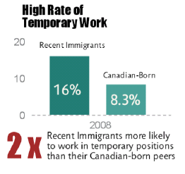
Precarity is racialized and gendered
Racialized Immigrant Women experience disproportionately higher levels of precarious employment
Rate of Precarious Employment: Compared to 27% of non-racialized men who experience precarious employment in Ontario, 43% of racialized women and 48% of recent immigrant women in Ontario are precariously employed.
Minimum Wage Workers: In 2011, the share of racialized employees working at minimum wage was 47% higher than that of the total population (13.2% compared to 9%). Recent immigrants are more than twice likely to be working minimum wage compared to all employees.
Part-time Temporary Workers: Racialized women workers in Ontario (which account for 11.8% of all workers) are most likely to be over-represented in part-time temporary forms of employment (18.4%). Meanwhile, 15.9% of recent immigrants in Ontario hold part-time temporary employment although this group comprises of only 9.8% of the total population
Wage Disparity: Racialized women earn 55.3 cents for every dollar earned by non-racialized men, and 79.1 cents for every dollar that non-racialized women earn (2016 Census). Precarious work is one of the reasons why.
Sources: 1) Block (2013), “Who is working for minimum wage in Ontario?”, 2) Noack, A.M and L.F. Vosko (2009). Precarious Jobs in Ontario. Mapping Dimensions of Labour Market Insecurity by Workers’ Social Location and Context, and 3) various catalogues from the 2016 Census, Statistics Canada

Slide 30

Precarity is deadly
The story of Amina Diaby
  Amina was 23 years old. She was a refugee trying to save for nursing school.
  She got a job at Fierra Foods through a temp agency.
  On September 2, 2016 , Amina’s hijab was caught in a machine, strangling her to death. She had been on the job two weeks.
Fierra Foods is one of GTA’s largest industrial bakeries. It supplies Dunkin’ Donuts, Costco, Tim Hortons, Metro, Walmart, and Loblaw. Fiera Foods mostly hires temp agency workers: it employs 400 workers, 70% of which are temporary workers.
Diaby was the third temp agency worker to die while working at Fiera Foods or one of its affiliated companies since 1999. Fiera has been slapped with 191 orders for health and safety violations over the past two decades, for everything from lack of proper guarding on machines to unsafely stored gas cylinders. Amina’s co-worker had not been trained about how to safely shut off the machine using the emergency stop button.
In 2017, Sara Mojtehedzadeh (Toronto Star Work and Wealth reporter) went undercover for a month as a worker in Fierra Foods. She got the job through a temp agency (Magnus Services). She was given a 5 minute workplace safety orientation and sent off to work. http://projects.thestar.com/temp-employment-agencies/
A recent legislative change now makes employers, in addition to temp agencies, responsible for temp worker injuries.

Slide 31
Research Questions and Methodology

Slide 32
Research Questions
Why and how are racialized immigrant women being pushed into precarious employment?
What are the economic, social, and health impacts of being stuck in precarious jobs for immigrant women and their families?
How do racialized immigrant women view and respond (manage, subvert, and resist) conditions and impacts of employment precarity?

Slide 33
Methodology
Community-based Research (CBR):
  7 racialized immigrant women trained as peer researchers
In-depth, semi-structured interviews with 30 immigrant women aged 25-54, actively participating in the labour market (currently working or looking for work) and have been in Canada for at least 2 years
Table 1. Demographic Profile of Study Participants Variable | Percent (N=30)
AGE
30-39 years | 33
40-49 years | 47
50-59 % Married or in a relationship | 20 80
% with university degree REGION/COUNTRY OF ORIGIN | 71
West Central Asia/Middle East (Afghanistan, Iran) | 13
China and South East Asia (Burma, Philippines) | 24
South Asia (Bangladesh, Nepal, Pakistan) Africa (Somalia, Sudan, Sierra Leone) Central and South America | 37 10 6
LENGTH OF STAY IN CANADA (2011 as reference)
2-5 years 6-10 years | 37 30
10+ years | 33
ARRIVAL IMMIGRATION STATUS
Skilled Worker/Economic class (Dependent) | 26
Skilled Worker/Economic class (Primary Applicant) | 17
Government Assisted Refugees | 17
Refugee Claimant | 13
Family Sponsored | 13
Live-in Caregiver | 7
Other | 7

Slide 34
Key Findings

Slide 35
Key Finding 1
Racialized immigrant women face many of the same economic structural barriers as their male counterparts, such as:
  Non-recognition of international credentials
  Lack of employment equity
  Job-skills mismatch
  Race-based systemic discrimination
  Language barriers
  Information and access barriers to services
  Limited professional network

Slide 36
What happens to RIW after arrival?
Srijana and her husband, Kamal, are both forestry experts from Nepal. They migrated to Canada in 2002. A mother of three children, Srijana juggled a series of survival jobs at Canadian Tire, housekeeping jobs in hotels, and as interpreter before finally getting a full-time job with the Ministry of Natural Resources because she was able to convince her family to move to a remote town in northern Ontario for a job. She got laid off after two and a half years and is back in Toronto working on a commission basis with an insurance company, while her husband toils long hours as a taxi driver.
Naznin, a highly accomplished female doctor and anaesthesiologist from Iran immigrated to Canada in 2008 fearing for her and her three children’s lives after her husband was killed in Iran. She has been barely etching a living here, going from one unrelated and precarious job to another (Subway franchise, on-call cooking, and cleaning). At the same time, she is hopelessly trying to get her medical license in Canada while putting in hundreds of volunteer hours in hospitals as a ‘patient escort’.
Fruzan is an OB/GYN from Afghanistan with years of experience working in the UN sponsored clinics for immigrants in Russia. She got tricked into an abusive spousal sponsorship scam by a Canadian. She came to Canada only to find that her sponsor was already married and just wanted to use her strong professional background to extort thousands of dollars from her during the sponsorship process and after arriving. Traumatized and unable to get her recertification license here, she has been spending the last 2 years doing hundreds of hours of volunteer work in hospitals.

Slide 37
Key Finding 2
Migration pathways and policies are highly gendered in ways that can negatively affect immigrant womens’ employment outcomes, thus structurally streaming them into highly gendered forms of low-paying and undervalued precarious jobs.
  [Live-in] Caregiver Program
  Spousal Sponsorship programs
    Conditional Permanent Residency – in place at the time of this study
  Proportion of female primary applicants is growing but our gender-insensitive immigration policies undervalue immigrant women

Slide 38
Key Finding 3
Gendered social barriers further impede Racialized Immigrant Womens’ access to decent work
  Lack of affordable childcare
  High load of unpaid gendered labour such as caregiving and household work
  Social Isolation and limited social support system
  Lack of supportive male partners
  Limited social mobility (eg. not being able to travel far for work, or do work that involves traveling when it is dark)

Slide 39
Like Wonder Women, Goddesses, and Robots
“After my first daughter was born, [my husband] opened the company so I was home taking care of the family, taking care of the business. Doing like Wonder Woman, everything, everything, everything. No help and not getting a single help in cleaning and nothing in the house.” (P25)
“I’m used to that from back home because I did non-profit organization there. It’s tough, hard but somehow I manage. Like I go to bed later and I wake up first, and I feel that I have ten hands. Like maybe you heard that one Hindu goddess, she has ten hands. Imagine because she did so many work. So I do, like in advance I just do lots of work….it’s extremely pressured for me but I manage it, I can do that.” (P22)
“I was doing everything. I was cleaning, I was cooking everything. Because as I said my husband he went to work at 5:00 in the morning until 5:00 or 6:00 in the evening. And as soon as I got home I starting to do the things for cooking, cleaning doing everything….from 8:00 a.m. until sometimes 7:00 or 8:00 in the evening. As soon as I got home, thank God my apartment was close to work, I didn’t lose time to come and go, but…until 1:00 a.m. I was taking care of the other things. Like a robot.” (P28)

Slide 40
Key Finding 4
Precarious employment is having damaging impacts on the health of immigrant women workers and their families.
  Health impact: depression, digestive problems, cardio-vascular illnesses, chronic muscular-skeletal pain, and life threating illnesses like diabetes.
  Social and family impact: household relationship tension, decreased quality time with family, decreased work-life balance, intergenerational impact on children

Slide 41
Health and Family Breakdown
“…I began to find work stress, problems at work, problems in the house already with family problems. I got sick, I really got sick, I had a panic attack at the [job] and I guess it’s due to the stress that I was going through. And then the doctor suggest to me that it was too much for me, all this work and the hours and the shift and nights and that stress because of my family, the problems. I could not get the hours that I wanted to. At work I find myself with lots of work, lots of issues, lots of issues that I have to deal with. I deal successfully but [at the] expense of my health.” (Lucia)
“No he’s [son] better now but my only problem with him is, especially when I went back to school is he’s constantly asking for attention... one time I was yelling at him last weekend and I asked him, I’m so tired and I’m also sick and I told him ‘what do you want from me? Tell me, I know you can speak now, tell me what do you want to say to mommy?’ And he was saying that ‘I just want you to hug me.’ Because he was saying that it seems that, since I was always busy I don’t really look as often as we did before, I don’t play with him anymore, and he said; ‘you don’t hug me as much as you did before.’ So at 3 years old ‘oh my goodness’, it’s like ‘wow’... I feel so guilty.” (Gemma)

Slide 42
Additional Key Findings
Many immigrant women do extensive volunteer work and informal income generating work in response to employment precarity (including lengthy periods of unemployment in between jobs) and as an active labour market strategy
Precarious employment conditions result in a heavily gendered social burden on immigrant women in ways that worsen their post-migration household gender relations and social status
Immigrant Women play an active role in maintaining and promoting the health of their family even when facing severe economic difficulties.

Slide 43
Case Studies:
Hasina, Diwa, and Natasha

Slide 44
Hasina:
Hasina has an MA degree and used to work as a manager in a reputed international development organization in Bangladesh. She came to Canada in 2000 with her husband and son as “economic immigrants” through the Federal Skilled Worker program. Her husband was comfortable working as a banker in Bangladesh and did not really want to move to Canada. But Hasina wanted a better future and security for herself and her son (who was 13 years old at that time) and so she decided to apply to immigrate to Canada. She was the “primary applicant” for her family in the Federal Skilled Worker application to Canada.

Slide 45
Hasina:
She sent out hundreds of job applications in the non-profit, community development sector, but did not get anything for a whole year. She was particularly disheartened when she was rejected for a job opportunity at a community agency focused on at-risk children (her exact area of work in Bangladesh) because of her lack of local experience. She finally managed to get a series of part-time contract jobs (e.g., as a school settlement counsellor) only to be laid off each time. Most of her job contracts lasted 2-3 years, after which she was back to lengthy periods of unemployment.
In between juggling these insecure jobs, Hasina went back to school to get a Personal Support Worker diploma from York University as well as a post-graduate diploma in advanced counselling.
Her husband got a job in a factory only to be injured; later, he was also diagnosed with a mental health condition. He decided to return to Bangladesh and only comes to Canada occasionally. Since then, Hasina has been responsible for raising their son with “minimal” help from her husband.

Slide 46
Diwa:
Diwa has an undergraduate degree in physical therapy from the Philippines. However, she could not find a job there in this field and so she worked as an HR assistant in an e-commerce company. Through her aunt who was in Canada, Diwa learned about the Live-In Caregiver Program. She took a leap of faith when she left her husband in the Philippines and came to Canada in 2004.
However, Diwa’s troubles started as soon as she arrived. The family who sponsored her changed their mind about hiring her, and made Diwa pay them back $3,000 in sponsorship-related expenses. The six months where she had to find another family to sponsor her and re-apply for a work permit ended up being one of the worst periods of her life. She had to work under the table in a series of very precarious jobs such as dishwashing and cleaning, and was very vulnerable to exploitation (extremely low wage, excessive workload, unpaid overtime hours, etc.).

Slide 47
Diwa:
In some jobs, she was told not to talk to any other staff and was often required to work double shifts and overtime. She was paid as little as $5 per hour (60 percent below the minimum wage at that time). Once she received her work permit, Diwa started to work as a live-in caregiver. However, things did not get better for her. Her employers treated her as a servant, calling her “nanny” and never by her name, and making her work overtime without pay, including asking her to give massages at 2:00 in the morning. They reduced her pay to $10 per hour from $13 per hour when they heard that other nannies were getting paid $5 per hour.
Eventually, Diwa fell in love with a man and got pregnant. When the employer found out she was pregnant, they laid her off. With the help of a local Filipina agency, Diwa filed an employment standards violation claim against her employer and has been waiting for a decision on her claim for more than two years.

Slide 48
Natasha:
Natasha, a Karen mother of two, came with her family to Canada in 2007 through the Government Assisted Refugee program. She was a farmer and history teacher in the refugee camps in northern Thailand. Following the job pathway of many of her Karen female friends in Canada, she worked in a used clothing factory for two and half years until it closed and moved to Mississauga. In absence of empowering employment programs, her main concern at the time of interview was that she could not work a night shift job in a golf ball production factory because her husband was also working a night shift factory job in a car parts company; she is hoping to get a dishwashing job.

Slide 49
Natasha:
In Toronto, she settled in the Jane and Finch area so she could be close to other Karen families living in that neighbourhood. Natasha and her family became permanent residents from the first day of arrival. Thus, she did not face work restrictions or other vulnerabilities associated with having a temporary and conditional immigration status. Natasha and her family received income support as part of the Resettlement Assistance Program (RAP) to help cover housing, food and other basic expenses.
However, due to her low education level and her limited English language fluency, she got streamed into low-skill manual labour factory jobs with little opportunities for skill diversification or upward economic mobility. She found a job in a used clothing processing factory through other Karen friends that used to work at that factory. The work involved standing up all day to sort clothing in an assembly line and lifting heavy loads for long hours each day. Natasha worked in that factory for two and a half years until it closed and moved to Mississauga.

Slide 50
Policy Recommendations

Slide 51
Labour Market and Employment
Solutions that address labour market barriers to stable and secure employment can include:
Decent Work policies: Increase minimum wage to $15, and ensure strong enforcement of and no exemptions under Bill 148
Re-introduce employment equity in Ontario and strengthen it federally
Make employment programs more gender-sensitive and newcomer/racialized women-friendly
  Eg. Introduce accessible and affordable training programs that support the professional development and training of low-skilled women
Expedite and make fair the recognition of international credentials
Expand demand-side employment strategies:
  Strengthen bridging programs (eg. Ryerson Internationally Educated Engineers Qualification Bridging) so they are easily accessible to racialized immigrant women
  Introduce paid internships, and professional networking/mentorship programs
  Link job-seekers to employers more actively

Slide 52
Gendered Social Barriers
Overcome gendered social barriers such as high caregiving and household responsibilities, through the following policy changes:
Fund and implement a national universal childcare program that is affordable and accessible to racialized women, while recognizing the connection between childcare and the Caregivers’ Program
Offer stronger community and social supports to racialized women, especially recent immigrant women who may experience isolation (eg. social peer support groups)
Reform Employment Insurance to make it flexible for parents to qualify for parental benefits, extend benefits period, raise EI benefit level for parental leave, and improve access to a Second Career grant for laid-off workers in Ontario

Slide 53
Immigration Reform
Immigration reform is needed to eliminate gender-insensitive migration policies and work towards a just immigration system:
Grant permanent residence status to caregivers upon arrival, as advocated for by Caregiver-led groups and other organizations like OCASI. Regularize immigration status for those currently here.
  “Good enough to work, good enough to stay!”
Ensure open work permits or at least sector- or province-specific permits
Expedite the family sponsorship process and make it accessible to low-income immigrant families
Address challenges around Conditional Permanent Residency, which has been eliminated but there are still concerns around womens’ safety

Slide 54
Authors and Contributors
Primary Investigators: Stephanie Premji, Yogendra B. Shakya
Peer Researchers: Wisal Abugala, Sehr Athar, Hareda Mohamud, Moo Law Naw, Almaz Reda, Moo Moo Say, Hamida Zia
Access Alliance Staff: Megan Spasevski, Thuy Tran
Students: Jessica Merolli, Muriam Salman
Thank you!

Slide 55
Questions?
Contact Information:
  Simran Dhunna
  Email: sdhunna@accessalliance.ca
  Twitter: @dhunnasim

Slide 56
The New Precarious – Professional Work in Canada
Ricardo Tranjan
Canadian Centre for Policy Alternatives

Slide 57
The New Precarious : Professional Work in Canada
@Ricardo_Tranjan
Senior Researcher
Canadian Centre for Policy Alternatives

Slide 58
The Survey
1000 professionals from across Canada interviewed in January of 2018
    college, university, or graduate degree
    “I have a knowledge-based job or trade that requires advanced or specialized credentials”
    Selected their occupation from a list of NOC professional occupations

Slide 59
The Survey
78% (secure professionals)
YES: “I have one employer, who I expect to be working for a year from now, who provides at least 30 hours of work a week, and who pays benefits.”
YES: “My job is a full-time, permanent position.”
22% (precarious professionals)
NO to one of the two questions

Slide 60
The hallmarks of precarious work

Slide 61
Not younger or less experienced

Slide 62
Not younger or less experienced

Slide 63
In every sector and industry

Slide 64
In every sector and industry
 | Precarious professionals
Business, finance and administration | 19%
Natural and applied science | 6%
Health | 18%
Education | 28%
Law, social, community or gov. services | 7%
Art and culture | 5%
Building trades | 2%
Other profession | 16%
 | 100%

Slide 65
It is not their choice
 | Precarious professionals | Secure professionals
I would prefer better job stability but it’s hard to find these days | 55% | 50%
Jobs in professions like mine used to be more secure | 61% | 57%
Jobs in my profession are increasingly unstable because government contracted out jobs that used to be permanent public sector jobs | 49% | 39%
A full-time permanent job in my field is almost non-existent for anyone entering the profession | 44% | 34%

Slide 66
It is not their choice
26% of respondents consider their job at least somewhat precarious
8 % totally precarious
18 somewhat precarious
74 % not precarious
Precarious work doesn't seem to be a choice
5% not in SER, earn more than $80,000, and don’t feel precarious

Slide 67
Key Findings and Implications

Slide 68
Question and Answer
Rising Tides Only Lift Some Boats: the differential impacts of precarious employment
Moderated by:
Tasleem Thawar, United Way Greater Toronto
Presenters:
Wayne Lewchuk, McMaster University
Stephanie Procyk, United Way Greater Toronto
Simran Dhunna, Access Alliance Multicultural Health and Community Services
Ricardo Tranjan, Canadian Centre for Policy Alternatives

Slide 69
Academic Conference
19 June 2018

Slide 70
International Ripples: precarious employment’s impact on immigrants and their families
Moderated by:
Stephanie Premji, McMaster University
Presenters:
Jennilee Austria, Filipino Talks
Don Wells, McMaster University
Janet McLaughlin, Wilfrid Laurier University

Slide 71
Precarious Migration, Filipino Family Integration and Student Success in Canada: Impacts and Policy Reforms
Jennilee Austria
Filipino Talks

Slide 72
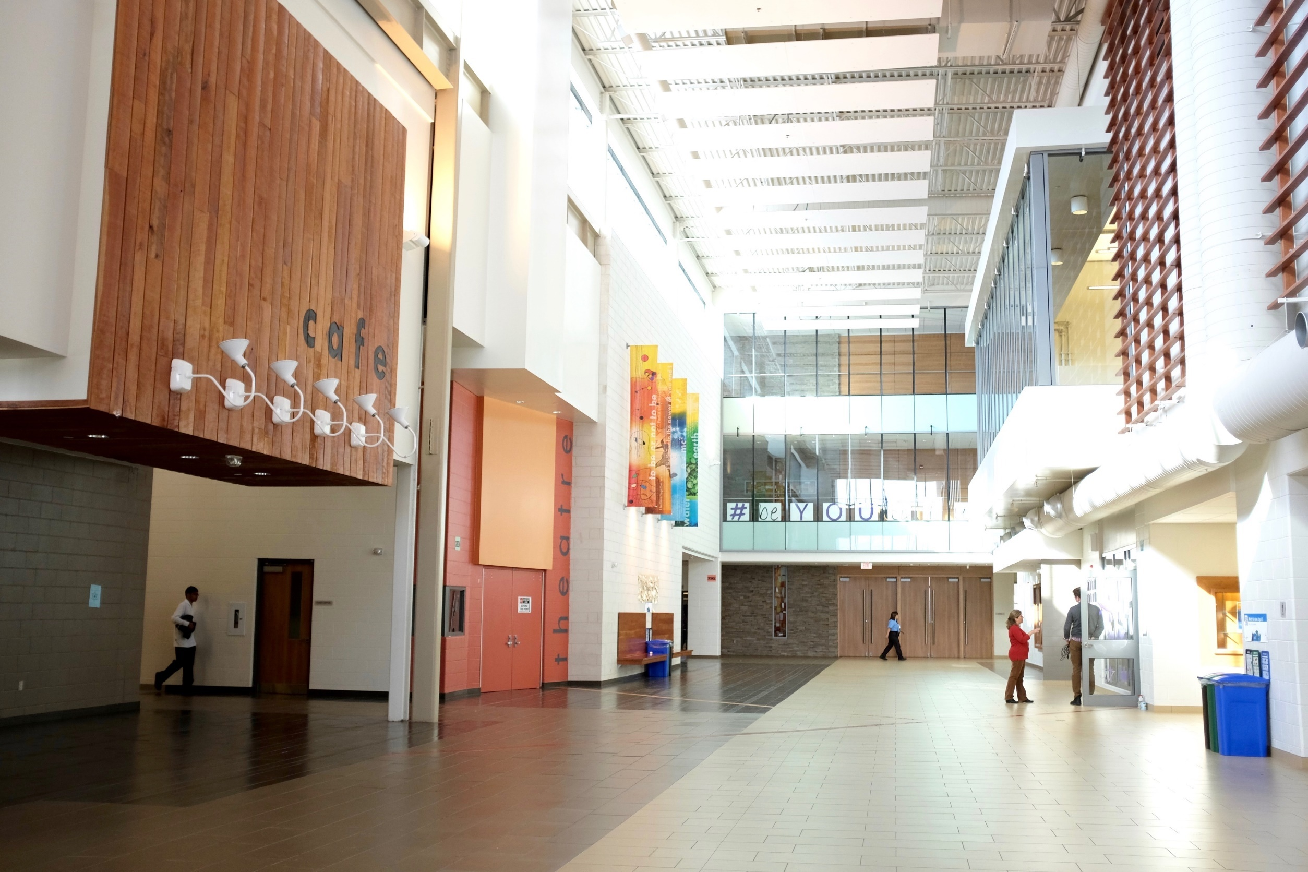





Precarious Migration, Filipino Family Integration and Student Success in Canada: Impacts and Policy Reforms
Jennilee Austria, Philip Kelly, Don Wells

Slide 73
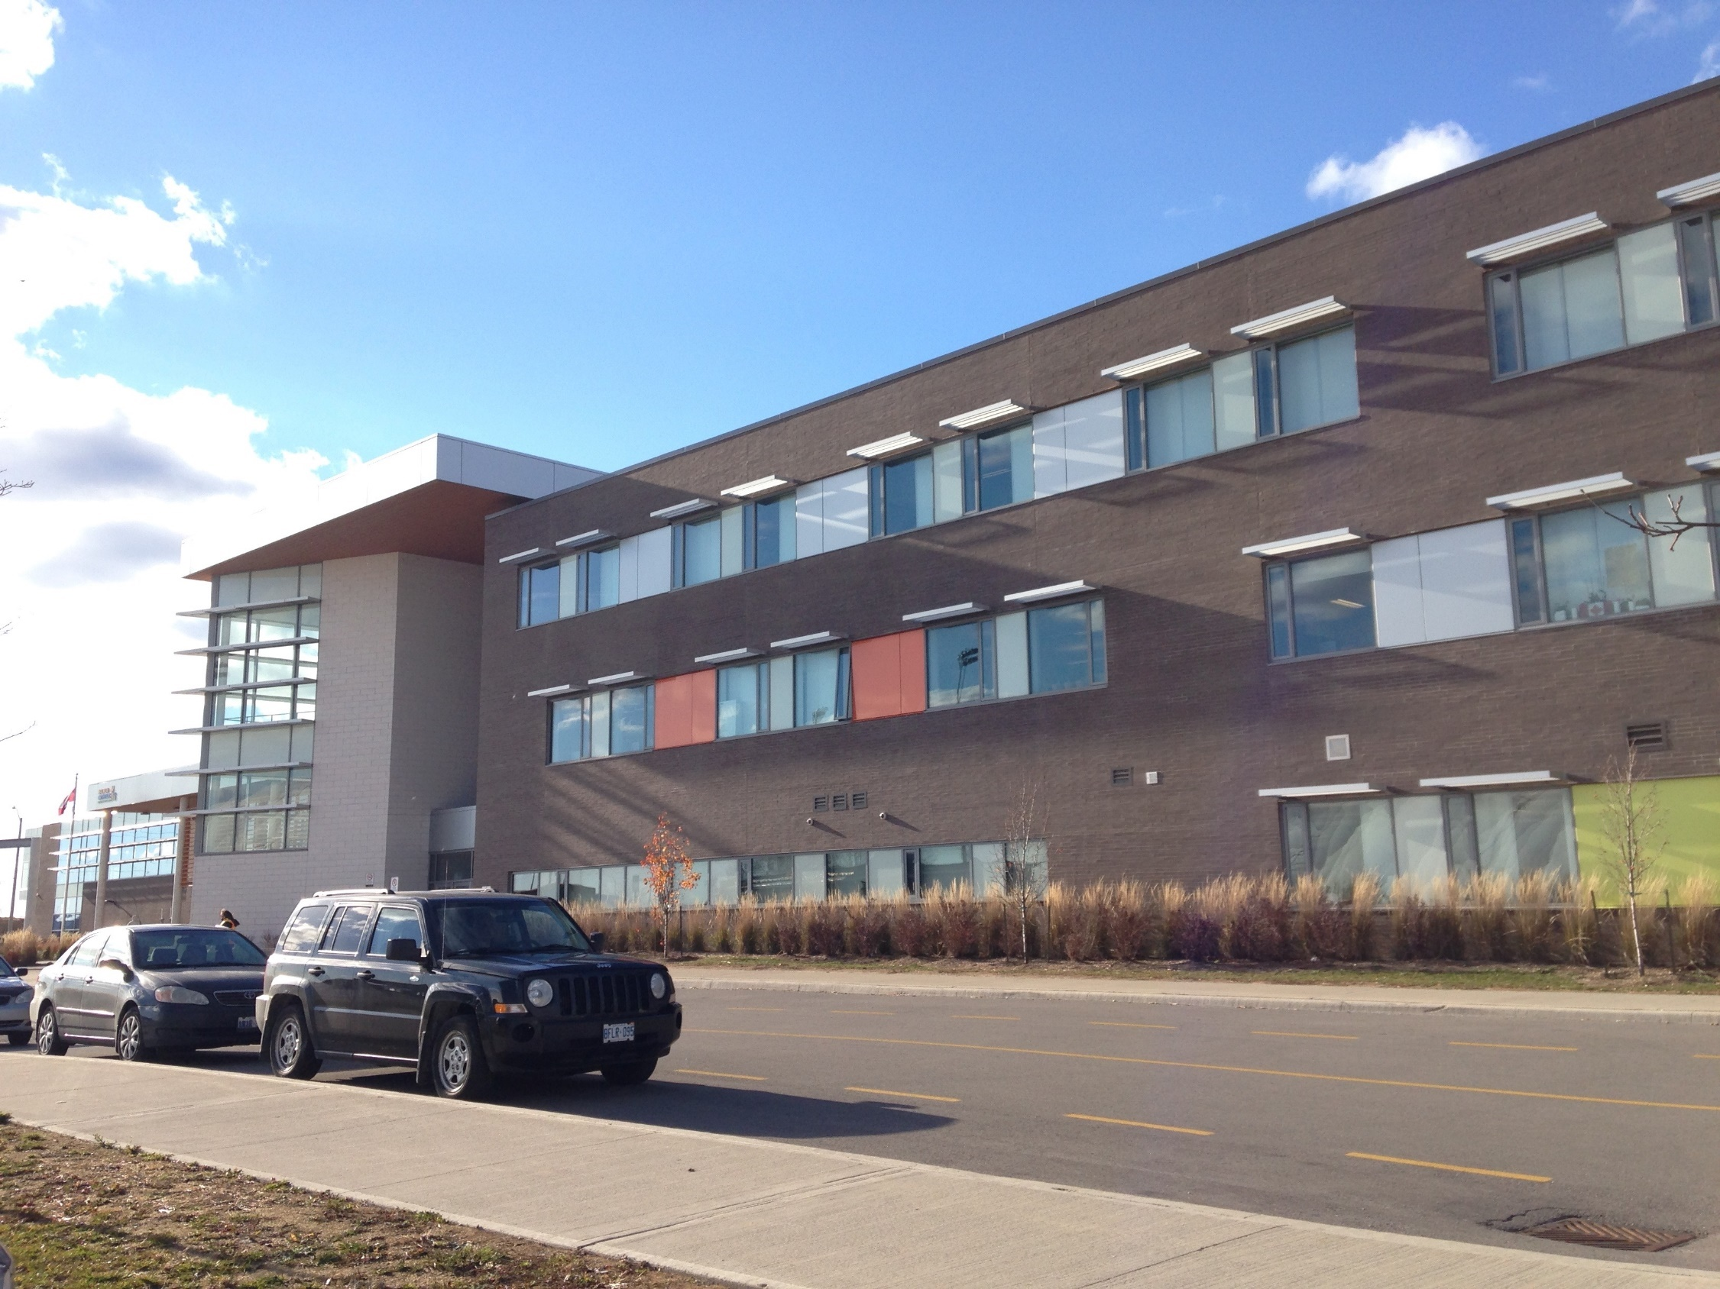
1. How do first-generation immigrant characteristics and settlement experiences affect the educational achievements and aspirations of the next generation?
2. How does precarious employment during and after immigration through the Live-in Caregiver Program affect families and children?
We explored these questions through a
survey of Grade 10-12 students in the
Halton Catholic District School Board.

Slide 74
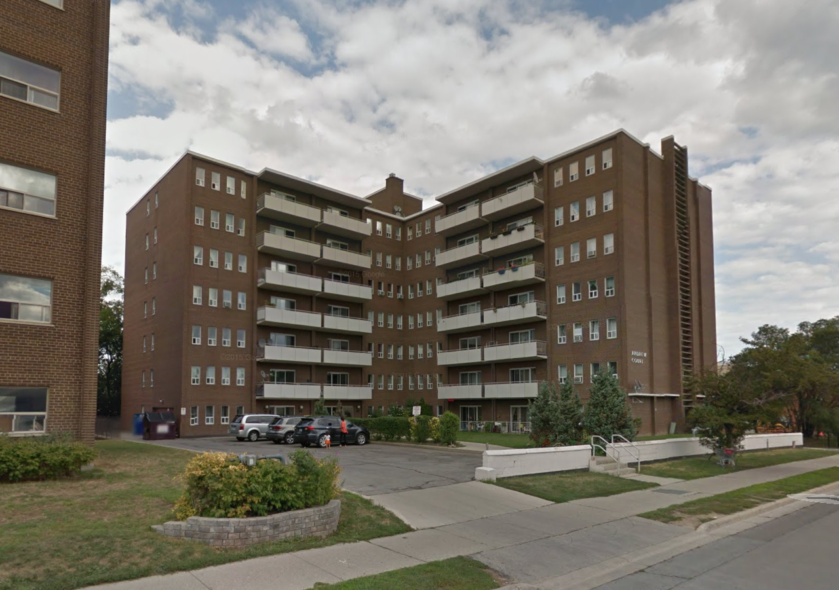
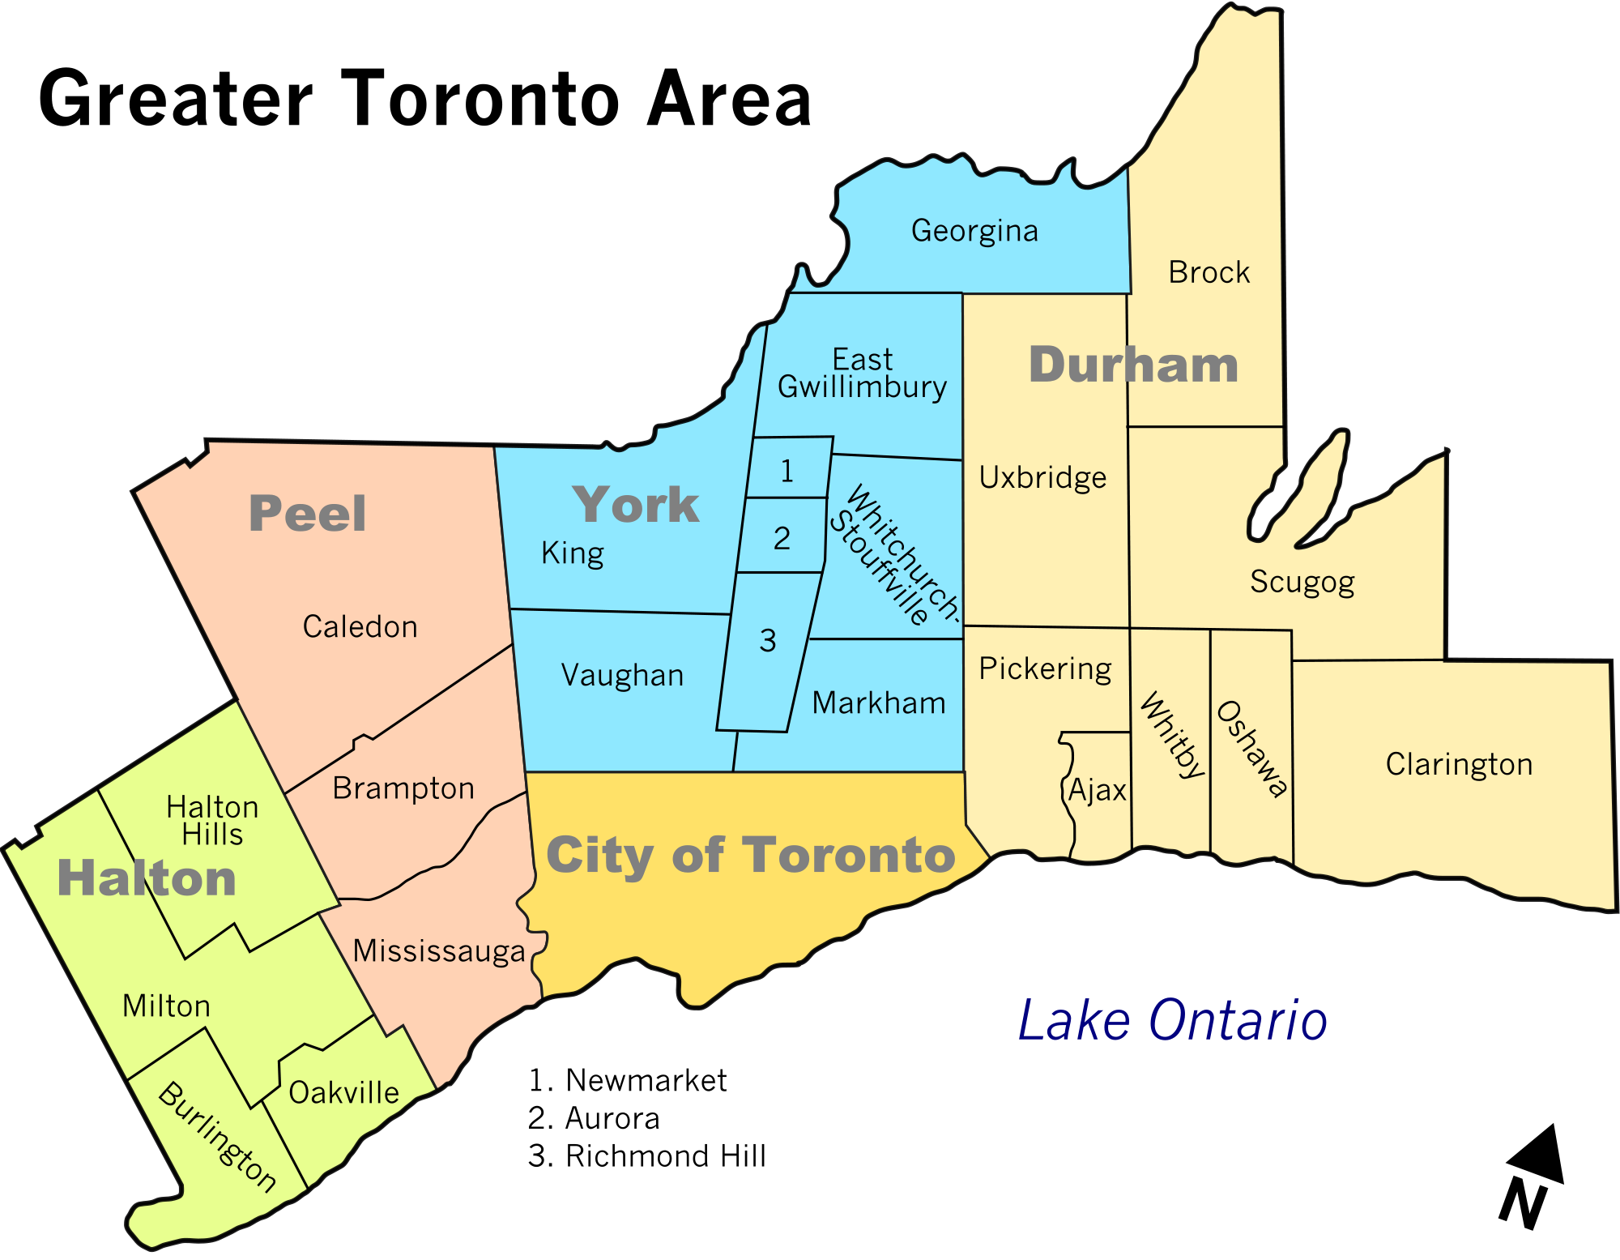
Average income per
household (2010):
Halton: $119,403
Ontario: $85,772
Canada: $79,102
Notes:
Location of Halton. Wealthy suburb. Schools generally have university aspirations for their students who are mostly middle and upper class. But beneath the averages, there is high level of income inequality in Halton

Slide 75


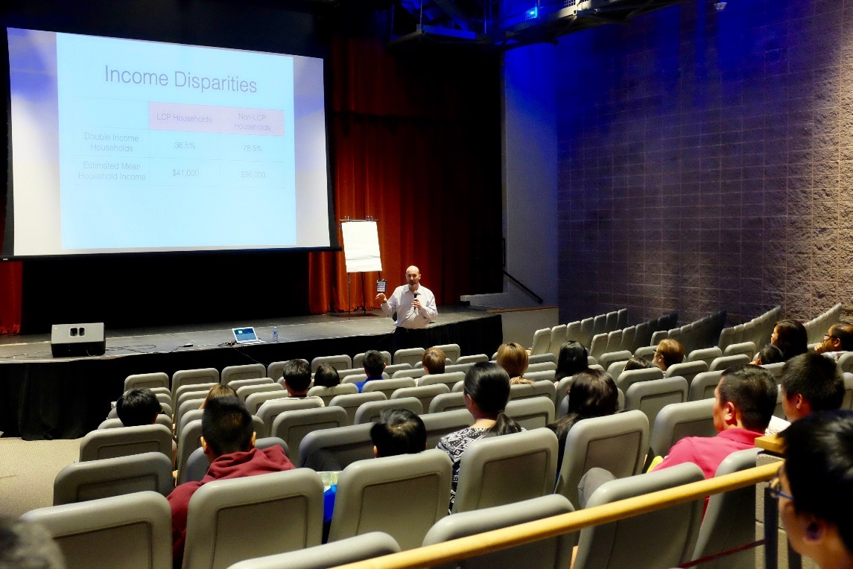
The Halton Pinoy Project
Surveyed:
128 Grade 10-12 students from
5 high schools
215 parents & guardians
Notes:
We collaborated with HCDSB to conduct a survey of grade 10, 11 and 12 students in 6 high schools.

Slide 76

Student Survey Respondents
Male/Female Ratio
Live-in Caregiver Children
Live-in Caregiver Children
Non Live-in Caregiver Children
ae
Notes:
Good gender balance in our respondents - important because gender is a key predictor of outcomes.
We had a roughly 50:50 balance of families who came under the LCP, and those who did not.
All our respondents had one or more parents born in the Philippines. This is important because it holds constant issues that will vary based on country of origin and ethno-racial discrimination.

Slide 77

LCP and Impacts on Family Cohesion
58 students were left behind in the Philippines by their mothers.
4 did not come under the LCP.
25 students were left behind in the Philippines by their fathers. Only 1 was LCP.
Notes:
Family separation from one or both parents is a common experience, especially for LCP kids

Slide 78

LCP and Impacts on
Family Cohesion
Notes:
For LCP students there were far more who had no father at home to respond to the survey

Slide 79

Notes:
Parental levels of education are not significantly different, regardless of whether they arrived through LCP
Hence, the usual intergenerational reproduction of educational levels is not an explanation for ay differences between LCP and non-LCP kids

Slide 80
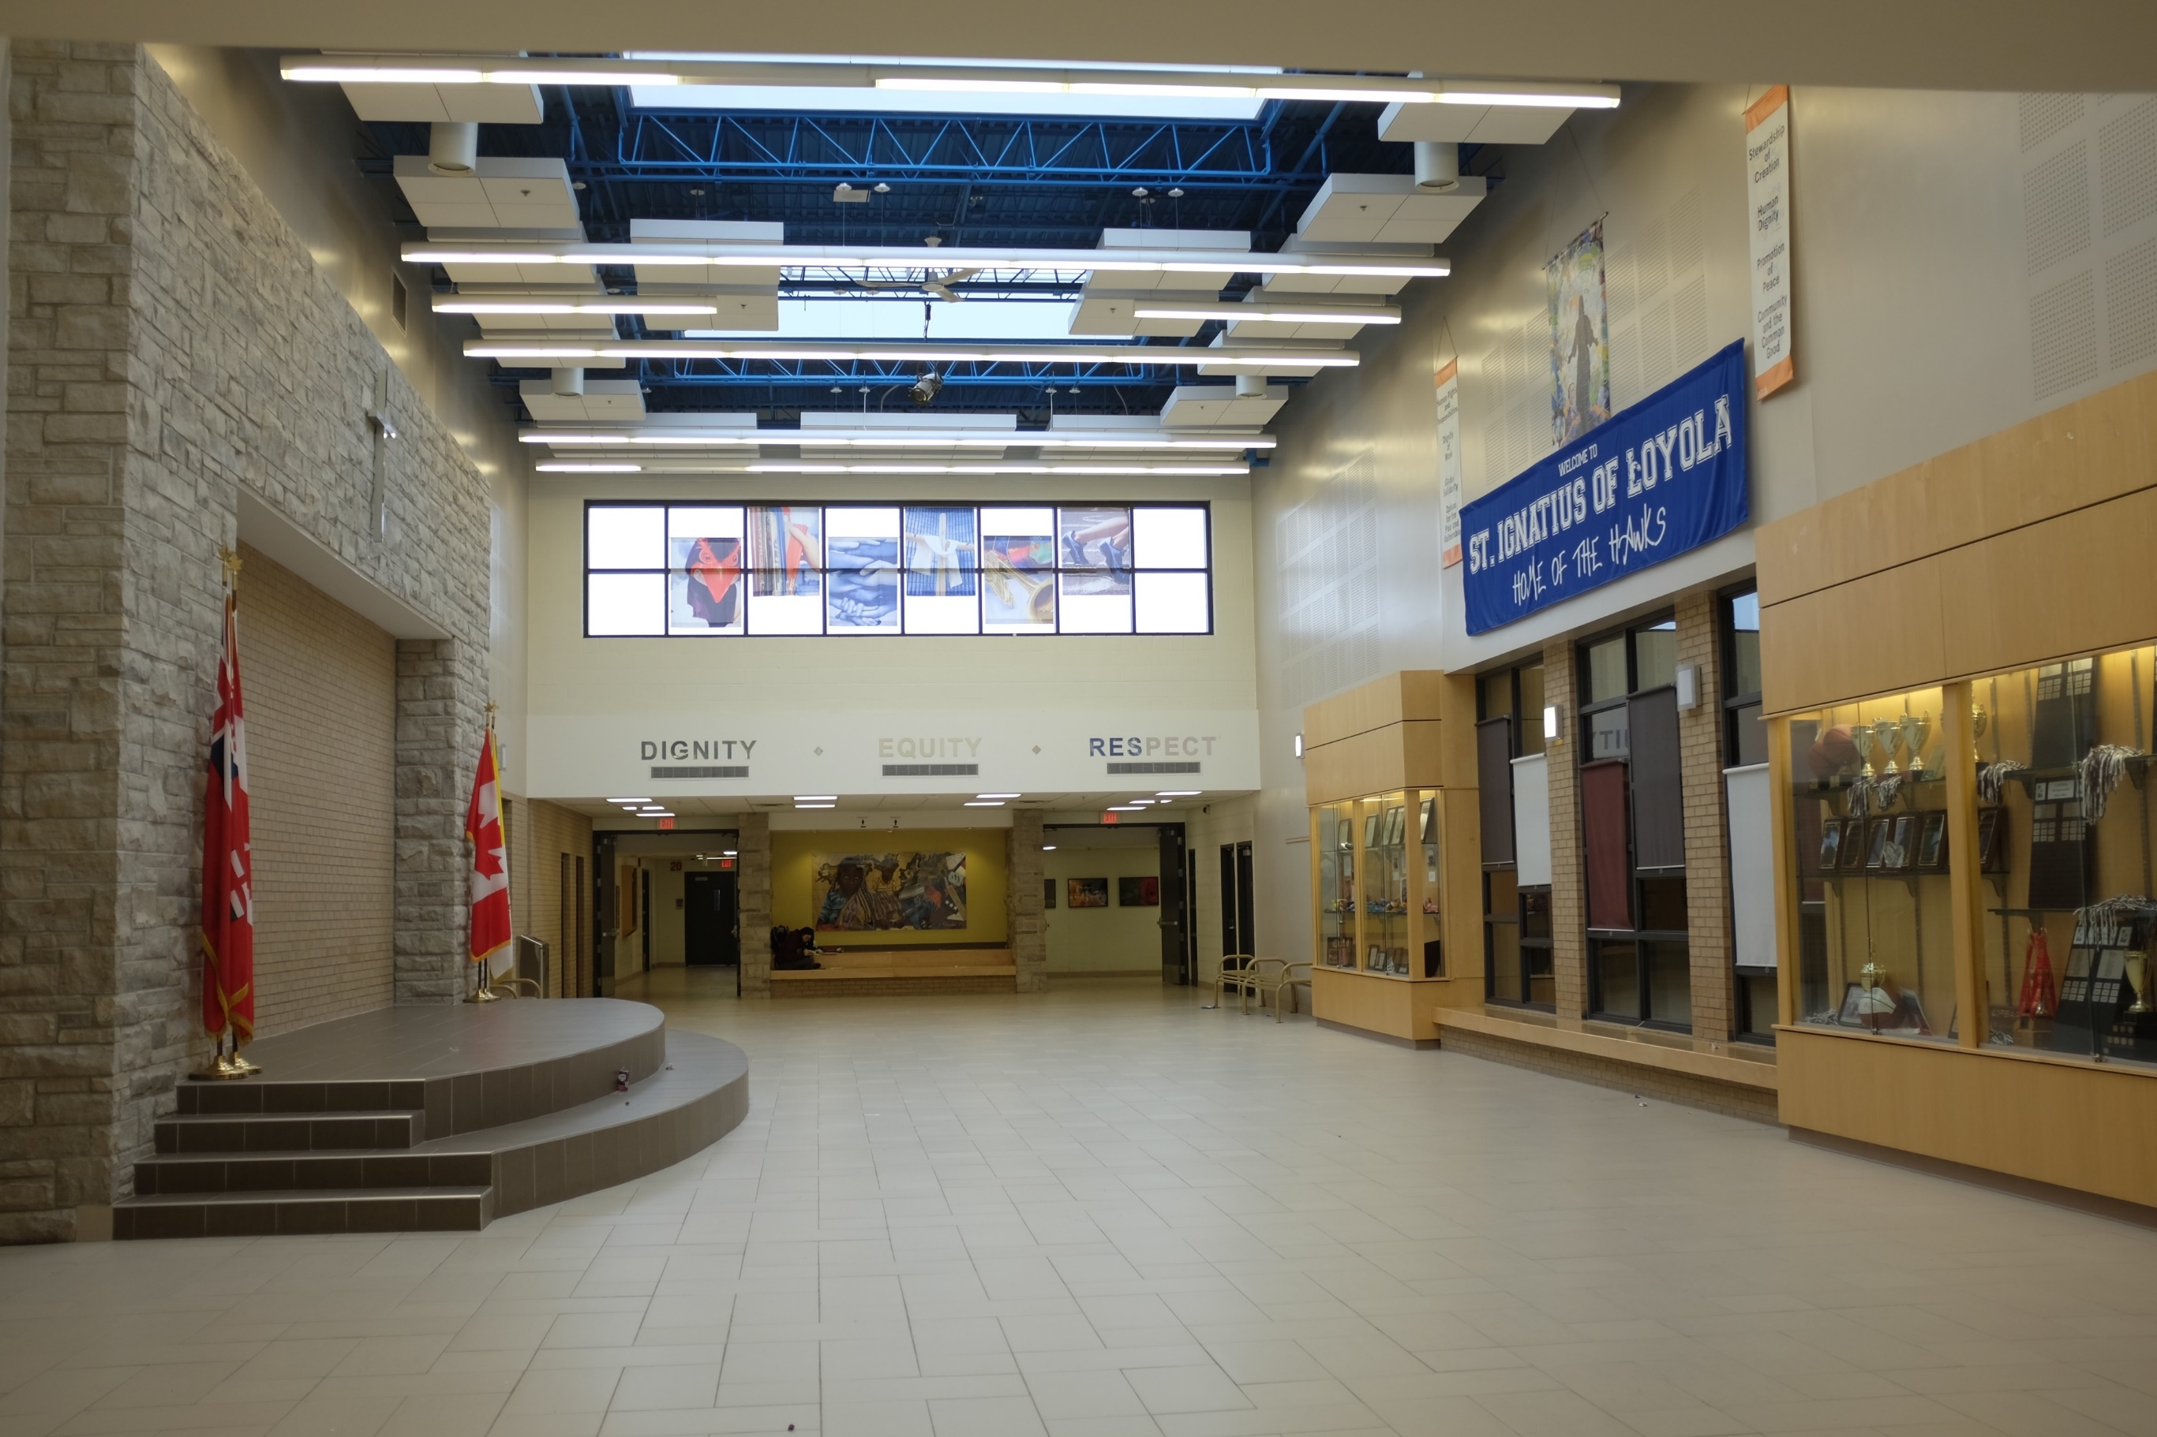
Notes:
What is different, however, is the experience of parents who came though these categories.
LCP parents are far more likely to be holding down multiple jobs.

Slide 81
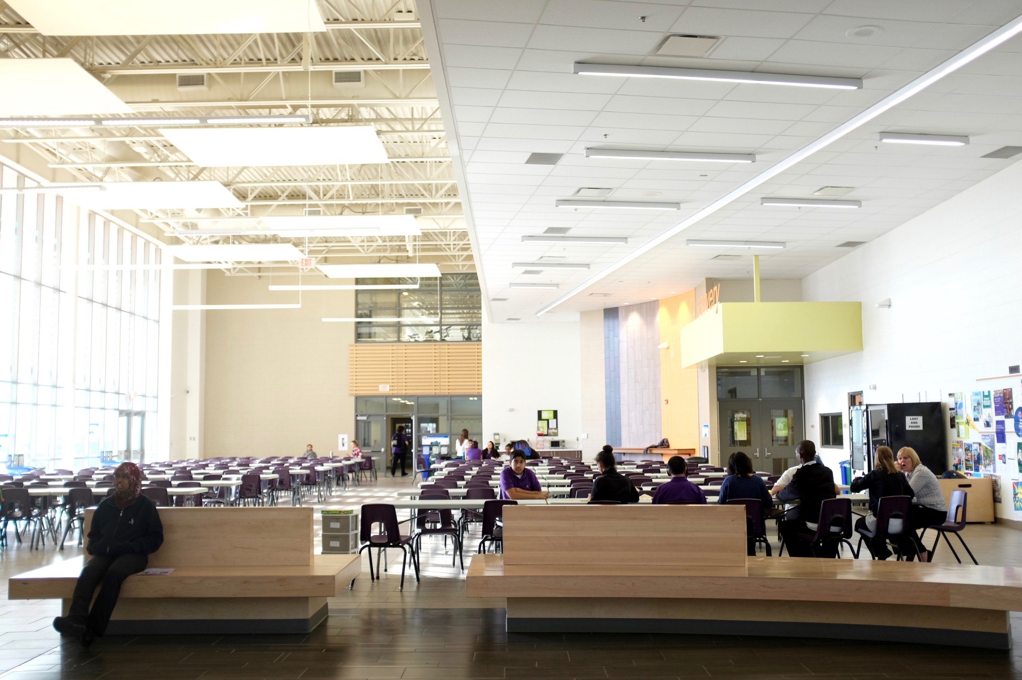
Notes:
LCP parents are also more likely to be in lower income brackets

Slide 82
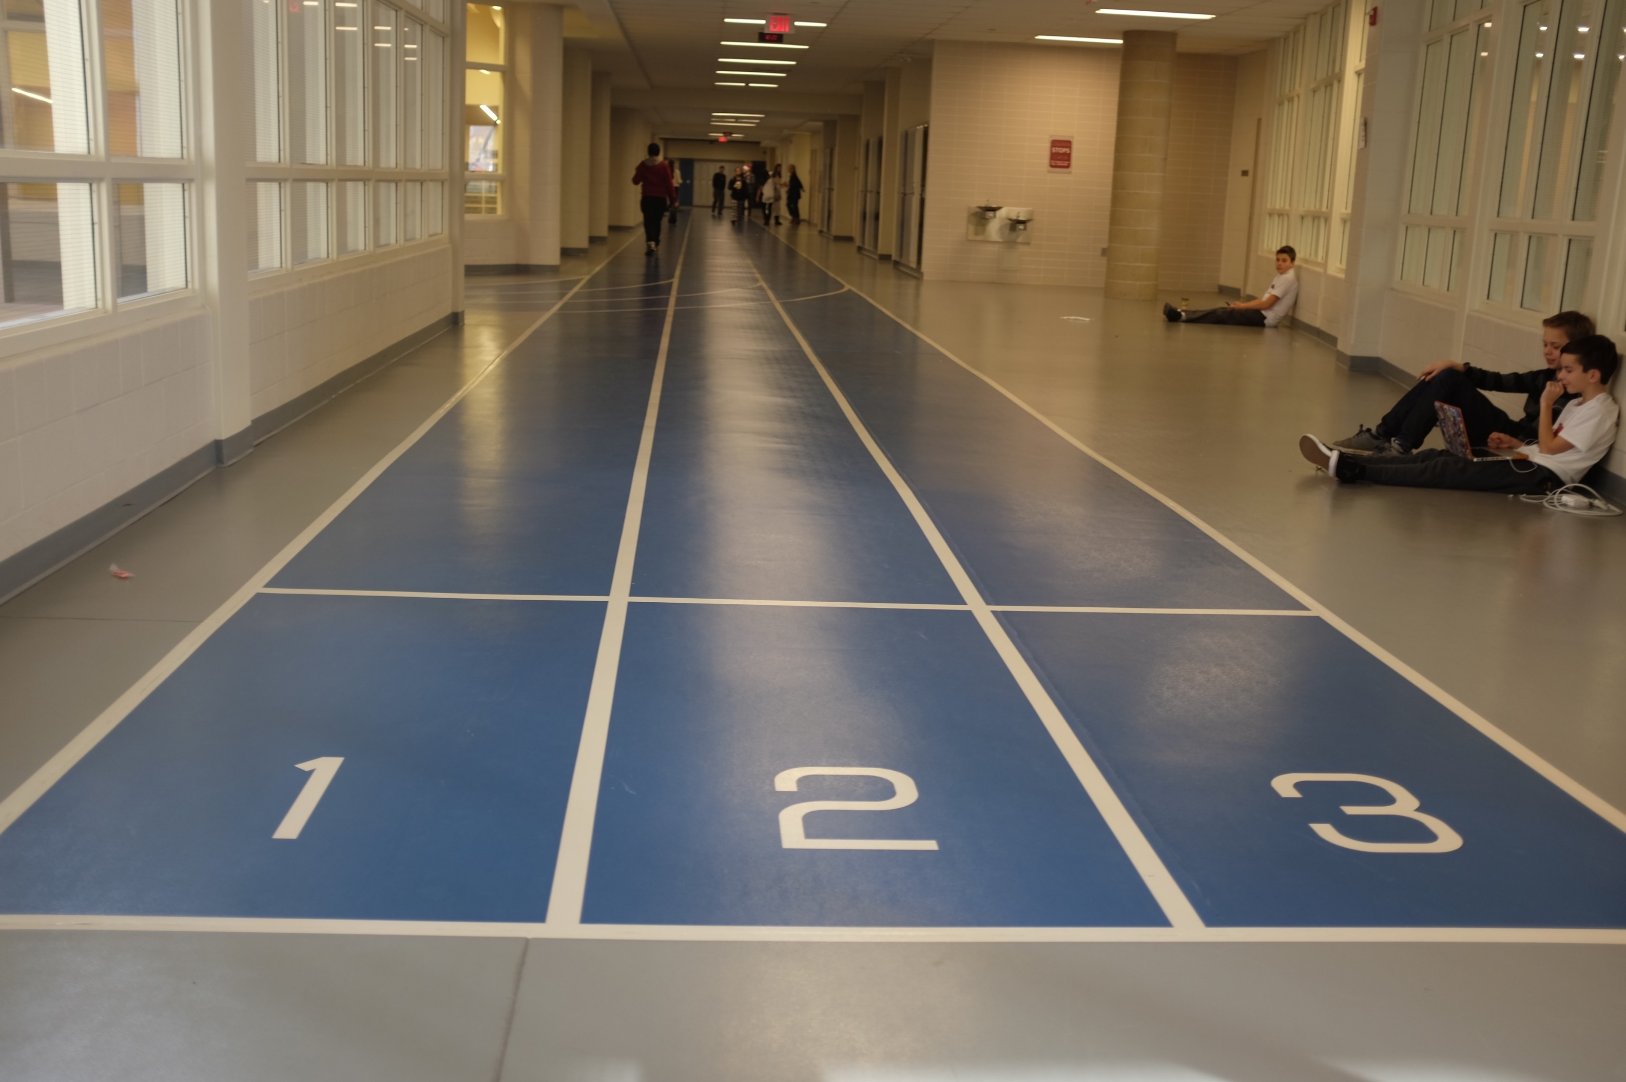
Notes:
And, if we look at how many hours students are working, we find that the children of LCP immigrants are much more likely to be working LONGER hours

Slide 83

Notes:
It’s not yet possibly to draw a firm and definite causation between being from LCP families and academic achievement, but there is certainly evidence to suggest that this is possible.
63% of non-LCP families have Math grades of 80% or higher. But only 35% of LCP kids.

Slide 84

Notes:
Post-graduation aspirations are quite different for LCP and non-LCP kids.
LCP kids less likely to see university in their future, and more likely to be looking at a college route.
Non-LCP kids overwhelmingly see a university pathway.
But, note there are still 50% of LCP families seeing university in their plans. So it’s not all doom and gloom! Nor should these kids be somehow stigmatized.

Slide 85
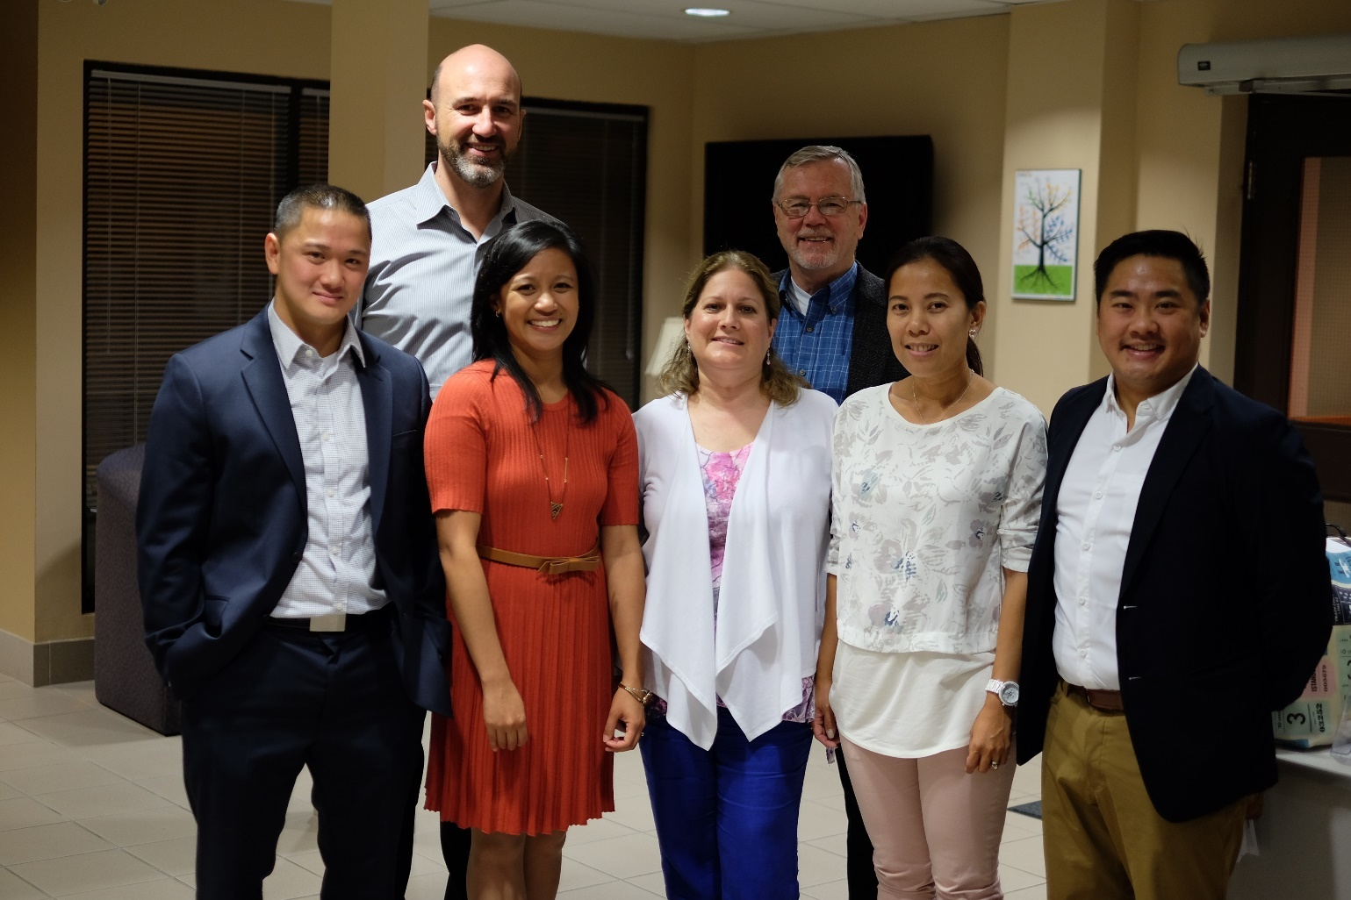
Conclusions
Precarious employment during and after the LCP affects a family’s cohesion, financial resources, and the age of children on arrival.
We believe this has a direct effect on the educational outcomes and future aspirations of children who are growing up in LCP families.
These outcomes are a direct effect of the family separation and employment circumstances that are created by the LCP.

Slide 86

Policy Recommendations
We recommend that
Permanent Resident status
for caregivers should be
granted upon arrival.
No systemic family separation
With PR status, parents could advantage of a greater spectrum of programs and resources for settlement and education
In the post-2014 Caregiver program, the pathway to Permanent Resident status has become constricted, leaving many caregivers with little to no chance of family reunification

Slide 87

Policy Recommendations
In Schools
Schools should strive to bring in more culturally relevant content when seeking curriculum resources and guest speakers, and when planning events
Schools should have a school settlement worker whose ethnic background reflects the newcomer population; he or she could run a newcomer club, newcomer family events, and provide culturally responsive one-on-one support
School staff should be trained on the intricate issues of their Filipino-Canadian students, with special regard to the impacts of family separation and reunification

Slide 88
Whole Worker Industrial Relations: Work and Family Precarity among Mexican Migrant Agricultural Workers
Don Wells
McMaster University

Slide 89

`Whole Worker’ Industrial Relations: Work & Family Precarity Among Mexican Migrant Agricultural Workers
Working Precariously: Causes & Consequences
Art Gallery of Hamilton, 19 June 2018
Don Wells
Thanks to all the workers & their families who helped our `team’, Janet McLaughlin, André Lyn, Aaraon Diaz & Biljana Vasilevska, to understand; and to Josephine Eric, for her research help. We are grateful to the late Stan Raper for his wise advice, encouragement and assistance. Thanks to SSHRC for funding this research through the PEPSO CURA grant. Photos by Janet McLaughlin.
Notes:
Revisions to consider for next time:
Mexican workers refer to SAWP using their families as “hostages” (says Barb Carpio)
Gabriel Allahdua says that there has never been any inquest in Canada regarding any of the deaths of migrant farm workers. A) confirm b) explain
Gabriel says that employers control the travel agencies that repatriate workers who have been fired, medical repatriations, etc. A) evidence B) explain implications for management control

Slide 90
‘Whole Worker’ Approach
social control through separation:
  Invisible labour: supply chains separate farm workers & their families from consumers (e.g., when we buy fruits & vegetables)
  “industrial relations” narrow workplace focus (pay, work safety, etc.), not family care, education, health, leisure, environment, transportation, etc.
`whole worker’ approach links work, family, community, participatory citizenship, etc.

Slide 91
Permanently `Temporary’ Foreign Workers & `Whole Worker’ Politics
Seasonal Agricultural Worker Program (SAWP): ~ 42,000 low paid, `flexible’ workers
SAWP requires family separation: “transnational families”
`forced rotation’, ¾ more than 6 mo. annually; for 10 + yrs (average)
Notes:
Over 300,000 temporary migrant workers are coming to Canada annually – more than the number of immigrants who gain permanent residency each year
~ 42,000 come here under Canada’s Seasonal Agricultural Workers Program (SAWP)
The SAWP supplies low wage, `flexible,’ highly controlled agricultural labour.
SAWP requires workers separate from their families while working in Canada.
Under this “forced rotation,” SAWP workers leave families 6-8 months every year for 5,10, 20,30 years. Sometimes even 40 years.
~ 97% men, 3% women
Almost all the male workers are married or in common law relationships, and have children.
Most of the female workers are single moms.
Their repeated absences create transnational families in which migrant workers spend more time in Canada than with their families.
Absent from their families, SAWP workers are a ‘just-in-time,’ flexible, on-site labor force, available to work night and day, holidays and weekends, often 10-12 hr/day, sometimes 18 hours/day, 6-7 days a week.
Working conditions are often harsh:
Agricultural labour among most dangerous occupations:
exposure to toxins
unsafe machinery
work in bad weather
ergonomic damage due to prolonged bending and lifting.
YET, ~ half the SAWP workers surveyed in ONT and BC reported they had no health and safety training or information
About half reported working while injured or sick to avoid being fired, or losing pay
Many also report mental health issues related to their separation from their families, and to their social isolation in Canada

Slide 92
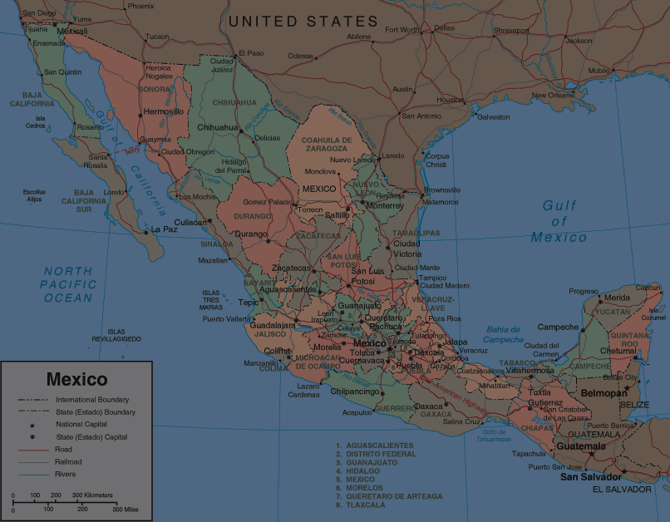
Repetitive Emotional Injuries
Repetitive emotional injuries – all families damaged
Research Methods: 74 semi-structured interviews (1-2 hrs) in Mexico (54) & Ont (20)
  Workers, spouses, adult children, teachers
Notes:
These repeated separations cause “repetitive emotional injuries” that can inflict long-term damage on migrants, as well as their children and partners.
The damage varies in nature and degree from family to family – but all families are damaged.
The main evidence for this damage comes from 74, 1-2 hour semi structured interviews with migrant workers and members of their families as well as from teachers and principals who teach the children of these migrant workers.
We also interviewed Jamaican workers and their families. But tonight we focus on the Mexicans’ experience .

Slide 93
Extreme State & Employer Power System
  competition by states & workers for jobs & remittances (a reason Canada invited Mexico)
  families ‘hostages,’ so workers return home
  contracts negotiated betw. states; managed by employer associations; no worker participation
  work permits `tied’ to only 1 employer
  employers’ ‘naming’ & repatriation powers
    “medical repatriation “ of injured & sick workers
  no union rights in Ont = labour violation (ILO)
Notes:
Canadian employers exploiting competition among sending states for jobs and remittances is called `country surfing’
One reason Canada asked Mexico to join SAWP in 1974 was to provide a competitive alternative to Caribbean workers .
By recruiting workers who have families that depend on them, and not allowing workers’ families to come with them, governments and employers help ensure that workers are likely to return home.
Is it reasonable to say this uses families as “hostages”?
Employers have extraordinary power:
The work permits are tied : only allow the worker to work for one employer.
SAWP gives the employer the right to `name’ workers = decides if the worker will be allowed back next season.
SAWP also gives the employer the power to repatriate workers if the employer feels they are undesirable. This usually leads to immediate forced repatriation -- with no right of independent appeal.
a) workers repatriated on medical grounds if they are sick or injured.
in Ontario alone, ~800 medical repatriations - many without receiving medical treatment before repatriation
4) In Ont., Canadian agricultural workers, as well as SAWP workers, are not allowed union and collective bargaining rights.
Ont is the only province that doesn’t allow agricultural workers these fundamental labour rights.
As a result, Ontario has been admonished by the UN”s International Labour Organization for these violations of fundamental labour rights.

Slide 94
Workers Isolated from the Community
lack of Eng. & Fr.; communication limited
long work hours = little time & energy for socializing with others, community
lack of transportation from isolated farms
some employers: surveillance cameras + curfews; require report location when off farm; deny/restrict visitors (esp. opposite sex)
social isolation contributes to depression, etc.

Slide 95
“Unfree Labour”
review for Ontario Ministry of Labour: SAWP conditions of work = “unfree labour”
former (PC) Immigration Minister of Canada (Jason Kenney):
Employers prefer temporary migrant workers because they “know they’re going to show up every day for work.” They have “a kind of quasi-indentured status.”
Notes:
You will not be surprised to hear that a review for the ON Min of Labour has concluded that SAWP working conditions constitute “unfree labour”

Slide 96
Well, it’s their choice to come to Canada, right?
Politically constructing Mexicans’ ‘choices’:
NAFTA, dumping subsidized US agr. exports: big fall in agr. wages & jobs pushes small farmers into deep poverty
  ½ Mexico’s rural pop’n earns less than needed to feed themselves;
  biggest rural exodus in Mex. history;
  SAWP recruits cheap, desperate rural workers;
  remittances for family survival
Notes:
Remittances workers send to their families are generally a lifeline to their families survival.
Remittances generally don’t take their families out of poverty but provide hope that the children may have a better future.

Slide 97
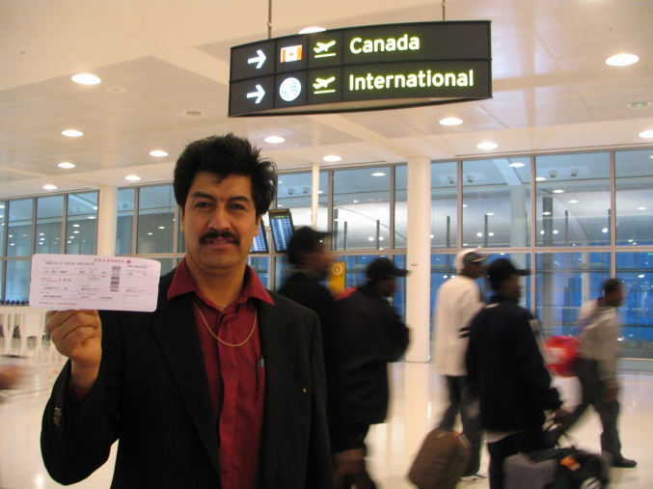
Impacts: Sacrificing the Family to Save the Family
Worker: “My motivation is my kids. (..) How is it possible that (..) I haven’t seen them grow up? (..) It affected me emotionally.”
Worker: “I’m so desperate. (..) I didn’t enjoy my children (..) They were little when I started going to Canada (..) [for them] to have a better life.”
Worker: “You feel so much pain in your heart when you leave (..) they stay crying , so you cry too.
Notes:
Workers’ main motivation is to get remittances to send to their families.
Remittances spent on four main kinds of material benefits:
1) better nutrition;
2) better housing;
3) better education for kids
4) better health care.
As noted earlier, these remittances allow family survival but not escape from poverty.
The cruel paradox: Mexican workers said working under the SAWP is a sacrifice they make for the survival of their families – but the cost of being away from their families year after year is that they lose their families.

Slide 98
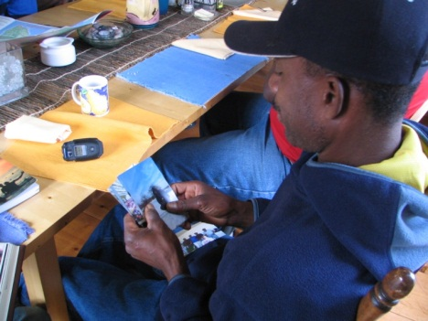

Fathers Become Strangers
Worker: “I felt really bad when she (daughter) rejected me and told me I was not her father.”
Daughter: “How can I love a stranger?”
Spouse: “`I have no dad’, (daughter) said.’ “My husband felt bad. `My daughter doesn’t love me,’ he said.” [Spouse:] “How can she love a stranger?”
Notes:
Many workers said their children saw them as strangers who come back only a few months each year.
They missed their kids when they were growing up.
Some of the hardest times were missing their kids birthdays, first days in school, graduations, 1st communions, and the Mexican coming of age celebration Quinceanera when daughters turn 15.
Some said they felt their kids saw them as a kind of Santa Claus – a person who brings them presents once a year when he comes home in the fall.

Slide 99
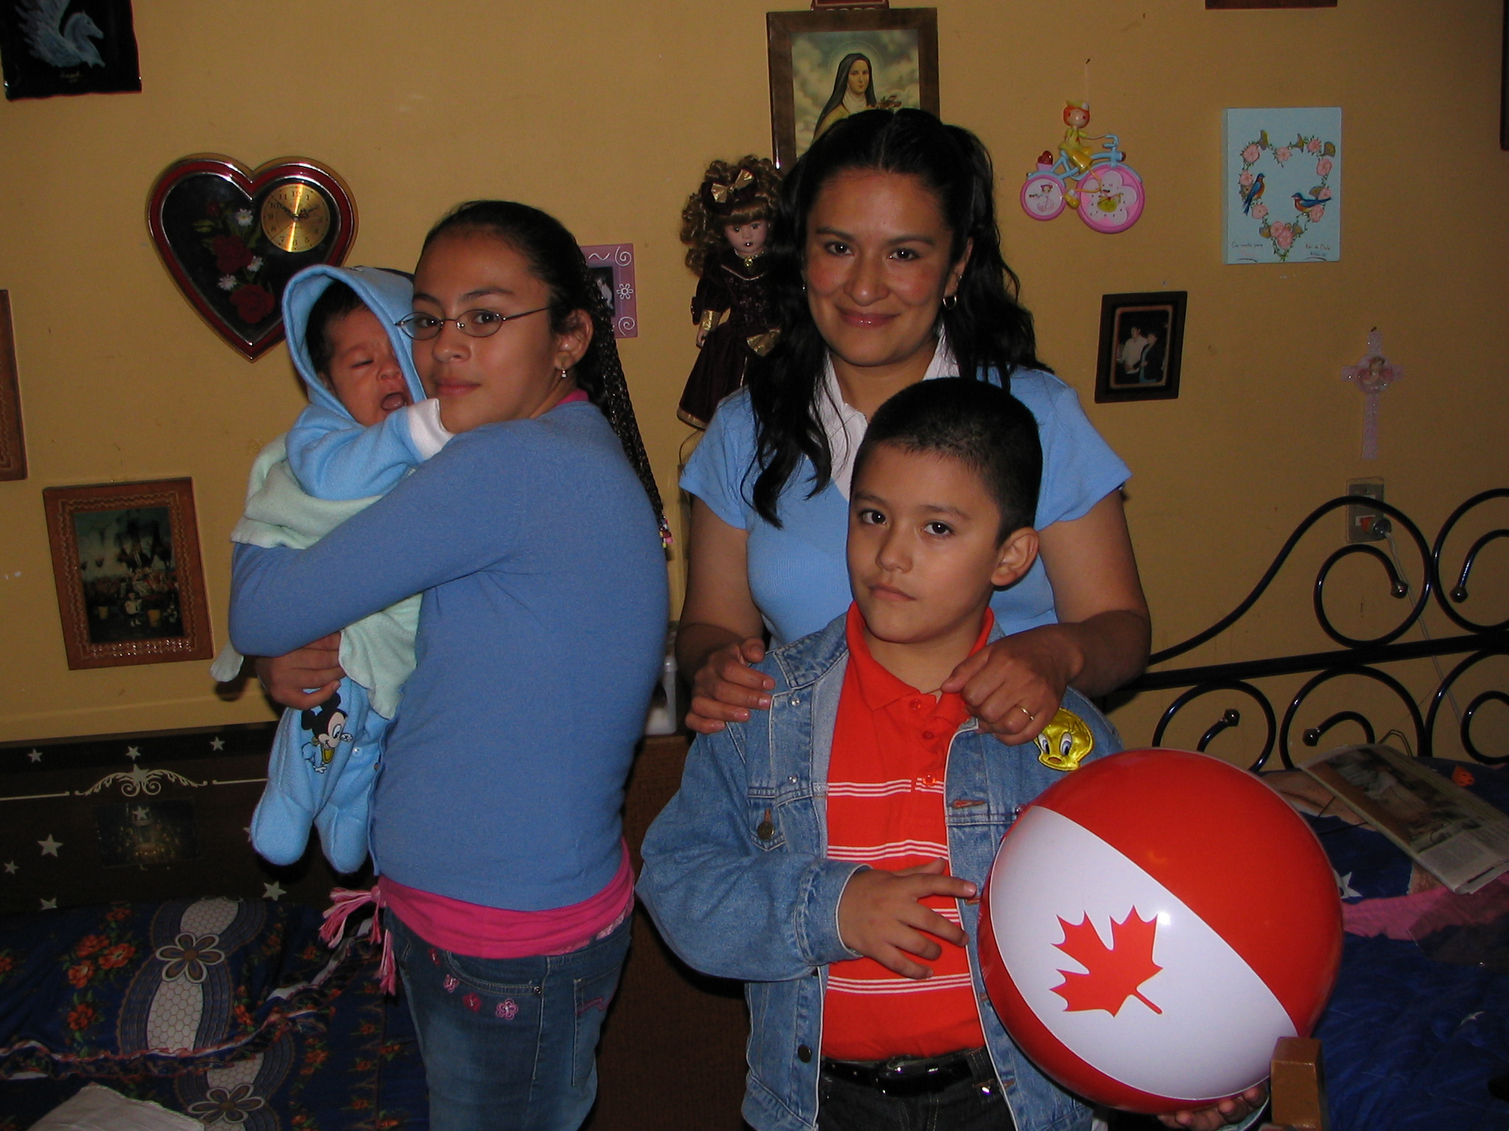
SAWP Creates “Single” Moms
Burdens: patriarchal div. of labour, loneliness
Spouse: “I have to solve everything alone. (..) The kids rebel. They don’t listen to me.”
Spouse: “I miscarried (when husband in Canada) because I was lifting buckets. My husband said `why did you carry the buckets?’ If I didn’t do it, who would?”
Notes:
Spouses make heavy sacrifices to support their husbands’ working in Canada.
The patriarchal division of labour means most women are not prepared to take on many roles of their absent husbands.
This includes:
disciplining the children
Home repairs
heavy physical work
protecting the children and the home, etc.
emotional losses, especially loneliness.

Slide 100
Impacts on Kids: School, Health, Violence, Drugs, Early Pregnancy
Worker [telephoning son being treated for depression]: “‘I’m almost there, son.’ How can I tell him this is the price for a better life?”
Daughter: [after father leaves]“my brother only wants to be in bed. (..) He goes to school sad and when he comes back he goes to bed.”
Mother: “a lot of young guys choose a wrong path, and all of them have absent fathers.”
Notes:
A surprising finding:
Many children get sick and/or depressed when their fathers leave for Canada. Every family reported this.
Symptoms:
colds and flus
Nausea
Fevers
depression.
Some kids are sick the entire time their fathers are in Canada – and then get better as soon as their fathers return home.

Slide 101
Conclusion
While contributing to short-term economic gains, SAWP harms family cohesion and family members (fathers, spouses and children)
A whole worker approach should guide policy reforms to strengthen family cohesion and reduce harm to family members
see publications based on research:
https:// pepso.ca/publications

Slide 102
Migrant workers and barriers to occupational health and safety protections
Janet McLaughlin
Wilfrid Laurier University

Slide 103
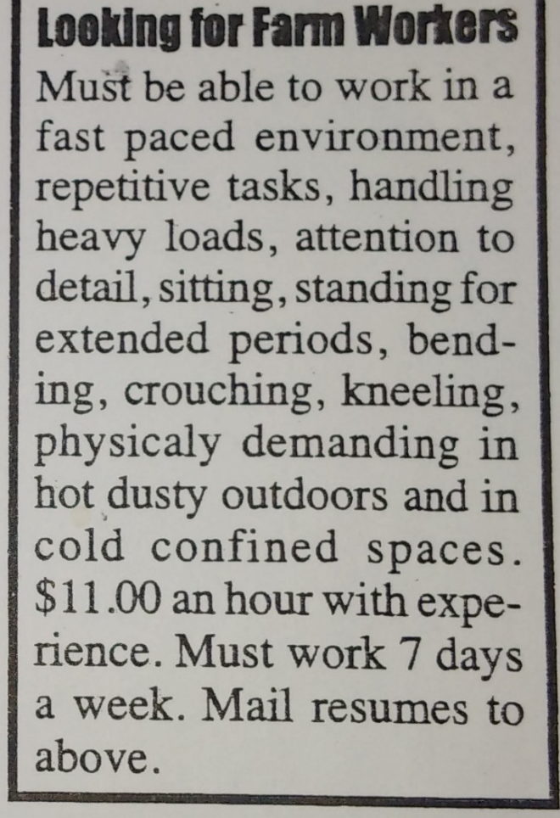
Occupational Health and Safety of Migrant Agricultural Workers in Ontario
Janet McLaughlin, PhD, Associate Professor, Health Studies Wilfrid Laurier University
June 19, 2018
Working Precariously: Causes & Consequences
Art Gallery of Hamilton, 19 June 2018

Slide 104
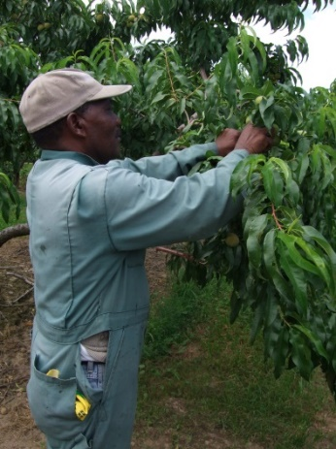
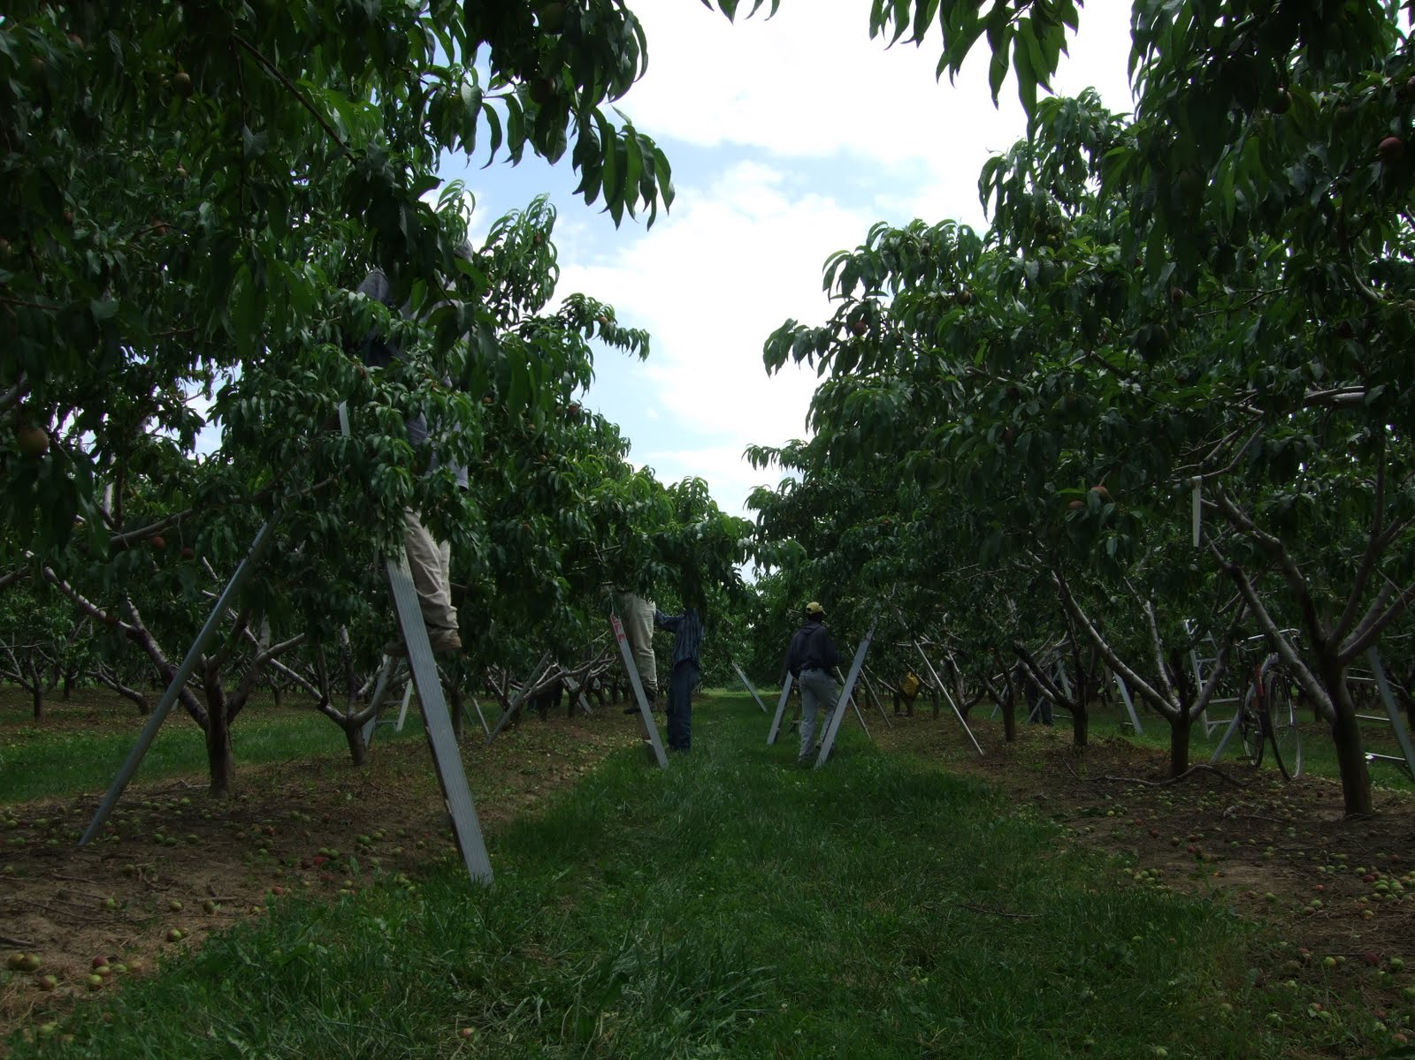
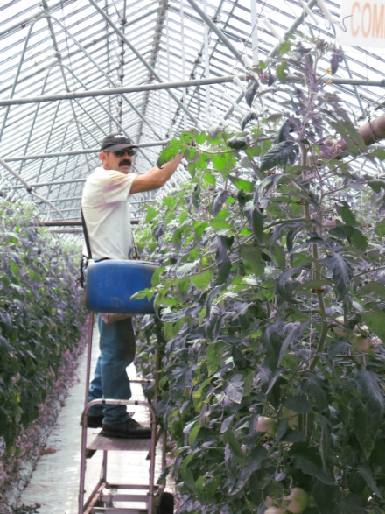
Working Context
Wide variability in hours – often 8-12 hours a day; can be substantially more during the high season
Usually work from 6-7 days a week
Often lack sufficient breaks / rest
Often lack health and safety training, PPE
Limited rights under OHSA, ESA; excluded from LRA

Slide 105

Common Health Hazards
Occupational hazards
  Ergonomic
  Chemical exposures
  Work sanitation/hygiene
  Climatic exposures
Unsafe transportation
  Bicycles (lacking reflectors, helmets, etc.).
  Unsafe vehicles (lacking seatbelts, etc.).
Poor/variable living conditions
  Housing conditions
  Lack of control
  Stress and challenges of being separated from families

Slide 106
Ontario Survey on Working Conditions:
59% said they had not received any OHS information / training
55% stated that they will work while sick to not lose paid hours
45% stated that they will work while sick because they are afraid of their employer (Hennebry, Preibisch & McLaughlin 2010)
“You have to be there to do what the boss tells you…if you start to disobey him, you will no longer return. For that reason one has to accept everything. Although you know that it is not the correct thing or that they are committing injustices against you, you have to allow it.” (Mexican migrant worker, McLaughlin 2009)

Slide 107
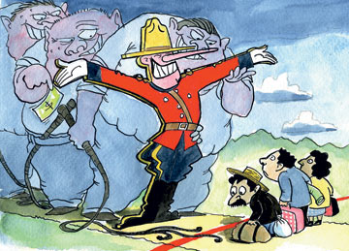
“…There are some bosses that are good, but there are also bosses that are totally horrible, the well-being of their workers doesn’t interest them. I don’t why… I guess we are like disposable machines to them…they work us hard until we wear out. Then they replace us with others.”
- “Pepe”, Mexican worker
The Economist, Nov. 23, 2007

Slide 108
Barriers to Rights’ Attainment: The Impact of Fear
“Migrant workers have...almost non-existent possibilities of complaining or refusing any work that they consider unhealthy or dangerous. There is no way…that they are going to stand up or challenge. Even the ones that … have the courage enough to do it, they don't want to lose the job. They don't want to be shipped back to their countries” - Legal worker, interview, 2011.

Slide 109

Barriers to Accessing Health Care & WSIB
Logistical:
Long work hours
Limited clinic hours
Lack of transportation
Delays in receiving health cards
Language and literacy
Structural
Lack of information about and integration into the local health care system
Dependence upon employers, and resulting confidentiality concerns
Fear of reporting concerns
Lack of long-term, transnational care

Slide 110
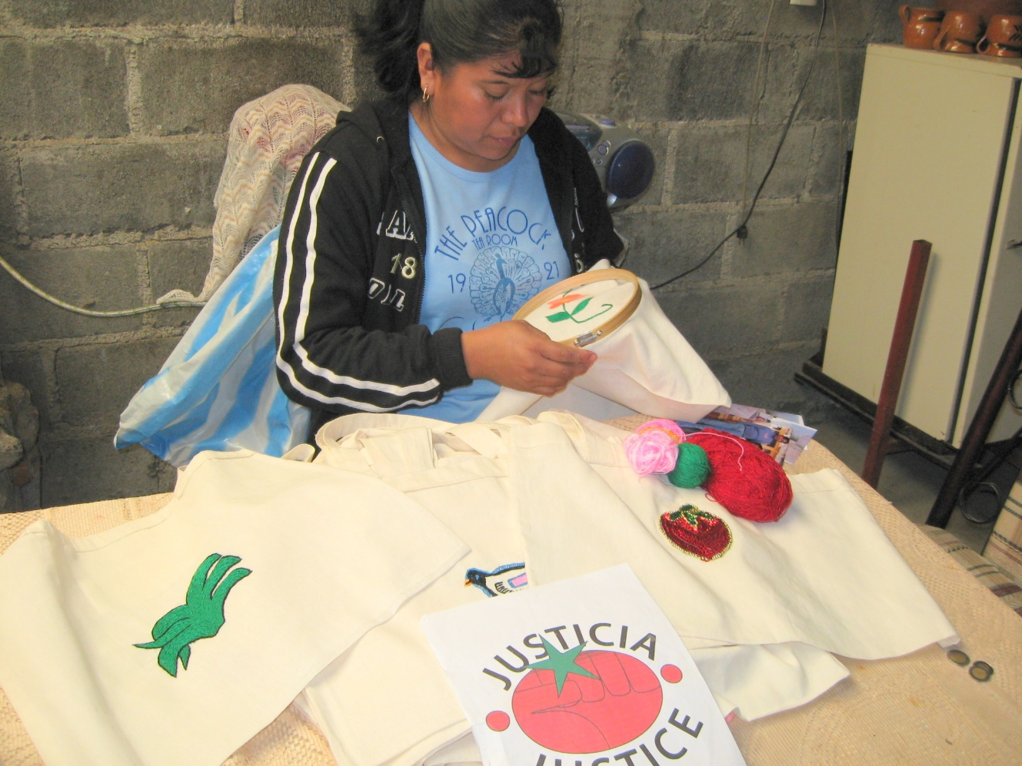
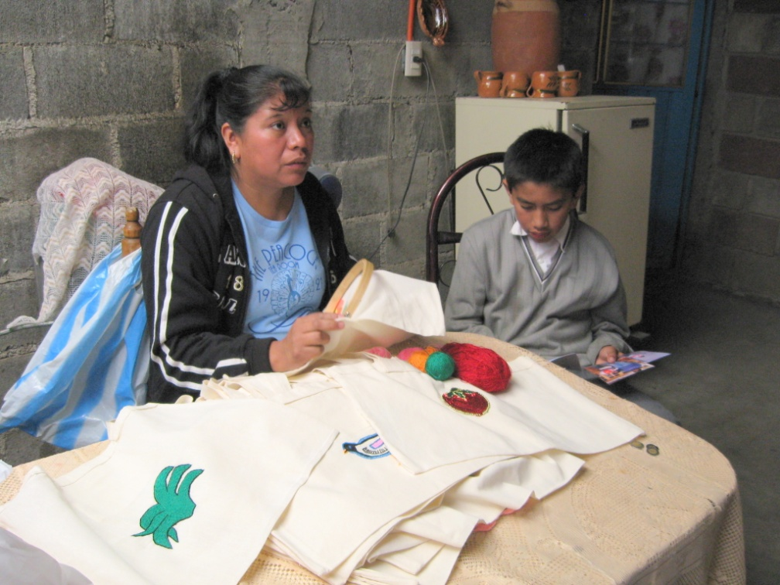
Alicia
Alicia

Slide 111
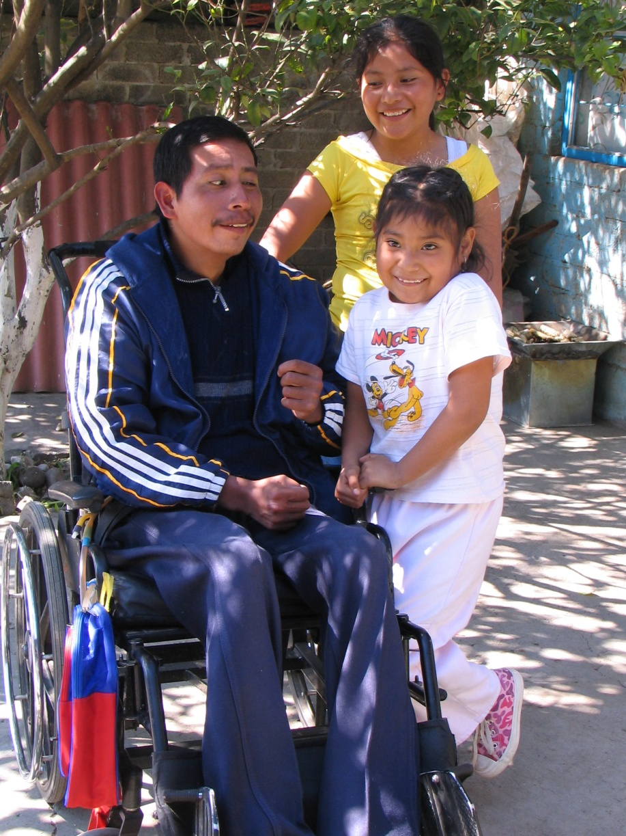
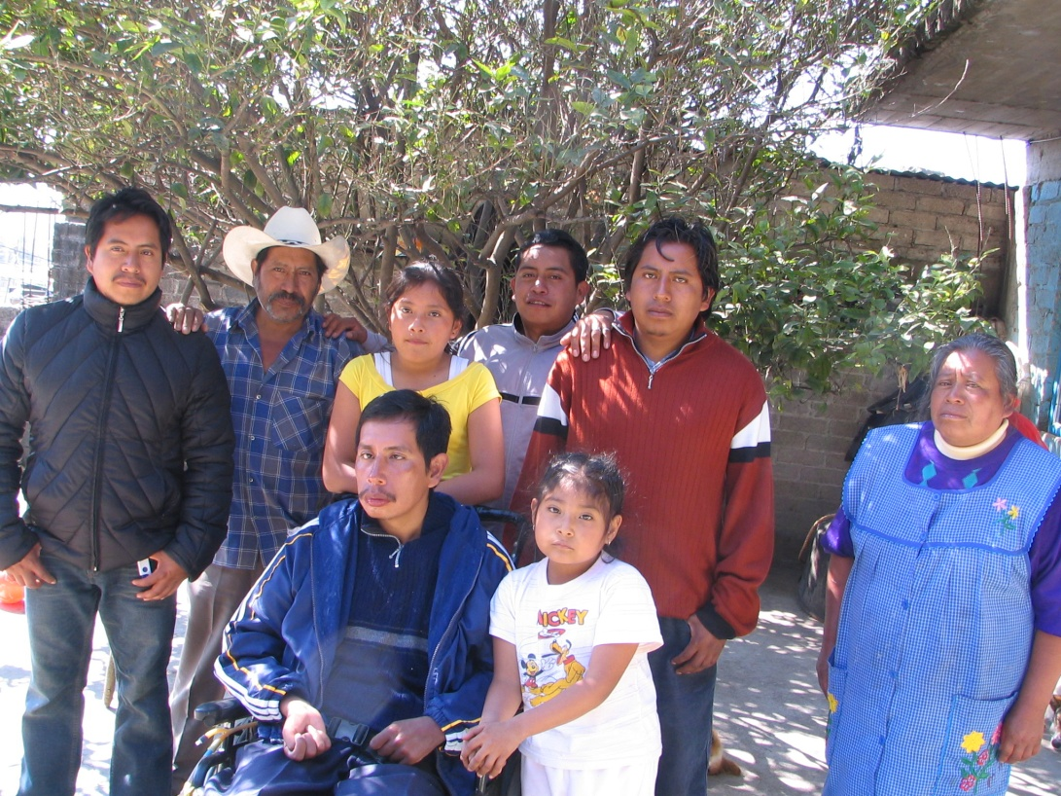
Ricardo

Slide 112

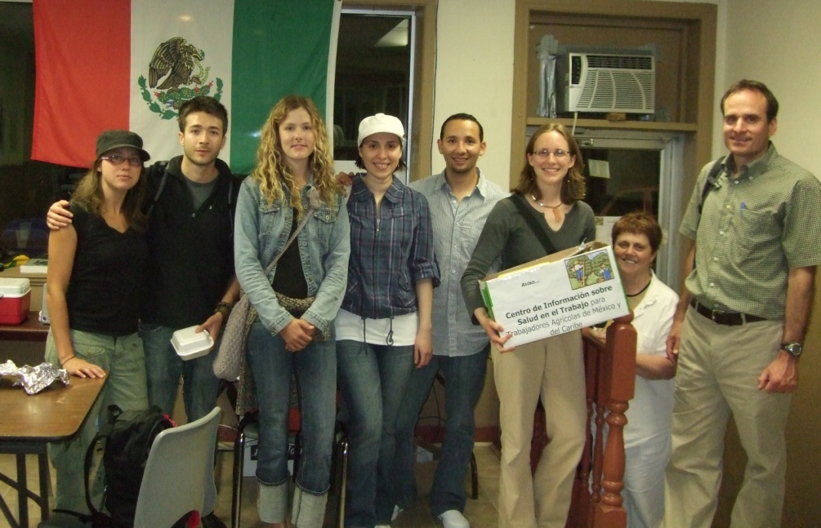

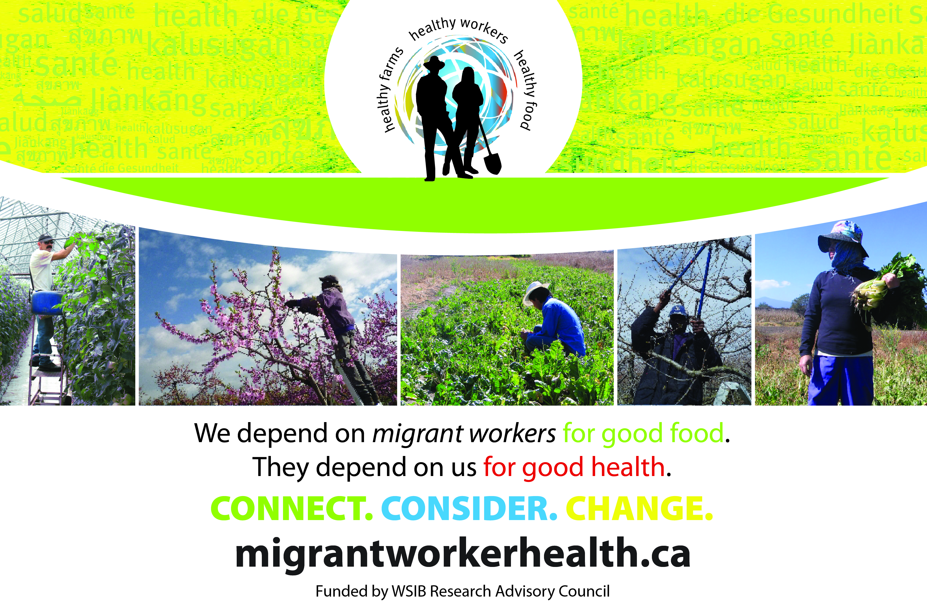
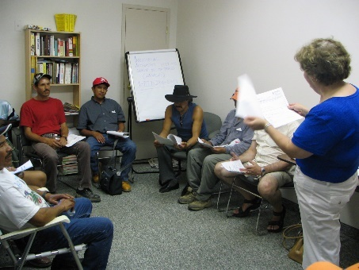


Positive Developments
OHCOW and CHC clinics and prevention-based workshops
Health fairs and broader community involvement
Support of legal clinics
2018 WSIB changes
MOL recognition and dialogue

Slide 113
Conclusion
Agricultural workers endure multiple levels of vulnerability to health issues:
  The risks inherent within agriculture
  Agricultural workers’ exclusions from key legal protections
  Precariousness of migrant workers’ temporary employment and migration status
Fundamental / structural changes are needed to address inherent and compounded vulnerabilities.

Slide 114
Policy Recommendations
  Worker-family communication & visiting rights
  EI benefits (incl. parental benefits)
  Health screening before return home
  Mandatory health & safety training
  Effective, proactive MOL enforcement
  Seniority recall rights, not ‘naming’
  ‘Open’ permits & flexible contract length
  Union & collective bargaining rights
  Permanent status & family unification

Slide 115
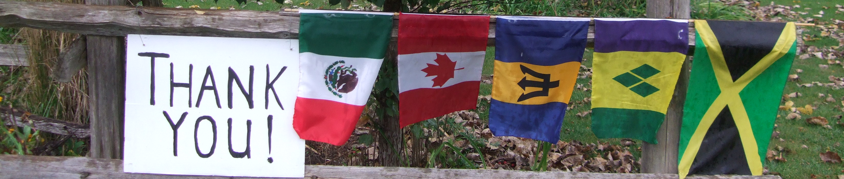
Acknowledgements:
Various aspects of this research were supported by the Social Sciences and Humanities Research Council of Canada (SSHRC), the International Development Research Centre (IDRC), the Institute for Work and Health (IWH), CERIS (the Ontario Metropolis Centre), the Workplace Safety and Insurance Board Research Advisory Council (WSIB RAC), the Canadian Institutes of Health Research (CIHR), the University of Toronto, Wilfrid Laurier University (WLU), and the Public Health Agency of Canada (PHAC).
Some material was developed in partnership with Jenna Hennebry, Michelle Tew and Don Wells
Opinions presented within are those of the author and do not necessarily reflect those of the funders
More information: www.migrantworkerhealth.ca

Slide 116
Question and Answer
International Ripples: precarious employment’s impact on immigrants and their families
Moderated by:
Stephanie Premji, McMaster University
Presenters:
Jennilee Austria, Filipino Talks
Don Wells, McMaster University
Janet McLaughlin, Wilfrid Laurier University

Slide 117
Lunch & Keynote
Moderated by:
Andrew Parkin, The Mowat Centre
Presenter:
Sara Mojtehedzadeh, The Toronto Star

Slide 118
Temporary Work – Dangerous for your Health
Sara Mojtehedzadeh
The Toronto Star

Slide 119


Slide 120

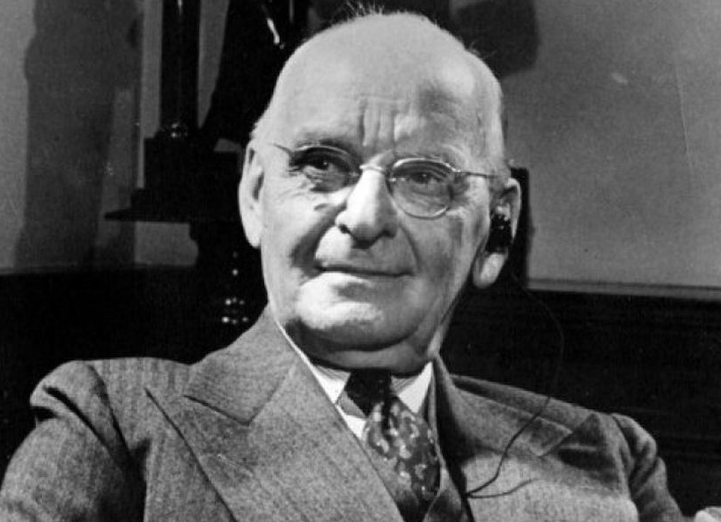
Joseph “Holy Joe” Atkinson

Slide 121
“A paper for the people”
“Never as did now did men recognize the evil which results from the accumulation of great wealth in a few hands,. It is a bar to progress, it blunts industry and it reduces the labourer to the position little better than that of a dependent.”

Slide 122
Precarious work in Ontario
One-third of the province’s workforce are vulnerable workers in precarious jobs
52 per cent of jobs in Toronto, Canada’s largest city, have some form of precarity
Minorities, recent immigrants, and women are overrepresented in these jobs
Unionization on the decline

Slide 123
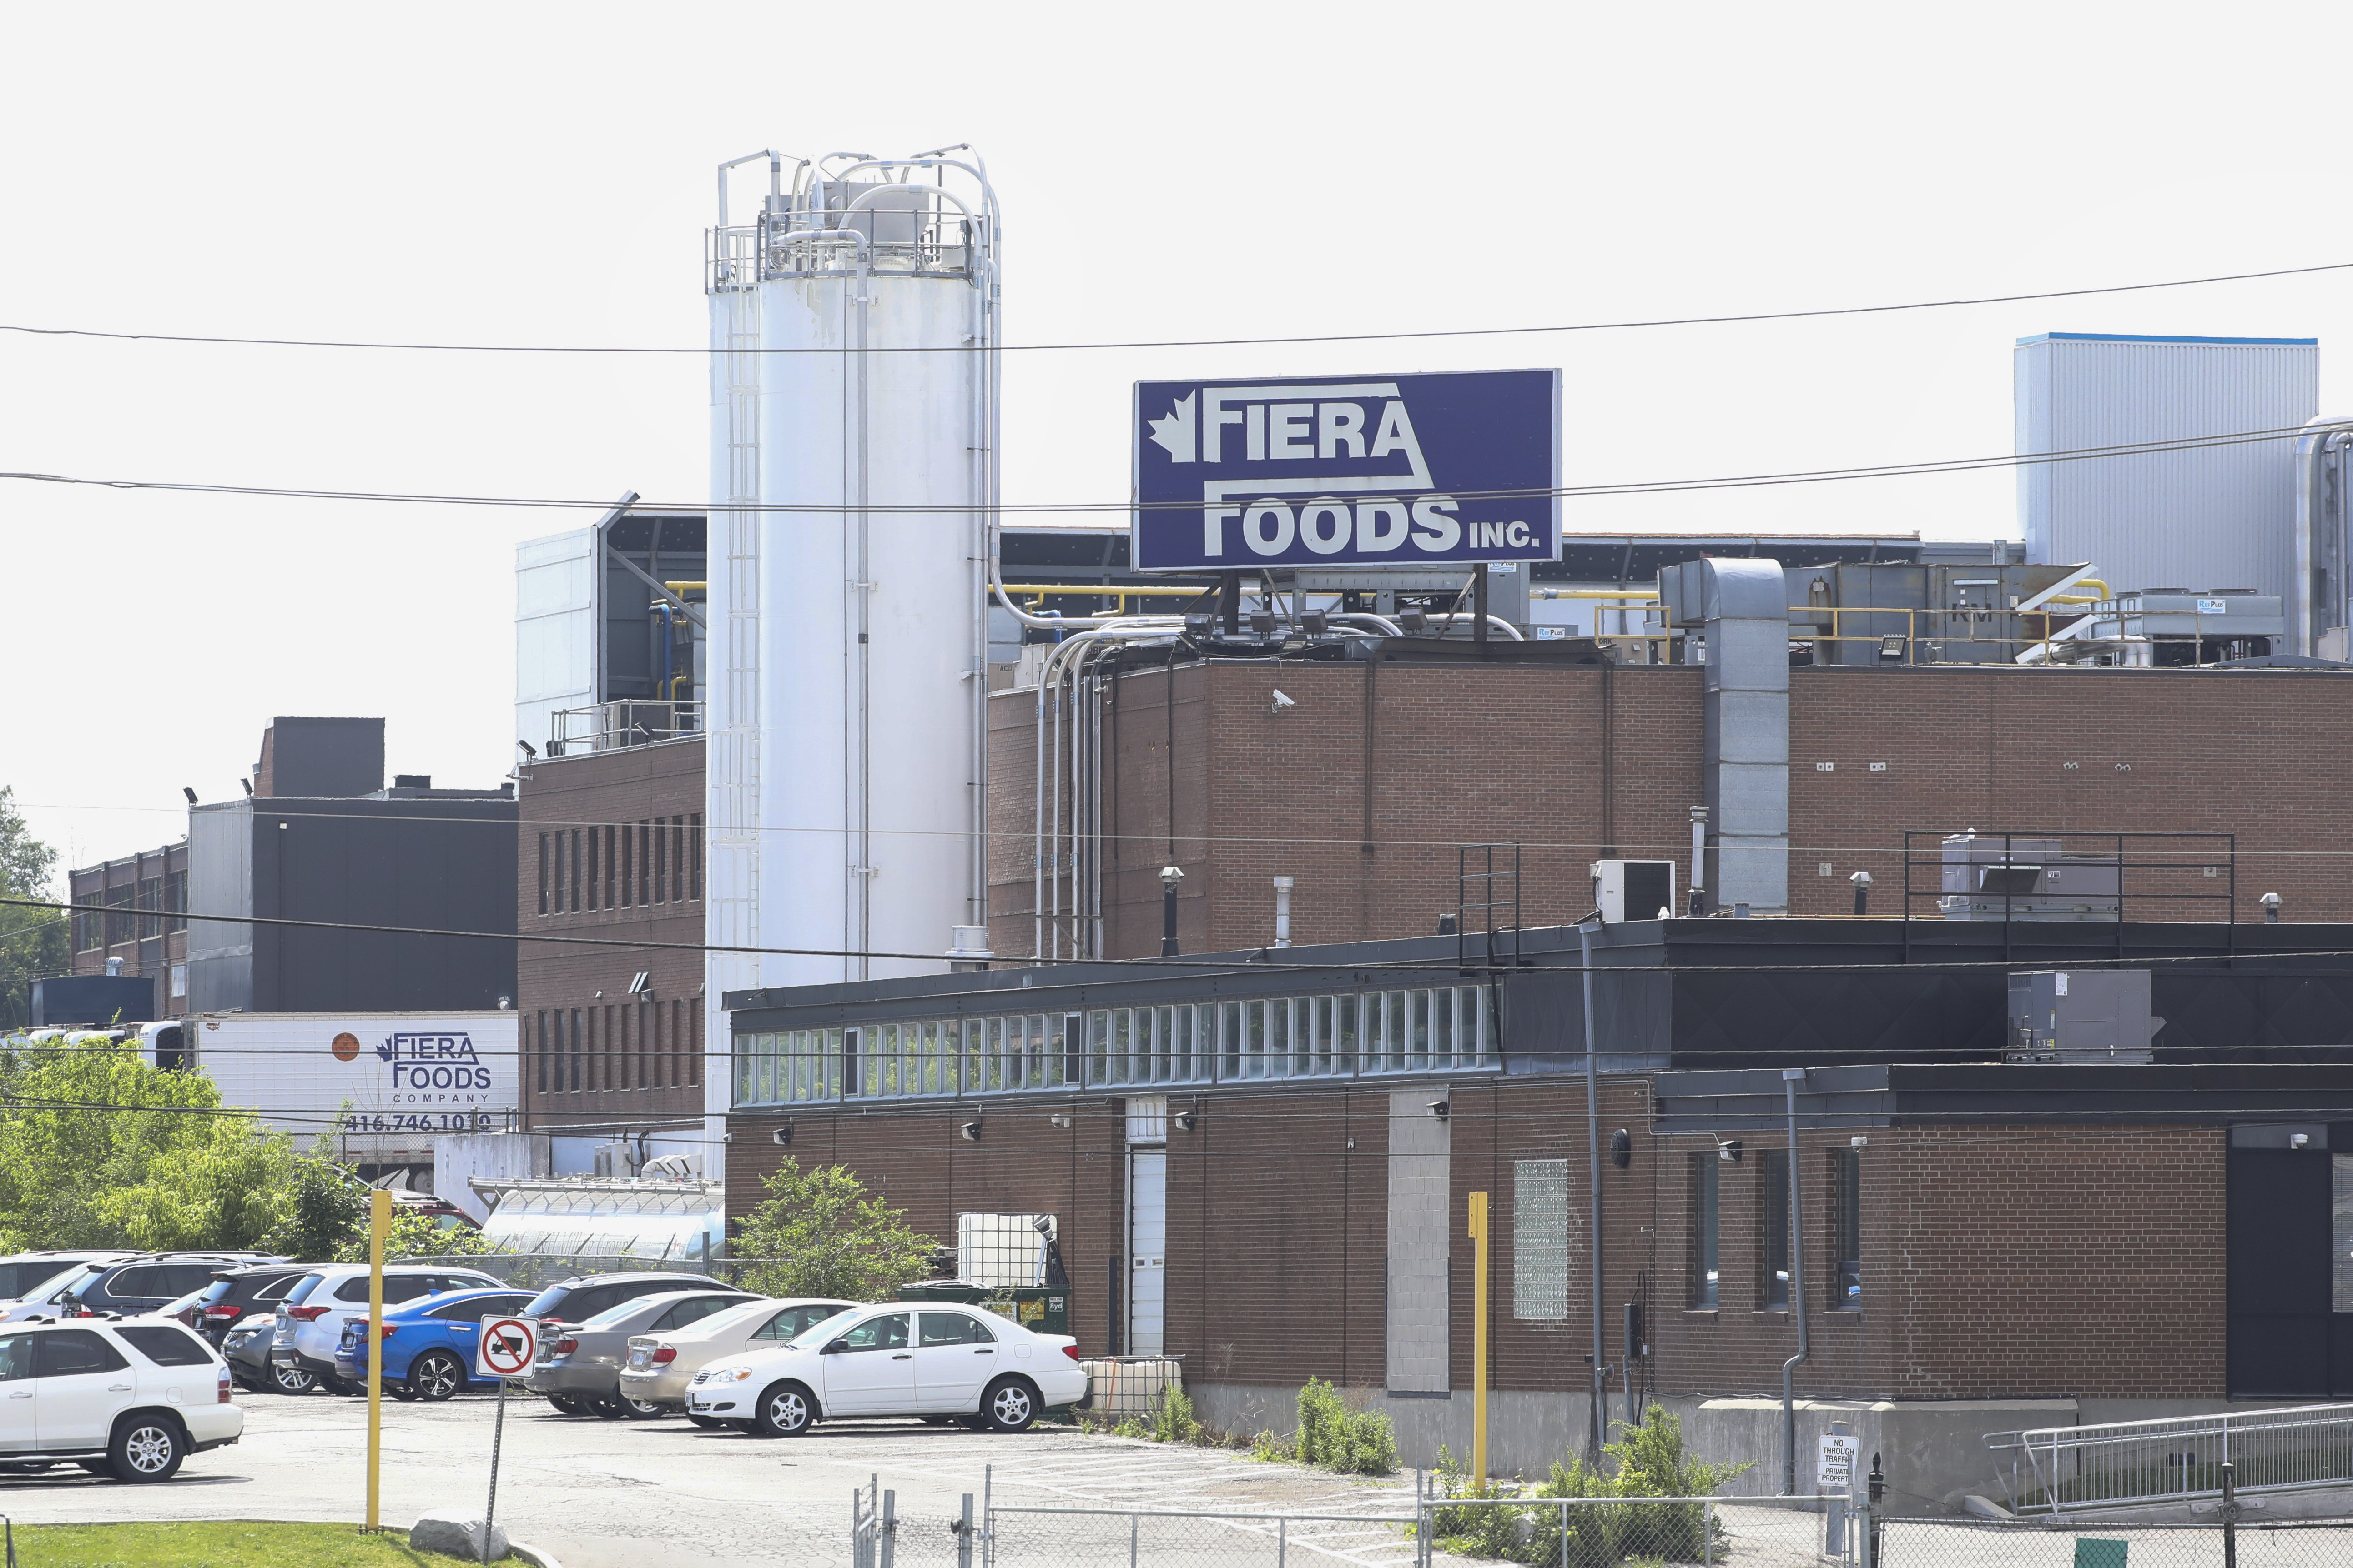

Slide 124


Slide 125
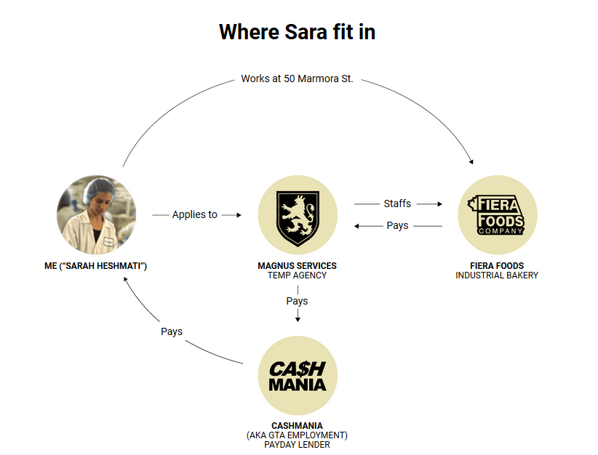

Slide 126
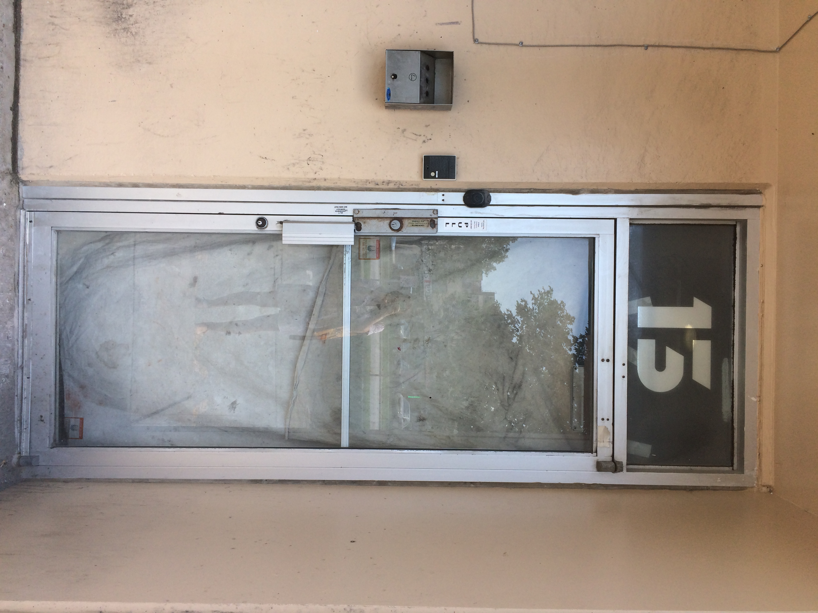

Slide 127
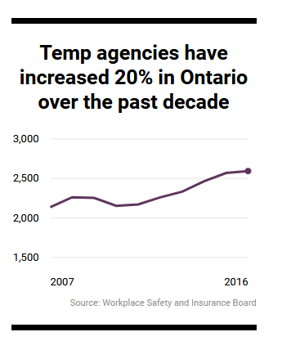

Slide 128


Slide 129


Slide 130


Slide 131


Slide 132
Question and Answer
Temporary Work – Dangerous for your Health
Moderated by:
Andrew Parkin, The Mowat Centre
Presenter:
Sara Mojtehedzadeh, The Toronto Star

Slide 133
Responding to Precarity: perspectives of those in precarious employment
Moderated by:
Colette Murphy, Atkinson Foundation
Presenters:
Jeffrey C. Martin, Quorum Communications Inc.
Sean Patterson, Queen's University
Deena Ladd, Workers' Action Centre

Slide 134
The PEPSO Millennial Survey
Jeffrey C. Martin
Quorum Communications Inc.

Slide 135

THE GENERATION EFFECT
Jeffrey C. Martin + Wayne Lewchuk
Millennials, employment precarity and the 21st century workplace
June 2018

Slide 136
Hamilton Millennial Survey
1,189 non-student millennials living in Hamilton/Burlington
Online survey | 89 questions | 60 PEPSO questions | future generational analys
5 themes: health | community belonging | quality of life + household wellbeing | work + workplace | financial security
Survey live April 1–May 7 2017
Focus: employment security | individual income | type of employment
Employed communications + social media strategy for survey launch

Slide 137




Slide 138
Employment security
Using PEPSO employment precarity index (EPI)
  Secure – 22%
  Stable – 23%
  Vulnerable – 24%
  Precarious – 31%

Slide 139
Individual income

Slide 140
Low income millennials

Slide 141
General + mental health | reported “poor/fair”

Slide 142
Depression + anger | reported “often”

Slide 143
Quality of life
Overall, 55% of millennials agreed they expect to have the same or better quality of life as their parents
38% disagreed and 7% were unsure
Agreement steadily declined as participants moved from secure work to precarious work

Slide 144
The game is harder
Overall, more than 75% of millennials believe “the game” is getting harder, not easier
Millennials believe they have far more challenges and hardship in getting there than previous generations
Lack of full-time jobs + housing are 2 biggest challenges/issues

Slide 145
Outcomes + next steps
Millennials have bore the brunt of neoliberalism
Employment precarity has permeated the millennial labour force
Dramatic impact on millennials wellbeing, future generations, communities, taxes, services
Mental health support
Basic income + living wages
Extended healthcare benefits + CPP
Tuition fees + student loan debt

Slide 146

Thank You

Slide 147
The Dirt on Precarity: What Cleaners Know & How They Resist
Sean Patterson
Queen's University

Slide 148

The Dirt on Precarity: What Cleaners Know and How they Resist
Sean Patterson
Jenny Carson
Myer Siemiatycki
June 19, 2018
Hamilton, Ontario

Slide 149
Introduction and outline
Toronto and cleaners resistance to precarious employment
“Justice and Dignity for Cleaners” campaign
Activism of private sector cleaners
Strategies in exposing working conditions and rallying public support for better jobs and employment
Notes:
In this talk, the focus is on Toronto and cleaners resistance to precarious employment. It will explore the “Justice and Dignity for Cleaners” campaign to stop Mayor Rob Ford from outsourcing municipal public-sector cleaner’s work. The ongoing activism of private sector-cleaners in “the Justice for Janitors” campaign will also be addressed. For us, both these campaigns demonstrate that publicizing the conditions of cleaners can rally public support for better jobs and employment. There are indeed limits to the overall effectiveness of both campaigns, and I would be happy to take this up with you in the Q and A.

Slide 150
Private and public-sector employment for cleaners
Municipal cleaners largely unionized
steady benefits, hours, and reliable equipment
Some private-sector cleaners non-unionized
minimum wage, part time, multiple job holders
Notes:
In Toronto, cleaners are employed both in the private and public sector, however, working conditions in these sectors differ. Municipal cleaners are largely unionized, employed in hospitals, colleges and universities, and government institutions. They belong to a variety of union locals that include members in a range of occupations. Local 79 of the Canadian Union of Public Employees (CUPE) has collectively bargained with strength in numbers for their current 20,000 members including cleaners. Cleaners have benefited from unionization with steady hours, benefits, and access to reliable equipment and proper health and safety training. They have also earned $22 per hour. By contrast, private-sector cleaners making minimum wage have had part-time hours, working multiple jobs, just to survive. Some are also without union status. A union organizer speculated 75 percent of Toronto’s workforce works the graveyard shift. This invisible army of cleaners enters in the most prestigious downtown commercial towers, hidden from public sight, and out of mind.

Slide 151
Since the 1970s who cleans downtown office buildings has changed...
No longer drawn from Portuguese, Italian and Greek Communities
South Asian and Central American immigrants increasingly employed in private-sector
Notes:
Since the 1970s, outside of longstanding unionized buildings, the workforce in Toronto’s downtown building industry is no longer drawn from the Portuguese, Italian and Greek communities. Today, especially in the private sector, South Asian and Central American immigrants are increasingly prevalent.

Slide 152
Poor conditions and wages in private-cleaning sector:
Rooted in the competitive bidding structure:
Contracts for buildings bided on and awarded to lowest bidder/service provider
Central to winning bid:
labour costs (i.e., wages and benefits)
In 15 years:
price per square foot dropped from $1.25 to .78
Profit on the backs of workers: workload increased from 3,000 to 6,000 square feet of cleaning per hour
Quantity and chemical usage harmful to cleaners and occupants
Notes:
The poor conditions within the private sector are rooted in the highly competitive bidding structure. Basically, property managers and building owners put cleaning work up for bidding. They then award the contract to service providers offering the lowest price. Eighty percent of all costs large labour cost. So, cleaning companies must keep these costs down (i.e., wages and benefits). Over the last 15 years, building managers, who use to pay $1.25, have dropped that price to .78 per square foot. Meanwhile, the workload of cleaners has drastically increased from 3,000 to 6,000 square feet of cleaning per hour. Cleaning companies nonetheless have still maintained 3 percent profit margins. How is this possible? Overworked and underpaid cleaners, and on the backs of workers, that is how. Private-sector cleaners rarely work for the businesses whose space they clean. In fact, the important work that they do in providing a vital service is often overlooked, as reflected in the poor pay and working conditions. Cleaners usually undertake dirty, degrading and dangerous work. And the quantity and chemicals they use can be harmful to their health and to other building occupants. We only need to think of the cleaning of toilets with one glove to understand how hazardous this can be to anybody’s health using the restrooms.

Slide 153
Three core strategies to keep labour costs down:
Employ vulnerable and racialized immigrant workers
Resist unionization
Identify workers as independent contractors
monthly salary = less than provincial minimum wage
misclassify workers – to avoid minimum wage laws, payroll taxes and Workplace and Safety Insurance Board Premiums (WSIB)
As a result: cleaners not covered by Employment Standards Act
Notes:
There are three core strategies cleaning companies use to keep their costs down: employ a vulnerable demographic as the workforce 2) resist unionization 3) identify workers as independent contractors to avoid employment standards obligations. The last of these strategies is my focus today. Cleaners subcontracted into the work are often classified as self-employed independent contractors rather than employees. They usually earn a monthly salary. This hides, however, what they are being paid per hour, usually less than minimum wage. We found cleaning companies have misclassified their employees to avoid minimum-wage laws, payroll taxes, and Workplace Safety and Insurance Board premiums. This leaves cleaners without Employment Standards protections.

Slide 154
In 2011:
Mayor Rob Ford targeted 1000 living wage jobs of municipal cleaners of Local 79 to cut corporate taxes and spending on social services and government staffing (i.e. “the gravy train”)
Ford’s intentions: contract out cleaning jobs to private-sector
Initial push successful in outsourcing 110 jobs at Toronto police stations
Notes:
In 2011, Mayor Rob Ford aggressively targeted the living wage jobs of almost 1000 municipal cleaners of Local 79 to generate cost savings for the city. Stopping what he referred to as the “gravy train,” Ford sought to cut taxes and spending for government staffing and social services in the interests of corporations. Ford’s intentions were clear: to contract out these jobs and push cleaners to the private sector. Ford’s plans went initially unchallenged, as the city outsourced 110 cleaning jobs at Toronto’s police stations.

Slide 155
Ford’s Plans Forestalled:
“Justice and Dignity for Cleaners” to defend and stop outsourcing of city cleaners
Academic, faith/union leaders helpful but...
cleaners voices most effective in rallying public support
Attack on public-sector cleaners lowers floor and standards for all cleaners (i.e., private-sector cleaners)
Cleaner’s not isolated...
”Social Impact of Low-wage Jobs”: growth of poverty and precarious employment – Toronto unequal place
Councilor Ana Bailão as young immigrant Portuguese women helped mother clean
Ford defeated: motion voted
Notes:
Several factors, however, halted Ford’s plans. In late 2011, in response, the “Good Jobs for all Coalition,” as a previous network of unions and community supporters, launched the “Justice and Dignity for Cleaners campaign” to defend city cleaners from further outsourcing. Workers and allies held rallies/demonstrations, and educated the public while lobbying city hall. It was the voices of the cleaners that was most effective in winning public support. One private-sector cleaner, as a former municipal cleaner, knew how important it was to prevent outsourcing good paying union jobs at city hall. It was clear that an attack on municipal cleaners could lead to the floor being lowered and possibly removed from underneath the private-sector. Let me be clear, the cleaner’s situation was not exceptional. A series of reports, including a “Social Impact of Lower-Wage Jobs,” found poverty was intensifying. Due to the growth of precarious employment, Toronto was becoming a highly unequal place. Contracting out would only make things worse. Nazrene Edwards told City Councillors “just because we pick up the dirt, doesn’t mean we should be treated like dirt.” Councillor Ana Bailao’s experience, working alongside her Portuguese immigrant mother, as a cleaner, moved other Councillors, who heard her story. This deputation and other factors led to defeat for Ford. His motion to contract out these city jobs was voted down 29-12.

Slide 156
Early 1990s
Bob Rae’s New Democratic Party introduces union successor rights
Protects cleaners from contract flipping or job loss: new contractor must honour previous union contract provision with previous contractor
Service Employees International Union (SEIU) and Labourers International Union of North America (LIUNA) and United Food and Commercial Workers (UFCW) organized individual buildings
Until...
Harris’ Conservatives eliminated union successor rights
Different organizing strategy needed
Notes:
In the early 1990s, under the New Democratic Party’s Bob Rae government, union successor rights protected workers from contract flipping. Any company displacing a previous company providing the cleaning service, had to honour the employment terms of the existing collective agreement. In Toronto, three main unions - the SEIU, LIUNA, and UFCW - organize cleaners. They used to focus on site-specific organizing and building-by-building collective bargaining. It made sense given union successor rights prevented the building owner from changing to non-union contractors, and wage gains could be made. In 1995, Mike Harris, under the Conservatives, eliminated successor rights, and a different strategy was needed to organize cleaners.

Slide 157
From 2005 to 2009:
The Justice for Janitors movement in Toronto led to significant changes – SEIU and LIUNA and intensive public information campaigns and picketing at downtown office buildings
Tenants in disbelief cleaners making less than minimum wage and no benefits
Building owners scrutinized and potential reputational harm force cleaning companies to bargain with workers
Cleaners benefited from city-wide agreements (i.e., same wages and benefits)
Notes:
From 2005 to 2009, the JfJ movement arrived in Toronto, which originates in Los Angeles, has led to significant changes, with the SEIU and LIUNA, engaging in intensive public information campaigns and picketing at downtown office buildings. Building tenants were dismayed to learn many cleaners were not being paid minimum wage or provided benefits. Building owners facing public scrutiny and reputational harm over the treatment of their cleaners pressured the cleaning companies to bargain with the workers. This demonstrates that gaining public sympathy can help workers overcome precarious employment. Five of the six largest cleaning companies, for example, Bee-Clean Building Maintenance, Compass, and Hallmark Housekeeping Services all signed city-wide agreements. Anytime an employee of one of these companies cleans in the City of Toronto, that company must recognize the union. Cleaners have benefited from city-wide agreements, resulting in them receiving the same wages and benefits.

Slide 158
In 2015:
Labour dispute over cleaner’s working conditions working at prime downtown Toronto office tower
Tenants supportive but...
union unsuccessful in organizing cleaners into city-wide agreement
Property developer prevents union and flips contract (i.e., changing service providers)
Cleaners owed $18,000 in unpaid wages – wage theft – from previous contractors
New contractor’s refusal to rehire all but three cleaners owed $25,000 in termination and severance – all opposed to union - based on union activities?
Notes:
In 2015, a battle over cleaners working conditions at a prime downtown Toronto office tower mobilized public support, with spirited union rallies and demonstrations held at 330 Bay Street. Tenants were supportive of the cleaners deserving fair treatment and pay, but this did not lead to unionization. Instead, organizing efforts by the SEIU were thwarted by a multi-million dollar property developer simply changing contractors. Cleaners, however, were owed $18,000 in unpaid wages – wage theft – from the previous contractor and subcontractor. The new contractor refused to hire all but three of the cleaners back – all opposed to the union. Charges of unfair labour practices were filed, with cleaners under the impression their union activities were behind being out of a job. The new contractor also owed them $25,000 in termination and severance pay, by law. To this day, the SEIU has been unsuccessful in organizing this contractor into a city-wide agreement.

Slide 159
In 2016, however...
City-wide agreements expanded to 7 cleaning companies covering 2,000 cleaners
Building owner pulls out of contract with cleaning company, cleaners no longer protected
Notes:
In 2016, the city-wide agreement, however, did extend to seven companies, and now covers 2,000 cleaners. Once the building owner pulls out of a contract with a unionized cleaning company, the city-wide agreement is no longer enforced at that site. As a result, workers are no longer protected and can lose out on employment.

Slide 160
Lessons learned and policy recommendations
More knowledge about precarious employment conditions of cleaners
Private and public-sector cleaners in solidarity can resist precarious work
Labour law reform (i.e. certification for building service workers)
Legislation to respond to subcontracted work to protect cleaners as independent contractors
”Fight for $15 and Fairness” ongoing movement
Notes:
So what can we learn from all of this? First, today there is more awareness of the precarious employment conditions of cleaners. Exposing it in this industry should be seen as a victory. Second, solidarity between private and public-sector cleaners helps resist precarious work, as both these campaigns demonstrated. Third, as the ongoing struggles of private-sector cleaners make clear, labour law reform is needed. Certification, based on a majority signing union cards will aid unions in organizing more cleaners and other building service workers. Otherwise, employers will continue to instill fear into workers telling them “will lose the building for bidding” if the company becomes union. Fourth, there must be legal measures to respond to the subcontracting of cleaning work, so cleaners deemed independent contractors can be protected. Finally, the “Fight for $15 and Fairness” was a hard-fought victory. It is an ongoing movement that has led to some important legislative changes. We think all this is a step in the right direction of a living wage. This I will defer to Deena.

Slide 161
Thank you

Slide 162
The Fight for $15 and Fairness
Deena Ladd
Workers' Action Centre

Slide 163


Raising the Floor of Wages and Labour Standards in Ontario
The Fight for $15
and Fairness
PEPSO Conference: June 19, 2018
Notes:
Welcome – we are here to talk about new rights for workers.

Slide 164
2018 New Labour Rights and Protections in Ontario!
$15 minimum wage – January 2019
10 days emergency leave: Job protections, broad definition of emergency and 2 of these days paid
Equal pay for equal work
More paid vacation
Misclassification as self-employment now illegal
Equal pay for public holiday pay for part-time workers and those with erratic schedules
Notes:
During this workshop we will talk about these new rights, what they mean for workers and how we can enforce our rights at work.

Slide 165
2018 New Labour Rights and Protections in Ontario!
Equal pay for public holiday pay for part-time workers and those with erratic schedules
Termination pay for temp agency workers
175 new Employment Standards Officers
Enforcement: Interest paid on wage theft; larger fines, publicity of bad bosses
Card certification in low-wage sectors: building services, community services and personal support workers
Scheduling rights and protections January 2019
Notes:
During this workshop we will talk about these new rights, what they mean for workers and how we can enforce our rights at work.

Slide 166
2018 New Labour Rights and Protections in Ontario!
Temporary Agency Workers: Workers’ Compensation costs are now assigned to the client company instead of the temp agency
Notes:
During this workshop we will talk about these new rights, what they mean for workers and how we can enforce our rights at work.

Slide 167









We organized!

Slide 168
Organizing for Change
March 2013: launched $14 minimum wage campaign
April 2015: launched Fight for $15 & Fairness
Petitions, rallies, workshops, events, and outreach in communities, campuses, and workplaces across Ontario
Health workers, faith leaders, students, unionized workers, economists, non-unionized workers
We pressured the government to respond. New labour laws were passed in November 2017.
Notes:
15,000 signatures on a petition to the government
1,000 health professionals signed a petition on paid sick days
Thousands of followers on social media
There are many new rights. This will be confusing for employers and employees.
We need to make sure that employers know what their new responsibilities are under the law.
The meaning of new rights takes time to test when workers bring claims for rights to the ministry of labour. We need to push for the best possible interpretation of the new rights.
Next slide – education is important first step.

Slide 169
What is under attack?
Notes:
Lead to next slide – what is the minimum wage in Ontario now?

Slide 170
Minimum Wage
 | General | Liquor Servers | Students under 18
January 1, 2018 | $14 | $12.20 | $13.15
January 1, 2019 | $15 | $13.05 | $14.10
October 1, 2019 (and every year after) | $15 + Cost of living adjustment | $13.05 + Cost of living adjustment | $14.10 + Cost of living adjustment
Freezing of minimum wage to $14 and indexation potentially gone as well
Notes:
A $15 minimum wage will bring our minimum wage just over the poverty line (low income measure for a full time full year worker).
But we don’t have the $15 minimum wage yet. It is not safe until it is in workers’ pockets.
Q – why is cost of living adjustment so important?
MW frozen for 9 of the last 20 years.
Q – who would be included in the liquor server minimum wage.
- Workers that serve liquor directly to customers as a regular part of the job; in a licensed premisis; regulary received tips or other gratuities as part of their work.
Not all jobs are covered by the minimum wage e.g. farmworkers. Ontario is the only province that still has a lower student wage, and one of only three provinces that has a lower server wage (along with BC & Québec)
Protect Yourself!
If your boss is paying you less than the minimum wage keep a record at home of all dates and hours worked and the wages you were paid.

Slide 171
Equal Pay for Equal Work
Part-time and temporary workers are paid up to 40% less than full-time workers doing the same job.
This has encouraged employers to hire on a part-time and temporary basis, so they could pay less in wages and benefits.

Slide 172
Workers Win Equal Pay for Equal Work!
Equal Pay for Equal Work
As of April 1, 2018:
Employers must pay casual, part-time, temporary and seasonal workers the same as full-time/permanent workers who are doing substantially the same work.
When you compare the jobs, they do not have to be identical. But the core work of the jobs has to be largely the same.
Notes:
Equal pay based on your job status adds to our existing equal pay rules that require employers to pay women and men the same pay rate when they are doing substantially the same work.
How does equal pay on the basis of employment status work?
For example two people work in a grocery store. One is full time and one is part time. Both the full time and part time jobs require workers to work on cash and stock shelves. Both workers work on the cash, but the full-timer does more stocking. When you compare these two jobs, they are substantially the same; they require substantially the same skill, effort and responsibility and should be paid equally even though the full timer does more stocking of shelves. To get equal pay, you have to compare jobs to see if they are substantially the same.
The responsibility for equal pay is on the employer. The Act requires the employer to ensure that there is no difference in pay between men and women and between full time regular workers and other part time, temporary workers. But if the employer is not complying with equal pay, there are steps that workers can do.

Slide 173
  Equal Public Holiday Pay for Part-time Workers and Temps
Notes:
What are our public holidays?

Slide 174
  Public Holiday Pay
How to calculate public holiday pay?
Add up all the regular wages earned in the pay period before the public holiday and divide by the number of days worked in that period.
For example,
This calculation is new and better for workers but now only until July 1, 2018. Then reverts back to pre-2018 calculation which is bad for workers. Review in place.
  $1,200 wages for 2 weeks
  10 days worked in 2 weeks
$120 public holiday pay
Notes:
For example, if you are part time and work 2 days a week – 8 hours a day, you would get your public holiday pay would be your regular day’s wage. That is you work 16 hours a week divided by 2 days = 8 hours of pay! Under the old rules you would have only got 3.2 hours of public holiday pay.
If a worker has 2 regular part time jobs at different employers then they would get public holiday pay from each employer based on their regular work days.
The Ministry of Labour website has a tool you can use to calculate your public holiday pay: https://www.ontario.ca/page/public-holiday-pay-calculator

Slide 175
  Public Holiday Pay
Linda works part time in a company, $15/hour, 2 shifts a week, 8 hour each shift. She get paid weekly. Here is a chart demonstrate her holiday pay and difference under the old labour law and new labour law respectively:
The Difference: 60% ($72)! Will be gone July 1,2018!
Old Labour Law (before Jan. 1, 2018） | New Labour Law（As of Jan.1, 2018）
(8hour x 2days x $15 x 4 weeks) /20 days = $48 | (8hour x 2days x $15 x 1 week) /2 days = $120
Notes:
For example, if you are part time and work 2 days a week – 8 hours a day, you would get your public holiday pay would be your regular day’s wage. That is you work 16 hours a week divided by 2 days = 8 hours of pay! Under the old rules you would have only got 3.2 hours of public holiday pay.
If a worker has 2 regular part time jobs at different employers then they would get public holiday pay from each employer based on their regular work days.
The Ministry of Labour website has a tool you can use to calculate your public holiday pay: https://www.ontario.ca/page/public-holiday-pay-calculator

Slide 176
  New Scheduling rules coming
  January 1, 2019
Shift Cancellation Pay:
If a shift is cancelled with less than 48 hours notice, employers provide 3 hours of pay.
Employers must pay 3 hours of pay to on-call workers that are not called into work.
Right to refuse a shift:
Workers have a right to refuse a shift that is scheduled with less than 96 hours (4 days) notice.
Notes:
As of January 1 2019.
On-Call pay once in every 24hrs.
FACTSHEET: Tell participants WAC will soon have a factsheet on the new scheduling rules to help workers make sure they are getting paid what they deserve and that their rights are being protected.

Slide 177
  What can you do to support the Fight for $15 and Fairness?

Slide 178
  Timelines
Equal Pay for Public Holiday Pay – July 1, 2018 – December 2019
Minimum wage increase – Fall 2018
Scheduling – Fall 2018
Equal Pay for Equal Work – now!
Notes:
It is very difficult for workers to enforce their rights when they don’t have a union to protect them.
Workers risk their job and income when they try to enforce their rights. The workers’ action centre can work with people having problems at work to discuss strategies. We support workers to talk with trusted coworkers to identify violations and key changes workers want. We support workers to build collective strength. This could involve unionization to better protect workers’ rights, wages and working conditions.

Slide 179
  Support
Statistics or data for info graphics
One page fact sheets
Media releases timed with current struggles
Report releases timed at important moments
Connect with people you have or are interviewing – interested in getting involved?
Feeding us information in a timely manner
Documenting stories – media/policy

Slide 180
WINNING FAIRNESS AT WORK
  Winning Fairness at Work
We have won important new rights. We need to enforce them, defend them and win more rights for all workers.
Join the Fight for Decent Work!
www.WorkersActionCentre.org
www.15andfairness.org

Slide 181
Question and Answer
Responding to Precarity: perspectives of those in precarious employment
Moderated by:
Colette Murphy, Atkinson Foundation
Presenters:
Jeffrey C. Martin, Quorum Communications Inc.
Sean Patterson, Queen's University
Deena Ladd, Workers' Action Centre

Slide 182
The Employment Precarity Index Beyond the GTHA: precarious employment in Canada
Moderated by:
Christine Yip, Organizations for Impact
Presenters:
Monique Beneteau, Peterborough Public Health
Michael Courey, London Poverty Research Centre
Jonah Butovsky, Brock University

Slide 183
Academic Conference
19 June 2018

Slide 184
Looking Forward: creating a labour market that serves us all
Moderated by:
Kofi Hope, Wellesley Institute; University of Toronto School of Urban Planning
Presenters:
Kaylie Tiessen, UNIFOR
Michelynn Laflèche, United Way Greater Toronto
Deirdre Pike, Social Planning and Research Council of Hamilton

Slide 185
No rest for the wicked: a research and policy agenda for the next 5 years
Kaylie Tiessen
UNIFOR

Slide 186
No Rest for the Researchers:
A research agenda for the next 5 years
@KaylieTiessen
June 2018
PEPSO Conference

Slide 187
More Questions than Answers

Slide 188
What, if anything, has changed for workers since Bill 148 was implemented?
What has changed for employers?

Slide 189
What has changed since Bill 148?
Income?
Hours worked?
Job loss?
Complete shut down of a business?
Feelings of anxiety about money, about future?
Permanency?
Use of sick days and emergency leave?

Slide 191
What about the middle class?
When education is at an all time high and unemployment is low:
How do we grow Canada’s middle class through higher pay and higher quality employment as opposed to tax cuts?

Slide 193
What role does the threat/promise of new technology play in the future well-being of workers and employers?

Slide 194
What role does tech change play?
1. Job loss, displacement & estrangement
2. Change in work organization & required skills
3. Productivity enhancement vs. workload increases
4. Increased surveillance
5. Health & safety and ergonomics
6. Low-wage & insecureWork

Slide 195
Thank you!
@KaylieTiessen
@Unifortheunion

Slide 196
Better Business Outcomes Through Workforce Security
Michelynn Laflèche
United Way Greater Toronto

Slide 197

Better Business Outcomes Through Workforce Security
Notes:
Thank you
I’m going to speak to you about the recent report that we at United Way Greater Toronto developed in partnership with KPMG, called Better Business Outcomes Through Workforce Security.

Slide 198
Previous Research on Workforce Security
The United Way, supported by KPMG, has been researching insecure employment since 2007
2007 | 2013 | 2014 | 2015
Revealed Issues of Precarious Employment | Identified Impacts of Precarious Employment | Explored Employer Understanding of Precarious Employment | Identified Further Impacts of Precarious Employment and Proposed Solutions
Notes:
This work grew out of our first PEPSO report, It’s More than Poverty, which was followed by a small report with KPMG on the employers’ perspective of precarious employment in 2014 and our second PEPSO report, The precarity Penalty Recommendation 6 –to build a Canadian experience informed business case to increase security for non standard workers in 2015.

Slide 199
Employer Perspectives on Insecure Employment
Our research showed many employers are aware of insecure employment, but there is limited knowledge and understanding of the social effects
Types of Insecure Employment
DRIVERS
Fill skills gaps and support project-based work
Adjust staffing based on fluctuating demand
Accommodate worker preferences for greater flexibility
Financial pressures to reduce total costs
Seasonal
Project Based
BENEFITS
Short-term cost savings and reduced long-term liabilities
Increased flexibility and ability to meet unforeseen demand
Short Term Replacement
New Role/Function
Recurring Contract
RISKS
Higher turnover, reduced worker engagement, reduced customer services, declining organizational performance
Increased health and safety risks
Temporary Workers
Notes:
In 2014, when we engaged employers we found that most were aware of the existence of these forms of insecure employment, but they didn’t necessarily have the language and most weren’t considering the impacts on individuals

Slide 200
Preliminary Potential Solutions
Employers identified a number of responses that could be implemented to reduce the negative social impacts of precarious employment
Proactive Supports
Cultivating Cultures of Inclusion
Employer Planning and Communication
Provision of Tools and Knowledge
Employers were interested in understanding the business case for increasing workforce security for the purposes of building awareness and developing solutions
Notes:
They did ID potential solutions that could be used to reduce the negative social impacts.
And in fact, one recommendation focused on the need to develop a business case for secure employment to help employers see the value. We called for the private sector to take this on in our recommendations in The Precarity Penalty, and that led to the development of this project. So it really came from the private sector.

Slide 201
Business Case Framework Overview
Better Business Outcomes builds on past research to outline a Business Case Framework for organizations to increase workforce security
    Provides a business performance rationale for increasing workforce security
    Explores leading practices that can improve business outcomes while:
      Reducing the incidence of insecure employment
      Increasing the security of workers in non-standard roles
    Provides employers with a first step to assess their organizations from a people-centric perspective - with insight on steps to take towards increasing worker security
    Three lines of inquiry were used to build the Business Case Framework
Literature Review
250+ articles
Case Studies
Based on employer interviews
Employer Roundtables
York & Toronto
Notes:
The case studies allowed us to highlight some of the leading practices that Canadian employers are already engaging in and to provide a set of examples for other employers to draw on.

Slide 202
Benefits of Increased Workforce Security
Greater workforce security can lead to increased employee engagement and satisfaction, which is tied to improved productivity, profit, returns and customer satisfaction
Engaged and satisfied employees tend to be more aligned with an organization’s mission and purpose
This can lead to the following benefits:
      Increased operating income and earnings per share
      Reduced turnover (and associated costs)
      Reduced absenteeism
      Increased reputational benefits and awards (e.g. ‘Canada’s Top Employer’ status)
Employers we engaged with all believe that these benefits outweigh the costs they experienced associated with increased workforce security
Notes:
Source: Towers & Perrin; HRE Online; CERS; PEPSO; Kalleberg (2000); Stickney (2008); Allan and Sienko (1997)

Slide 203
Introduction to Workforce Security Maturity Model
A maturity model was developed to enable employers to assess their own practices and policies around insecure employment
Not all organizations will find their employment practices at the fully comprehensive end of the spectrum
The goal of the model is not to imply what is the right answer for each organization
Every employer should consider their own business objectives and situation, while referencing industry peers, to make decisions on how to improve the security of their workers
A maturity model is tool for assessing how ‘comprehensive’ an organization’s practices are in specific topic area, along a continuum, and provides some examples of possible practices and policies.
Notes:
In addition to the human capital practices discussed in our report, operational excellence is an enabler for organizations to achieve improved business outcomes
Research from Zeynep Ton (Good Jobs Strategy; MIT operations professor) shows how operational excellence can create a ‘virtuous cycle’ and enable increased investment in people
Others believe human capital practices can be sufficient to improve productivity – this is referred to as the ‘high road approach’

Slide 204
Workforce Security Business Case Framework Overview

Slide 205
Increasing the Proportion of Secure Workers
The first component of the maturity model relates to an organizations’ proportion of secure workers.
Explore how to strategically reduce proportion of workforce in non-standard insecure roles to improve business performance.
Assess how more secure employees in various roles can drive value and contribute to achieving desired organizational outcomes.
Develop a people strategy that supports their organization’s overall strategy
    Should be mutually reinforced by improving operational practices to increase efficiency, empower employees in their roles, and to manage the trade-offs between investing in people and delivering low-cost offerings to customers.

Slide 206
Practices and Policies to Increase Security
Employers can use practices in the following dimensions to enhance workforce security for non-standard workers if transitioning to permanent full-time jobs isn’t feasible.
1. Income Benefits
2. Other Benefits
3. Predictability
4. Training & Professional Development
5. Inclusion
Notes:
Income benefits: Employers can increase security of workers through a range of benefits options including coverage equivalent to full-time standard workers, partial coverage, or coverage based on a pre-determined threshold
Other benefits: Other benefits are supports without direct financial components such as paid leave, flexible hours, and alternative work options
Predictability: Predictability refers to supports to make working schedules more predictable, consistent, and stable for workers
Training and Professional Development: Increased security can be provided through partial or full inclusion in training and skills development opportunities, mentorship programs, and promotion from within the organization
Inclusion: Inclusion means to involve non-standard workers in the social and cultural aspects of the business as both participants and leaders

Slide 207
Workforce Security Maturity Model
 | One | Two | Three | Four
Income Benefits | No benefits (medical, dental or pension) No financial incentives (e.g. RRSP, RPP, stock options, etc.) | Partial or modified benefits and financial incentives (e.g. fixed or variable bonuses based on certain targets) Possible eligibility requirements (e.g. minimum hours worked; minimum contract duration) to qualify for partial or modified benefits and financial incentives Increased wages in lieu of benefits | Identical benefits and financial incentives to standard workers provided eligibility requirements are met (e.g. minimum hours or duration of work) Benefit fund – fund provided for workers to withdraw payment for benefits coverage³⁸ Flexible options which could be selected by workers based on individual preferences | Identical benefits and financial incentives to standard workers with no eligibility requirements*
Other Benefits | No paid sick or personal days** Flexible work arrangements only provided based on legislation or regulation No time or monetary allocation for volunteering activities | Reduced paid sick days compared to standard amount Reduced paid personal days compared to standard amount Increased wages in lieu of leave benefits | Equivalent paid sick days to standard amount Equivalent paid personal days or premiums to standard amount Benefit fund – offer a fund for sick pay from which workers could draw⁴³ Limited worker-led flexibility (e.g. input on work hours, start and end times, breaks, etc.) | Equivalent paid sick and personal days or premiums to standard amount Flexible arrangements if desired (e.g. telecommuting, incremental leave, flextime, compressed workweeks) Time or monetary allocation for volunteering activities Significant worker-led flexibility (e.g. input on work hours, start and end times, breaks, etc.)
Predictability Practices | No guaranteed advanced notice of scheduling No guaranteed scheduled minimum hours | Advanced notice of scheduling Limited scheduling stability and predictability Guaranteed minimum hours | Scheduling and minimum hours established in contract Consistent work scheduling (e.g. same frequency and duration of shifts week over week) | Ongoing worker input and control over scheduling Consistent work scheduling with opportunities for increased work (e.g. internal or external workforce pools providing workers access to additional hours, contracts, contract extensions, etc.)
Professional Development Practices | No access to informal or formal training (other than mandatory/legislated training) No access to mentorship programs No clarity around current role expectations No involvement in performance management process No advanced notice of upcoming permanent opportunities | Access to limited role-specific internal training Access to limited mentorship programs Clearly communicated current role expectations No involvement in performance management process Some advanced notice of upcoming permanent opportunities | Full access to internal training and mentorship programs Access to cross-training to broaden skillsets and prepare workers for a range of internal or external opportunities Involvement in performance management process Advanced notice of upcoming permanent opportunities | Clear and preferential access to permanent, full-time roles and promotions Access to external training programs and funding Policies that facilitate the transition from non-permanent to permanent roles
Inclusion Policies | No inclusion of non-standard workers in work-related activities and communications | Limited inclusion in work-related activities and communications (e.g. select or longer term workers only; limited events) | Full inclusion in all work-related activities and communications No involvement in planning committees / activities | Business culture that values input of non-standard workers Full inclusion in all work-related activities, social events, and communications Participation in planning committees / activities
Notes:
*There may be CRA implications for some types of non-standard workers that organizations should be careful to evaluate and address.
** The proposed Bill 148 in Ontario would legislate two paid sick days per year for employees.

Slide 208
Next Steps
We recommend the following next steps for employers to embark on the journey to increase security of workers in insecure arrangements

Slide 209
Thank You!
Thank You!

Slide 210
The local view on next steps
Deirdre Pike
Social Planning and Research Council of Hamilton

Slide 211
Question and Answer
Looking Forward: creating a labour market that serves us all
Moderated by:
Kofi Hope, Wellesley Institute; University of Toronto School of Urban Planning
Presenters:
Kaylie Tiessen, UNIFOR
Michelynn Laflèche, United Way Greater Toronto
Deirdre Pike, Social Planning and Research Council of Hamilton

Slide 212
Closing Remarks
Michelynn Laflèche
United Way Greater Toronto

Slide 213
Academic Conference
19 June 2018

