Slide 1
What are the social effects of precarious employment?
Before I knew I had a job, I went and did it, I came home and I had a life. . . . It’s like this precarious work. … It changes you as a person.

Slide 2
“We’re just giving you jobs or work as it comes. . . . You don’t have benefits. . . . If you get assigned work, great; if you don’t, you don’t get any. . . . That was stressful because you could get a month without work and then suddenly work a long weekend, twelve hour shifts. . . . You get all this money, but you have to make it last because who knows when they’re going to call you again.”
-Rafael
Notes:
Introductions
PEPSO is a 6 year research project that is being led by United Way Toronto and McMaster University. It started in 2010 and concludes next year.
It’s funded by a 1 million dollar federal government grant and it is a partnership between Universities and the community sector to look at precarious employment and it’s impacts.
The key messages that are coming out of this report are:
Many people can be trapped in precarious jobs that make it hard to build a stable, secure life.
Many people in precarious jobs have a hard time moving into better opportunities.
Precarious employment has a major impact on the wellbeing of individuals and their families.
Precarious employment is bad for everyone, but your race, gender and where you were born can make things worse.

Slide 3
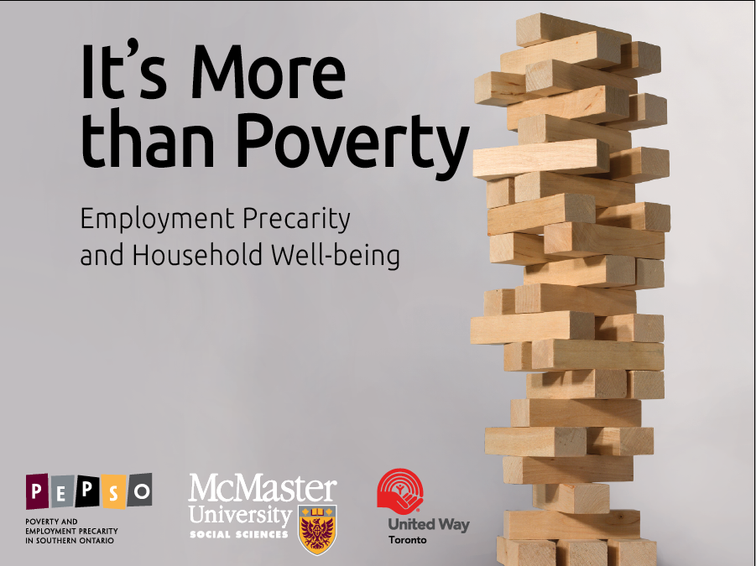
Notes:
It’s More than Poverty concluded that:
• Today, only 60% of workers in the Greater Toronto-Hamilton Area have stable, secure jobs. About 80% of these jobs are full-time and 20% are part-time.
• Everyone else is working in situations with some measure of precarity. This includes jobs without benefits and jobs with uncertain futures.
• Precarity has always been most prevalent among immigrants, racialized groups and women. While this remains a concern, evidence indicates that it is becoming even more widespread: it is now found at all income levels and in all demographic groups.
• Being precariously employed impacts those in low-income households the worst. However, it hurts everyone who experiences it, regardless of income levels.
• Without changes, the growing prevalence of precarious employment is likely to have a harmful effect on individuals, children and families, and it may damage the social fabric that ties our communities together.
A lot of great success emerged from that report:
Bill 18 that revised the Employment Standards Act
Some major reviews happening at the provincial level of employment standards, labour standards, and pensions
Widespread acknowledgement that insecure employment is a problem and acceptance of precarious employment

Slide 4
What are the social effects of precarious employment?
Before I knew I had a job, I went and did it, I came home and I had a life. . . . It’s like this precarious work. … It changes you as a person.
Notes:
What’s new in the Precarity Penalty:
• We confirm the findings reported in It’s More than Poverty and assess labour-market trends since 2011;
• We examine issues related to the social impact of precarious employment, first raised in It’s More than Poverty, including household and community well-being, discrimination and health—with a special emphasis on how these effects are experienced at different income levels; and
• We offer recommendations on building sustainable employment relationships that will reduce the depth and prevalence of precarious employment, and minimize its negative effects on households and communities

Slide 5
The Study
Random survey of 4,193 individuals by Leger Marketing
Covers Hamilton and the GTA
28 interviews with individuals in precarious employment

Slide 6
How to measure precarious employment?
Form of the employment relationship
Is it temp agency work, short-term, casual, own account self-employed?
Characteristics of the employment relationship
Employment Precarity Index

Slide 7
The Employment Precarity Index
What is included?
Not paid if miss work
Not in standard employment relationship
Weekly income not stable
Hours worked not stable
Work on-call
Don’t know work schedule in advance
Paid in cash
Temporary employment
No benefits
Weak voice at work
What is not included?
Income
Notes:
by precarity9: sum precarity
---------------------------------------------------------------------------------
-> precarity9 = LOWEST
Variable | Obs Mean Std. Dev. Min Max
-------------+--------------------------------------------------------
precarity | 932 .5579399 1.041497 0 2.5
---------------------------------------------------------------------------------
-> precarity9 = LOW
Variable | Obs Mean Std. Dev. Min Max
-------------+--------------------------------------------------------
precarity | 1097 10.28031 4.128696 5 17.5
---------------------------------------------------------------------------------
-> precarity9 = HIGH
Variable | Obs Mean Std. Dev. Min Max
-------------+--------------------------------------------------------
precarity | 977 28.0783 5.942067 20 37.5
---------------------------------------------------------------------------------
-> precarity9 = HIGHEST
Variable | Obs Mean Std. Dev. Min Max
-------------+--------------------------------------------------------
precarity | 1051 53.28021 10.84349 40 95

Slide 8
Many people can be trapped in precarious jobs that make it hard to build a stable, secure life.
“I’ve done so much temporary work, and no one’s ever made me permanent or extended the contract. . . and it’s really frustrating because I’m tired of temping. I just want some stable employment, and it’s so frustrating.”
-Tanvi
Notes:
Tanvi: A young racialized woman with a college education working in a call centre.

Slide 9
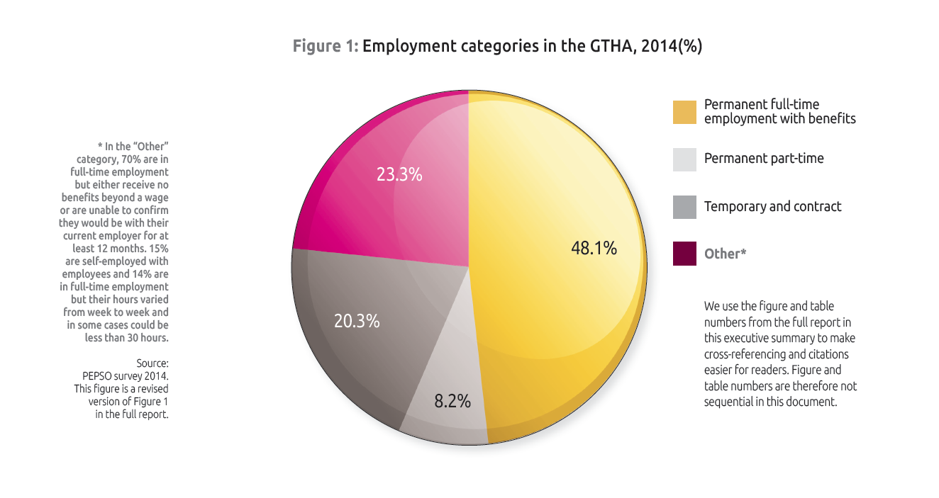
Fewer workers are in permanent full-time employment in the 2014 sample
Notes:
Since our last report, there has been a decrease in secure employment – the yellow part (down from about 50%) and an increase in the dark grey and red parts – which represent some degree of precarity.
The dark grey are people who are firmly in precarious employment – those people who are in temporary and contract work.
The red is a category we called ‘other’ who are in some degree of precarious employment. These people may look secure from the outside, but if you dig a bit deeper they are actually much more similar to those workers in precarious employment – not having access to benefits, not getting paid if they miss work, etc.

Slide 10
Many people in precarious jobs have a hard time moving into better opportunities.
“I’ve never been at a job where they were offering that kind of training. They actually wanted you to know the stuff already. . . . They’re not going to say “Oh, we’re going to be willing to train.” All they see is a bunch of applicants in front of them and they’re not going to take somebody on that doesn’t have the training or the experience.”
-Francesca
Notes:
Francesca, an older white woman who finds work through a temporary-employment agency

Slide 11
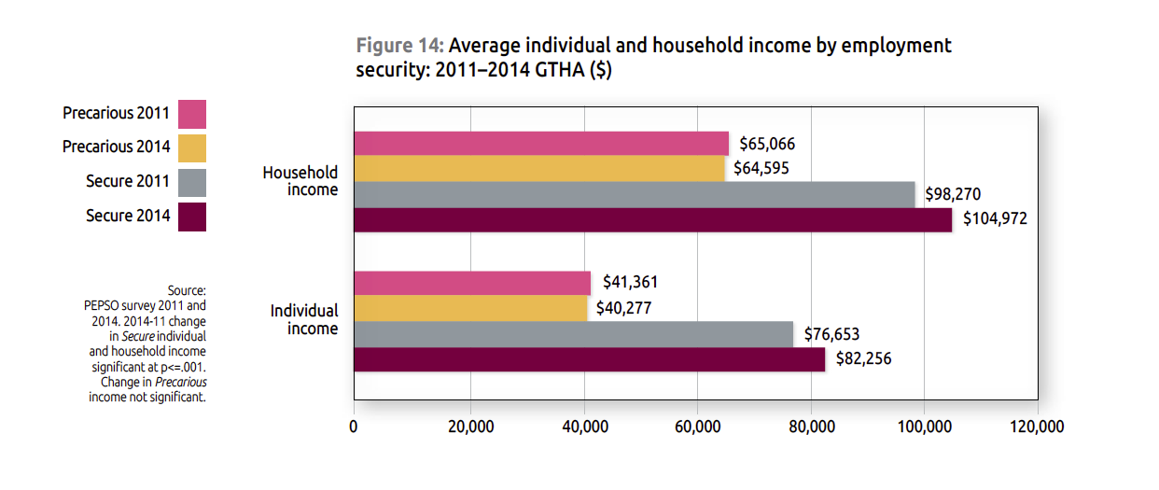
They earn less income and live in households with less income
Notes:
Those in precarious employment earn 51% less than those in stable, secure employment and they live in households with 38% lower income.

Slide 12
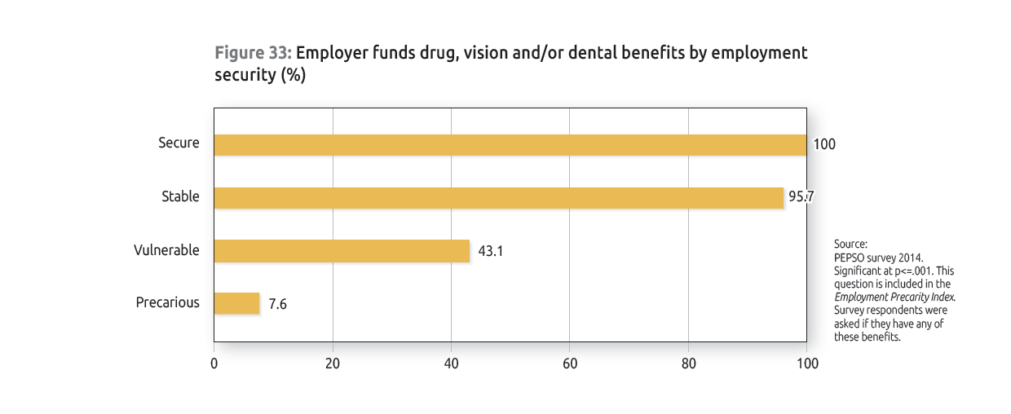
Workers in precarious employment do not receive supplemental health benefits.
Notes:
They have limited benefits like extended health benefits – only 8% of precarious workers have extended health benefits compared to 100% of secure workers.

Slide 13
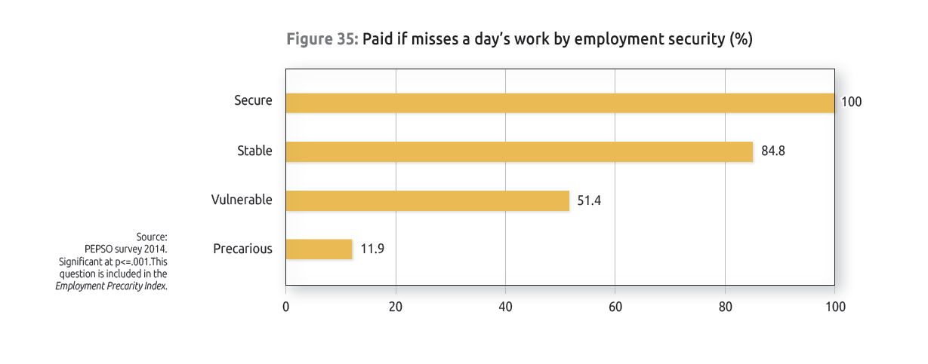
Workers in precarious employment do not get paid if they miss work.
Notes:
They have limited access to being paid if they miss a day’s work. So this is going to capture things like holidays, and sick days. As you can see, there are only 12% of those in precarious work who have access to this, compared to 100% of those in secure employment

Slide 14
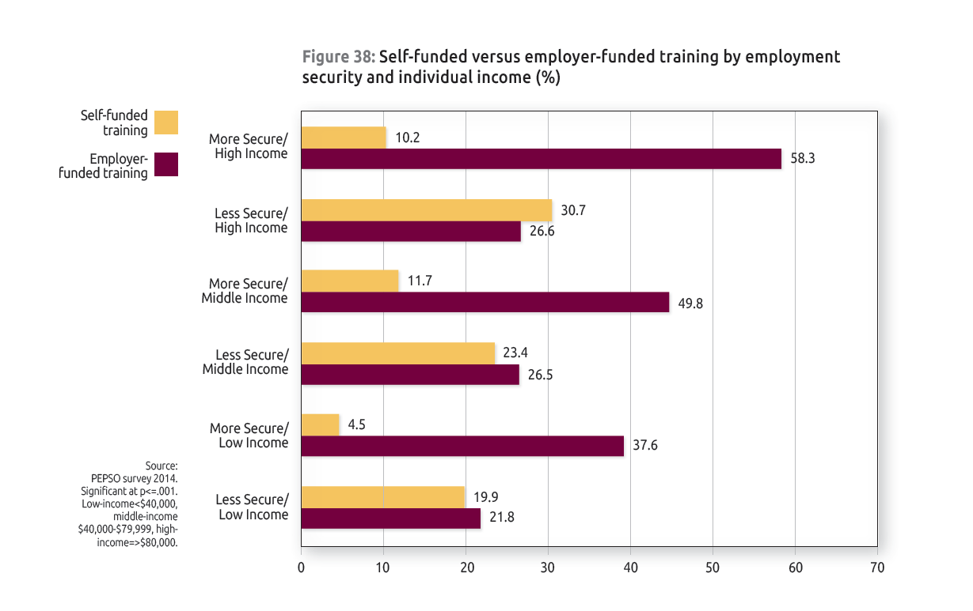
They have less access to training.
Notes:
Despite making less money, people in precarious jobs are three times more likely to have to pay for their own training.
Those in secure employment are more likely to have access to employer-provided training.

Slide 15
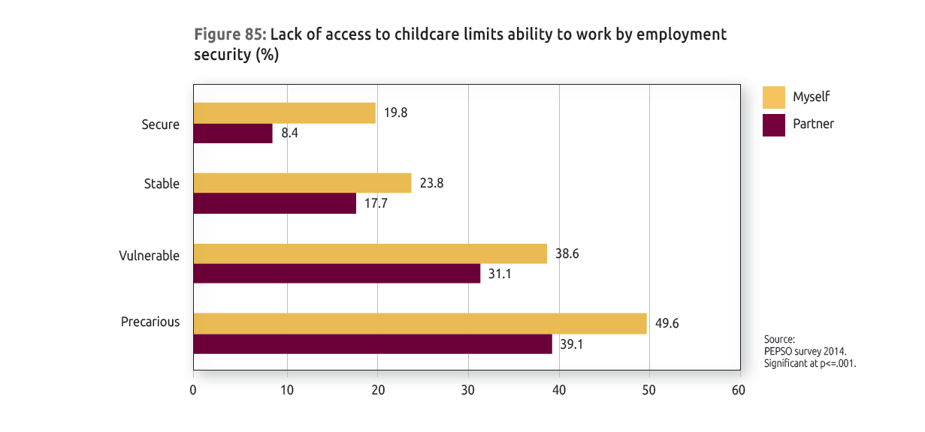
Lack of childcare is an issue for workers in precarious employment.
Notes:
Those in precarious employment have less access to childcare. As you can see here about 50% of those in precarious employment say that a lack of access to childcare limits their ability to get work, and 40% said it limits their partner’s ability to get work.

Slide 16
Precarious employment has a major impact on the health and well-being of individuals and their families.
“You’re just constantly fighting for work; you’re constantly trying to find work. . . . But the way that my brain is going right now is like I just need a steady income because this is just getting ridiculous. Where I’m at right now is, financially, really precarious; it’s really precarious.”
-Eva
Notes:
Eva: A middle-aged white female doing freelance writing.

Slide 17
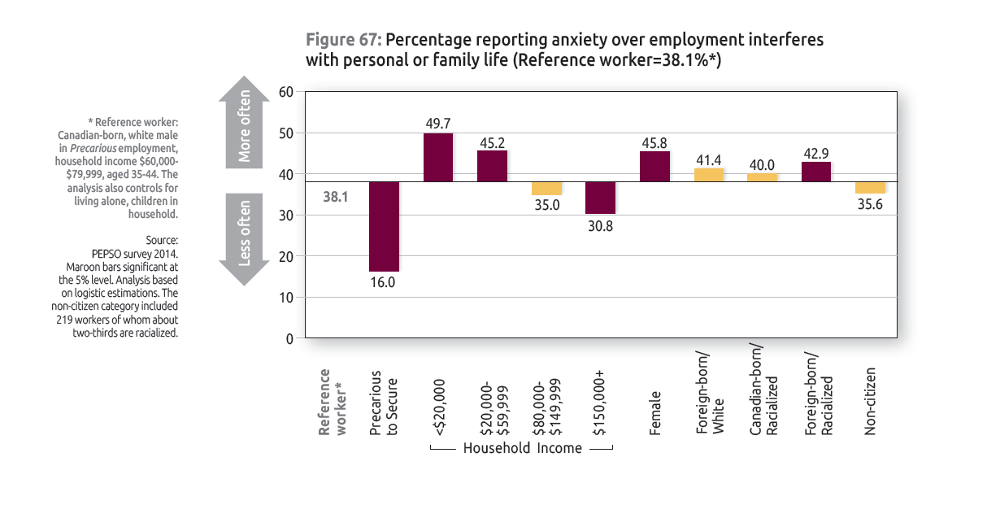
Precarious employment is associated with increased anxiety at home.
Notes:
They experience more anxiety due to their employment situation that interferes with their home life.

Slide 18
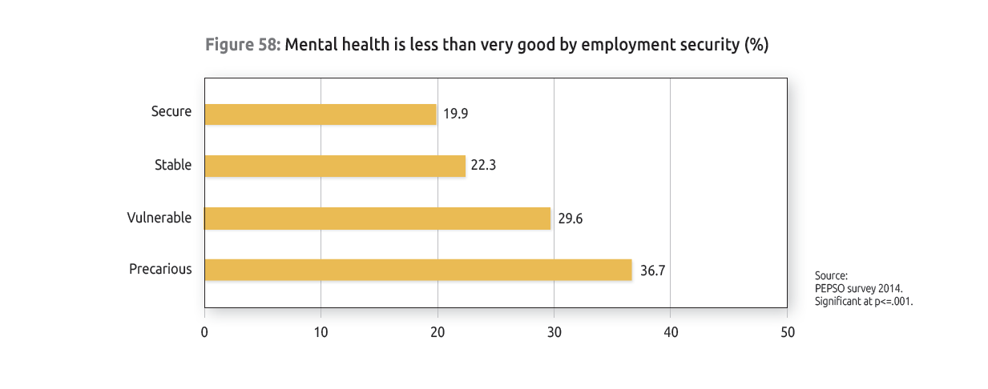
Precarious employment is associated with increased risk of mental health issues.
Notes:
Workers in less secure low-income employment are more than twice as likely to report poorer mental health than those in more secure high-income employment. (Note – not this figure).

Slide 19
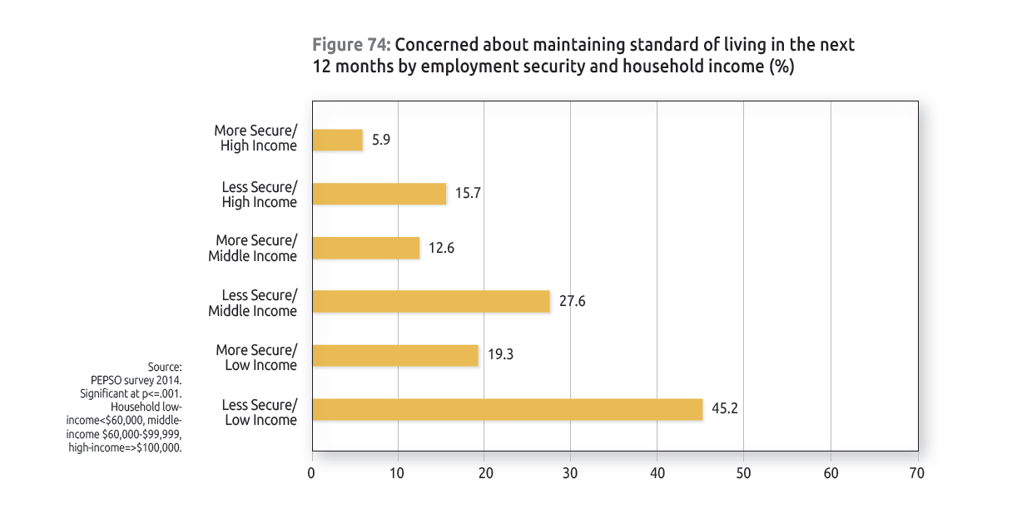
Precarious employment is associated with increased income stress.
Notes:
They report more challenges in keeping up with bills and keeping up with debt obligations.

Slide 20
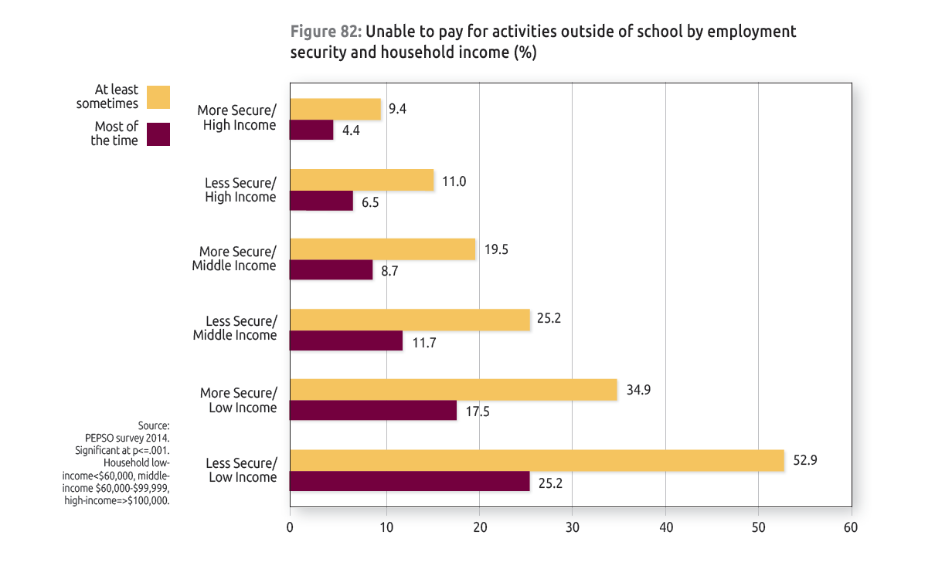
Precarious employment can affect children.
Notes:
Families are hurting. Across all income levels, parents with insecure jobs tend to be less able than those who are secure to afford school supplies, clothing, and activities outside of school for their kids.

Slide 21
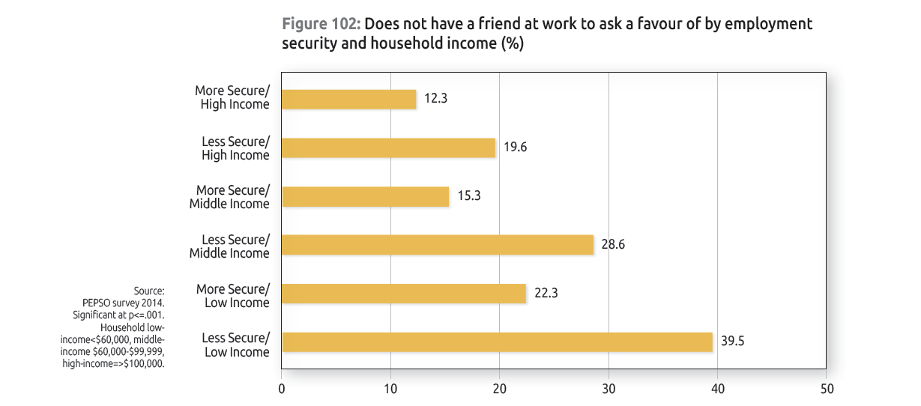
Workers in precarious employment can be more isolated.
Notes:
The uncertainty and anxiety associated with insecure employment increases social isolation by making it difficult to form and sustain friendships within and outside of work.

Slide 22
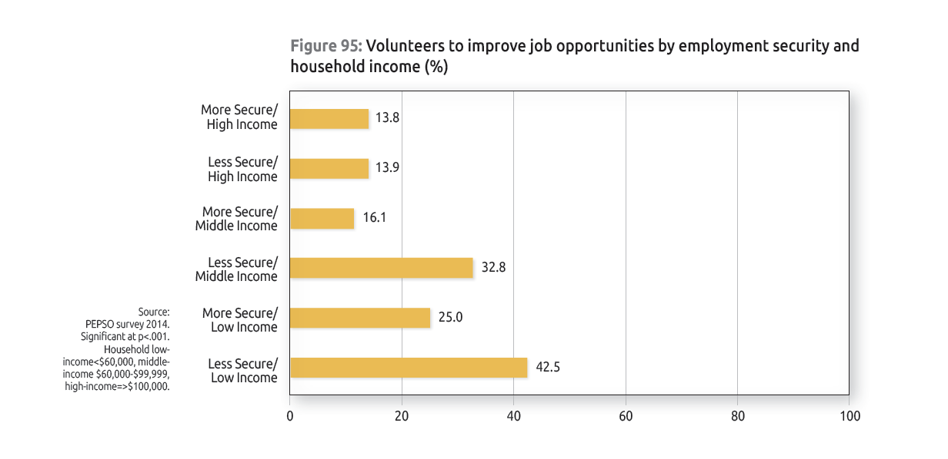
They volunteer more for job opportunities.
Notes:
Volunteer more often for job opportunities and networking reasons.

Slide 23
Precarious employment is bad for everyone—but your race, gender and where you were born can make things worse.
“I couldn’t find job. I looked and looked . . . so I said “you know what? It is not there”. . . This is very, it’s very degrading, it’s very humiliating. . . . It makes me feel like “okay, I’m not doing well here, so maybe I had to go back to where I come from, because I’m just getting by in this country.”
-Sofia
Notes:
Sofia is an older racialized women who works as a contract translator

Slide 24
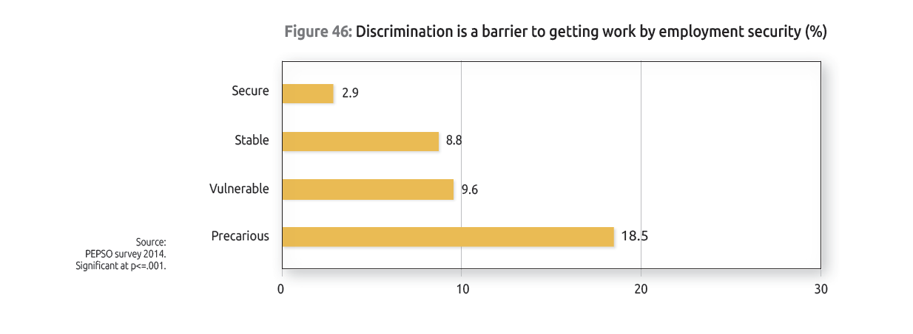
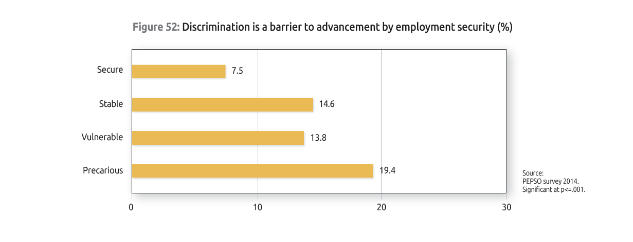
Workers in precarious employment face more discrimination

Slide 25
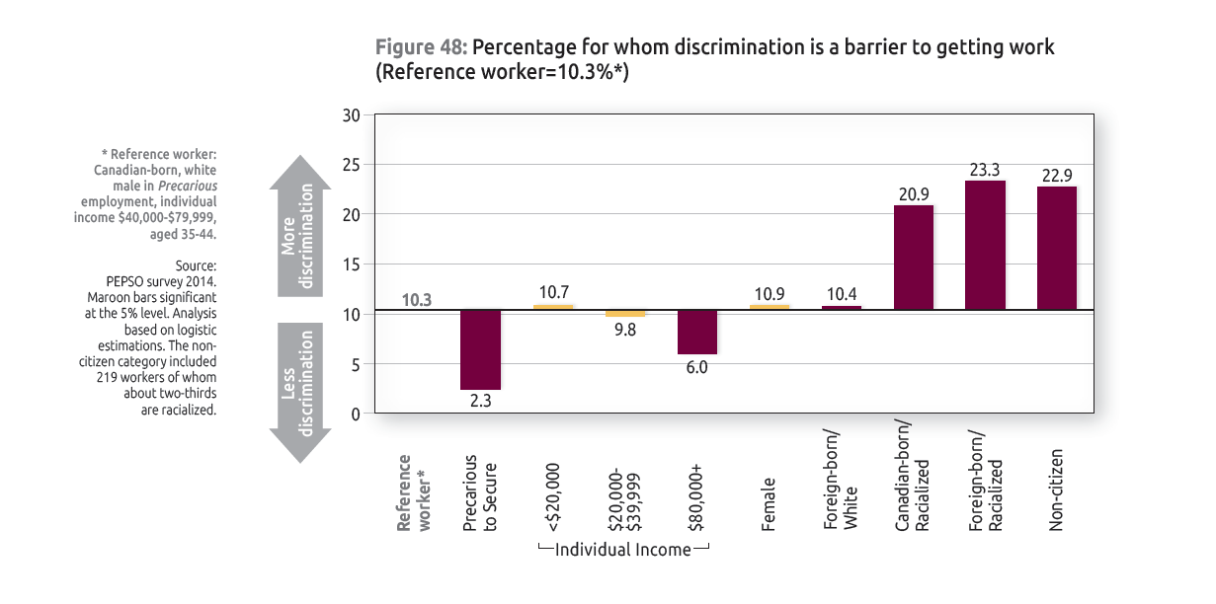
Racialized workers report more discrimination
Notes:
Racialized groups – both foreign born and Canadian born experience 2-3 times more employment discrimination (hired, retaining jobs, advancing in jobs)

Slide 26
There are practical solutions that will give people in precarious jobs a pathway to more stability and security
Building a dynamic labour market that supports workers in precarious employment
Ensuring that jobs are a pathway to income and employment security
Enhancing social and community supports for a new labour market

Slide 27
Building a dynamic labour market that supports workers in precarious employment
Building a workforce-development plan for a changing labour market
Providing training opportunities for those in insecure employment
Enabling more secure employment
Addressing discrimination in hiring, job retention and advancement

Slide 28
Ensuring that jobs are a pathway to income and employment security
Modernizing employment standards
Reducing the impacts of irregular work schedules for workers
Improving income security for workers in precarious jobs
Enhancing access to benefits for workers in insecure jobs
Supporting voice at work

Slide 29
Enhancing social and community supports for a new labour market
Enabling flexible, quality childcare
Improving access to community services
Creating accessible opportunities for children and youth
Ensuring meaningful volunteer opportunities

Slide 30
What are the social effects of precarious employment?
Before I knew I had a job, I went and did it, I came home and I had a life. . . . It’s like this precarious work. … It changes you as a person.
Internal Pre-publication Briefing
14 & 15 May 2015

