Slide 2
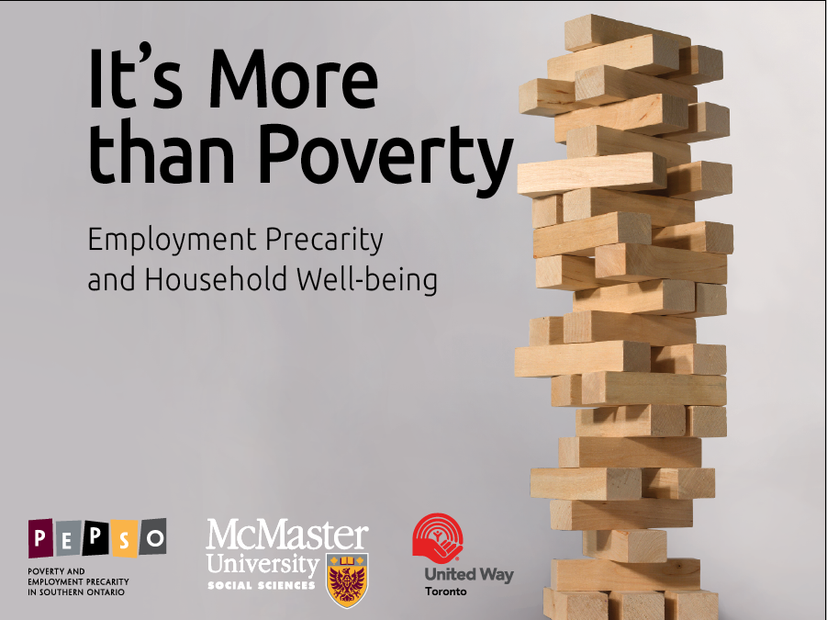
Notes:
Wayne Lewchuk (McMaster University)
Michelynn Lafleche (United Way Toronto)
Diane Dyson (WoodGreen Community Services)
Luin Goldring (York University)
Alan Meisner (QUANTACAN)
Stephanie Procyk (United Way Toronto)
Dan Rosen (City of Toronto)
John Shields (Ryerson University)
Peter Viducis (City of Toronto)
Sam Vrankulj (McMaster University)

Slide 3
What are the social effects of precarious employment?
Before I knew I had a job, I went and did it, I came home and I had a life. . . . It’s like this precarious work. … It changes you as a person.
Notes:
SER and the Male Breadwinner, Female caregiver family structure
The rise in women’s employment in the 1970s
Precarity becomes a new employment norm in the 1990s
What does this mean for household wellbeing?

Slide 4
The Data
random survey of 4,000+ surveys of individuals (Leger Marketing)
covers Hamilton and the GTA
83 interviews with individuals in precarious employment

Slide 5
How to measure precarious employment?
Two ways to measure:
Form of the employment relationship
Is it temp agency work, short-term, casual, own account self-employed?
2) Characteristics of the employment relationship
Employment Precarity Index

Slide 6
The Employment Precarity Index
What is included?
Not paid if miss work
Not in standard employment relationship
Weekly income not stable
Hours worked not stable
Work on-call
Don’t know work schedule in advance
Paid in cash
Temporary employment
No benefits
Weak voice at work
What is not included?
Income
Notes:
by precarity9: sum precarity
---------------------------------------------------------------------------------
-> precarity9 = LOWEST
Variable | Obs Mean Std. Dev. Min Max
-------------+--------------------------------------------------------
precarity | 932 .5579399 1.041497 0 2.5
---------------------------------------------------------------------------------
-> precarity9 = LOW
Variable | Obs Mean Std. Dev. Min Max
-------------+--------------------------------------------------------
precarity | 1097 10.28031 4.128696 5 17.5
---------------------------------------------------------------------------------
-> precarity9 = HIGH
Variable | Obs Mean Std. Dev. Min Max
-------------+--------------------------------------------------------
precarity | 977 28.0783 5.942067 20 37.5
---------------------------------------------------------------------------------
-> precarity9 = HIGHEST
Variable | Obs Mean Std. Dev. Min Max
-------------+--------------------------------------------------------
precarity | 1051 53.28021 10.84349 40 95

Slide 7
How does temp agency worker score?
Precarity Score
Not paid if miss work ✓
Not in standard employment ✓ relationship
Weekly income not stable ✓
Hours worked not stable ✓
Work on-call
Don’t know work schedule in advance ✓
Paid in cash
Temporary employment ✓
No benefits ✓
Weak voice at work ✓
TOTAL 80/100
Income
Income. $30,000
Precarious and low income

Slide 8
How does the child-care worker score?
Precarity Score
Not paid if miss work ?
Not in standard employment relationship
Weekly income not stable
Hours worked not stable
Work on-call
Don’t know work schedule in advance
Paid in cash
Temporary employment
No benefits
Weak voice at work ?
TOTAL 10/100
Income
Income. $30,000
Secure and low income

Slide 9
How does the university contract worker score?
Precarity Score
Not paid if miss work
Not in standard employment relationship ✓
Weekly income not stable
Hours worked not stable ✓
Work on-call
Don’t know work schedule in advance
Paid in cash
Temporary employment ✓
No benefits ✓
Weak voice at work ✓
TOTAL 50/100
Income
Income. $60,000
Precarious and middle income

Slide 10
How does the consultant score?
Precarity Score
Not paid if miss work ✓
Not in standard employment relationship ✓
Weekly income not stable ✓
Hours worked not stable ✓
Work on-call
Don’t know work schedule in advance ✓
Paid in cash ?
Temporary employment ✓
No benefits ✓
Weak voice at work ?
TOTAL 80/100
Income
Income. >$100,000
Precarious and high income

Slide 11
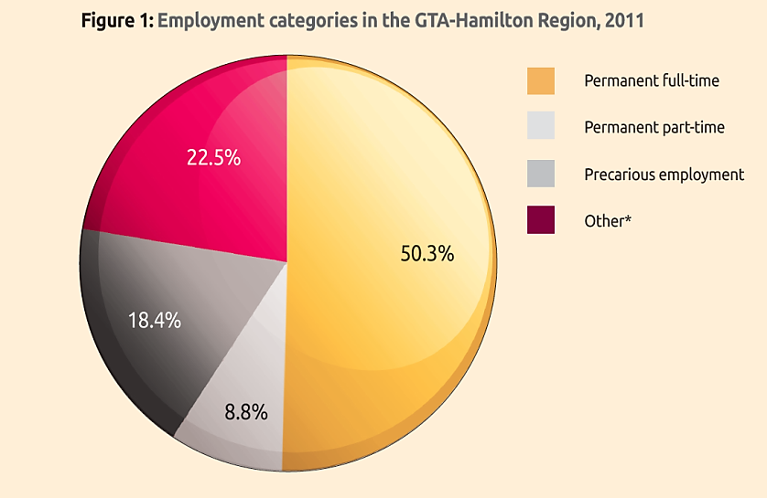
Precarious employment is increasing.
Only 60% of GTA workers today have stable, secure jobs.

Slide 12
2. Precarious employment is widely distributed among social and income categories.
Precarity is now found in sectors, in occupations, and in socio-economic groups that were previously immune to this form of employment.
Men and women are equally likely to be in precarious employment.
New immigrants are mainly in precarious employment.
Notes:
PRECARITY | RACE
INDEX | White Chinese Other | Total
-----------+---------------------------------+----------
LOWEST | 684 26 200 | 910
| 25.01 17.22 18.35 | 22.89
-----------+---------------------------------+----------
LOW | 745 47 288 | 1,080
| 27.24 31.13 26.42 | 27.16
-----------+---------------------------------+----------
HIGH | 617 44 298 | 959
| 22.56 29.14 27.34 | 24.12
-----------+---------------------------------+----------
HIGHEST | 689 34 304 | 1,027
| 25.19 22.52 27.89 | 25.83
-----------+---------------------------------+----------
Total | 2,735 151 1,090 | 3,976
STANDARD |
EMPLOYMENT |
RELATIONSH | RACE
IP | White Chinese Other | Total
-----------+---------------------------------+----------
NO | 1,364 79 576 | 2,019
| 48.75 51.63 51.47 | 49.61
-----------+---------------------------------+----------
YES | 1,434 74 543 | 2,051
| 51.25 48.37 48.53 | 50.39
-----------+---------------------------------+----------
Total | 2,798 153 1,119 | 4,070

Slide 13
3. People in precarious employment earn less and face more uncertainty.
You cannot relax because you don't have steady work. . . . I think the most stress is the financial component of it. When you don't know how much you may be making per month or per week. . . .

Slide 14
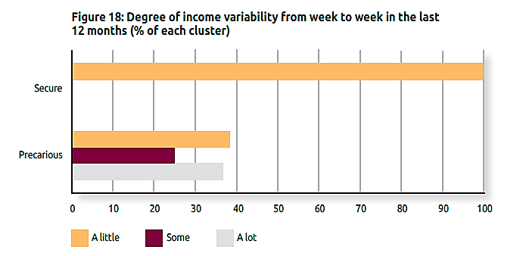

Slide 15
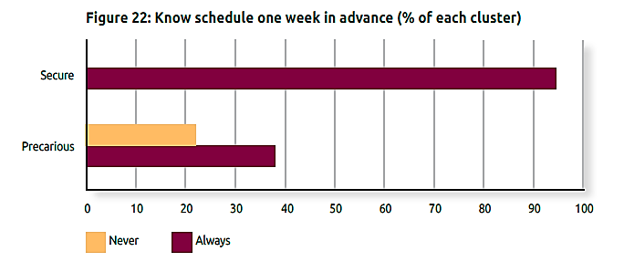

Slide 16
4. Precarious employment has harmful
effects on individuals, families, and
community life.
I want to work and have a good job and pay my debt and be a provider and be able to have children and provide for them. . . . I wouldn’t even think of it [having children] right now. . . .

Slide 17
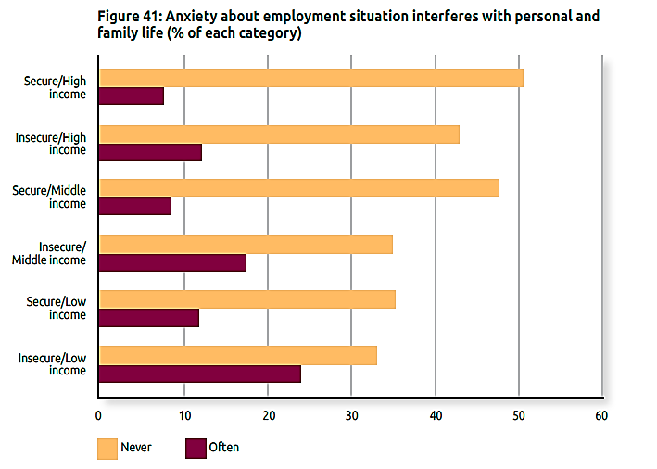
Notes:
See table 6 page 61

Slide 18
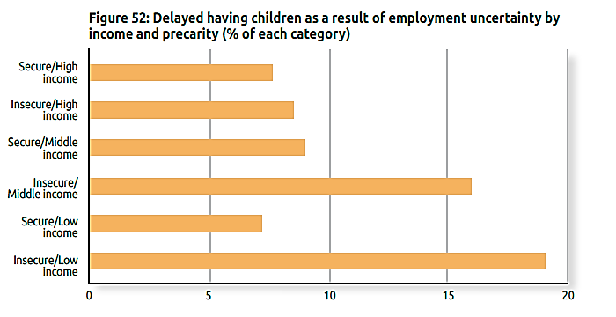

Slide 19
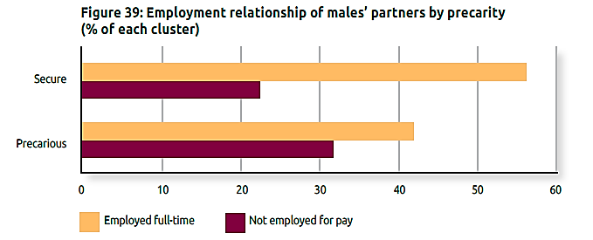

Slide 20
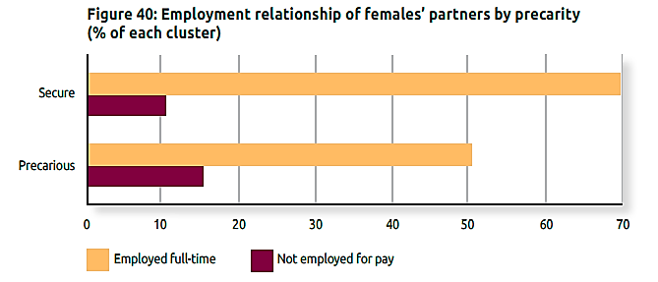

Slide 21
5. Precarious employment makes it more difficult to raise children.
This year our oldest son started to crumble under the pressure through last year in high school, so he's been in counselling for depression. Unfortunately, the kids went through the ringer when I look back on it. . . . It was bad at times.

Slide 22
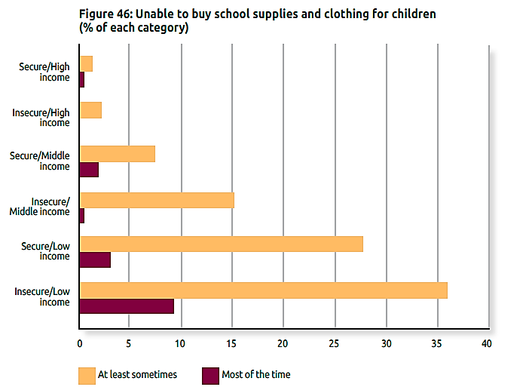

Slide 23
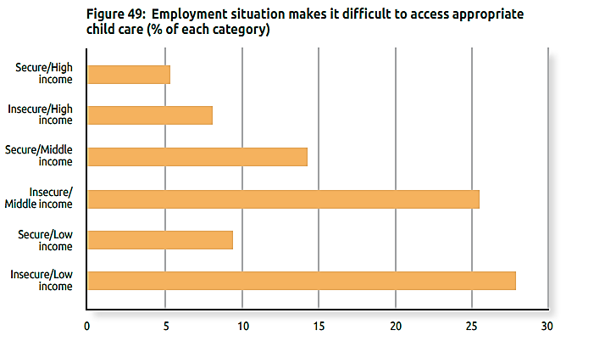

Slide 24
6. Precarious employment can both limit and enable community connections.
Yes I would like to be more involved with my community. . . but I can't afford to be giving away my time for free, or any more of my time.

Slide 25
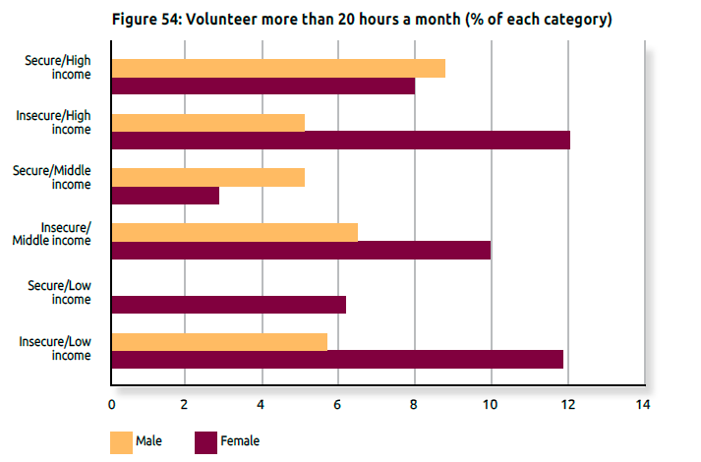

Slide 26
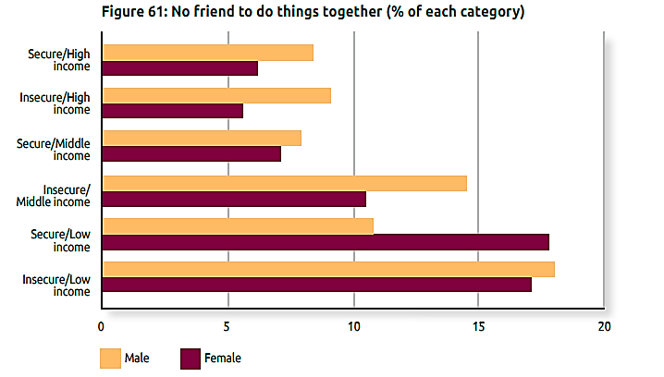

Slide 27
An Agenda for Reform
How to minimize the prevalence of precarious employment?
How to mitigate its negative effects?

Slide 28
Ensuring jobs are a pathway to income and employment security
Supporting human capital development
Enhancing social and community supports for families and communities

Slide 29
Thanks

