Slide 1
Altmetric Top 10
A Novel Approach to Marketing Research Impact Services
Jack Young
McMaster University Health Sciences Library
jkyoung@mcmaster.ca

Slide 2
Context
McMaster’s Health Sciences Library has gradually expanded its research impact services over the past 3 years. Service currently includes support for author identifiers/profiles, bibliometric topic analysis, and impact reports for research groups/ departments.
Three barriers when it comes to stakeholder engagement:
Library: Cost of tools.
Administrators: Narrow view of what constitutes research impact.
Researchers: Concern over how research impact data might be used.

Slide 3
The Altmetric Top 10
A yearly countdown of the Top 10 most attention-grabbing articles coming out of McMaster’s Faculty of Health Sciences based on Altmetric Attention Score.

Slide 4
How We Did It
Used Web of Science to identify all articles published by McMaster researchers in 2019.
Further refined results to 54 Web of Science health-related categories.
Exported all results to Excel and compiled the DOIs of the publications in a Word document.
Pasted the DOIs (50 at at time) into the free Altmetric Explorer tool and exported these results to a new Excel document.
Sorted this final Excel document by Altmetric Attention Score to generate the list of the Top 10 most attention-grabbing articles.

Slide 5
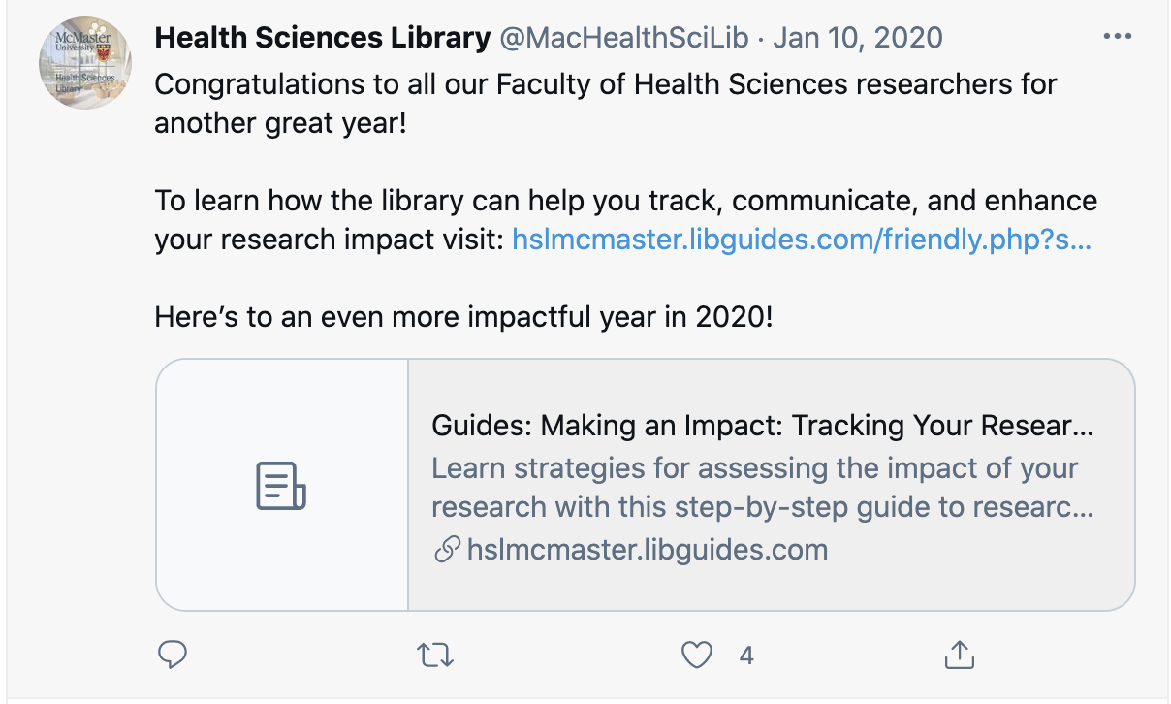
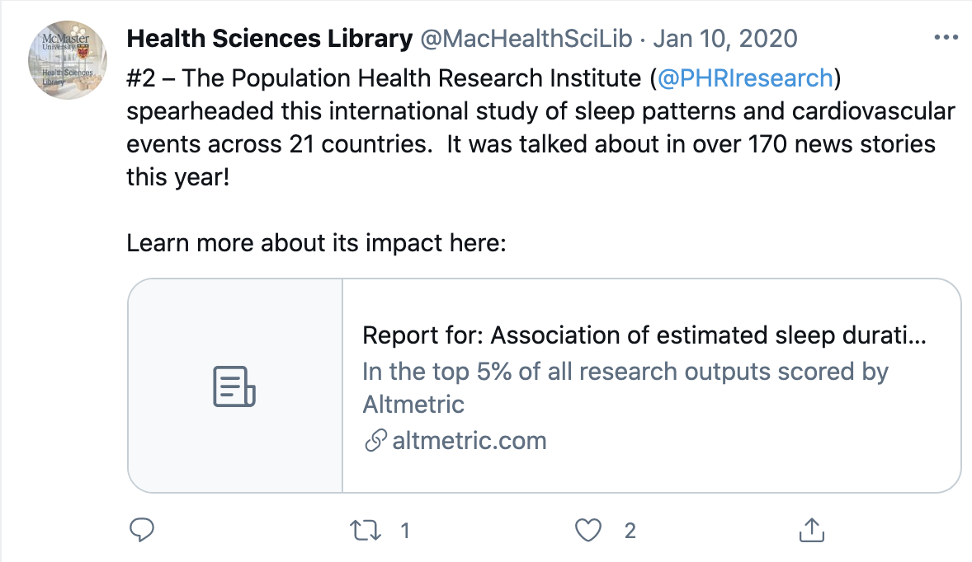
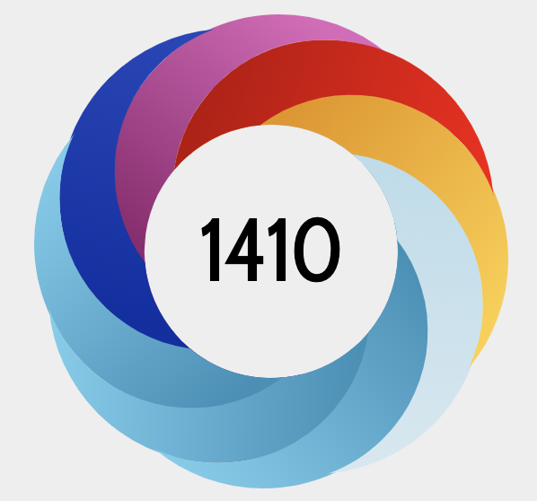
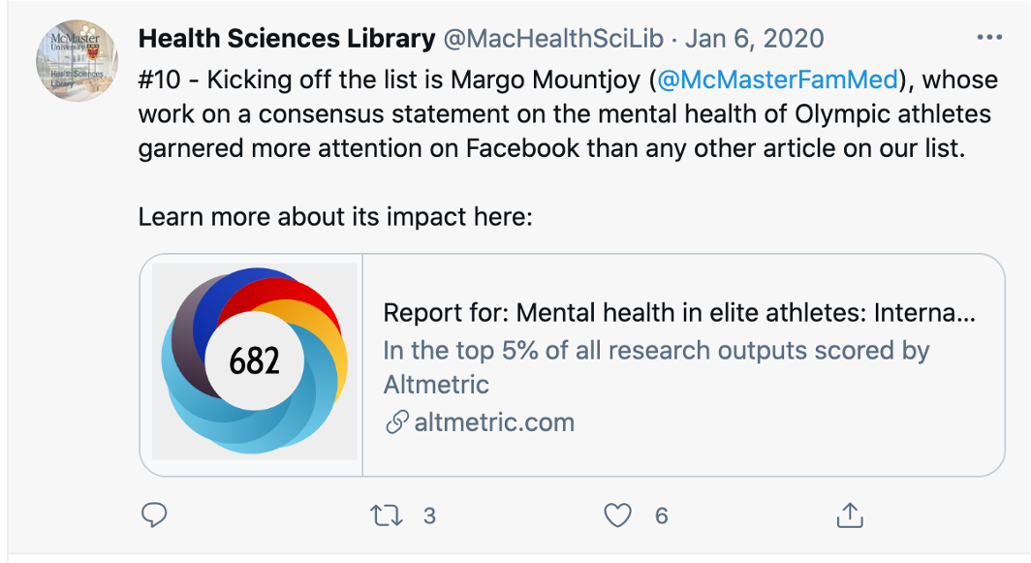
How We Did It

Slide 6
Results
Two campaigns (run in 2019 and 2020) generated considerable interest and the library gained a number of influential Twitter followers as a result.
Views of the library’s Research Impact subject guide increased 39% over the year, with spikes at the time of the campaign.
Effectively addressed the three barriers identified:
Library: Used free tools or tools that the library already had access to.
Administrators: Introduced alternate ways of understanding research impact.
Researchers: Demonstrated that research impact services are about more than evaluation.

Slide 7
Questions?
Jack Young
jkyoung@mcmaster.ca

