Slide 1
The Standardized Bibliometric Report
BRIC Conference – April 29, 2021
Increasing efficiency, engagement, and educational opportunities through standardization
Jack Young
Health Sciences Librarian - McMaster University
jkyoung@mcmaster.ca

Slide 2
Overview
BRIC Conference – April 29, 2021
Context
Our Approach
Choosing Indicators
Sample Report
Results
Next Steps

Slide 3
Context
BRIC Conference – April 29, 2021
Bottom-up approach to bibliometrics and research impact.
Initial focus on building up a strong foundation of knowledge and seeking out use cases within the Faculty.
Added InCites subscription to the library’s existing Web of Science subscription.
High barrier to engagement, as a deep understanding of bibliometric indicators was necessary to know what types of questions they could answer.
Limited dedicated staff to pursue this work.

Slide 4
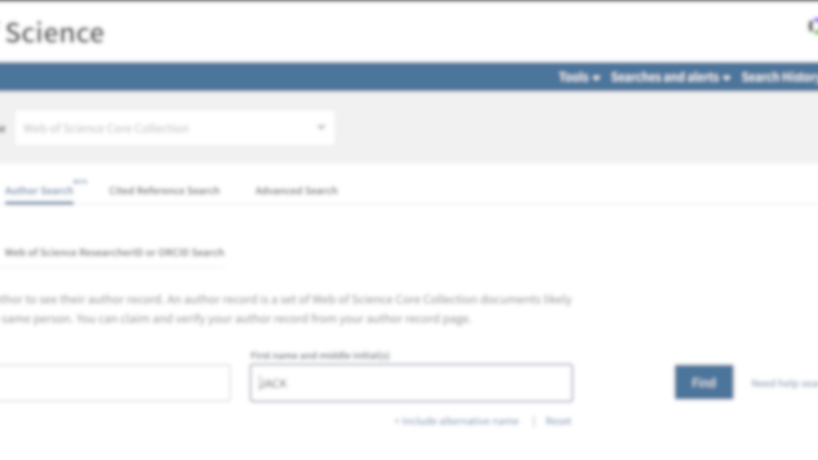
Our Approach
BRIC Conference – April 29, 2021
Leveraging the new algorithmically generated author profiles in Web of Science to produce rapid (if imperfect) data sets based on a list of provided names.
Using InCites to analyze these data sets on a set of predetermined bibliometric indicators and visualizations.
Packaging these indicators into a prebuilt reporting template.
Meeting with submitting departments to go through the report and explain the indicators used.

Slide 5
Choosing Indicators
BRIC Conference – April 29, 2021
Included a representative range of aggregate, percentage-based, and normalized indicators:
Total Publications
% of Pubs in Q1 JIF
% of Pubs in Top 1%
Total Citations
% of International Collabs
% of Pubs in Top 10%
% of Industry Collabs
Average Percentile

Slide 6
Sample Report
BRIC Conference – April 29, 2021
Report was broken down into five sections
Introduction
Methodology
Data
Visualizations
Article List

Slide 7
Sample Report: Introduction
BRIC Conference – April 29, 2021
The Standardized Bibliometric Report pulls together eight key indicators of research productivity and impact for your department or research group. Presenting data in both tabular and graphical forms, we aim to create a report that is transparent, concise, and easy to navigate.
The data included in this report explores the citation- and publication-based activity of research published in academic journals. This type of data is only one lens through which to view research impact and should be considered alongside a multitude of other qualitative and discipline-specific indicators for the most accurate picture of true impact.

Slide 8
Sample Report: Methodology
BRIC Conference – April 29, 2021

Slide 9
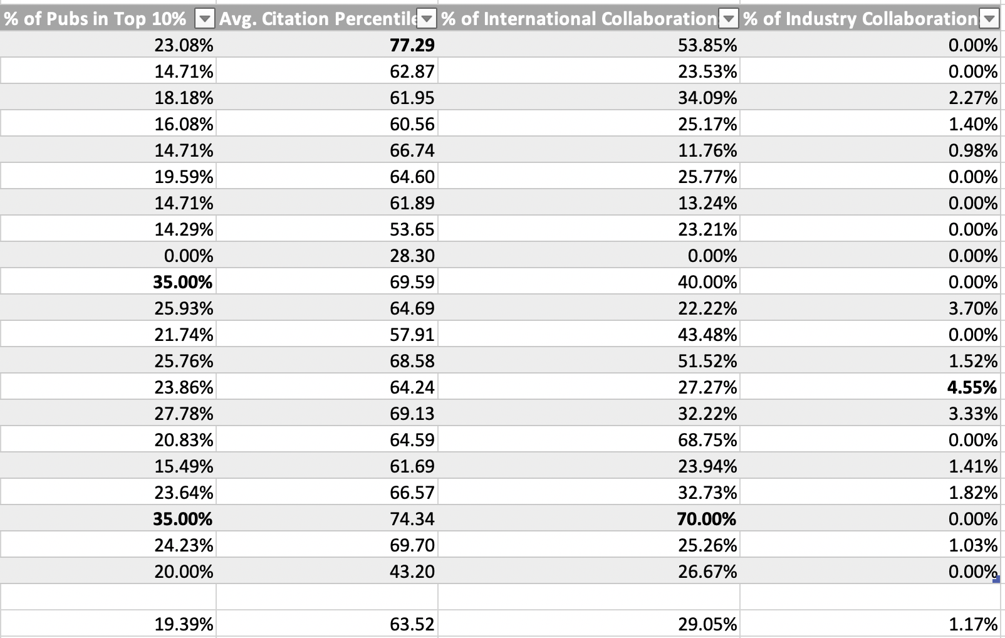
Sample Report: Data
BRIC Conference – April 29, 2021
*Data section also included a legend defining each indicator.

Slide 10
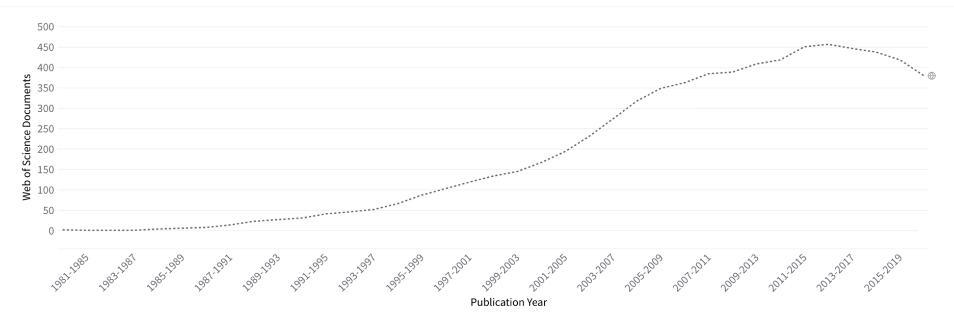
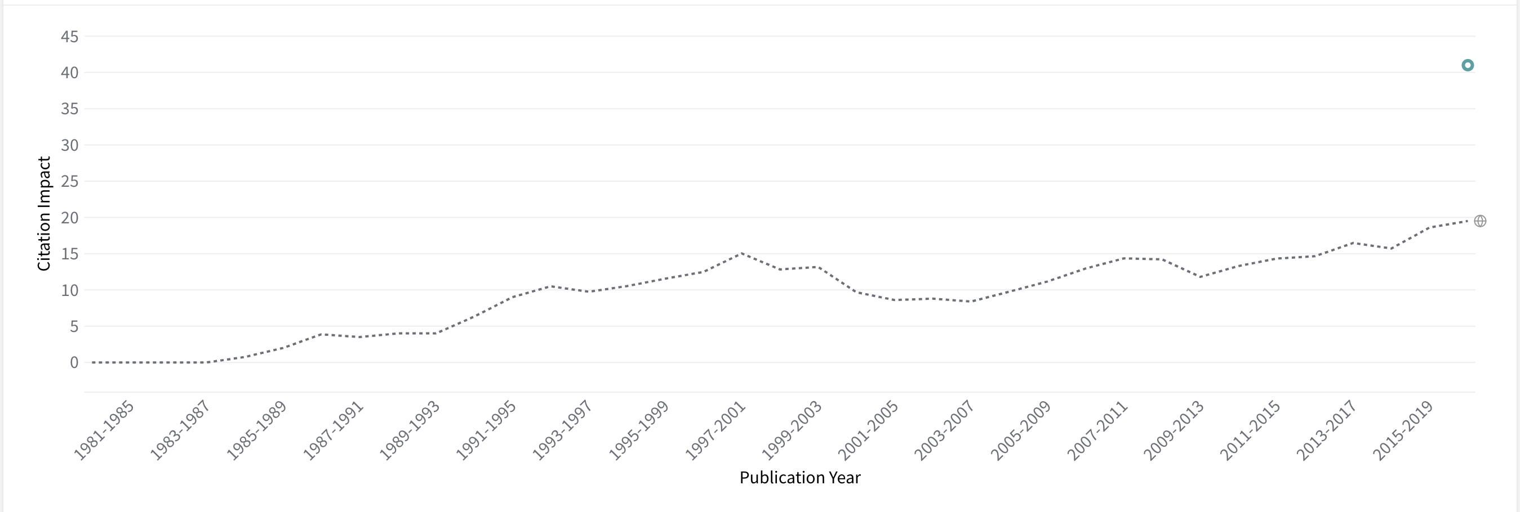
Sample Report: Visualizations
BRIC Conference – April 29, 2021
Total Publications – 5-Year Trend
Citations/Publication – 5-Year Trend

Slide 11
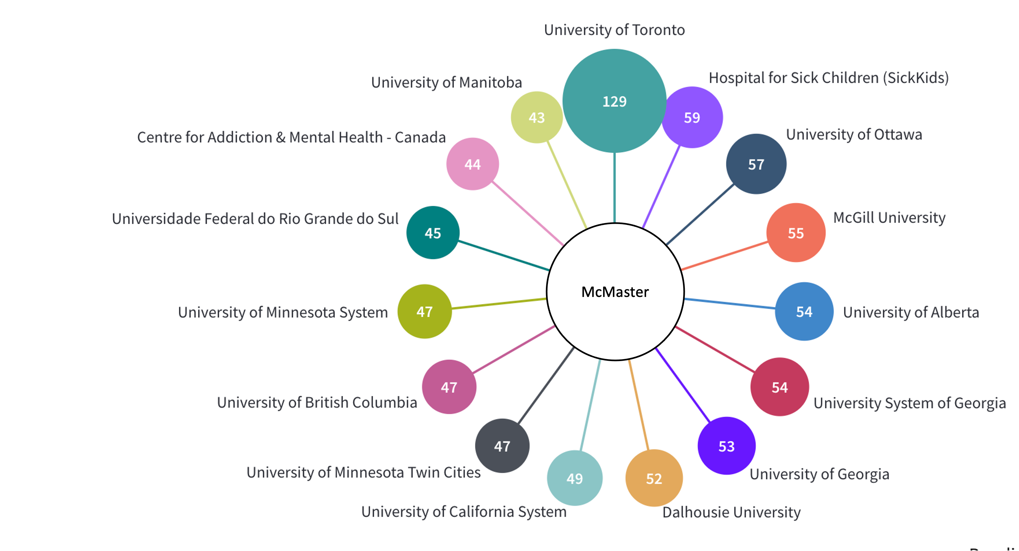
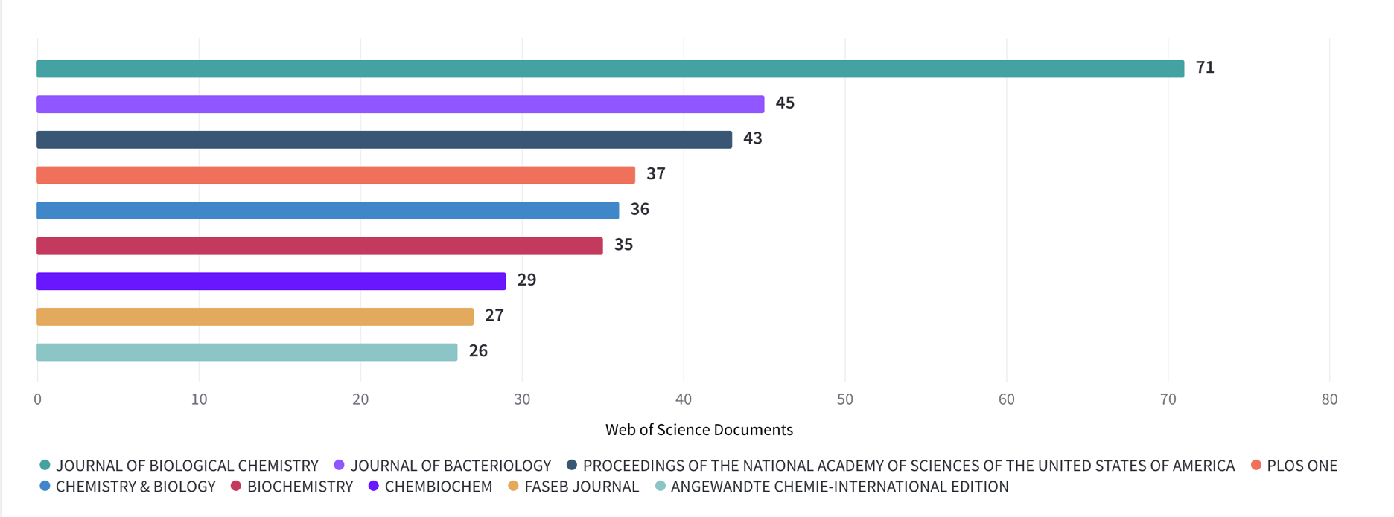
Sample Report: Visualizations
BRIC Conference – April 29, 2021
Total Publications –
By Collaborator
Total Publications – By Source

Slide 12
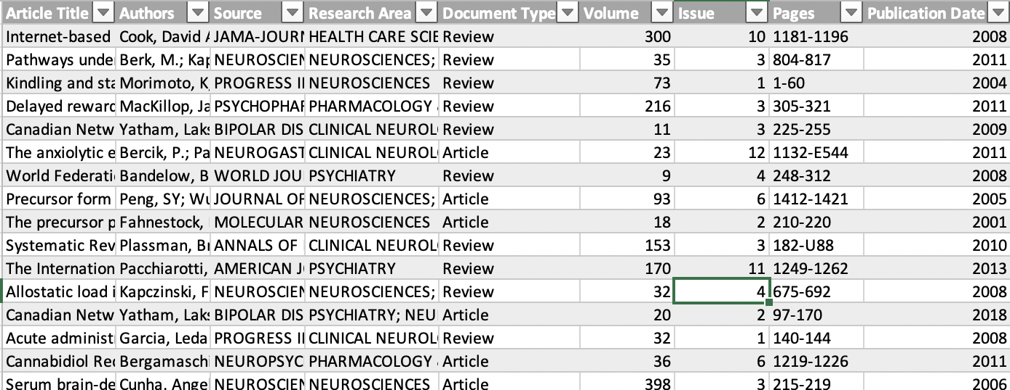
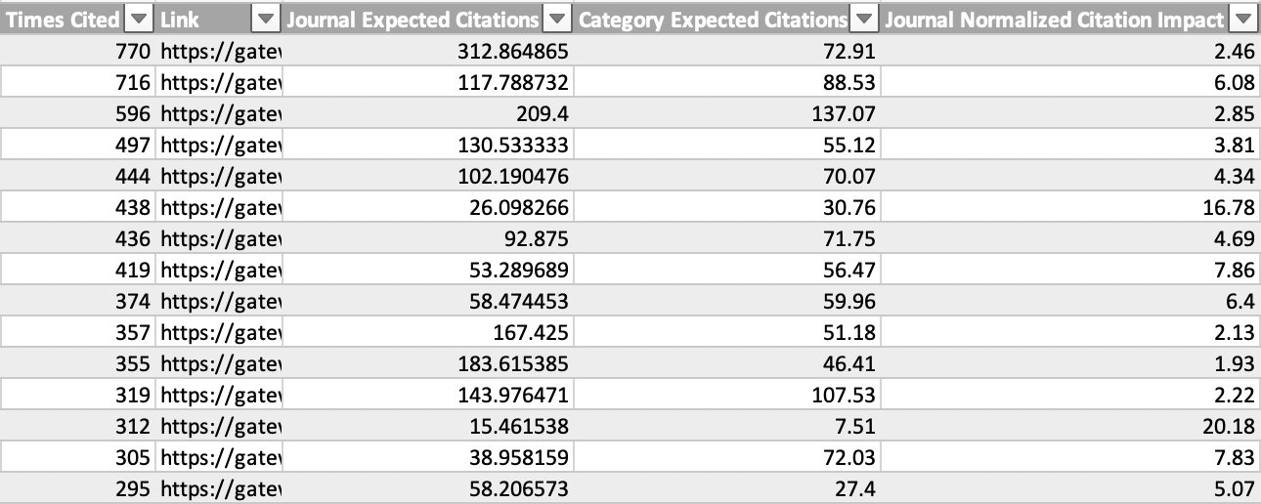
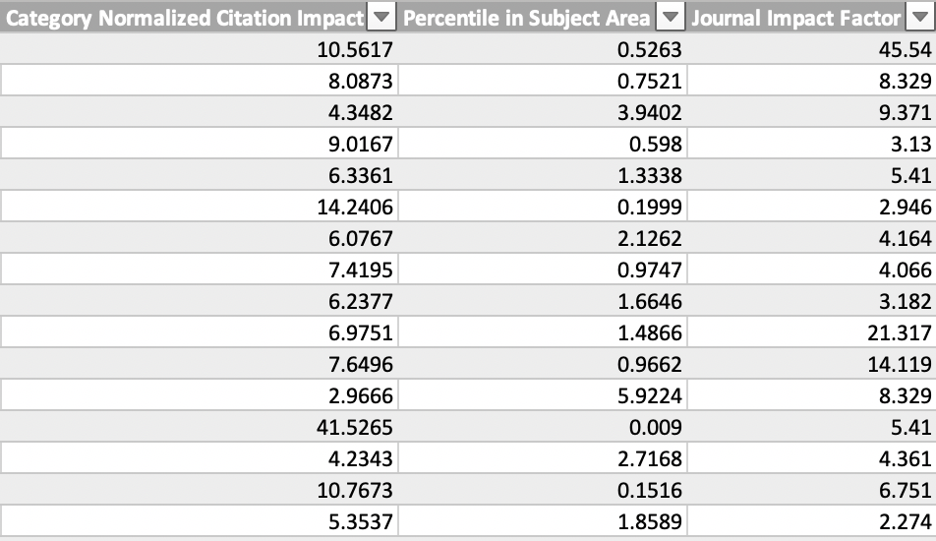
Sample Report: Publication List
BRIC Conference – April 29, 2021

Slide 13
Results
BRIC Conference – April 29, 2021
Produced reports for six departments within the Faculty of Health Sciences since October 2020.
Follow-up meetings were very successful.
Three questions:
Customizability
Frequency
Additional Indicators

Slide 14
Next Steps
BRIC Conference – April 29, 2021
Using the Standardized Bibliometric Report as a launching pad to discuss the importance of author identifiers with the departments.
Launched the “Claiming Your Publications” LibGuide and workshop series that teaches researchers how to set up self-sustaining profiles/identifiers in ORCiD, Publons, and McMaster Experts:
https://hslmcmaster.libguides.com/claiming
Successfully updated a report for one department using their researchers’ Publons identifiers in place of author names.

Slide 15
Questions
BRIC Conference – April 29, 2021
jkyoung@mcmaster.ca

