Slide 1
Citations in Wikipedia for Understanding Research Reach
Jennifer McKinnell (McMaster University)​
Denise Smith (Brock University, formerly McMaster U.)​
Jack Young (McMaster University)
November 11, 2023
WikiConference North America
This work is licensed under CC BY-NC 4.0

Slide 2
Disclosure
The authors have no conflicts of interest to declare. All co-authors have seen and agree with the contents of this presentation, and there is no financial interest to report. We certify this is original work.

Slide 3
Agenda
Research Impact & Wikipedia​
Research Questions ​
Findings​
Limitations
Insights
Next Steps/Future Research
*"Measuring Institutional Research Impact with Wikipedia Citations" currently undergoing peer-review in JMLA

Slide 4
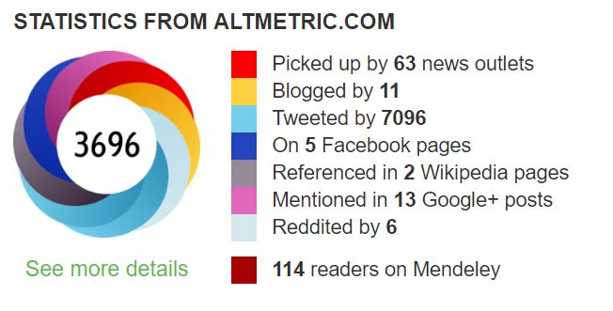
Research Impact & Wikipedia
The impact of any research output can be understood across multiple dimensions:​
Knowledge Generation​
Industry & Commercial Use​
Public Policy​
Societal Wellbeing​
Traditional impact indicators rely on the academic citation as the core unit of impact.​
Altmetrics focus on public engagement with a piece of research by exploring the attention it receives across multiple online platforms:​
News​
Social Media (Twitter/X, Facebook, Reddit)​
Wikipedia​
The Altmetric Attention Score aggregates this attention into a single metric.
Notes:
Jack (4min)​
When we talk about research impact, we're talking about the influence of a given research output across multiple dimensions... ​
​
Depending on the type of impact we’re exploring, we need to analyze a variety of metrics or indicators. ​
​
But traditionally, the research impact conversation has been dominated by academic citations. So if a research group wants to understand the impact it's having, it will typically look at the number of times it's work has been cited by other researchers.
But academic citations only address one of the dimensions of impact mentioned here.
​
Maybe that same research group wants to learn about how the knowledge their research is generating is being utilized by the general public. Now the academic citation doesn’t provide much clarity. The general public is interacting with the research in a different way, and we need to consider different indicators. ​
​
One class of indicators that have grown significantly over the past decade are called altmetrics. Instead of focusing on academic citations, these indicators examine the online attention at piece of research is receiving by tracking the number of times it has been mentioned on a variety of platforms, from news, to social media, to Wikipedia. ​
​
One popular tool, Altmetric Explorer, aggregates these online mentions and calculates an overarching Attention Score. By looking the Altmetric Attention Score of a research output, you can get a sense of how the public is engaging with your work. ​
​
For this project we used Altmetric Explorer to focus specifically on Wikipedia citations to McMaster’s research, I'm going to pass it to Denise to talk about why Wikipedia is such a unique tool for examining research impact.

Slide 5
Research Reach & Wikipedia
2 billion pageviews/year (2019)​
Wide recognition for coverage of COVID-19 pandemic worldwide​
Provides overview of health topics​
Knowledge, summarized & translated​
Open and transparent​
For our global community
Notes:
Denise (1.5mins)​
​
Wikipedia is the most frequently accessed web site for health information. It's health and medical pages have been reported to receive around two billion views per year (2019). Early in the pandemic, Wikipedia received media acclaim for its role in mitigating the misinformation crisis, and later became an official partner with the WHO for doing so. Also, in 2020 it was identified in The Lancet Countdown as a key player in the amplification of science. ​
​
Given its key role in public health education, we explored using citations in Wikipedia as a measure of research impact for several reasons:​
​
News media, frequently available to the public, communicates new or promising findings but does not necessarily provide an overview of the topic as a whole ​
Wikipedia requires an element of knowledge translation: contributors are asked to summarize high-quality secondary sources (e.g. evidence syntheses)​
The transparent and open process of peer-review and community debate aims to ensure neutrality, accuracy, and verifiability of any contributions made to a Wikipedia article, which is not a perfect system, but has a net positive impact.​
​
Understanding research reach through the lens of Wikipedia citations could potentially offer additional insight into the dissemination and translation of an institutions research outputs. Namely, it offers a view of community-level access to these outputs. ​
​
So where did we start? With research questions, of course!

Slide 6
Research Questions
What proportion of health evidence syntheses from McMaster University affiliated authors, published between 2017 and 2022, have been cited in Wikipedia​
Of McMaster University's top 10% most impactful health evidence syntheses, ranked by Altmetric Attention Score, what proportion are cited in Wikipedia?​
How many citations to McMaster University's published evidence synthesis outputs from 2017 to 2022 appear in Wikipedia? ​
How many Wikipedia articles do these citations appear in?​
Is there a relationship between Open Access publication and a research output's citation in Wikipedia?
Notes:
Using McMaster university as our case example, we used Altmetric explorer to track publication citations in Wikipedia. Our hope was that we could gain some insight into the reach of health evidence syntheses.
Because our literature review related this study was one of the first of its kind, we took an exploratory approach and landed on four broad research questions:
What proportion of health evidence syntheses from McMaster University affiliated authors, published between 2017 and 2022, have been cited in Wikipedia​
Of McMaster University's top 10% most impactful health evidence syntheses, ranked by the Altmetric Attention Score, what proportion are cited in Wikipedia?​
How many citations to McMaster University's published evidence synthesis outputs from 2017 to 2022 appear in Wikipedia? ​
How many unique Wikipedia articles do these citations appear in?​
Is there a relationship between Open Access publication and a research output's citation in Wikipedia?
For the purpose of this talk, we will not be delving too far into our methodology, however, if you have questions, we are happy to address them in at the end. In addition, we have a manuscript out for review, which provides a complete description of our methods.

Slide 7
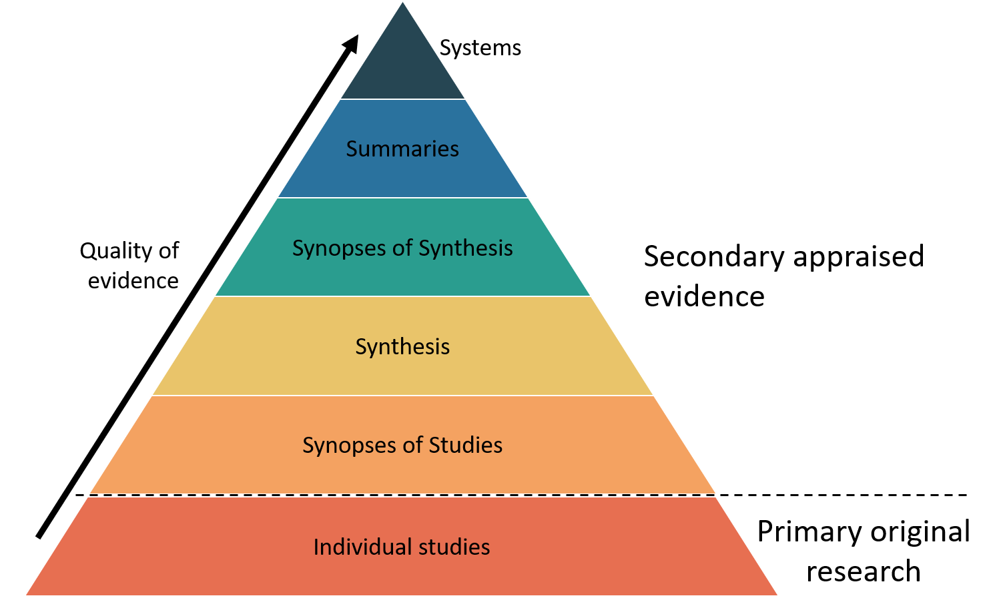
Define evidence syntheses
Health evidence syntheses are studies that combine information from multiple studies investigating the same topic.
Their purpose is to help readers comprehensively understand findings and determine the effectiveness of a particular intervention or how individuals experience health conditions or treatments.
Evidence syntheses are used by policymakers, healthcare institutions, clinicians, researchers, and the public to better inform healthcare decisions.
Definition modified from: Conchrane.org (https://www.cochrane.org/news/evidence-synthesis-what-it-and-why-do-we-need-it)
This Photo by Unknown author is licensed under CC BY.
Notes:
Before we proceed, I want to be sure everyone is clear by what we mean when we say health evidence synthesis.
In general, Wikipedia prefers that the evidence referenced in it’s health entries are of the highest quality – and as such – evidence synthesis are often used.
Health evidence syntheses are studies that combine information from multiple studies investigating the same topic. Their purpose is to help readers comprehensively understand findings and determine the effectiveness of a particular intervention or how individuals experience health conditions or treatments.
Basically, these syntheses are studies that bring together the results of dozens, or even hundreds of individual primary studies, to help the reader better understand the strength or validity of the findings.
The diagram on this slide shows there are many levels of synthesis, each producing a higher quality of evidence. Our study pulled any publication that used methodologies associated with papers falling above the dotted line.

Slide 8
Findings: RQ1
What proportion of health evidence syntheses from McMaster University affiliated authors, published between 2017 and 2022, have been cited in Wikipedia?
3,582 health evidence syntheses published between 2017 and 2022 were tracked in Altmetric Explorer ​
6.1% (n=219) cited in Wikipedia articles
Notes:
So now lets look at our results:
The findings for question #1 indicate that of the 3,582 health evidence syntheses published between 2017 and 2022 tracked in Altmetric Explorer 6.1% (n=219) were cited in Wikipedia articles at the time of analysis. ​
​These 219 articles are important because they formed the foundation data set used for the subsequent analysis. These results also establish a baseline should we decide to continue our research in this area or to look for change over time.

Slide 9
Findings: RQ2
Of McMaster University’s top 10% most impactful health evidence syntheses, ranked by AAS, what proportion are cited in Wikipedia?
Top 10% = 358 ​
29.3% (n=105) cited in Wikipedia​
Represents:​
48% of the 219 outputs cited in Wikipedia​
62.5% (n = 355) of cumulative citations to outputs
Notes:
SLIDE 9
The findings for question 2 show that of the top 10% (n=358) of McMaster University’s evidence syntheses, ranked by the altimetric attention score, 29.3% (n=105) were cited in Wikipedia. These 105 articles represented 48% of the 219 outputs cited in Wikipedia and 62.5% (n = 355) of cumulative citations. ​
​Now, remember that our goal was to try and determine whether or not knowledge synthesis work results in knowledge translation, and ultimately, improve health care practice and outcomes. Therefore, we thought it might be useful to see if the biggest articles (in terms of reach as defined by altmetrics) might also be heavy hitters in terms of their presence in Wikipedia.
Given these numbers, and knowing that Wikipedia is one of the most heavily consulted online health resources, this result indicates there is some evidence that these high performing articles are making a difference. ​

Slide 10
Findings: RQ3
How many citations to McMaster University's published evidence synthesis outputs from 2017 to 2022 appear in Wikipedia? How many Wikipedia articles do these citations appear in?
568 citations across 524 unique articles​
29 different language editions​
44.9% (n=255) of the citations were in English Wikipedia​
54.1% distributed across 28 languages
Notes:
Denise (1 min)​
​
At the time of analysis there were 568 cumulative citations to McMaster’s health evidence syntheses within Wikipedia ​
across 524 unique articles ​
in 29 different language editions.​
44.9% (n=255) of the citations were in English Wikipedia, the remaining 54% were distributed across articles in 28 different languages.​
​
​
Differentiating between the number of times an article is cited vs. the number of articles that cited an evidence synthesis output allowed us to understand the difference between citation count (one research output can be cited multiple times in a WP article), and the reach of the outputs in Wikipedia (how many articles include a citation to Mcmaster research). The insights into where these citations are occurring, less than half in English language Wikipedia articles, provides space for potential conversation about the role of language translation in knowledge translation and communication. It also provides insight into the potential global impact of McMaster's outputs.

Slide 11
Findings: RQ4
Is there a relationship between Open Access publication and a research output's citation in Wikipedia?
79% (n = 173) were Open Access​
When the proportion of outputs cited in Wikipedia adjusted for OA status = 8.1% (+33%)
Notes:
Jack ​
​
Of the 219 health evidence syntheses cited in Wikipedia, 79% (n = 173) were published using an Open Access model.​
When the proportion of articles cited in Wikipedia (6.1%) was adjusted for Open Access publication status, the proportion of articles cited in Wikipedia increased to 8.1%. A 33% increase. Suggesting a relationship between the open access publication status of a research output and its likelihood of being cited in a Wikipedia article. ​
​
Why is this important: Open access can increase attention – can we see if this is specifically true for altmetric (and Wikipedia in particular)

Slide 12
Limitations
Almetric Explorer tracks Wikipedia citations in real time​
Historic citation data is not captured​
Affiliation data is not always consistent​
Some researchers have multiple appointments​
McMaster is comprised of many sub-affiliations​
Cross institution collaboration ​
McMaster cannot be seen as being wholly responsible for the impact of publications with multiple collaborators
Notes:
Jack

Slide 13
Insights
Altmetric Explorer: a valuable tool for tacking attention gained outside academia​
A methodology for future analysis that can be applied to future analysis of other research outputs (topic-, institution, author-based)​
We have a baseline for citation activity in Wikipedia, can be applied in future​
High- attention articles are well represented in Wikipedia; more to learn​
Relationship between OA publication and citation in Wikipedia consistent with Wikipedia community practices​
Beyond scope, but notable: interplay between attention score, OA status and citation in Wikipedia
Notes:
Denise (2.5 mins)
We suggest that Altmetric Explorer can be a valuable tool for tracking attention gained outside of the academic sphere, specifically to understand the inclusion of research in a frequently accessed public health information resource like Wikipedia. We've learned that Wikipedia mentions can provide insights not available through traditional citation-metrics, such as the global, community-level reach of a work.
We've also reported, in our paper, a methodology that could be applied to future analyses of research outputs: be they topic-, institution-, or author-based.
The 6.1% of health evidence syntheses from McMaster affiliated authors appearing in Wikipedia provides a baseline for future investigations into citation activity of our institution's evidence synthesis outputs in Wikipedia. This baseline can be applied to future research that reports on the growth or decline of McMasters’ presence in Wikipedia over time.
The research found that, when ranked by attention score, the top ten percent of evidence syntheses in the data set were well represented among the evidence syntheses cited in Wikipedia. In addition to demonstrating the University’s reach, this data can be related to the university's institutional goals around knowledge translation. However, the nature of this relationship wasn't investigated.
Our finding that open access evidence syntheses are more likely to be cited in Wikipedia is consistent with Wikipedia’s well-known preference for verifying its content by citing open-access materials. This relationship between open access publishing models and presence in Wikipedia across multiple languages could be included in ongoing conversations about the value of open access publishing.
Finally, Wikipedia’s reliability guidelines for medical information name six core medical journals as preferred information sources. While outside the scope of this study, we noticed these core journals were strongly represented among the top ten percent of evidence-syntheses as ranked by attention score. So, we believe there is an undefined interplay between an article's attention score, presence in Wikipedia and open access status that requires further investigation.
Speaking of future investigation...

Slide 14
Opportunities for Future Research
Understanding trends in authorship​
What factors influence a publication’s likelihood of being cited in Wikipedia? ​
Article-level metrics ​
Leveraging Wikipedia’s pageviews data to better understand the true reach of individual publications cited in Wikipedia​
Identifying trends in knowledge translation ​
Wikipedia citation trends may indicate the types of topics that the general public is most interested in – could be used to guide research practice.​
Investigating the relationship between various Altmetric sources​
Understanding the correlation between the various altmetric indicators (e.g. news vs. social media vs. Wikipedia) and the diverse purposes they serve in impact assessment
Notes:
Jack

Slide 15
Jennifer McKinnell (McMaster University)​ Denise Smith (Brock University, formerly McMaster U.)​ Jack Young (McMaster University)
Notes:
So why did we do this study?
Both Jack and Denise hold leadership roles at their respective institutions where they are responsible for supporting and accelerating research. This type of study will help them better understand the reach of their organizations’ output and perhaps consider where health research outputs might be reaching lay audiences and influencing improved health care delivery and quality of life – goals that are closely aligned with the priorities of their parent institutions.
I hold an administrative role at McMaster. In this role I am always looking to explore how and where the library can most efficiently and effectively support our constituencies. Again, it seems that this type of work can help provide some insight into our research reach beyond the just the academic community.
And with that, I think I’ll stop, and we can take some questions.

