Slide 1
Awareness,
Authenticity, Authority
John Bandler
Major & Planned Giving Retreat
McMaster University
Hamilton, Ontario
August 23, 2017

Slide 2
Wikipedia Pages
John Bandler
Space Mapping
Optimization Systems Associates
Bandler, 2017

Slide 3
FEAR
Bandler, 2017

Slide 4
Combating Fear
of performance, of publication
of conflict, of disruption
of guilt, of shame
of inferiority
of failure, of success
Bandler, 2013

Slide 5
Combating Fear
of performance, of publication
of conflict, of disruption
of guilt, of shame
of inferiority
of failure, of success
of competition
Bandler, 2013

Slide 6
Combating Fear
of performance, of publication
of conflict, of disruption
of guilt, of shame
of inferiority
of failure, of success
of publicity!
Bandler, 2017

Slide 7
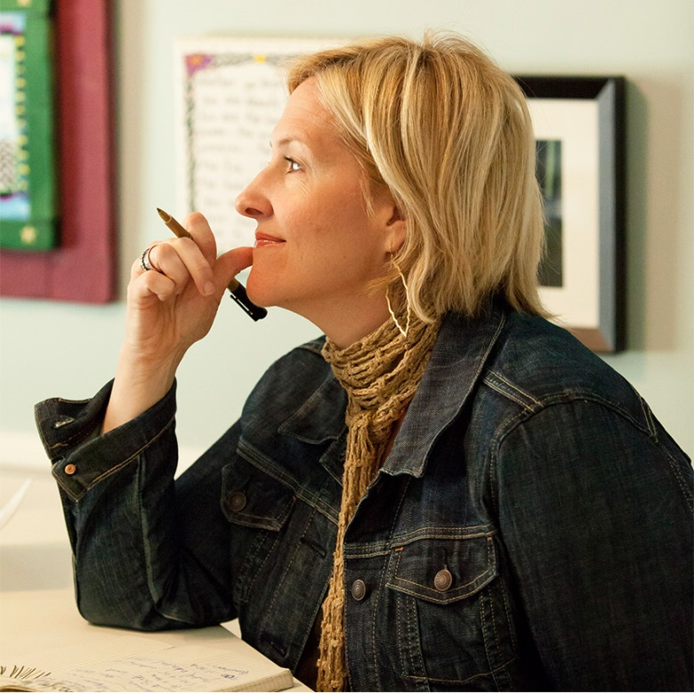
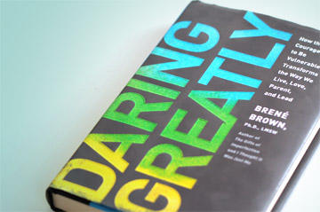
“Vulnerability is the birthplace of innovation, creativity and change.”
—Brené Brown, Listening to shame, TED.com, 2012
http://brenebrown.com/
Bandler, 2014

Slide 8
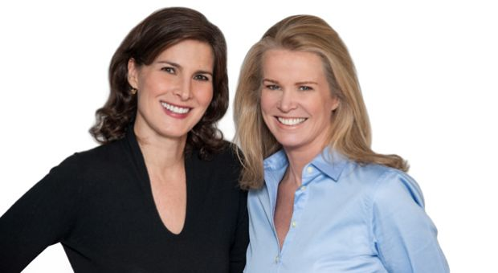
“fail fast”
—Katty Kay and Claire Shipman,
The Confidence Code, 2014, p. 138
http://thedianerehmshow.org/shows/2014-04-17/katty-kay-and-claire-shipman-confidence-code
Bandler, 2015
Notes:
Lies or xxx?

Slide 9
“flattery and praise are as lethal as sugar”
—Katty Kay and Claire Shipman,
The Confidence Code, 2014, p. 133
http://thedianerehmshow.org/shows/2014-04-17/katty-kay-and-claire-shipman-confidence-code
Bandler, 2015
Notes:
Lies or xxx?

Slide 10
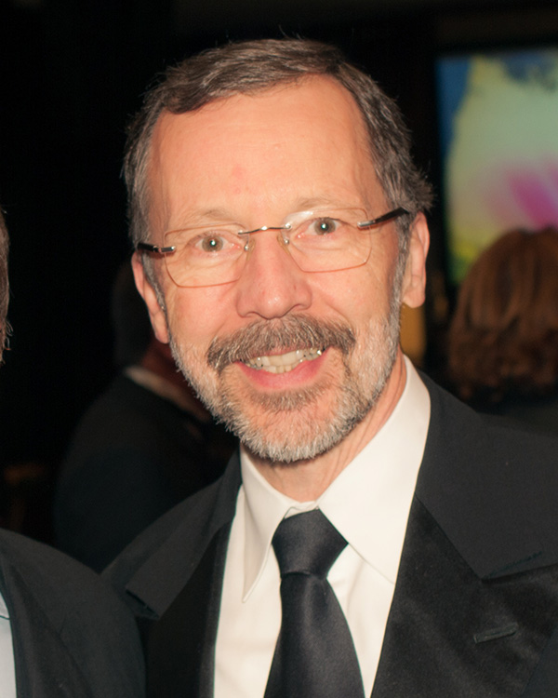
Ed Catmull, President
Walt Disney and Pixar Animation Studios
“Unleashing creativity requires that
we loosen the controls, accept risk,
trust our colleagues,
work to clear the path for them, and pay attention to anything that creates fear.”
—Creativity, Inc., 2014, p. 295.
http://en.wikipedia.org/wiki/Edwin_Catmull#mediaviewer/File:VES_Awards_89_cropped.jpg
Bandler, 2014

Slide 11
FEAR
Bandler, 2017

Slide 12
THE FEARFUL ENTREPRENEUR
Bandler, 2017

Slide 13
You And Your Budget
Are your business hotels more expensive than your vacation hotels?
Do you take taxis only on business?
Do you ever pay for a “business lunch” out of your own pocket?
Do you over-eat/over-drink on someone else’s tab?
Bandler, 2013

Slide 14
if your pocket feels no pain,
if your brain feels no risk
you may be a psychopath
you’re not an entrepreneur
Bandler, 2013

Slide 15
FEAR
Bandler, 2017

Slide 16
THE FEARFUL
EXPERT
Bandler, 2017

Slide 17
BEWARE OF EXPERTS, TEACHERS, GURUS,
AND PEERS
Bandler, 2013

Slide 18
Beware Of Experts, Teachers, Gurus, And Peers
who see no future in your creative endeavor
who nudge you back to the well-trodden path
who insist that you must be understood to be accepted
who ridicule or reject you
who say that your chance of success is nil
who wall you out with secrets
Bandler, 2013

Slide 19
Beware Of Experts, Teachers, Gurus, And Peers
who see no future in your creative endeavor
who nudge you back to the well-trodden path
who insist that you must be understood to be accepted
who ridicule or reject you
who say that your chance of success is nil
who wall you out with secrets
who cheat you with false praise
Bandler, 2013

Slide 20
FEAR
Bandler, 2017

Slide 21
THE FEARFUL
FUNDRAISER
Bandler, 2017

Slide 22
indulges in blitzkrieg spam
sidelines “poor” prospects
delivers one-sided pitches
fawns over deep pockets
suppresses the truth
Bandler, 2017

Slide 23
indulges in blitzkrieg spam
sidelines “poor” prospects
delivers one-sided pitches
fawns over deep pockets
suppresses setbacks
Bandler, 2017

Slide 24
CHANGE
Bandler, 2017

Slide 25
EXPERTS RESIST CHANGE
Bandler, 2013

Slide 26
Me Too! I Was Wrong…
…about my peers (1960s)
I thought they had my best interests at heart
…about computer engineering (1970s)
I thought we should stick with EE
…about personal computers (1980s)
I thought they were toys
Bandler, 2013

Slide 27
Beware Of “New” Ideas
Bandler, 2015

Slide 28
Beware Of “New” Ideas
that are
instantly understood
instantly acclaimed
instantly “awesome”
Bandler, 2015

Slide 29
MASTERING
SUBTEXT

Slide 30
Once Into A Persuasion Event . . .
subtext comes into play . . .
subtext:
an underlying,
often distinct theme
with traps and hidden agendas

Slide 31
US Senator George Mitchell
“The notion of poisoning
your own people, I think, is something that is repulsive to everyone.”
—George Mitchell, CNN, December 13, 2012

Slide 32
US Senator George Mitchell
“The notion of poisoning
people, I think, is something that is repulsive to everyone.”
—George Mitchell, CNN, December 13, 2012

Slide 33
US Senator George Mitchell
“The notion of poisoning
your own people, I think, is something that is repulsive to everyone.”
—George Mitchell, CNN, December 13, 2012

Slide 34
George Mitchell’s Subtext?
subtext: it is sometimes essential, I think, to poison people other than your own

Slide 35
“We Got Him”
PETER BERGEN: Did torture lead to bin Laden?
Silence.
BARACK OBAMA: You know (pause) I (pause) do not believe (pause) that torture (pause) was (pause) the key to us getting bin Laden . . . You can’t argue counterfactuals . . . What ended up being absolutely critical is hard to (pause) disentangle.”
—CNN, May 6, 2016

Slide 36
“The Aspiring Novelist
Who Became Obama’s Foreign-Policy Guru”
“Like Obama, [Ben] Rhodes is a storyteller who uses a writer’s tools to advance an agenda that is packaged as politics but is often quite personal.”
—David Samuels,
The New York Times Magazine,
May 5, 2016
http://www.nytimes.com/2016/05/08/magazine/the-aspiring-novelist-who-became-obamas-foreign-policy-guru.html?action=click&contentCollection=Opinion&module=Trending&version=Full®ion=Marginalia&pgtype=article

Slide 37
PERSUASION

Slide 38
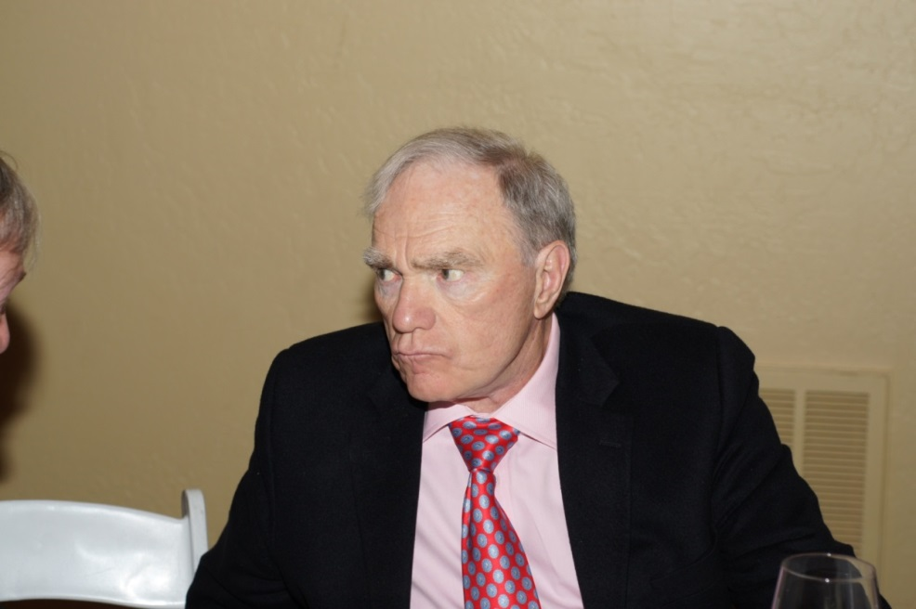
The Art Of Persuasion
“A story persuades because you have to admit both the positive and the negative.”
—Robert McKee
Photo: John Bandler

Slide 39

“Elevate” Your Work!
By Distancing Previous Work
(even your own)
for previous work:
admit the “few good” attributes list the “major bad” attributes
http://www.theguardian.com/technology/2009/sep/21/pass-notes-emoticons-email

Slide 40
“Elevate” Your Friends!
By Embracing Their Work
(even your own)
for your friends’ work:
admit the “few bad” attributes
list the “major good” attributes

Slide 41
ENHANCING YOUR AUTHORITY

Slide 42
Your Optimal Stance
if the screen is center stage
stand downstage right
in front of all barriers

Slide 43
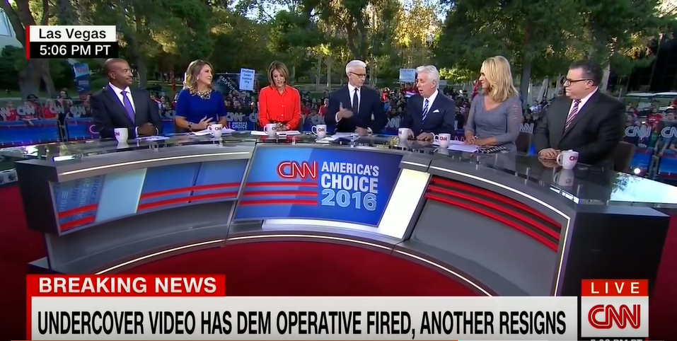
Placing TV Talking Heads
the host
the friend
the foe

Slide 44
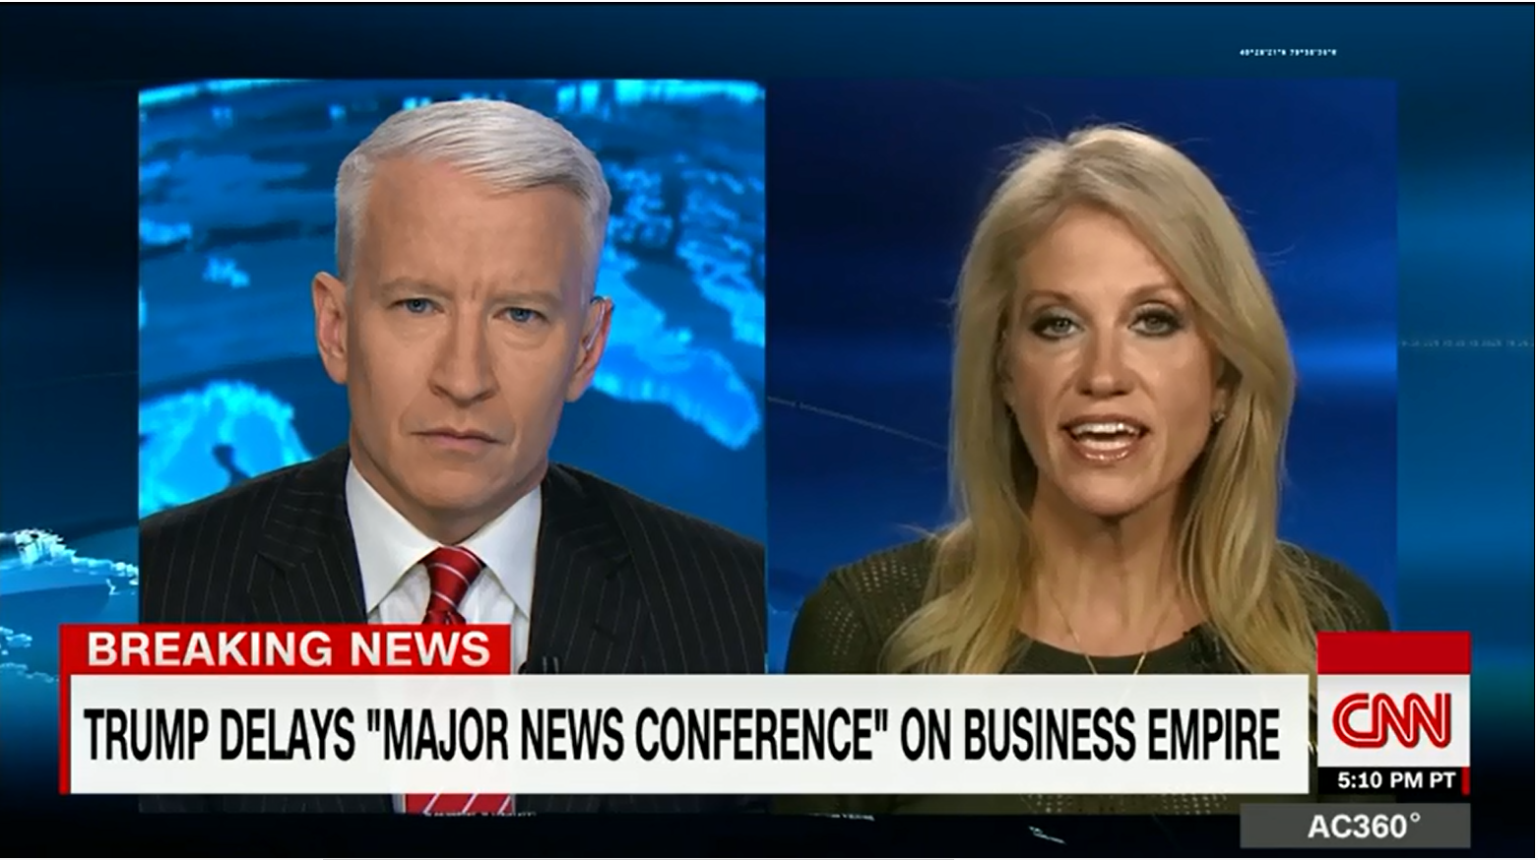
Placing TV Talking Heads
the host
the foe

Slide 45
ENHANCING ENGAGEMENT + AUTHENTICITY

Slide 46
Your Optimal Actions
walk towards the audience
engage through arms outstretched, palms up
ask the audience questions

Slide 47
SOME ARTISTIC INITIATIVES
Bandler, 2017

Slide 48
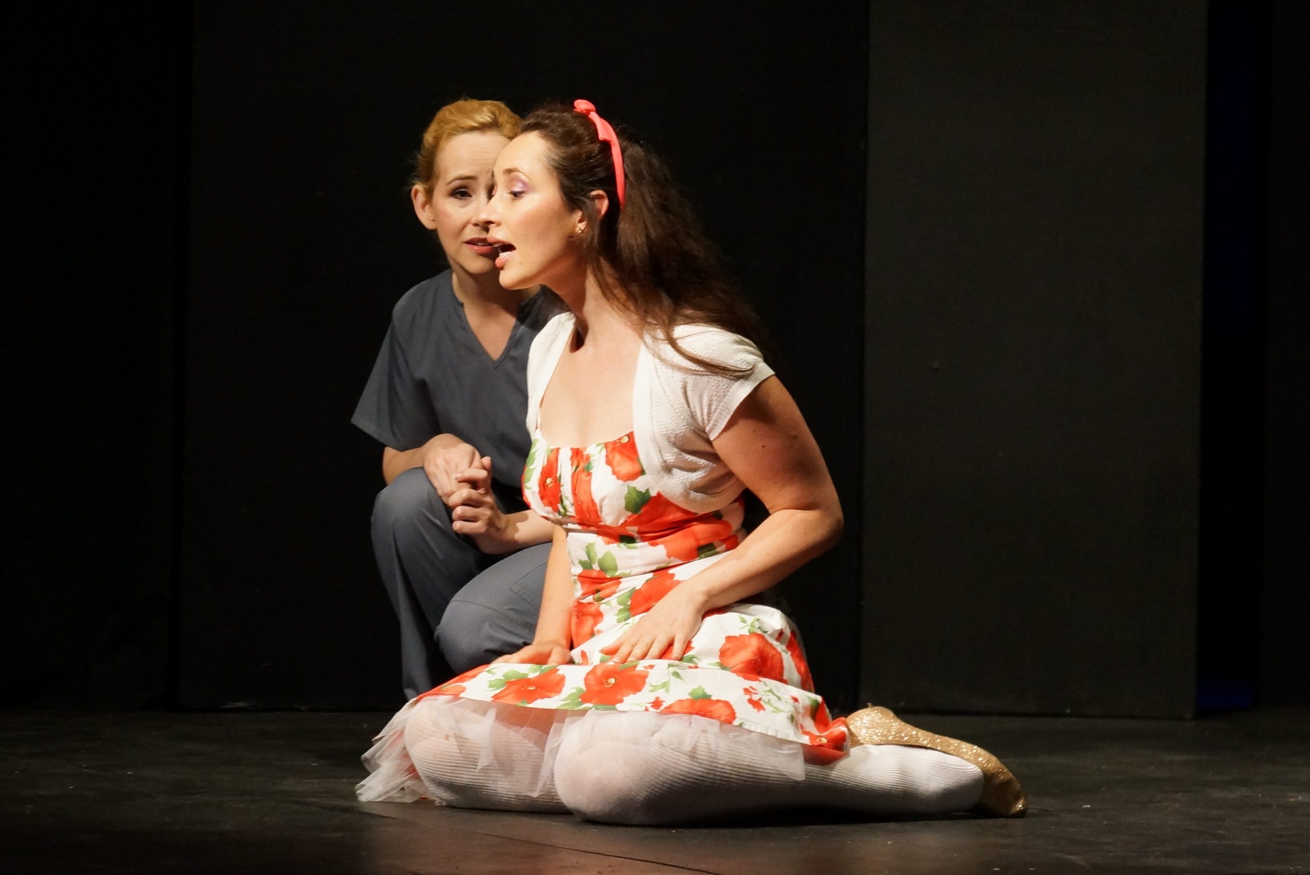
Photo: John Bandler

Slide 49

The Hamilton Fringe Festival, July 17-27, 2014, www.bandler.com/coalition
Photo: John Bandler

Slide 50
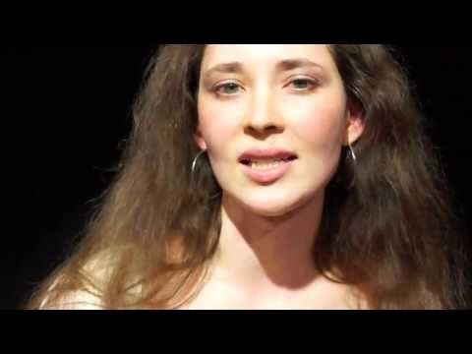
John Bandler’s Jahzara’s Triangle
pitched on YouTube by Genevieve Jack as Candy Quill

Slide 51
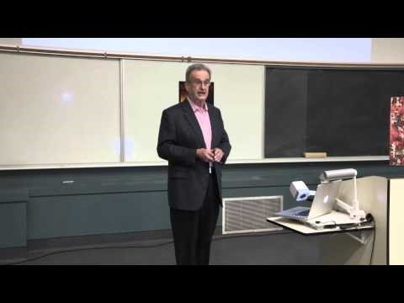
John Bandler’s “From Creativity To Success Via Risk And Setback: An Insider’s Perspective”
McMasterUTV, 2013

Slide 52

John Bandler’s
Christmas Eve
at the Julibee Motel
Directed by Tom Mackan
Aimee Kessler Evans
James Thomas
Photo: John Bandler Image Design: Paulina Rzeczkowska
The Hamilton Fringe Festival, July 14-24, 2016 www.bandler.com/julibee

Slide 53
THE THREE MINUTE PITCH

Slide 54

Welcome To
The Inaugural IMS2017
Three Minute Thesis (3MT®)
Competition
John Bandler and Erin Kiley
Honolulu, HI, Monday, June 5, 2017

Slide 55
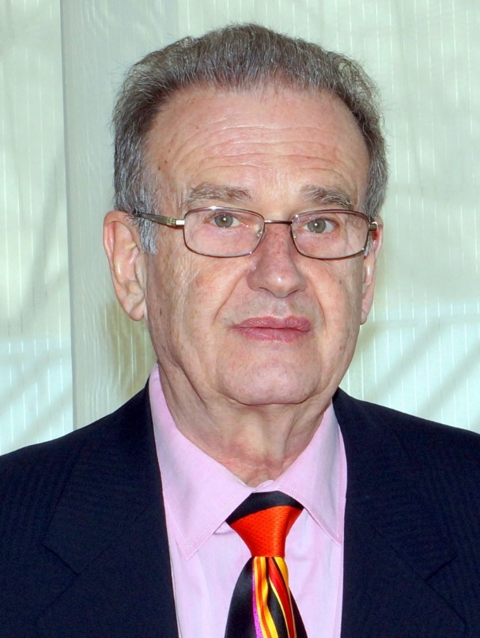
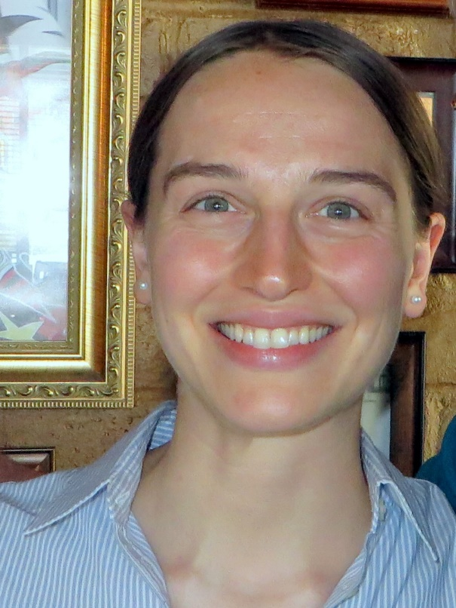
Co-Organizers/Co-Chairs
John Bandler Erin Kiley
Photo: Beth Bandler
Photo: John Bandler

Slide 56

The 3MT® Requirements
3-minute (or less) oral presentation
one static PowerPoint slide
Bandler, 2016

Slide 57
You Have 3 Minutes…
…to present years of complex research
…to kindle excitement and curiosity
…to make “them” want to hear more
Bandler and Kovacevic, 2017

Slide 58

The Inaugural IMS2017
Three Minute Thesis (3MT®)
Competition

Slide 59
Microwave Holography: The Future of Medical Imaging (TH1H)
Daniel Tajik
McMaster University

Slide 60
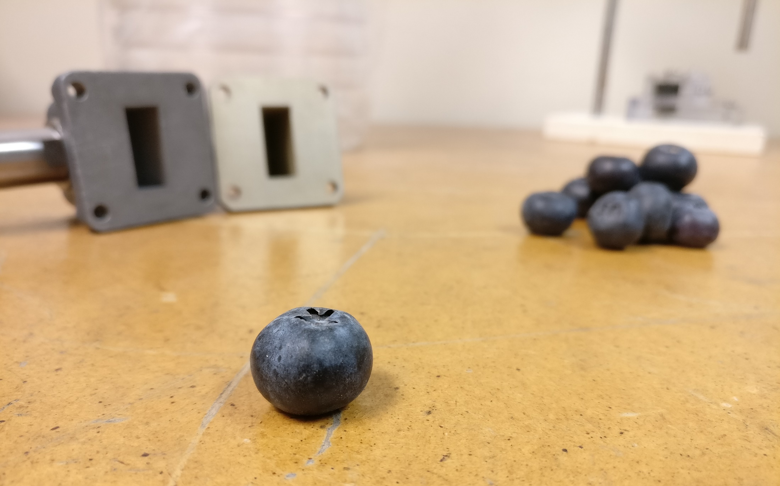
Microwave Holography:
The Future of Medical Imaging
Daniel Tajik

Slide 61
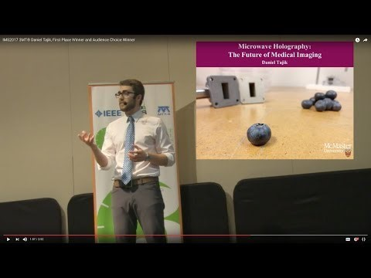
IMS2017 3MT® Daniel Tajik, First Place Winner and Audience Choice Winner, “Microwave Holography: The Future of Medical Imaging”

Slide 62
ETHICS
Bandler, 2017

Slide 63
“You’re an engineer. If your data doesn’t fit the theory,
fix the data.”
—A Lecturer
Imperial College of Science and Technology
private advice, circa 1962
Bandler, 2015

Slide 64
Fact or fiction: do you
occasionally bestow false praise?
occasionally withhold information?
often withhold acknowledgements?
copy intellectual property without license or permission—books, papers, software?
Bandler, 2015

Slide 65
Fact or fiction: do you
occasionally bestow false praise?
occasionally withhold information?
often withhold acknowledgements?
copy intellectual property without license or permission—books, papers, software?—and even boast about it?
Bandler, 2015

Slide 66
It’s not my fault.
They made me do it.
Hey, everyone does it.
Bandler, 2015

Slide 67
BREAKTHROUGH
Bandler, 2017

Slide 68
Your Breakthrough
is staring you in the face
Bandler, 2015

Slide 69
Your Breakthrough
is staring you in the face
but you don’t see it
Bandler, 2015

Slide 70


Their Breakthrough
was staring them in the face
but they didn’t
see it either
BBM
Bandler, 2015

Slide 71

An Expensive Rejection
rejects Brian Acton and Jan Koum
then
buys
for US $19,000,000,000.00
Bandler, 2015

Slide 72
FINAL WORD
Bandler, 2017

Slide 73
recognize
embrace
respect
achieve
Bandler, 2017

Slide 74
recognize fear
embrace change
respect ethics
achieve breakthrough
Bandler, 2017

Slide 75






Thanks For The Invitation
Paul Grossman
Acknowledgements
Beth Bandler, Barbara Fenesi, Farzad Foroutan, Erin Kiley, Ana Kovacevic, Daniel Tajik, John Vlachopoulos
Bandler, 2017

Slide 76
THANK YOU

