Slide 1
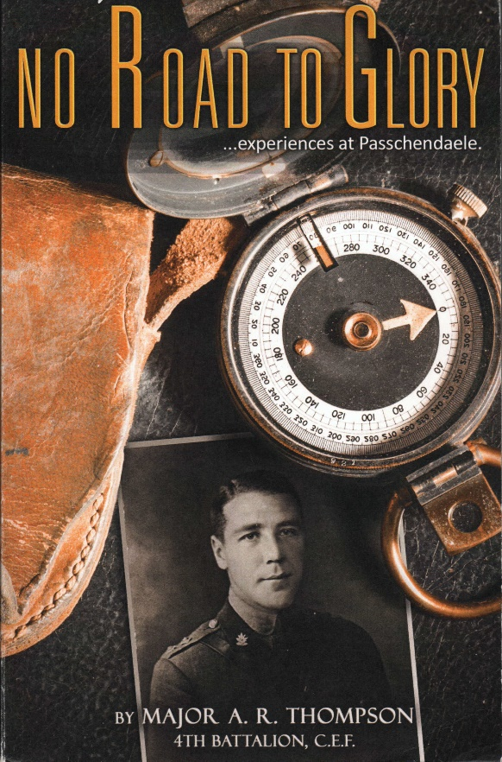
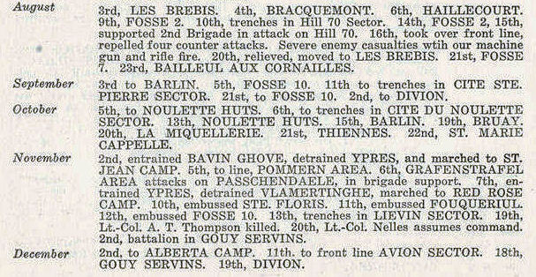

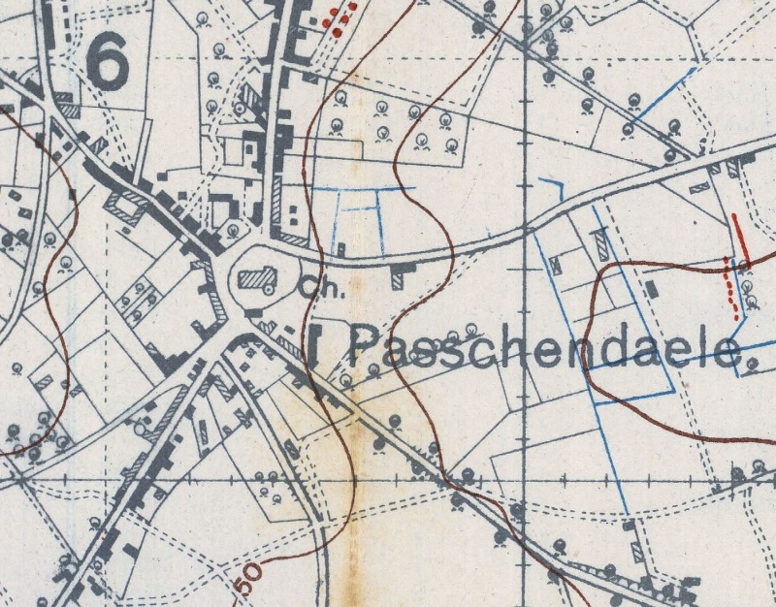
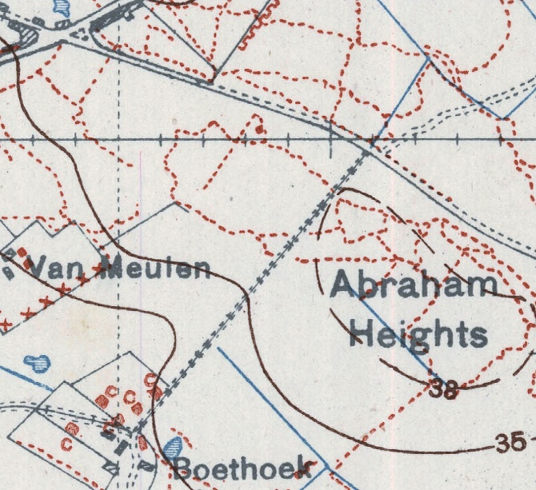

Back to the Front 100 Years Later:
Retracing the Steps of A. R. Thompson Using WWI Trench Maps
Records of the Fourth Canadian Infantry Battalion in the Great War
Gord Beck
Map Specialist
Lloyd Reeds Map Collection
Mills Memorial Library
beckg@mcmaster.ca
(905) 525-9140 ext. 24745
“Abraham Heights, a slight elevation to the right. This was to be the reserve line for the coming show and to be occupied by the 4th.” (Thompson, page 54)
Notes:
Ruthven Park National Historic Site
Presentation: November 10th, 2016
Back to the Front 100 Years Later: Retracing the Steps of A.R. Thompson Using WWI Trench Maps
Gord Beck, Map Specialist
Lloyd Reeds Map Collection
Mills Library, McMaster University
SLIDE 1: Title
Thank you for coming on this eve of Remembrance Day.

Slide 2
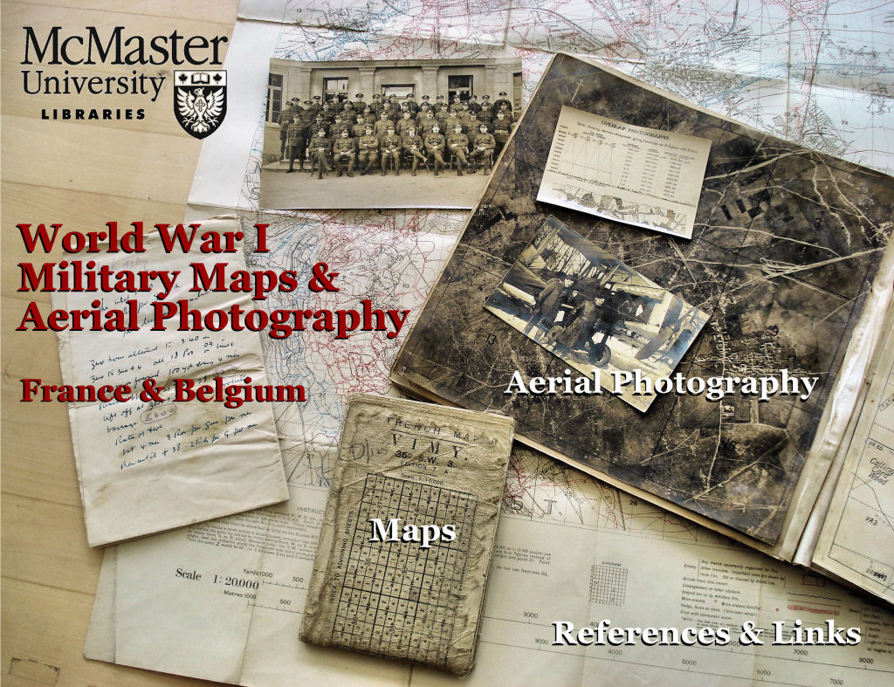
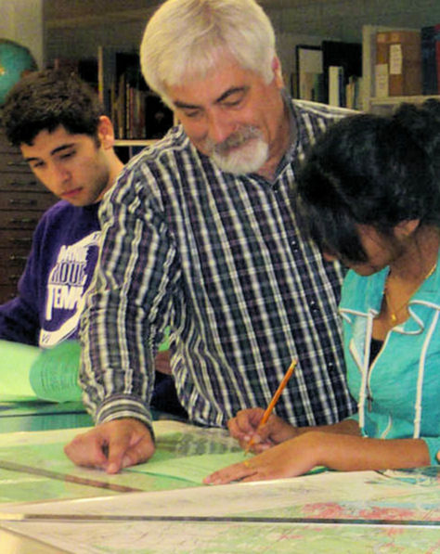

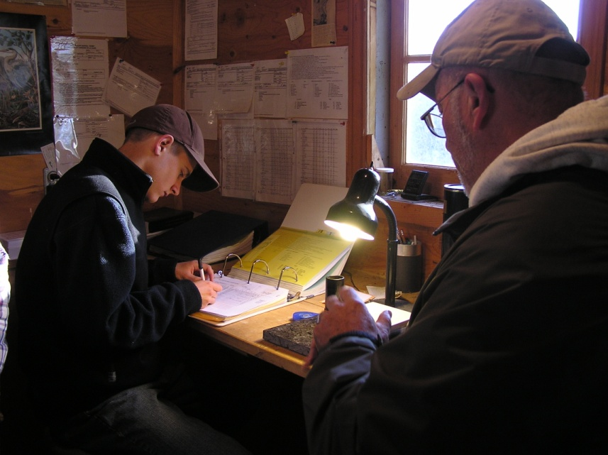

My Ruthven Connection & This Project
Sharing:
My research
My methods
Dr. Walter Peace
Mitch & Rick Ludkin
Gord, Helen & Mitch Beck
Notes:
SLIDE 2: My Ruthven Connection
My connections to Ruthven have been many over the last 12 years. It started with my son, Mitchell, bird-banding here during his high school years and working one summer in the Mansion. I also began to discover that several of my colleagues also had connections to Ruthven, like geography professor Dr. Walter Peace. My wife, Helen, and I soon began attending events and became members. At one of these events I fell into conversation with Marilynn Havelka (The Chief Administrative Officer at Ruthven), and mentioned my interest in Andrew Thompson’s military career. I commented upon the fact that McMaster had a world-renown collection of Great War trench maps and aerial photographs and that I received many requests for help in deciphering map reference numbers in order to help researchers track the movements of individuals during the Great War.
Well, this must have registered itself on Marilynn’s ‘hard drive’ because on our next visit she approached me and asked if I would consider mapping out Andrew’s war service. Now this was very well played by Marilynn as the event just happened to be an Irish whiskey tasting night and I was feeling very accommodating. I accepted and tonight I would like to share my research results with you. I would also like to share my methods so that if there are any genealogists or historians in the audience they could adopt these methods and avail themselves of the digital resources available to them on McMaster University’s website.
…oh, and by the way, this is the only bird I was ever able to net at Ruthven [Redbreast label].

Slide 3
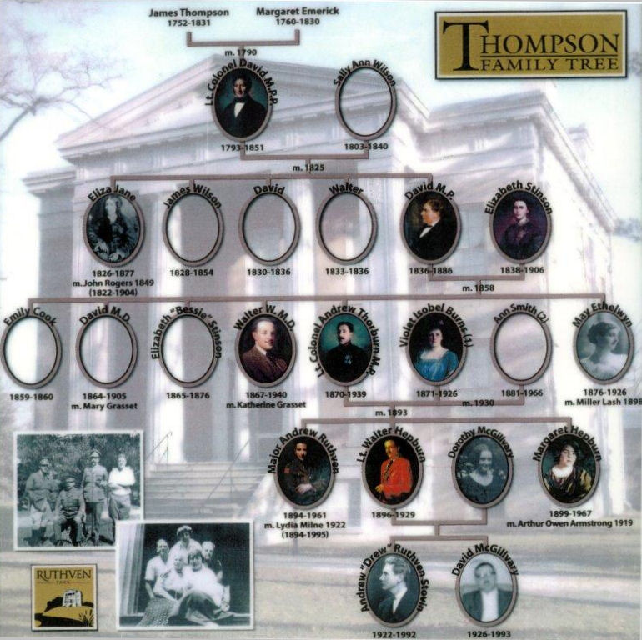
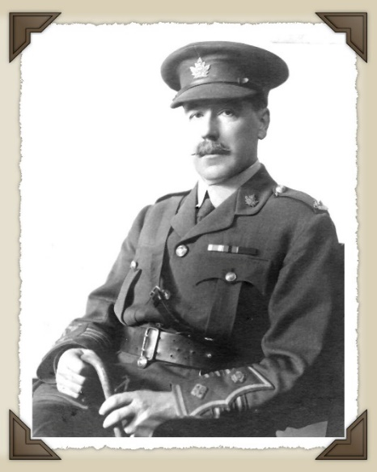
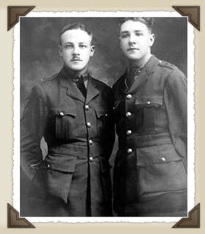
Thompson Family Tree
Thompson vs Thomson
Given Names
Nicknames & Legal
Lt. Col. Andrew Thorburn
Lt.s Walter Hepburn & Andrew Ruthven
Notes:
SLIDE 3: Thompson Family Tree
Here is the Thompson family tree. We see Andrew here on the right next to Walter, his brother, on the left. Above them we see their father, Andrew senior. Now the Thompsons were of Scottish origin so one has to wonder whether or not there was an element of thrift at play when selecting names for their children. If you look closely, every generation has a David, a Walter or an Andrew—the same names used over an over again. Think of the money you could save on stationery! You wouldn’t even have to change the initials on your luggage if it wasn’t for the middle one. And this is exactly my point, when performing research of this nature you have to be very careful about surnames and given names in order to differentiate, not only between one family and another—because there were a lot of Thomsons in the records spelled without the ‘P’—but to also differentiate between one generation and the next within one family. The key in the Thompson family is the middle name. Andrew senior who also served in WWI, but from a desk in England, can be differentiated from Andrew junior by their middle names of Thorburn and Ruthven respectively. Likewise, Andrew’s brother Walter can be distinguished from his uncle in the same way.
One further point on the topic of names, a nickname doesn’t always have to be something like ‘stinky.’ I had a grandfather who I always knew as Jack yet his legal name was John. Jack was his nickname. I also have a friend whose name is Robert but he goes by his middle name which is Tony. So, you need to be sure you know your research subject’s legal names.

Slide 4
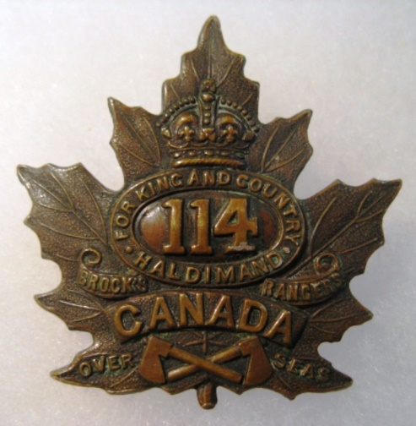

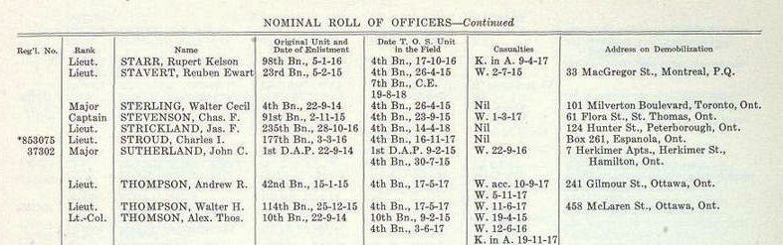

Basic Starting Information
Unit Names (RHLI) or Numbers (114th)
Reassigned Overseas:
Name or Number of Military Unit
Best: Unit in France (4th Bn., CEF)
Good: Unit in Canada (114th Bn., CEF)
Okay: Place of Enlistment (Cayuga)
Authorized Dec. 22, 1915
42nd Bn., CEF was a highland regiment recruiting out of Montreal
authorized in 1914.
Records of the Fourth Canadian Infantry Battalion in the Great War, 1914-1918 (Toronto, 1924) by Capt. W. L. Gibson, Paymaster & Historian
Notes:
SLIDE 4: Basic Starting Information
Now that we have established proper surnames and given names, we now need to determine either the name of the military unit—like the Royal Hamilton Light Infantry or the Black Watch—or the number as in our case of the 114th. The practice of the day in Canada was to create our own units in the hopes that when they reached the battlefields abroad they would remain in those same units under Canadian command. The reality, however, was that quite often the British dismantled these units and reassigned the men in them to other units. For this reason it is best to have the unit name or number they served in when overseas. In Andrew’s case we knew he was in the 4th Battalion, CEF (Canadian Expeditionary Force).
When researching this I discovered a fact which I think may be unknown to the staff at Ruthven. It has always been assumed that Andrew enlisted in the 114th because his father formed that battalion and his brother, Walter, enlisted in it. However, according to the records of the 4th Battalion which both Andrew and Walter were assigned to upon arriving in France, Andrew actually originally enlisted in the 42nd Battalion, a highland regiment recruiting out of Montreal. The reason for this is that the 114th did not receive official authorization to form until December 22, 1915—just three days before Walter enlisted on Christmas day. Andrew, however, enlisted in the Canadian army almost twelve months earlier before the 114th came into being necessitating him to join a different unit on January 15, 1915.

Slide 5
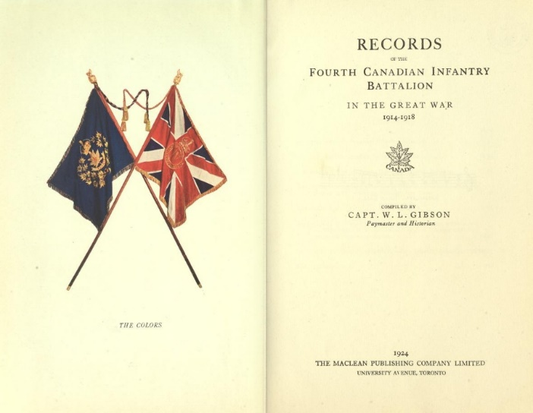
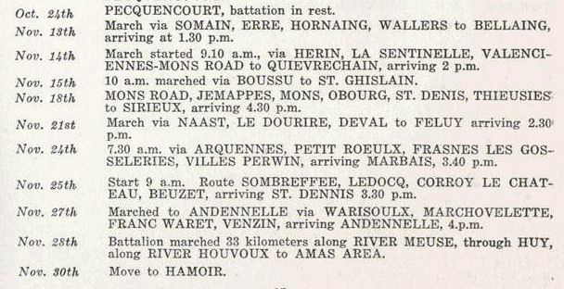
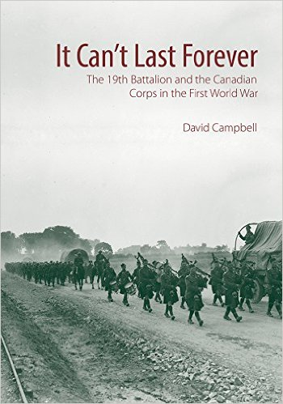
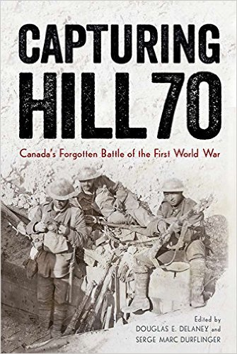
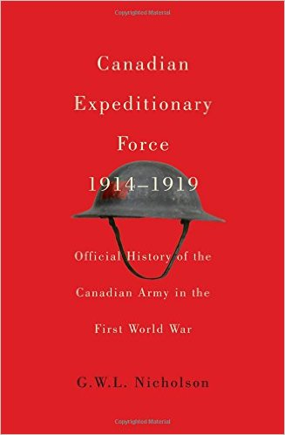

Military Histories
War Diaries, Official, Unit, and Battle Histories
War Diaries:
From the start of the First World War, Canadian Expeditionary Force (CEF) units were required to maintain a daily account of their "Actions in the Field." This log was called a War Diary. Infantry diaries were recorded by battalions, which consisted of approximately 1,000 men.
Unit Histories:
Capt. W. L. Gibson, Paymaster and Historian
Battle Histories:
Official Histories:
Personal Memoirs:
Argyll & Sutherland Highlanders
(expected May 2017)
Notes:
SLIDE 5: Military Unit Official Histories
Now that we know the unit name or number we need to find records of their movements and actions. Of course there is the official history of the Canadian Army in WWI which gives you a very good overview of the war and includes a lot of very good maps of the most important battles but it won’t get into a lot of detail about any one particular unit and won’t mention what they were doing in between battles. Likewise, battle histories will give you a lot of information about a particular battle and the part played by each unit but that is the extent of it. ‘Regimental’ or ‘Unit’ histories are a great resource as they focus on the history of just one unit but they could cover the unit’s entire history over centuries, not just one war, and therefore do not necessarily give you a day-by-day account of their activities during WWI.
The best resources are personal papers or memoirs, if they exist, and something called a ‘war diary.’ [read section under war diary on slide] I was lucky enough to find a copy of such a diary for the 4th Battalion digitized and freely available online. It was put together by Captain W. L. Gibson the Paymaster and Historian for the 4th and gives you a day-by-day account of where the unit was and whether or not they were at rest, on the march, or involved in an action. It was Andrew’s memoirs and this war diary that I relied on for most of my research.

Slide 6
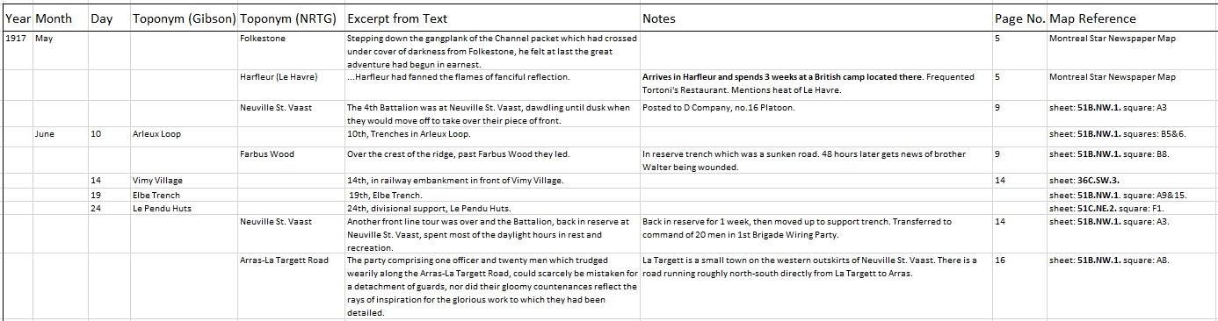
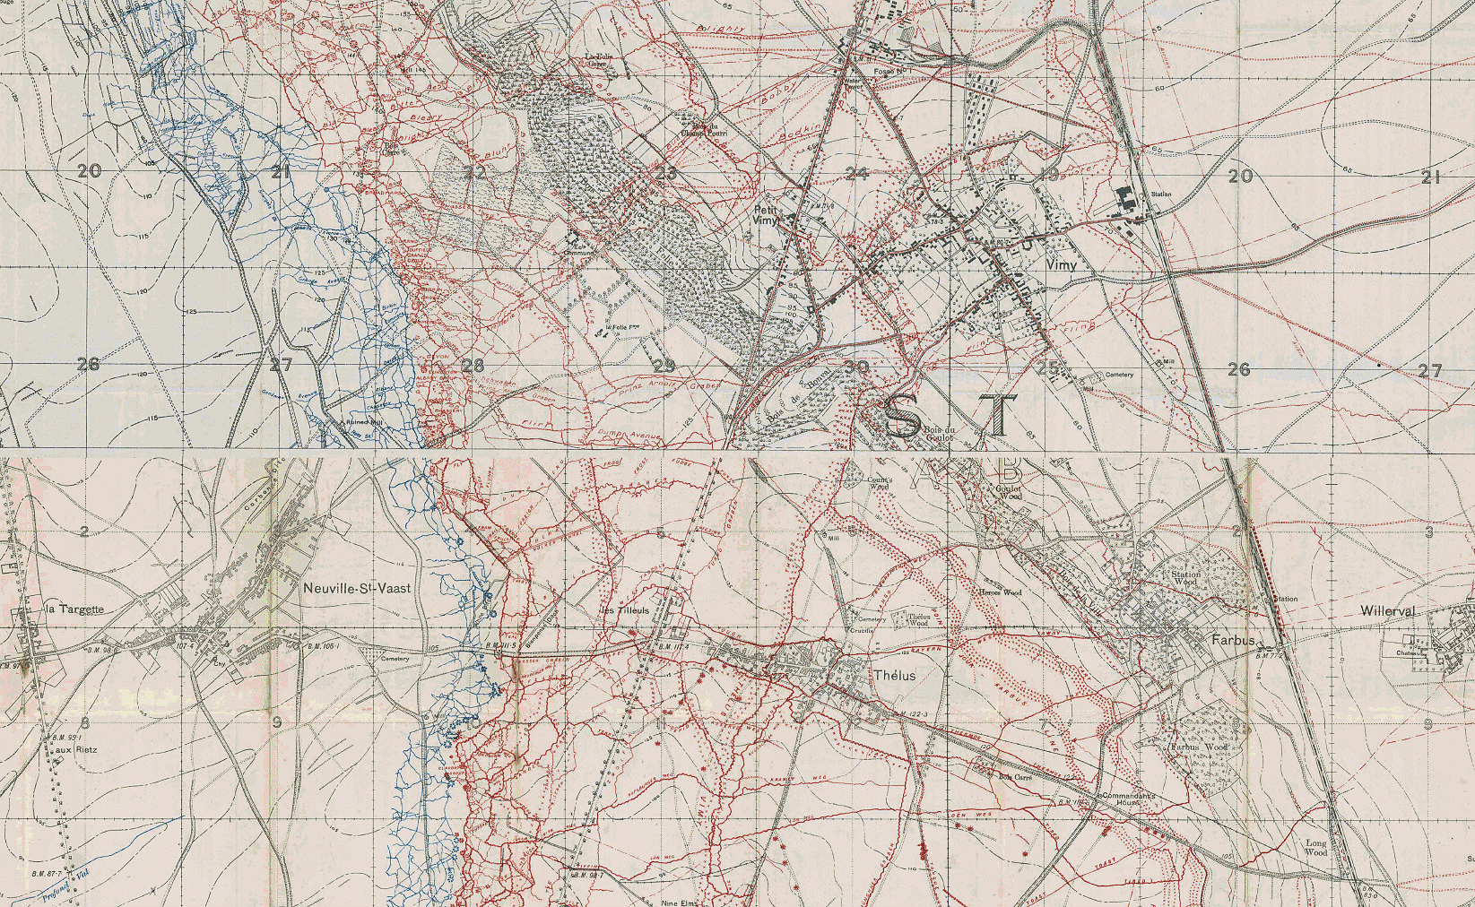
Organizing Your Search
Year-Month-Day-Toponyms-Excerpt-Notes-Page-Map Reference
1
2
1
2
Notes:
SLIDE 6: Organizing Your Search
Now before I started to read any of these materials I created a spreadsheet to capture all the necessary information. I started off with separate columns for the year, month and day. Then I created 2 separate columns, one for the war diary and one for Andrew’s memoirs in order to capture the occurrence of any toponyms in the text. A toponym is simply a place name, either a populated place like a town or village or a physical feature like a river or hill. Next I created a column to add any additional notes about my findings for my own benefit. This is followed by a column recording the page number on which I found the toponym so I could always go back to the text for more information. The next column contains what I determined to be the proper map reference number needed to find the place on a WWI map. And the final column contains a link to view the map online in high resolution on McMaster’s website. I did not include it here as I felt it was unnecessary for this presentation and it made the table too wide for the slide. [demonstrate example of Neuville St. Vaast]

Slide 7
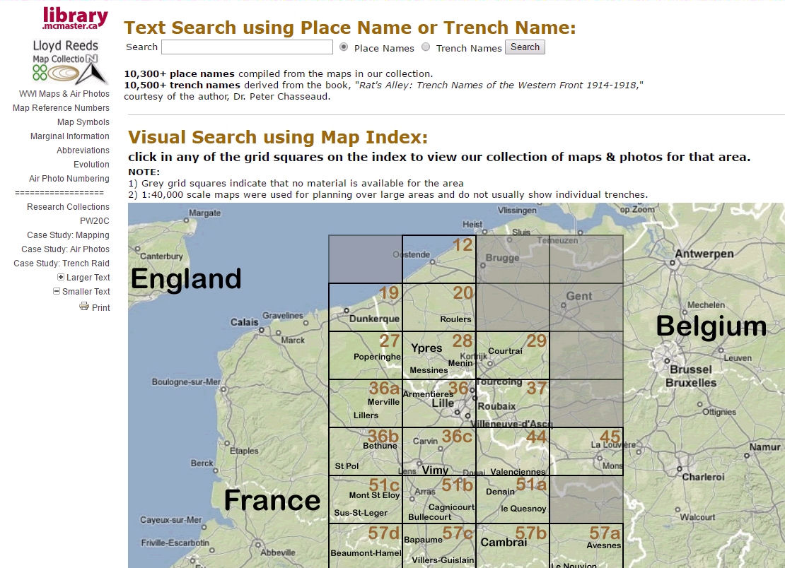
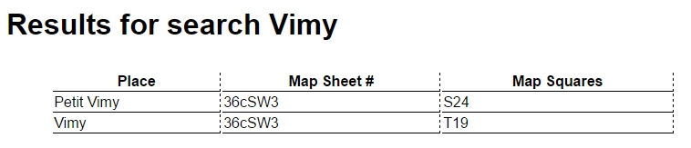
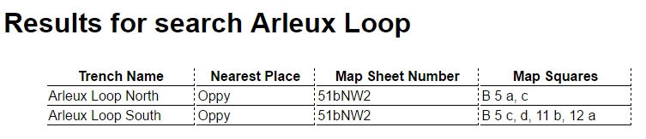
Website Search
Finding Maps of the Area
Arleux Loop
Vimy
Notes:
SLIDE 7: Website Search
How did I find the map reference number you may ask? Well it’s simple. If you go online to library.mcmaster.ca/maps and click on the link to ‘historical maps,’ you will find our WWI website. On the index page there is a search box where you can type in a place name or trench name and it will produce a table of results giving you the map reference number. For example, I could type in the word ‘Vimy’ and click the radio button next to place names and then hit the search button and I would be presented with these results. Likewise, I could click the radio button for trench names and type Arleux Loop into the search box and then hit the search button and I would be presented with these results. We have over 10,000 place names and another 10,000 trench names in this database.

Slide 8
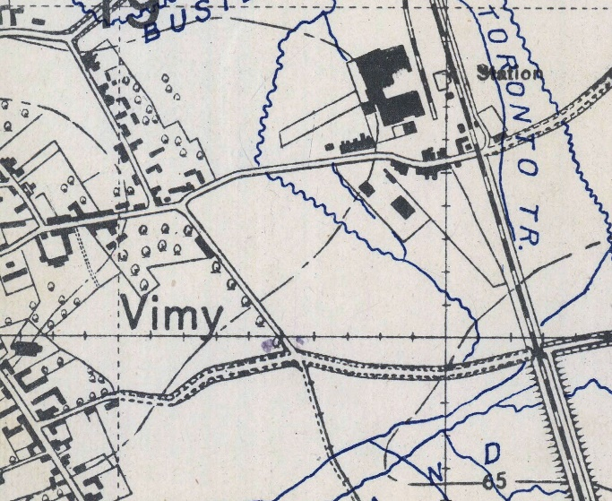

Spelling of Toponyms
TRENCH MAP
Gauchin Legal
Madoc
Haillicourt
Ste. Marie Cappel
le Mt. des Cats
Bavinchove
Wieltje
Gravenstafel
Wimereux
4th Bn. WAR DIARY
Gauchin Le Gal
Haillecourt
Ste. Marie Cappelle
Bavin Ghove
Wiltje
Grafenstrafel
ANDREW’S MEMOIR
Maroc
Marie Qu’Appelle
Monte de Cat
Gravenstaefel
Wimerow
Notes:
SLIDE 8: Spelling of Toponyms
Now here are some of the pitfalls you may encounter. Pronouncing French and Belgian names were hard enough for the average Canadian Soldier, let alone having to spell them. On the left, I have the names as they appear on the official war maps. In the middle I have the spelling that was used in the war diary and, on the right, I have how they appeared in Andrew’s memoirs. In order to get any search results on our website you must enter the name with the spelling that matches the toponym on the trench map. Here are two examples where all three resources spelled the same name differently.

Slide 9

Humorous Corruptions
Translations from ‘Trench Talk’
parlay-view on-glaze?
TRENCH MAP
Ypres
Etaples
Auchonvillers
Wytschaete
Ploegsteert
Houplines
Mouquet Farm
Albert
BRITISH ‘TOMMY’
Wipers
Eat-ables, Eat-apples
Ocean Villas
White Sheet
Plug Street
Hoop Lane
Moo Cow Farm
Bert
The Humble British ‘Tommy’
Notes:
SLIDE 9: Humours Corruptions
In addition to misspellings we could encounter playful corruptions of French names like those displayed here.

Slide 10
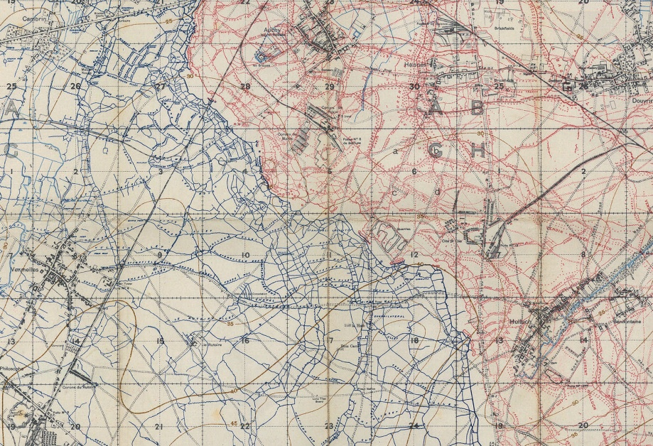
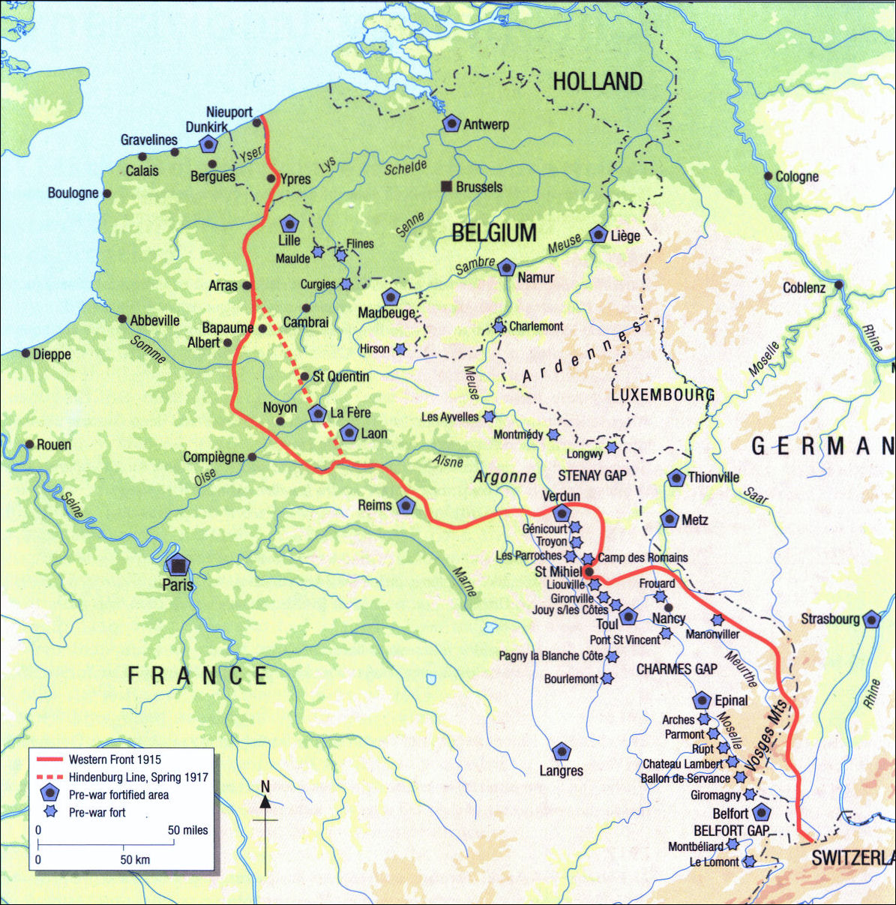
WWI Trench Geography
765 km of trench network from the English Channel through Belgium, France and Germany to the border of Switzerland.
British (northern portion of the line)
Over 40,000 km of zig-zagging trenches,
not a single line of opposing trenches...
Germans
no man’s land
Allies
French & U.S. (southern portion of the line)
Notes:
SLIDE 10: WWI Trench Geography
The last thing you need to know before we embark on Andrew’s journey is a little bit about trench geography.
First, many of you are probably unaware of the colossal scope of the trench networks of both opposing armies which stretched 475 miles (765 km) from the English Channel in the north all the way to the Swiss border in the south. I say ‘trench networks’ because the trenches were not simply two, long opposing lines but—as this trench map image in the upper corner of the slide shows—spread out in a spider web network consisting of 25,000 miles (40,233 km) of zig-zagging trenches stretching back to towns and supply roads and railways. Remember, we have over 10,000 trench names in the gazetteer on our WWI website and this, by no means, is complete. Britain and her commonwealth forces covered that portion of the front roughly equivalent to the area indicated by this black rectangle while France and, and later the U.S.A., covered the southern portion.
[mileage stats taken from: Larabee, Mark Douglas. Front Lines of Modernism: Remapping the Great War in British Fiction. New York: Palgrave Macmillan, 2011.]

Slide 11
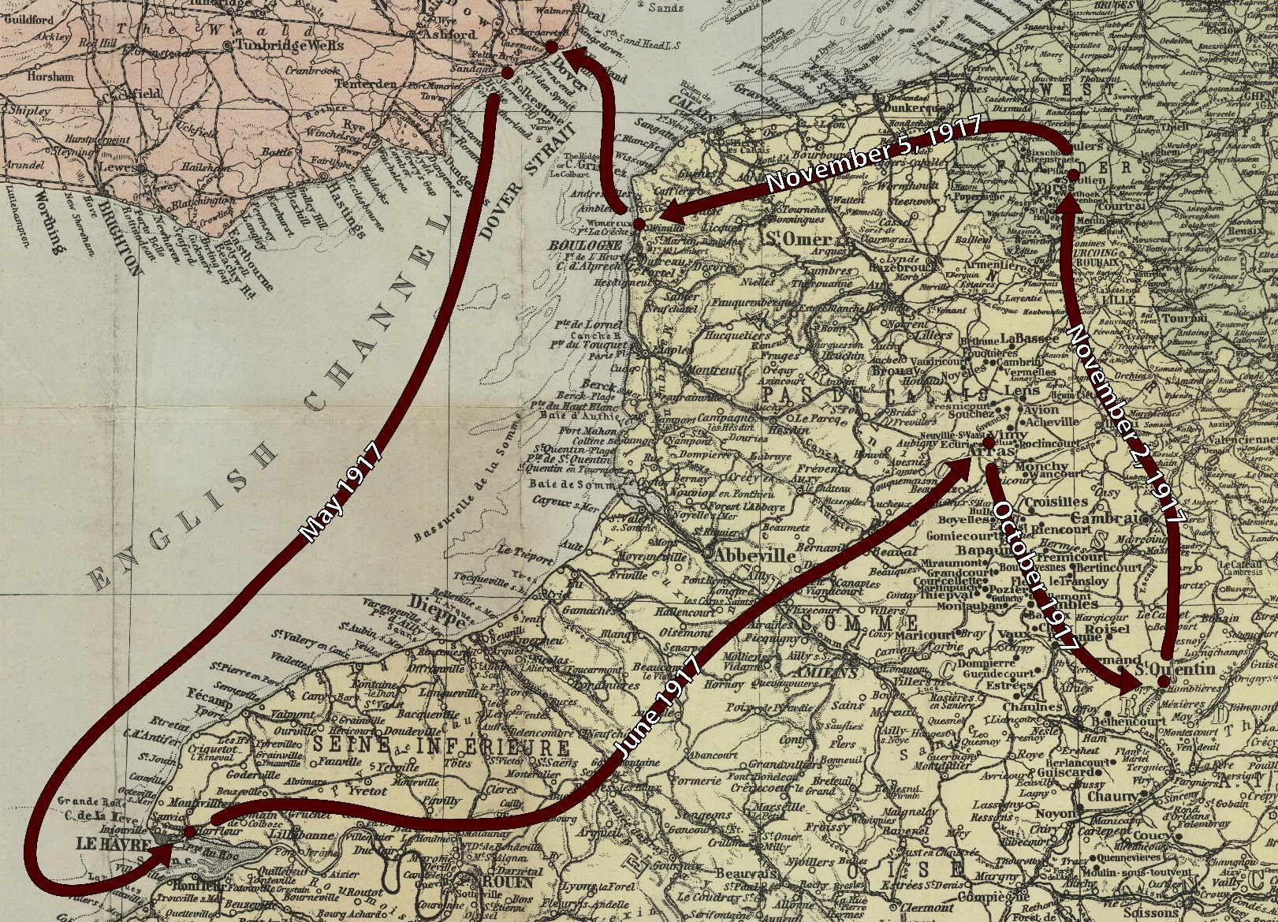
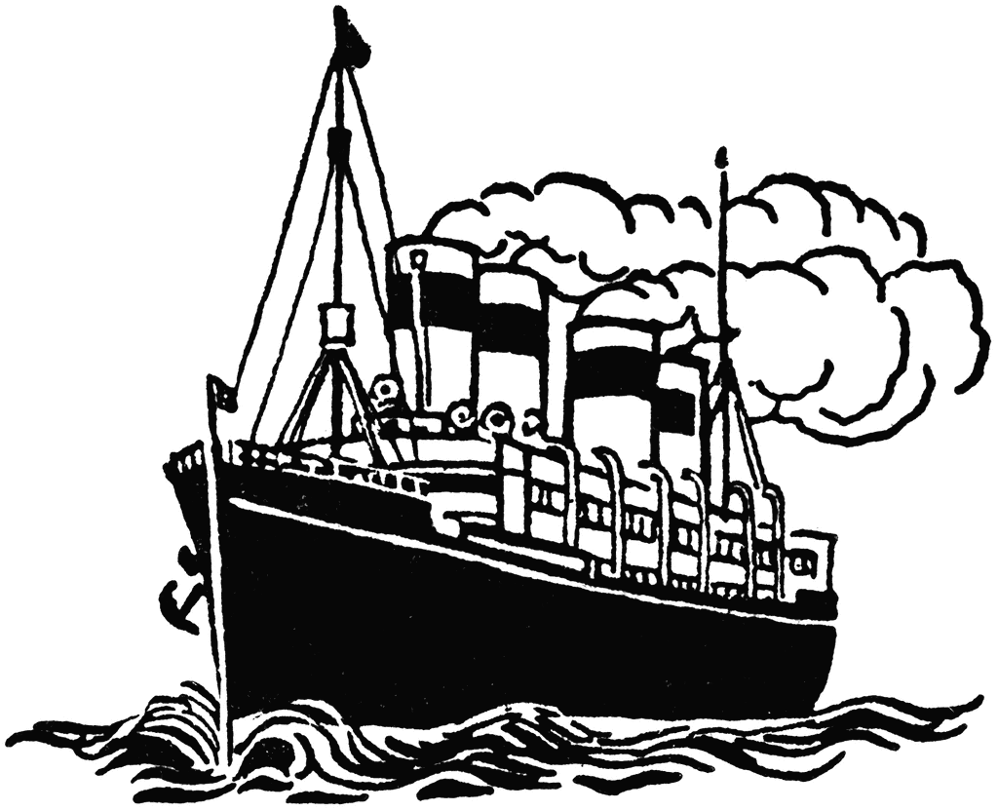
http://digitalarchive.mcmaster.ca/islandora/object/macrepo%3A76369
April - May 1917
NOTE:
Montreal Star map
Overall route
Copy on display
England
Belgium
The Journey Begins
France
Embarks from Folkestone, England sometime in late April or Early May
Disembarks at Harfleur, France just east of Le Havre
Spends 3 weeks in a British camp nearby
Frequents a restaurant called Tortoni’s
May 17, 1917 both Andrew and Walter reorganized into 4th Battalion
Notes:
SLIDE 11: The Journey Begins
For his travels outside the trenches I have made use of a map produced in 1918 by the Montreal Star newspaper. I have annotated it with his overall route and we have a reproduction copy of the map in its entirety here on display tonight so, feel free to have a better look at it after the presentation. [read bullet point itinerary]

Slide 12



http://digitalarchive.mcmaster.ca/islandora/object/macrepo%3A76369
June 9, 1917:
Arrival at the Front
(Neuville St. Vaast)
England
Belgium
Arrival at the Front
France
Issued orders to join the 4th Battalion near the front at Neuville-St.-Vaast
Travels by train, then 10 km by truck then 8 km by “shanks’ mare”
Posted to ‘D’ Company, no. 16 Platoon on arrival
Notes:
SLIDE 12: Arrival at the Front
[read bullet point itinerary]

Slide 13
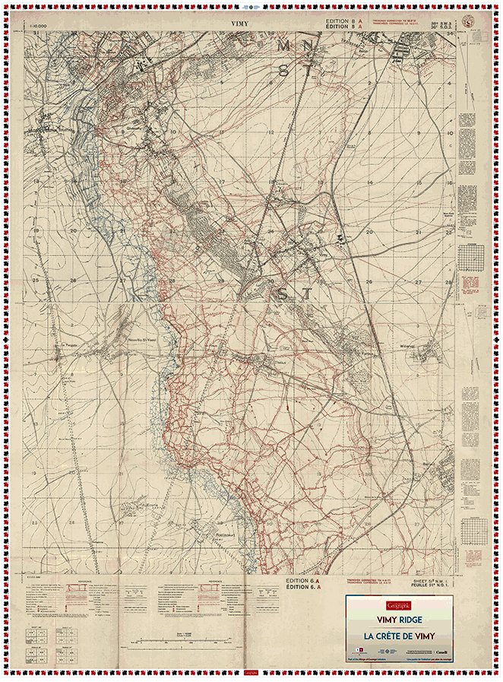
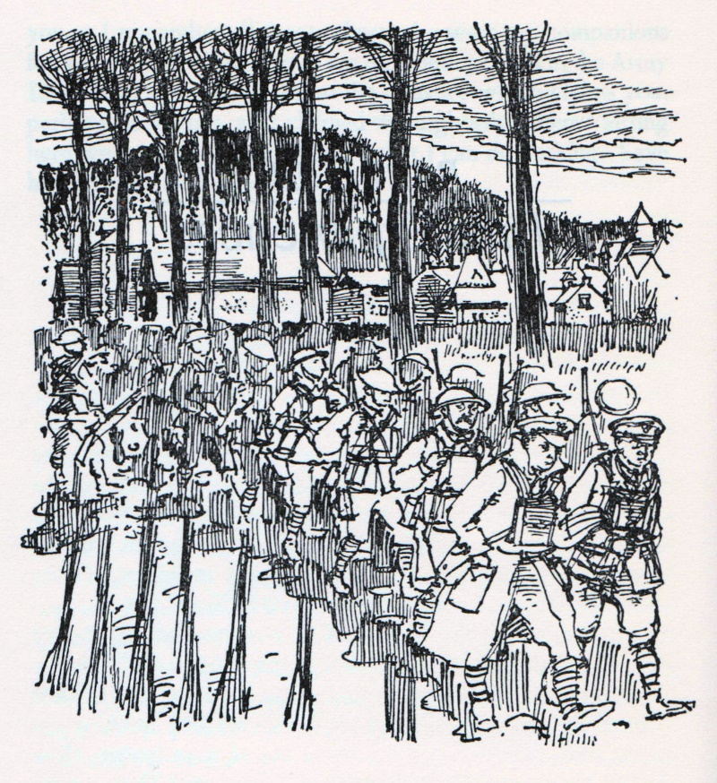
Vimy Ridge
2 Months Before & After
Situation before Battle of April 9-12, 1917
NOTE:
Date of map
Colour of trenches
Extent of trenches
Region travelled by Andrew
Notes:
SLIDE 13: Vimy Ridge
This is a giant floor map of Vimy Ridge created for use in schools by the educational branch of Canadian Geographic Magazine. We recently collaborated with them on this project as they used our trench maps to produce this one. I am using it in this presentation because, normally to cover the entire ridge would mean having to piece a number of maps together. In this way you can see the whole area even if the detail has been drastically shrunk down. The area within the red rectangle all but encompasses Andrew’s travels in this sector. Neuville St. Vaast where he first checks in with his unit can be seen facing the ridge here. The village of Vimy can be seen on the opposite side of the ridge here. All these red lines on top of the ridge are German trenches. These blue lines, much fewer than the red, running along the foot of the ridge are the British trenches. This represents the situation before the battle of Vimy Ridge which occurred in April, two months before Andrew’s arrival. By the time Andrew crossed this ridge, all these trenches would have now appeared as blue on British maps.

Slide 14

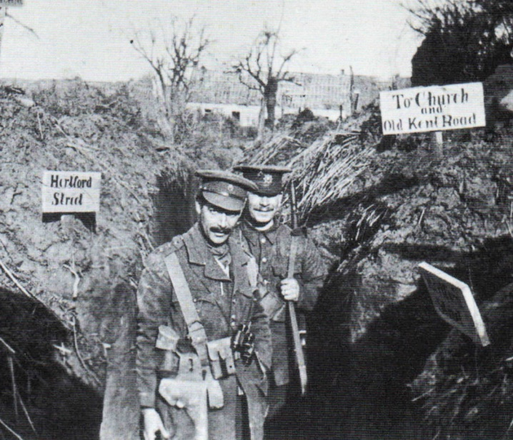
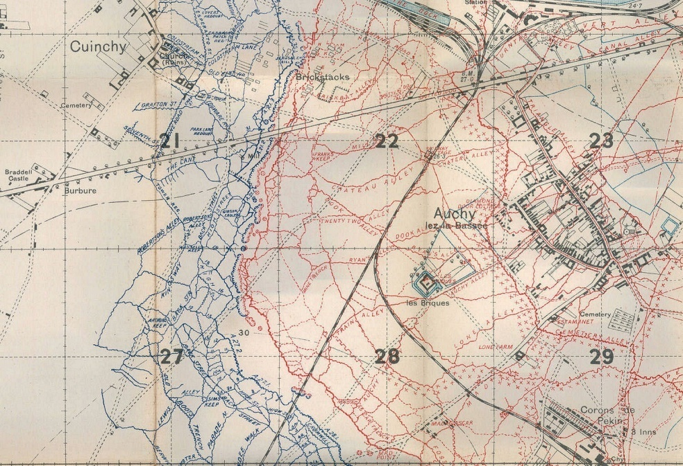
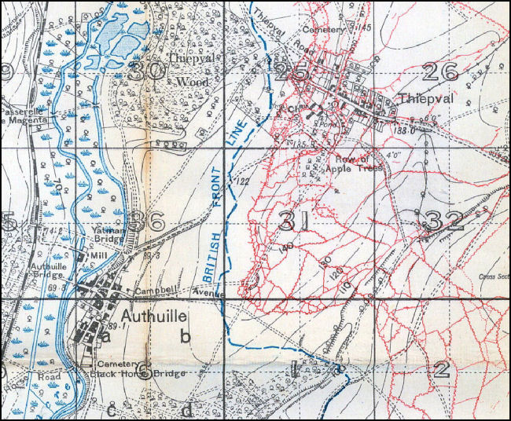
Early & Late War Maps
Seeing is not Believing
Exception:
‘SECRET’
editions
All Trenches (1918)
First 200 Yards Only (1916)
Front Line Only (1914-15)
Notes:
SLIDE 14: Early & Late War Maps
Now you may have wondered why on the previous map there seemed to be so many fewer blue trenches than red. That is because in the early days of the war from 1914 until sometime in 1916 British trenches only showed the front line in case they fell into enemy hands. The only exception to this rule was a very limited number of maps printed for the top brass and kept at General Headquarters marked as ‘secret.’ However, as many of their own men became lost in their own trench networks taking days to return to their unit, they began to loosen security surrounding maps and permitted the first 200 yards of trenches to be shown. This, unfortunately was still not good enough to prevent men getting lost in the rear trench areas and so they started to create their own maps for finding their way around. These often unintentionally including more classified information than just trenches for orientation and were therefore much more dangerous had they fallen into enemy hands than a map of the trench network so, it was decided in 1918 to finally show all trenches on standard trench maps since it was evident by this time that they could be seen in aerial photographs anyway.
So, what all this means to your research is that sometimes you have to use a map from 1918 to find a trench that existed in 1917 but does not appear on a 1917 map.

Slide 15
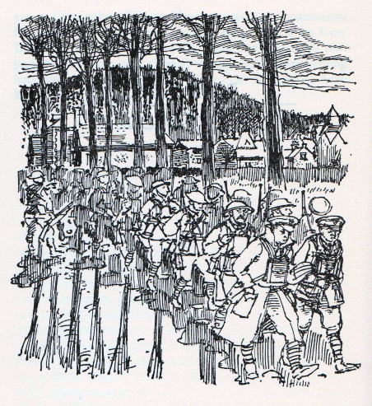
Andrew Goes Over the Ridge
…And Walks off the Map
NOTE:
British trenches blue
German trenches red
June 9 (night) – June 10 (early morning)
walk by night over the ridge past Farbus Wood
Notes:
SLIDE 15: Andrew Goes Over the Ridge
On the evening of June 9th Andrew sets out on a night march with his destination to be the trenches around the village of Arleux. We see his starting point of Neuville St. Vaast…he mentions passing Farbus Wood…and he passes the village of Willerval. Arleux is just a couple of kilometres east so, at this point, he takes a walk off the map so-to-speak.

Slide 16
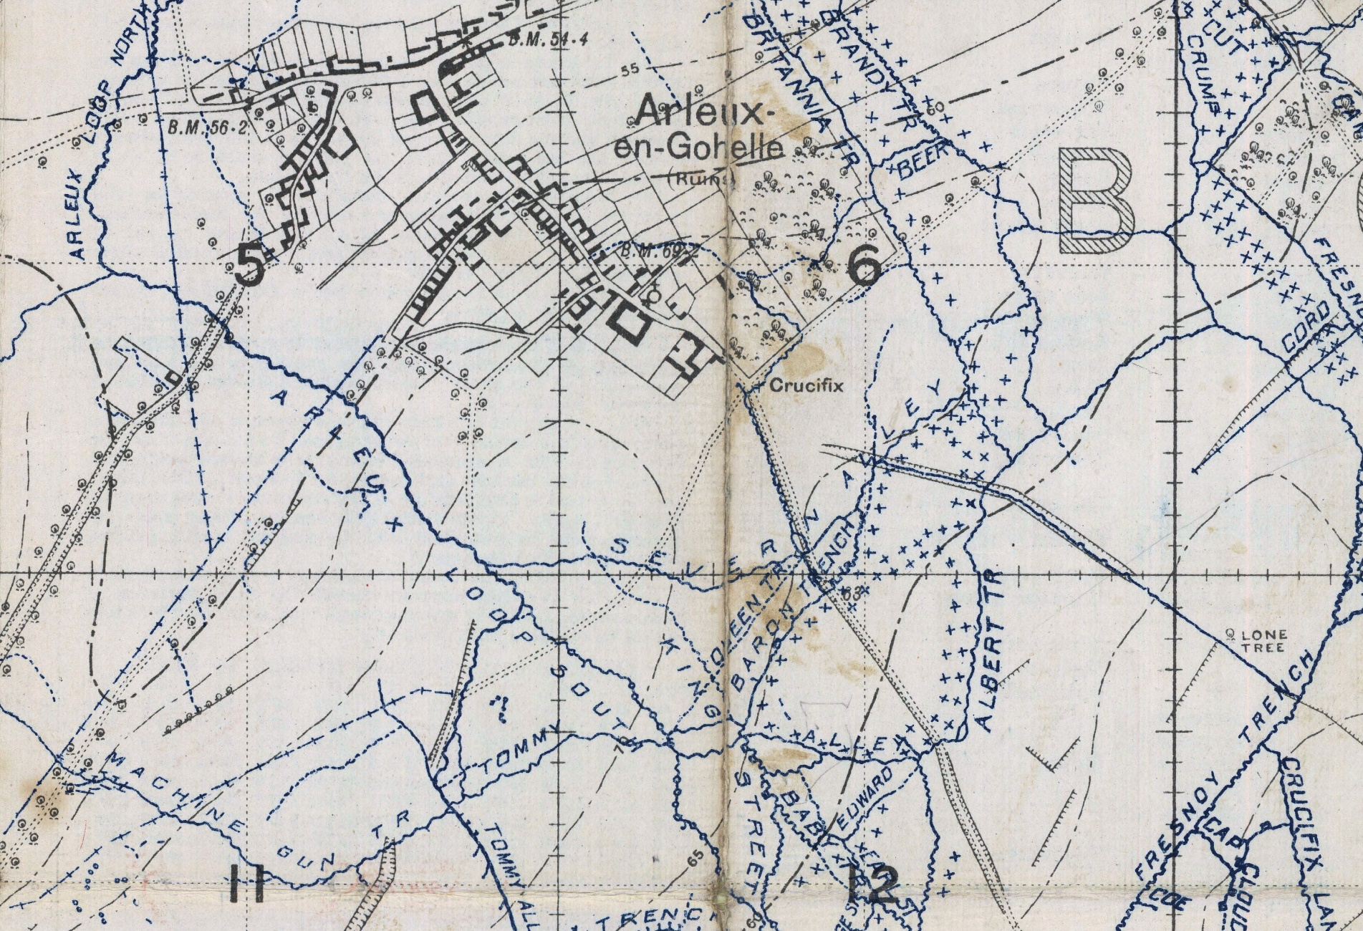
June 10, 1917:
Enter Arleux Loop
Relieve troops in reserve trench in sunken road in ‘Arleux Loop’
Germans notice the activity and shell the area while relief taking place
Notes:
SLIDE 16: Entering the Arleux Loop
On June 10th Andrew enters a reserve trench which he says is in a sunken road in the loop of trenches surrounding Arleux. Here we see a trench labelled Arleux Loop North, and one labelled Arleux Loop South, and here we see two roads which are indicated as sunken by the little pointy lines jutting out from their sides so, one of these two would be my best guess as to the location.

Slide 17
A visit from the ‘Batman’
A Shot in the Dark
“I felt awful sorry for him hanging wounded on that bloody wire with death whizzing past his ears a hundred times or so.”
June 11, 1917:
Walter is wounded in the arm while providing cover for a wiring party
June 12, 1917:
Andrew learns of Walter’s wound.
Gibson, W.L. Records of the Fourth Canadian Infantry Battalion in the Great War, 1914-1918 (Toronto, 1924).
Notes:
SLIDE 17: A Visit from the ‘Batman’
Now Andrew has been at the front no more than 48 hours when he receives a visit from his brother Walter’s batman. For those who are not familiar with the term, a batman is a low-ranking soldier who has been assigned to an officer to act as his servant. He shines his boots and tunic buttons and makes him tea but he is also required to fight when necessary. Well, Walter’s batman was here to deliver the message that Walter had been shot while providing cover for a wiring party. A wiring party was a group of soldiers assigned the task of stringing and repairing barbed wire in no-man’s land between the trenches at night during the cover of darkness. It required the ability to work very quietly and to freeze instantly should a flare be lit or a light be shone in their direction. Unfortunately, many of the men in the party were green recruits and when the order was given that the work was done and that they should make their way back to their own lines, instead of returning stealthily, they instead simply got up and ran making a racket which attracted the attention of the Germans who opened fire on their position necessitating Walter and his batman to run to. Walter was unlucky and ran straight into some wire and got stuck. He tried to crawl through but his tunic got hung up and it was only by chance that a random bullet happened to cut the wire he was stuck on, freeing him and allowing him to make it back to safety, although wounded. So, Walter’s service was very short-lived and that was the end of the war for him.

Slide 18

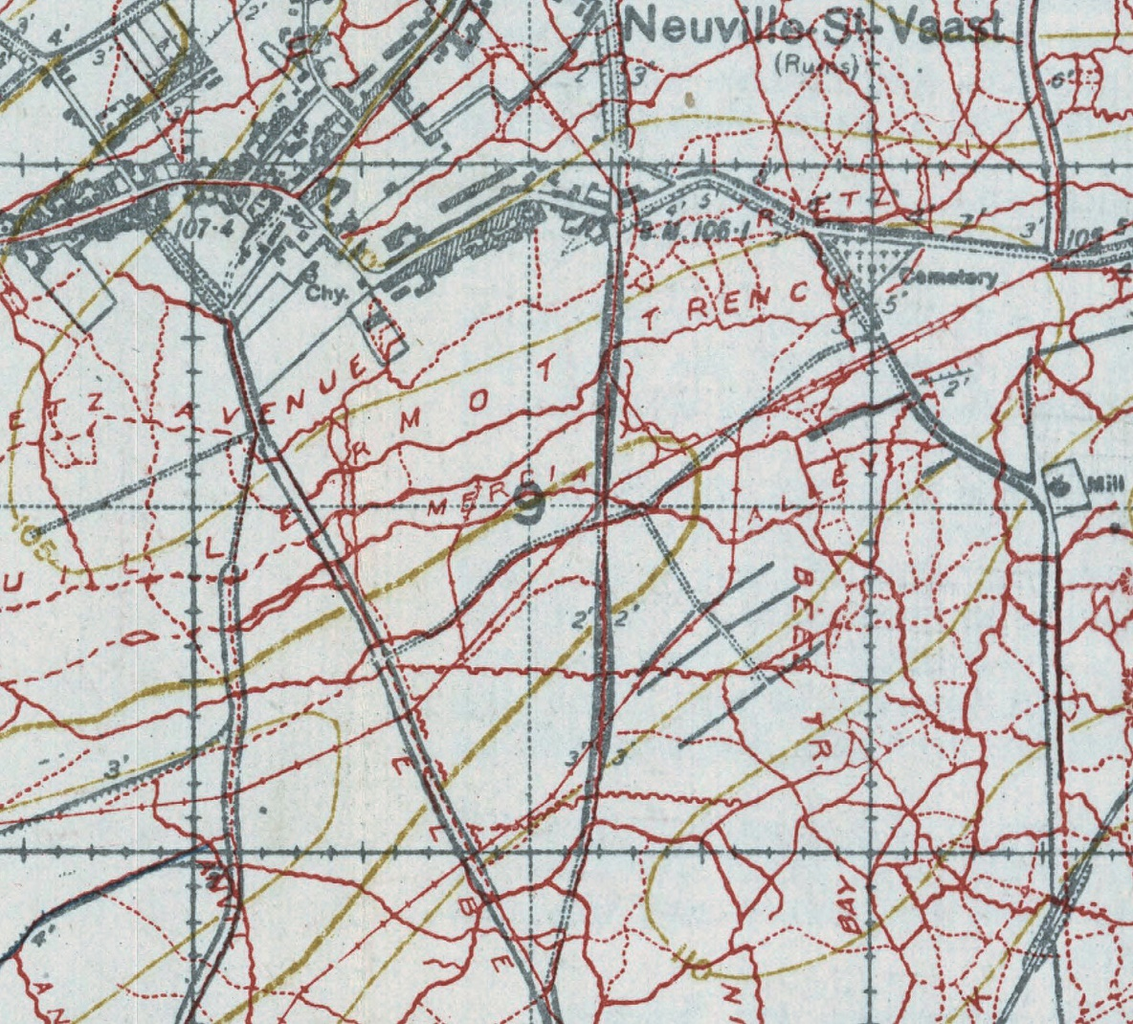
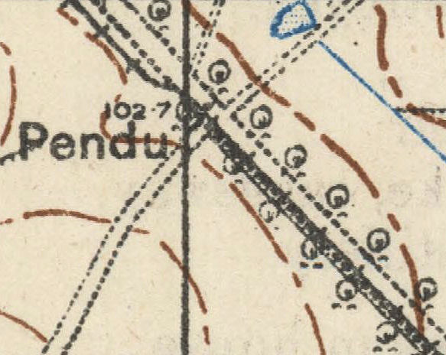
June 14, 1917:
Railway embankment near Vimy
On the Move
Advantages of Trench Maps
June 19, 1917:
‘Elbe’ trench near
Neuville St. Vaast
June 24, 1917:
Le Pendu
Visualization
Orientation
Scope
Notes:
SLIDE 18: On the Move
A couple of days later we find Andrew on Manoeuvres and taking up position in a railway embankment just in front of the village of Vimy. On the 19th he is back near Neuville St. Vaast in a trench called ‘Elbe’ undoubtedly named after the river Elbe in Germany. And on the 24th we find him further behind the lines at Le Pendu.
These images demonstrate the advantage of using trench maps when they are available. The ability to be able to pinpoint the movement of someone 100 years later, right down to the individual trench, I think, is amazing. It really helps you visualize their experience, helps you orient yourself when reading the narrative and gives you a better sense of the sheer magnitude of the trench networks. These, of course, are simply screen captured close-up images. Using the high resolution digitized maps live online allows you to zoom-in and out, pan back-and-forth. I hope to have time to demonstrate one live at the end of the presentation.

Slide 19
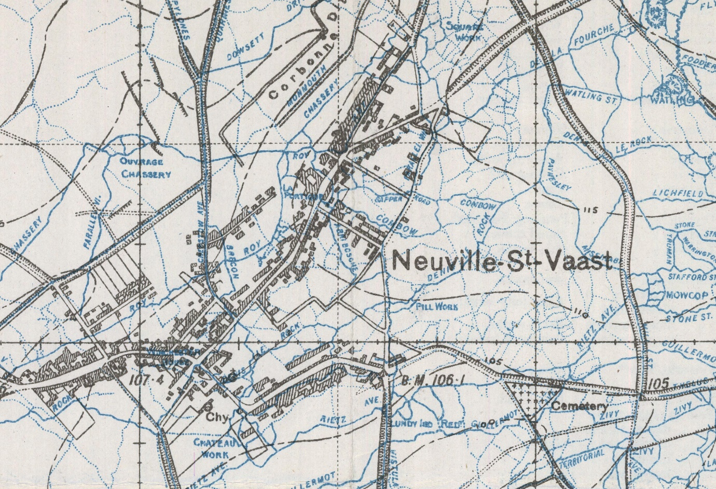
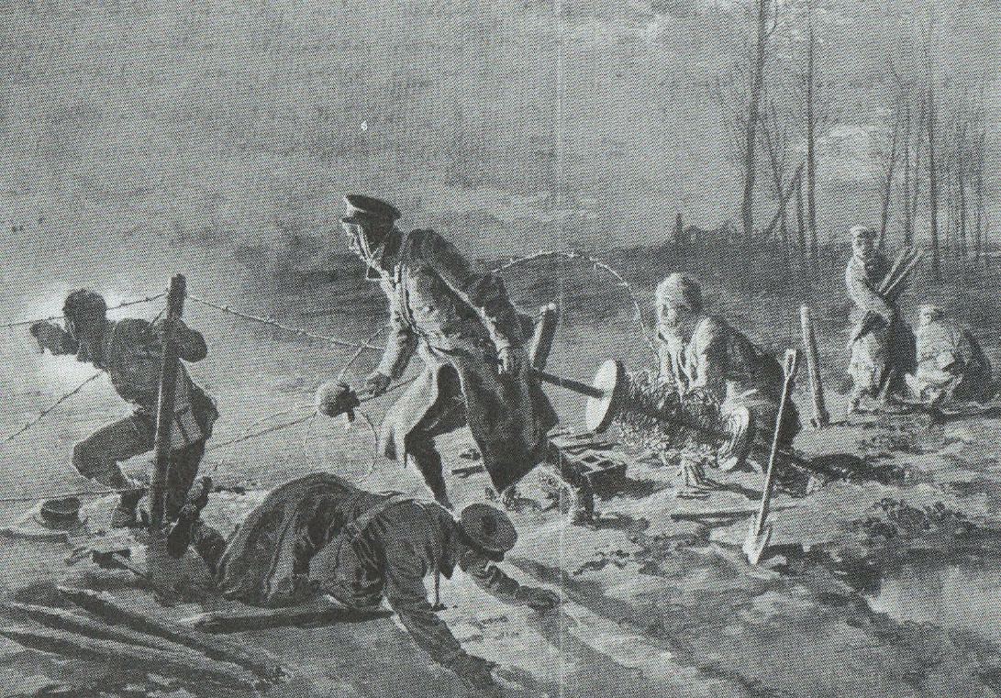
In Command of a Wiring Party
June 25 - July 4, 1917:
Back in reserve at Neuville-St.-Vaast
Placed in command of wiring party
Move up to support trench
Duty for the next 5 months.
Notes:
SLIDE 19: In Command of a Wiring Party
Between June 25th and July 4th he is back in reserve at Neuville St. Vaast and there is some dark irony here because it is at this time he is placed in command of a wiring party of 20 men which would occupy him for the next five months. After Walter’s experience only 2 weeks before, this must have sent shivers down his spine.

Slide 20
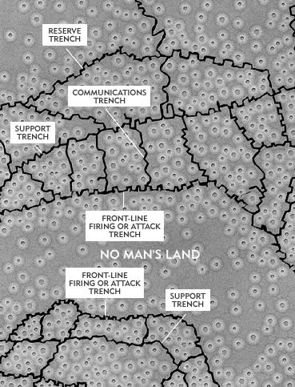
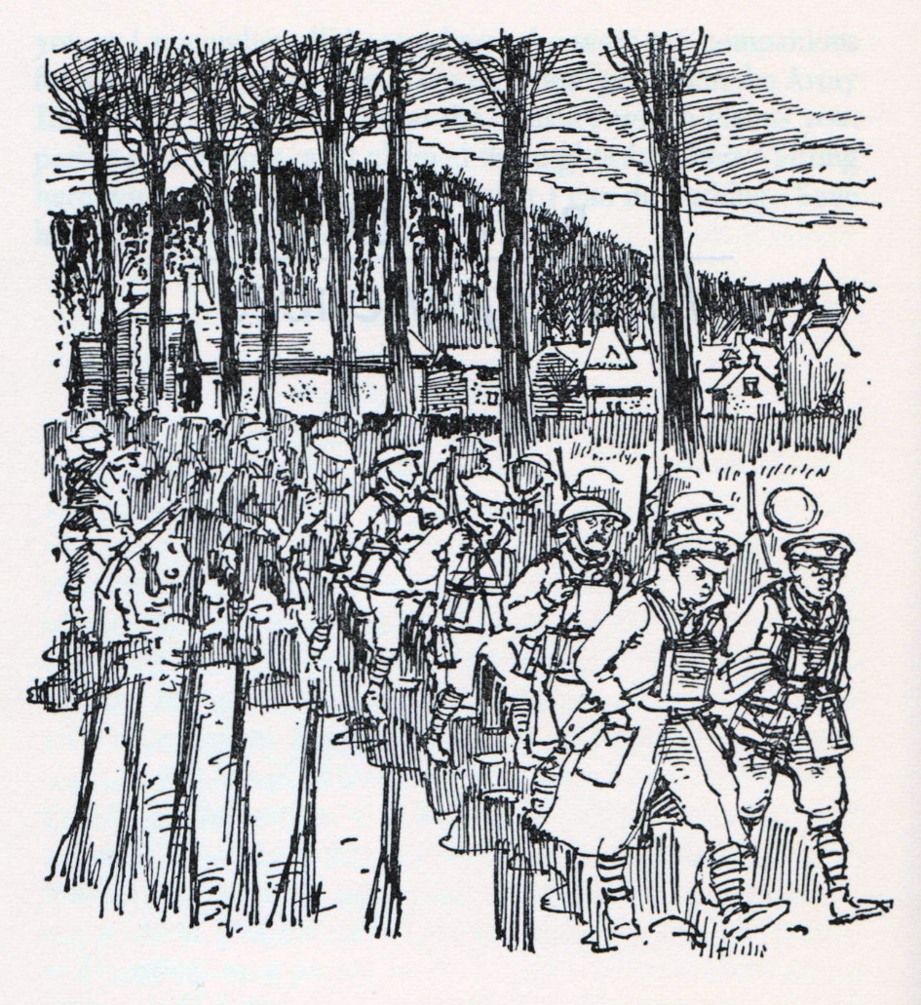
A Month of Unexplained Activity
Unusual Behaviour
July 5, 1917:
Move into Mericourt Sector for 8 days
July 14 - 19, 1917:
Rest at Fraser Camp
July 20, 1917:
Gauchin Legal
August 3, 1917:
Back in Les Brebis
July 21, 1917:
Bruay
July 23, 1917:
Les Brebis
August 4, 1917:
Bracquemont
July 24, 1917:
In support in the Loos area
August 6, 1917:
Haillicourt
Notes:
SLIDE 20: Unexplained Activity
Next follows a month of unexplained activity. On July 5th he moves into the Mericourt Sector for roughly a week. From July 14th-19th he is at rest at the Fraser Camp...on the 20th at Gauchin Legal...on the 21st Bruay, etc., etc.
Now this pattern of movement does not fit the normal protocol of service in the trenches unless they were on some special sort of duty which is not explained in the records.
Let me explain with another quick lesson in trench geography. Trench networks were made up of three, roughly parallel, main lines. I say ‘roughly’ parallel because the lines would obviously bend and twist out of necessity or the desire to take advantage of features of the terrain.
The first line of defence was the ‘Fire’ trench which was, quite literally, in the line of fire. Your first line of defence.
The second was the ‘Support’ trench, so named, because men could be quickly sent up to the fire trench to support the infantry there in the case of an attack.
The third was the ‘Reserve’ trench where even more men could be called upon for support if things went really badly.
Connecting these three main lines were ‘Communication’ trenches allowing the back-and-forth movement of men and supplies without exposing them to enemy fire.
The normal protocol would be to go into a sector and take up position in the forward Fire trench for a week. You would then rotate back to the support trench for the second week and then the reserve trench for the third. On the fourth week you would rotate out of the line for a week’s rest before heading back in to start the whole process over again. So, this is a bit of a mini-mystery which may be solved with further research in the future.

Slide 21
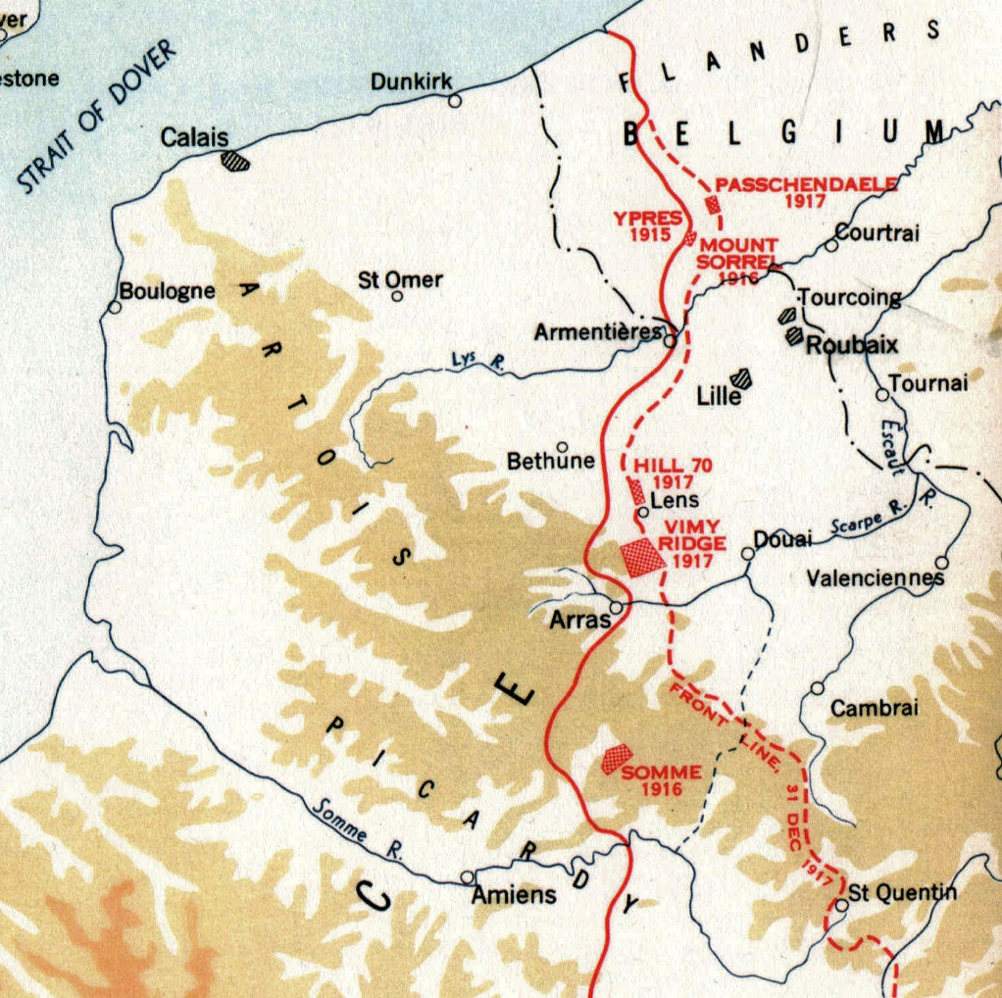

The Passchendaele Campaign
July 31st to November 10th
August 10, 1917:
Enters trenches in the Hill 70 sector northwest of Lens
A Strategic Diversion
Not just Passchendaele
3 months and many km of front
Haig launches attack with British troops July 31st
Bogged down by heavy fighting, rain, and mud
Canadians in south opposite Lens
Ordered to attack Lens as a diversion
Currie convinces superiors to attack Hill 70
Notes:
SLIDE 21: The Passchendaele Campaign: Capturing Hill 70
Andrew entered the trenches in the Hill 70 sector on August 10th and now we enter the period of The Passchendaele Campaign.
Normally when Canadians think of Passchendaele we think of the latter part of the campaign when Canadians were actually attacking the area around the town of Passchendaele itself but the campaign stretched over three months and a very large portion of the front. At the opening of the campaign the Canadians were south of Passchendaele opposite the city of Lens. Because General Haig’s initial attack toward the town with British troops was getting, quite literally, bogged-down with heavy fighting, rain and mud. As a result, he ordered the Canadians in the south to create a diversionary attack on Lens to draw German forces away from Passchendaele. The Canadian General Arthur Currie now in command of all Canadian troops after Vimy decides a frontal assault on the city of Lens would be costly and instead recommends an attack on Hill 70 just north of the town as its elevated position would give his artillery command over the town and would be easier to defend if won. The Germans would be forced to counter-attack to take the position and would tie up many of their troops.

Slide 22
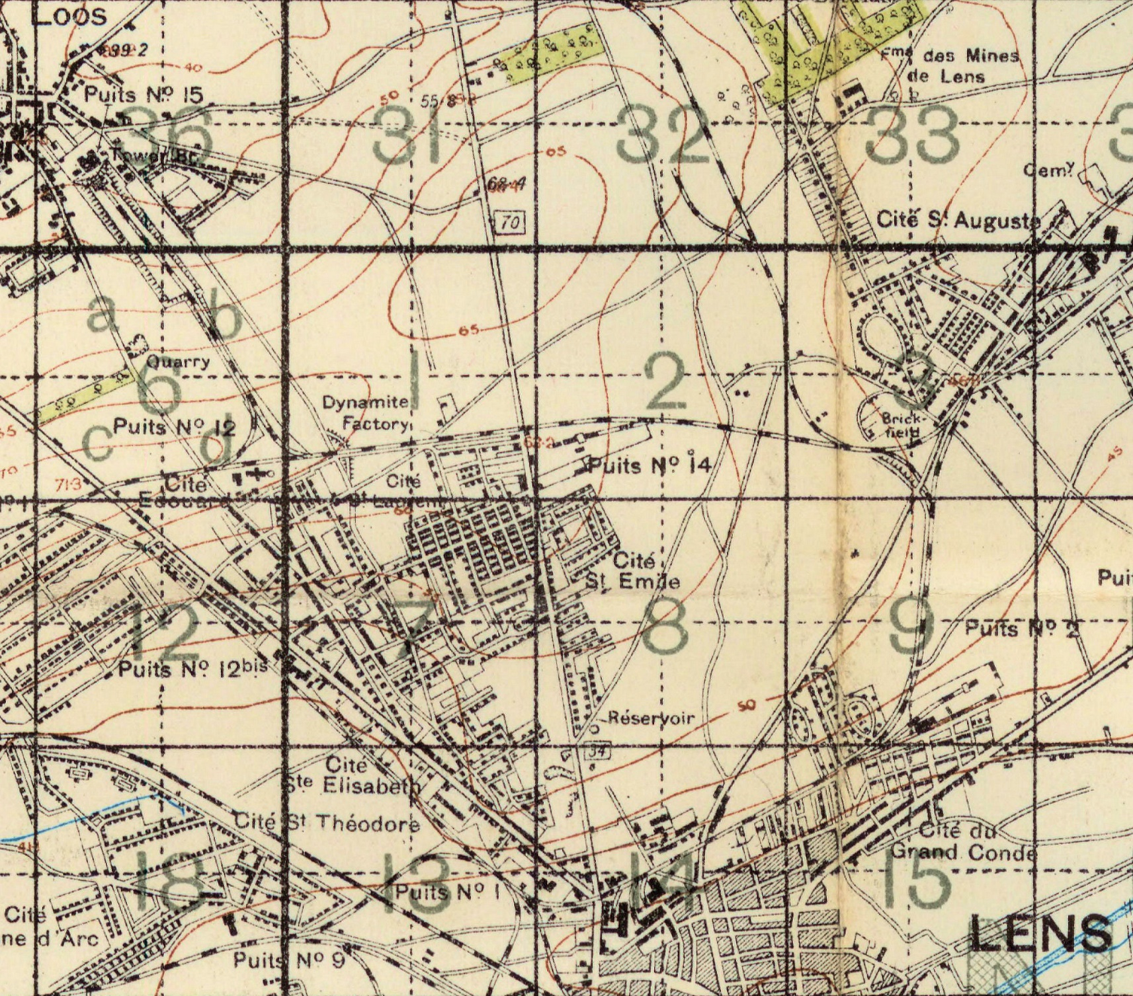
The Attack on Hill 70
Canadians attack on August 15th
Capture high ground & objectives
21 German counter-attacks in 4 days
August 15, 1917:
Supported 2nd Brigade in attack on Hill 70
Notes:
SLIDE 22: Attack on Hill 70
The battle was launched on August 15th and Andrew’s 4th Battalion was placed in support of the 2nd Brigade’s attack.

Slide 23

The Passchendaele Campaign
Defending Hill 70
August 16, 1917:
Took over responsibility of the front line
Repelled 4 German counter-attacks
Severe enemy casualties with our machine gun and rifle fire.
A Canadian Victory
Canadians lost more than 9,000 soldiers
killed or wounded 25,000 Germans
Currie and the Corps would soon move north to aid in Haig’s faltering attack.
August 20, 1917:
Relieved and moved back to Les Brebis
Notes:
SLIDE 23: The Passchendaele Campaign: Defending Hill 70
On August 16th Andrew’s Battalion took over responsibility of manning a portion of the front lines. They repelled 4 determined German counter-attacks and inflicted severe enemy casualties with their machine guns and rifles. The battle was a victory. The Canadians lost more than 9,000 soldiers but killed or wounded an estimated 25,000 Germans [so I guess that made the accountants happy].
Currie would soon be moving his Canadian troops north to help Haig’s failing attempts at taking Passchendaele.
On August 20th Andrew’s battalion was relieved and moved back to Les Brebis.

Slide 24
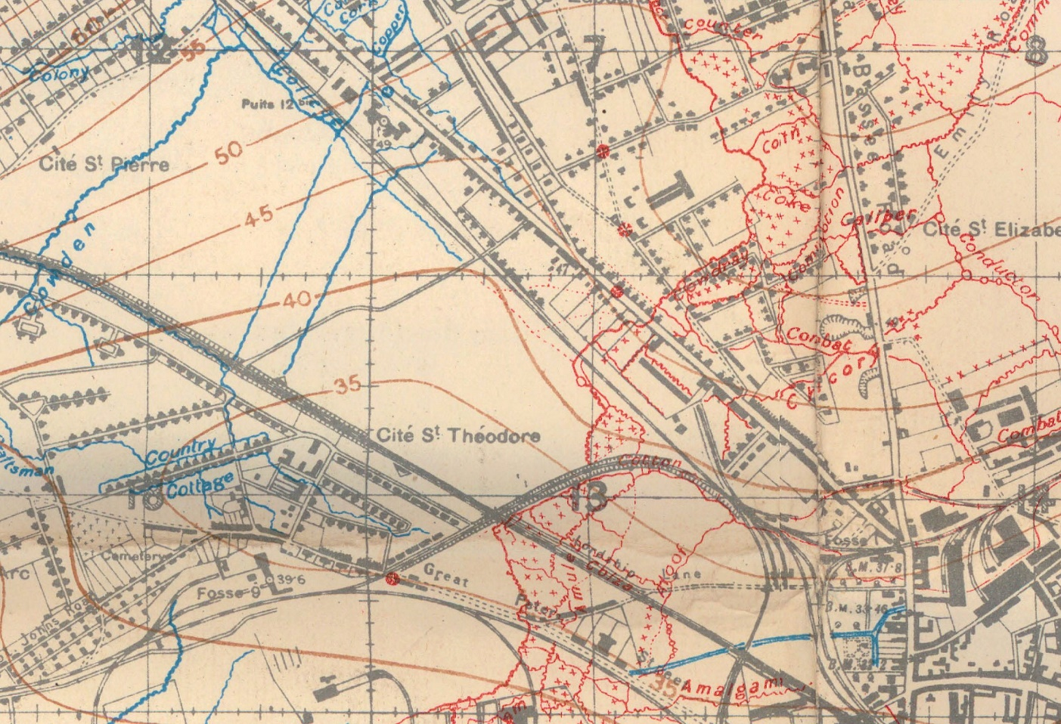
A Wiring Party Goes Wrong
September 11, 1917:
Moved into Cite-St.-Pierre Sector
(south of Hill 70, across from Lens)
“Well, if I can’t have the pleasure of seeing you in a cage, at least I feel you owe me some souvenir of our unusual encounter.”
“Pretty good actor you were, squatting so business-like, dead as a doornail and not a mark on you.”
Notes:
SLIDE 24: A Wiring Party Goes Wrong
On September 11th Andrew is moved to Cite-St.-Pierre south of Hill 70 and across from Lens. It is about this time that an interesting incident occurs. One night on while on wiring duty the Germans send a flare up and instead of freezing, Andrew reflexively drops to the ground. The movement is noticed by the Germans who fire in his direction and hit a young soldier only in his teens. His wounds are bad and he has to be carried out so Andrew crawls back toward his line to get stretcher bearers. On his way, on the edge of a crater right in front of him, he sees a crouched German soldier facing toward the Canadian trenches. Slowly he creeps up on the German and tells him to put his hands up. There is no response from the German so he prods him in the back and the German topples over. He had been talking to a corpse. Upon discovering this, and the fact that he has been cheated out of a prisoner, he decides to take his water bottle as a souvenir.
When he finally gets back to his own trench and starts to slip over the side he slices his left hand on a bayonet affixed to a rifle that had been left propped-up against the parapet. He sends out a stretcher team and then has his wound seen to at the field dressing station where they send him back of the lines for a week to heal. However, when reaching a hospital in the safe zone he is interrogated by a medical officer who believes his wound to be self-inflicted. Apparently, wounds in the left hand were as common as shooting yourself in the foot to get out of military service.

Slide 25
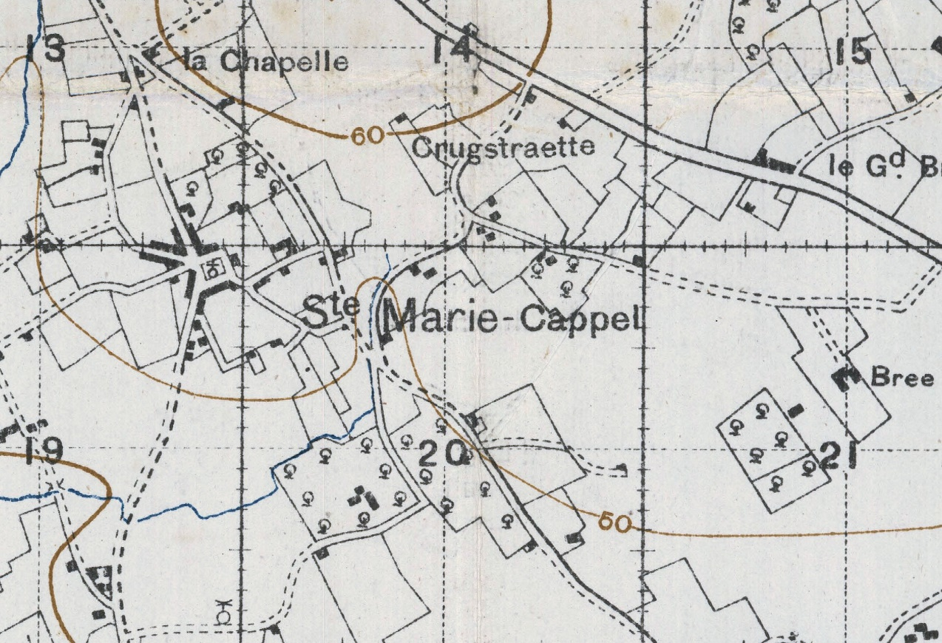
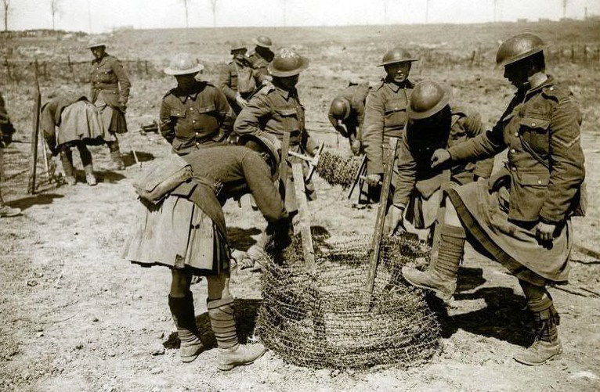
Wired Enough
Back in Familiar Company
October 1 – 19, 1917:
St. Quentin Brigade School as Wiring Trainer for 2 weeks
Leaves the school and his command of wiring party
Returns to his original unit in 4th Bn. (D Company but no.13 not 16 Platoon) in anticipation of the action at Passchendaele
October 22, 1917:
Ste. Marie Cappel
10 days of training for Passchendaele
“...training and polishing up for the coming show, bayonet and bombing practice, formation in attack, establishing communications, entrenching and marching. It was now generally known that the corps was to participate in the big offensive on Passchendaele Ridge...”
Notes:
SLIDE 25: Wired Enough
In about a week’s time he is back on duty and is sent to a military training school for two weeks to train new recruits in wiring techniques. At this point, anticipating the action at Passchendaele, he completes his duties with the wiring party and returns to his original unit to take command of Company D, but this time the 13th , rather than the 16th Platoon.

Slide 26
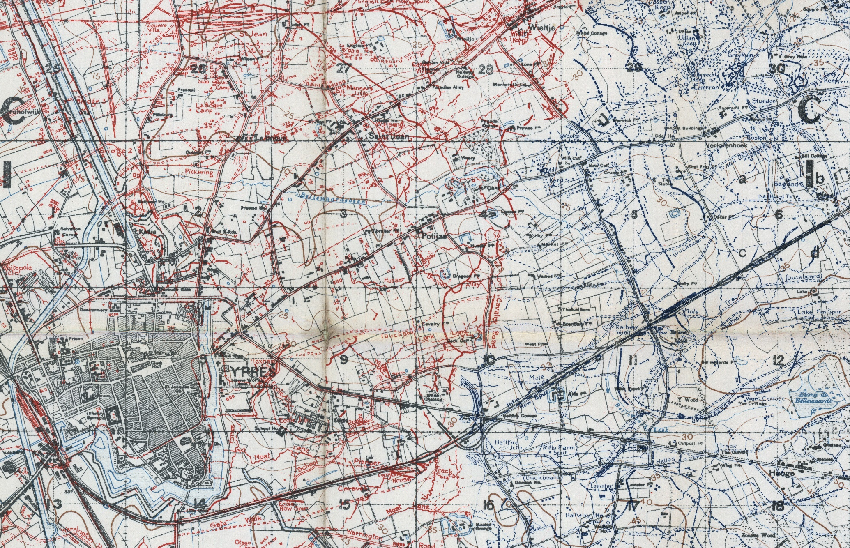
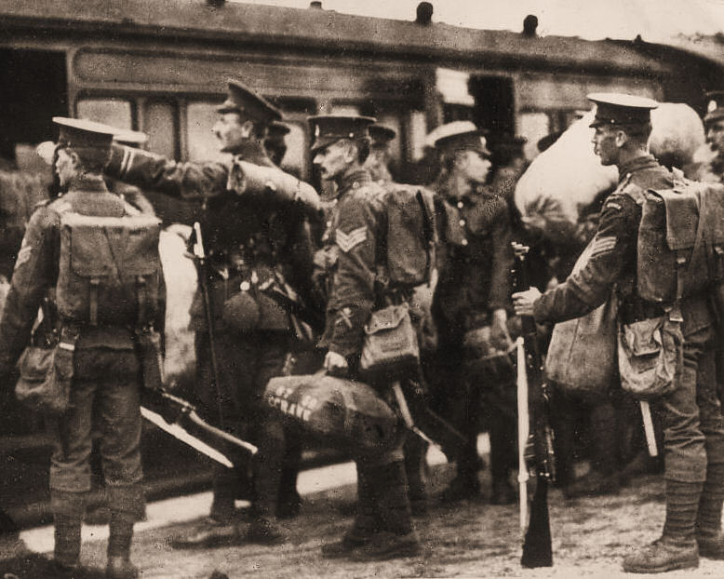
The Road to Passchendaele
Note:
Trench colours changed on maps in 1918
November 2 - 4, 1917:
Entrained for Ypres at Bavinchove
Detrained, hiked rapidly due to shelling
Marched along Wieltje Road to St. Jean Camp
Notes:
SLIDE 26: The Road to Passchendaele
On November 2nd Andrew entrains for Ypres. On his arrival there his unit is forced to quick-march through town as they are undergoing shelling from German positions. They arrive at the village of St. Jean which has been wiped off the map but replaced with a village of tents now called St. Jean Camp. One brief side note about the change in colour of trenches. For the entire war up until 1918 the British had been colouring their trenches blue and the German trenches red, while the French, had been using the exact opposite colour scheme. So, in the last year of the war, out of the interest of achieving uniformity, the British switched their colour scheme.

Slide 27
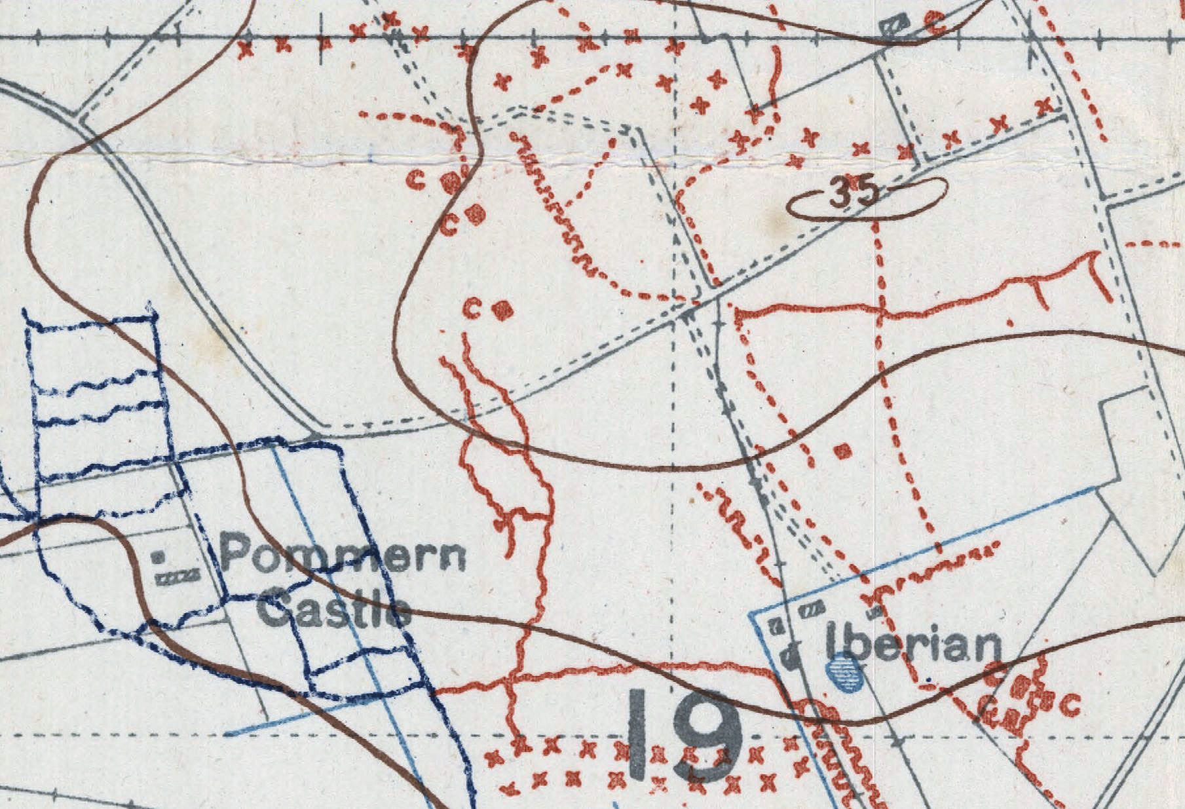
The Road to Passchendaele
Pommern Castle Area
November 5, 1917:
Entered the line in the Pommern Castle area
Notes:
SLIDE 27: The Road to Passchendaele
The next day, November 5th , Andrew and his unit advanced far enough northeast of Ypres to enter the front lines in a network of trenches called the Pommern Castle.

Slide 28
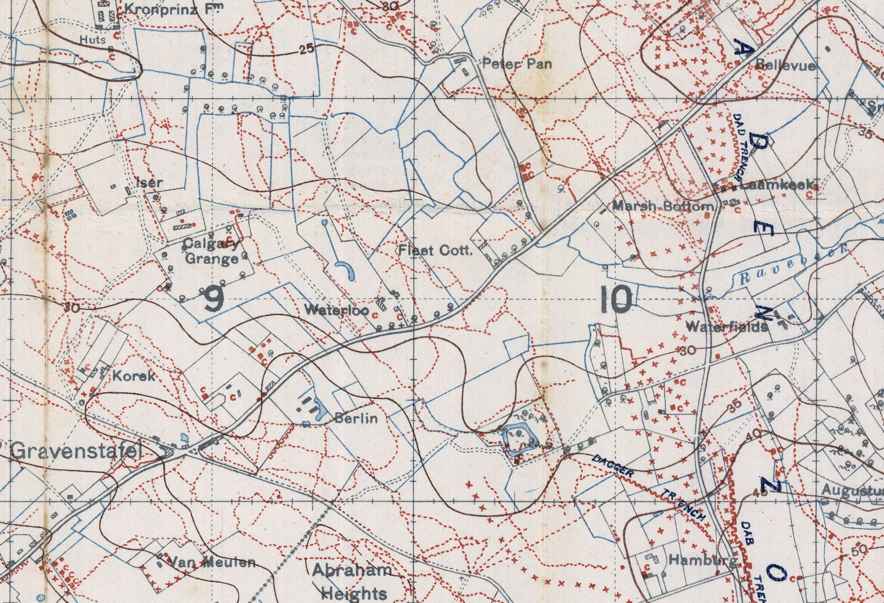
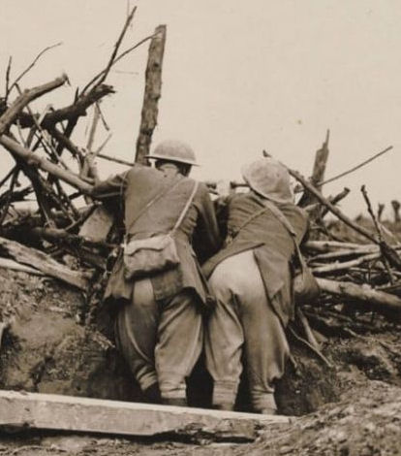
Reconnaissance
Gravenstafel
Abraham Heights
Kronprinz Fm
Bellevue Spur
“Gravenstaefel was a crossroads and an advance dump; Crown Prince Farm a pillbox on the left front rear; Abraham heights a slight elevation to the right. This was to be the reserve line for the coming show and to be occupied by the 4th. The Bellevue Spur, a high promontory almost immediately in front, had been taken, after bitter fighting and great loss a few days earlier.”
http://digitalarchive.mcmaster.ca/islandora/object/macrepo%3A66734/-/collection
Notes:
SLIDE 28: Reconnaissance
Once there, he ventures forth for a reconnaissance of the landscape into which his platoon will be heading, resulting in this descriptive passage you see here. We have a reproduction copy of the trench map that covers this area here tonight which you are encouraged to view after the presentation and, if we have enough time and our Internet connection works, I would be happy to demonstrate the digital version online.

Slide 29


Play-Acting
Late for the Show
November 5, 1917 (same day):
Ordered into action
Wounded by artillery fire
5 minutes made the difference
Platoon of 31 men
3 unhurt
10 dead
15 wounded
3 missing, presumed dead by drowning
Notes:
SLIDE 29: Play-Acting
Later that same day Andrew is ordered with his platoon into the action.
But there is a malingerer in his platoon that had been avoiding combat by playing dead lying among the corpses. Apparently he had gotten pretty good at it. When Andrew found him lying rigid in a very convincing pose, he lifted his eyelids and found that even the man’s pupils were distended and wild looking. Andrew, himself, wasn’t even sure the man was not dead until he poked him with his gun barrel and the man popped to attention.
This sideshow, however meant they were 5 minutes behind schedule and, looking back, this could have made all the difference. As they were moving forward three German artillery shells fell and made direct hits in the platoon—one right in the middle. Andrew was paralyzed but seemed unhurt except for a small cut on his cheek. It wasn’t until he reached the casualty clearing station and they removed his tunic that they discovered a deep hole near the spine. He was going home.
As for his platoon, they were nearly wiped out. Out of 31 men only 3 were unhurt. 10 were dead, 15 wounded and more were missing, presumed drowned because if you fell into a shell crater filled with rainwater with all your equipment you would sink to the bottom.

Slide 30


Going Home
Llandovery Castle: One Last Problem with Names
Evacuated from Wimereux
Lands in Dover
Taken to a hospital in Empire Square, London
Buckstone
Llandovery Castle
Home to Ottawa
HMHS Llandovery Castle was torpedoed and sunk by a German submarine June 1918. Firing at a hospital ship was against international law and standing orders of the Imperial German Navy. The Captain, seeking to cover up what he had done, surfaced, ran down all the lifeboats and machine-gunned the survivors in the water. Only 1 lifeboat with 24 people escaped.
Notes:
SLIDE 30: Going Home
One last problem with names.
In Andrew’s memoirs he states that he was sent to Wimereux on the coast and from there, shipped back to England where he landed in Dover. He then states that he was taken to a hospital in London in Empire Square, then Buckstone and Llandovery Castle and then home to Ottawa. I took this to mean that Buckstone was also a hospital and that a Castle named Llandovery had been converted to a hospital as well. But upon a little research I discovered that the Llandovery Castle was actually 1 of 5 Canadian hospital ships. So, this must have been the ship that brought Andrew home.
This time, however, Andrew’s timing was lucky because less than a year later, this same ship was struck by a U-boat torpedo and sunk. This, of course, violated international law so the captain, seeking to destroy evidence of his actions, surfaced his sub, ran down all the lifeboats and machine-gunned the survivors. Only 24 people in one remaining lifeboat survived.
END

