Slide 1
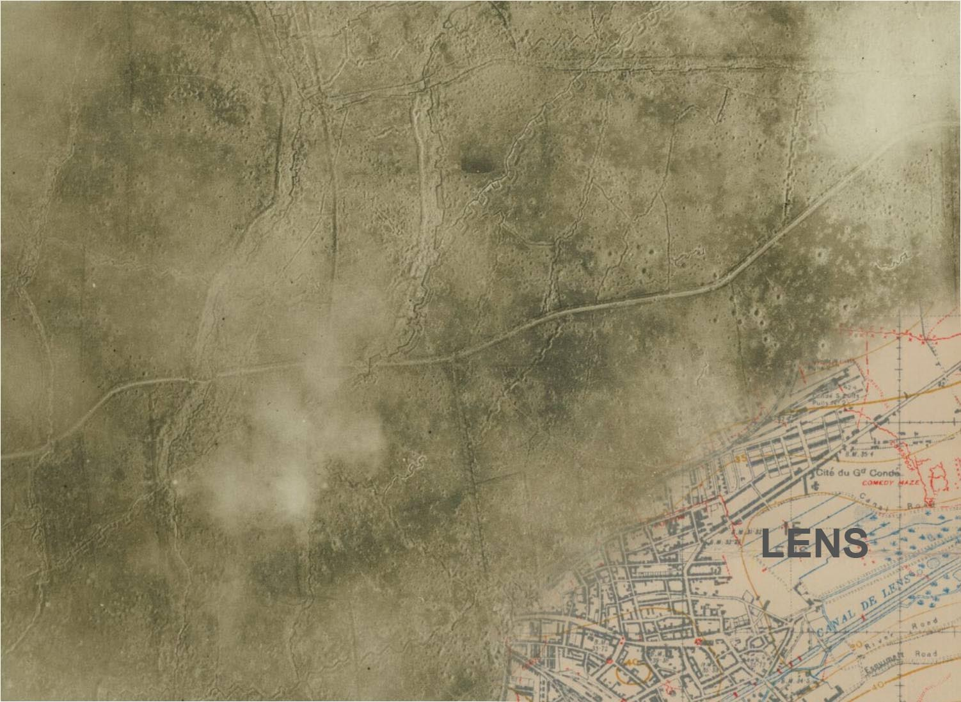

Lens above Lens
The Development & Use of Aerial Photography in WWI
Gord Beck, Map Specialist
Lloyd Reeds Map Collection
Notes:
SLIDE 1: Lens above Lens: the Development and Use of Aerial Photography in WWI
Gord Beck, Map Specialist, McMaster University Lloyd Reeds Map Collection
Presentation at the National Gallery of Canada (2014)
as part of their event schedule for their exhibit,
The Great War: The Persuasive Power of Photography

Slide 2
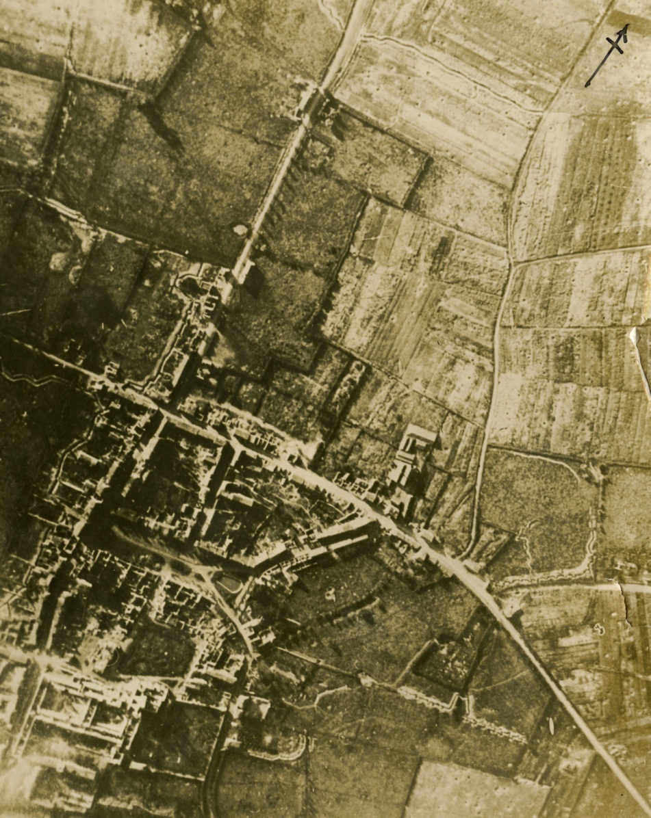
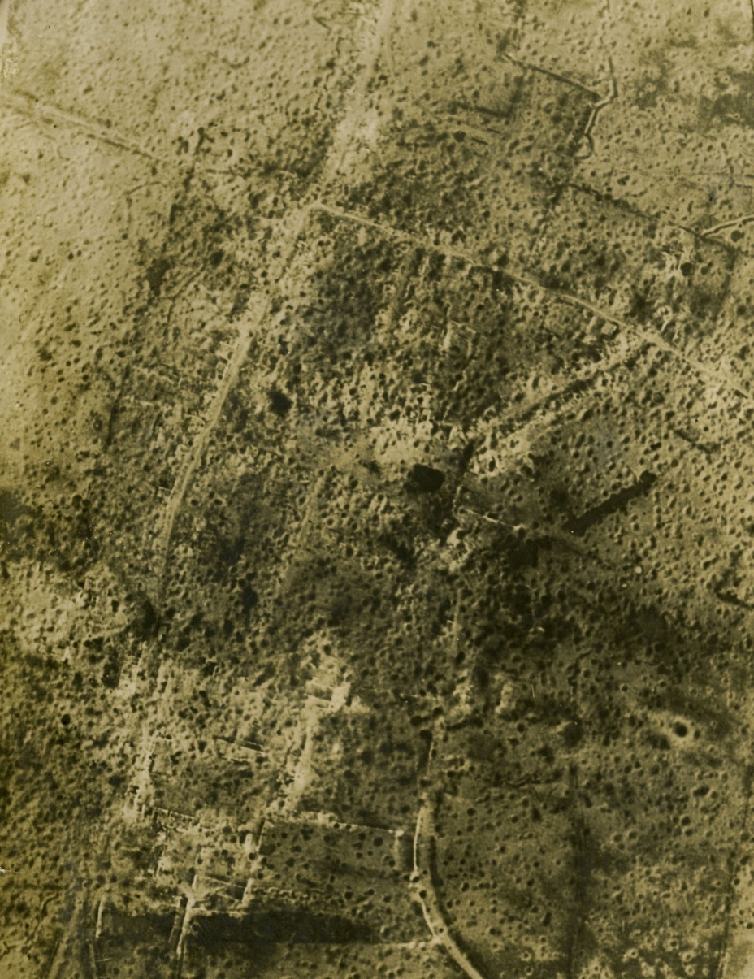

Damage Assessment
Messines
Before
Messines
After
Digital Archives #4801
Digital Archives #4801
Notes:
SLIDE 2: Damage Assessment
[Messines before and after]

Slide 3
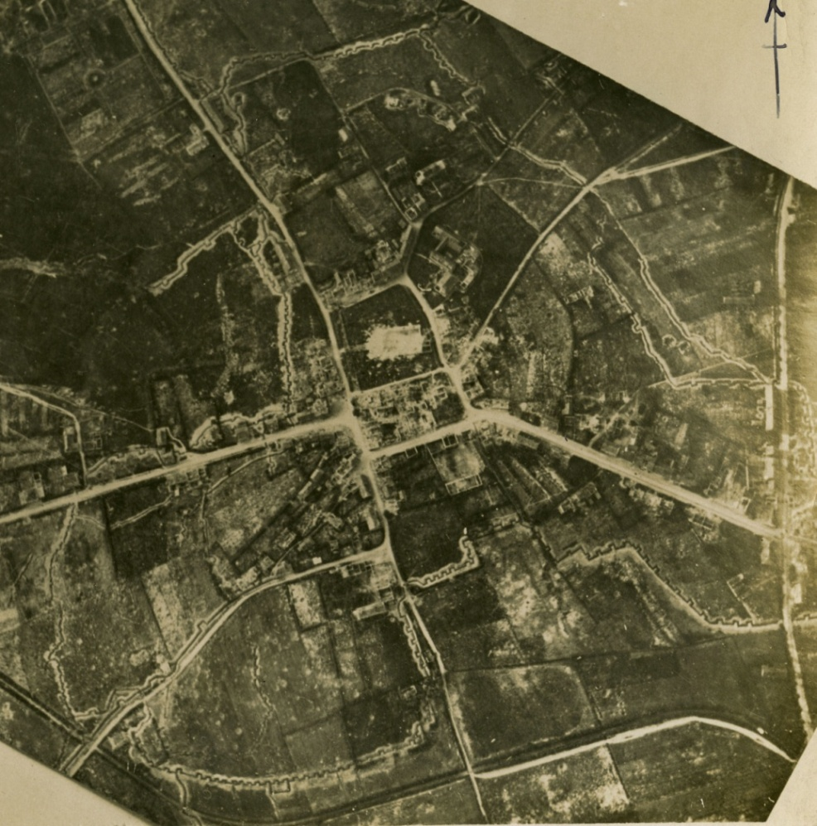
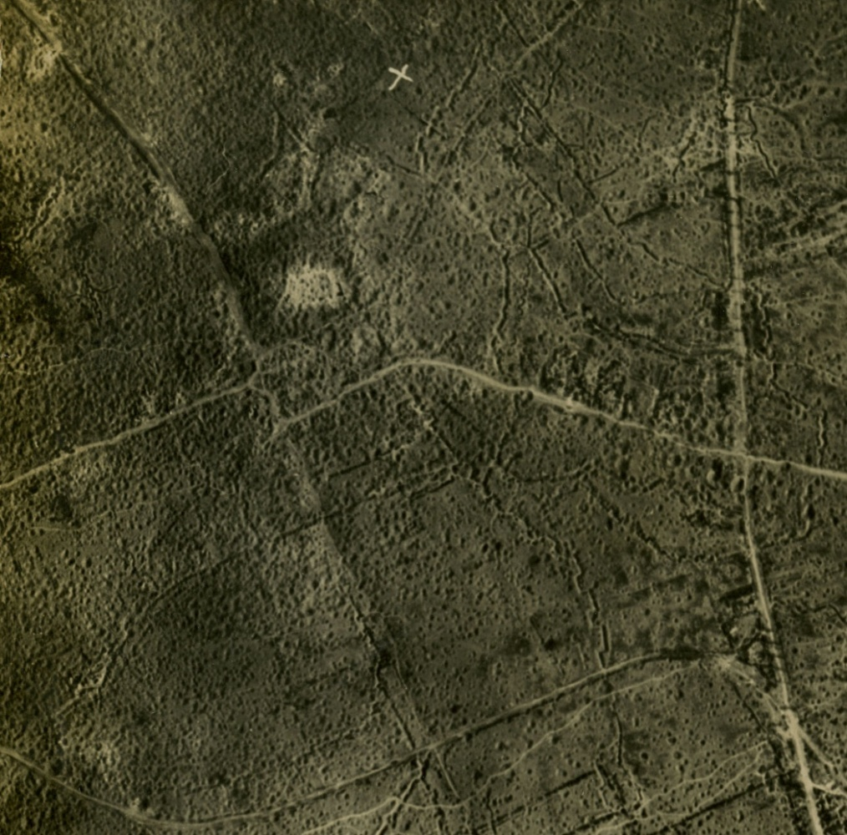
Damage Assessment
Wytschaete
Before
Wytschaete
After
Digital Archives #4931
Digital Archives #4931
Notes:
SLIDE 3: Damage Assessment
[Wytschaete before and after]

Slide 4
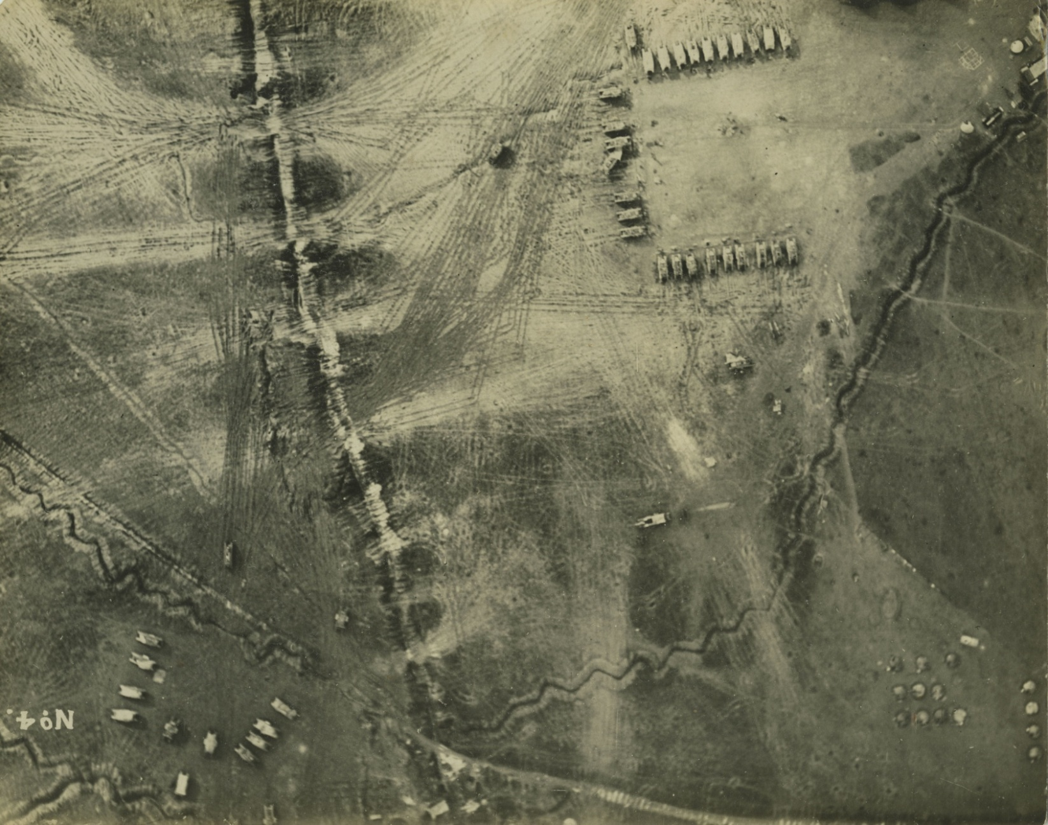
Scouting
Massed Tanks
Digital Archives #4744
Notes:
SLIDE 4: Scouting
[massed tanks]

Slide 5
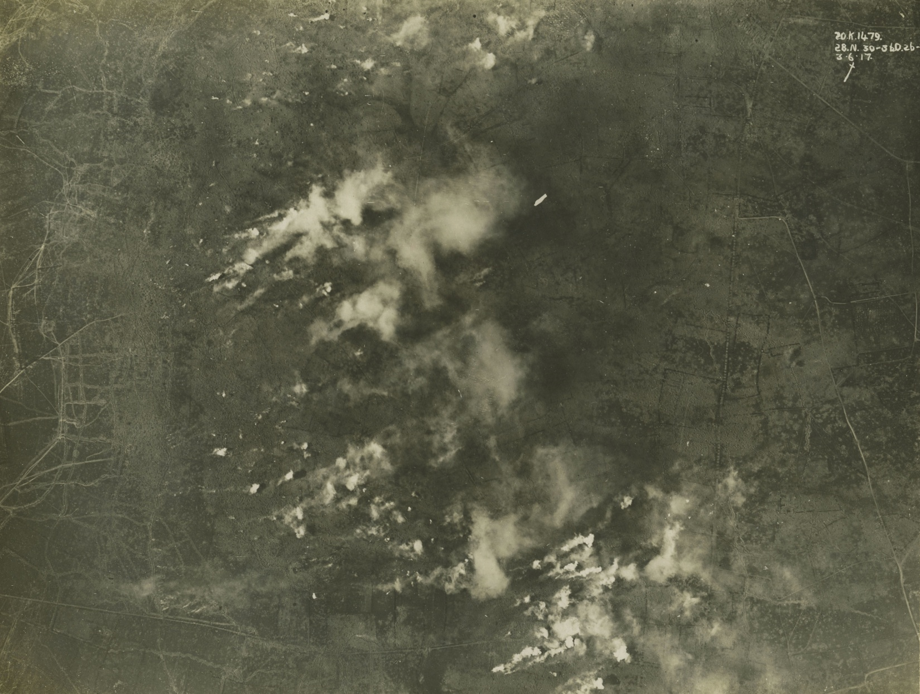
Artillery & Target Spotting
Smoke from Artillery
Digital Archives #4887
Notes:
SLIDE 5: Artillery & Target Spotting
[puffs of artillery smoke]

Slide 6
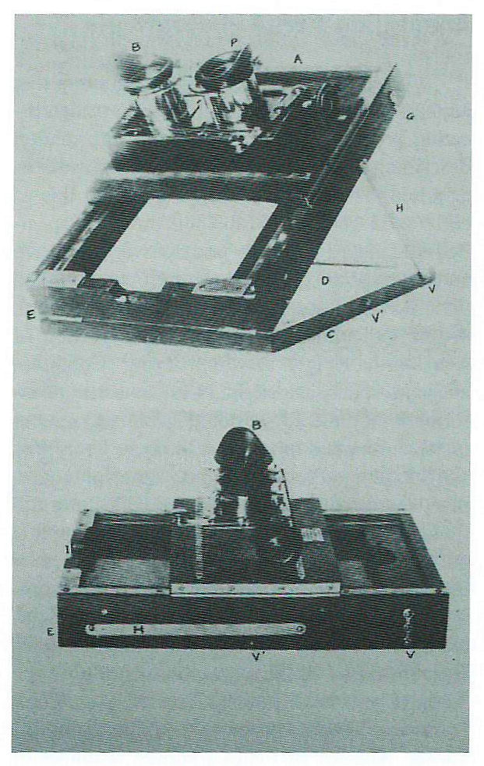
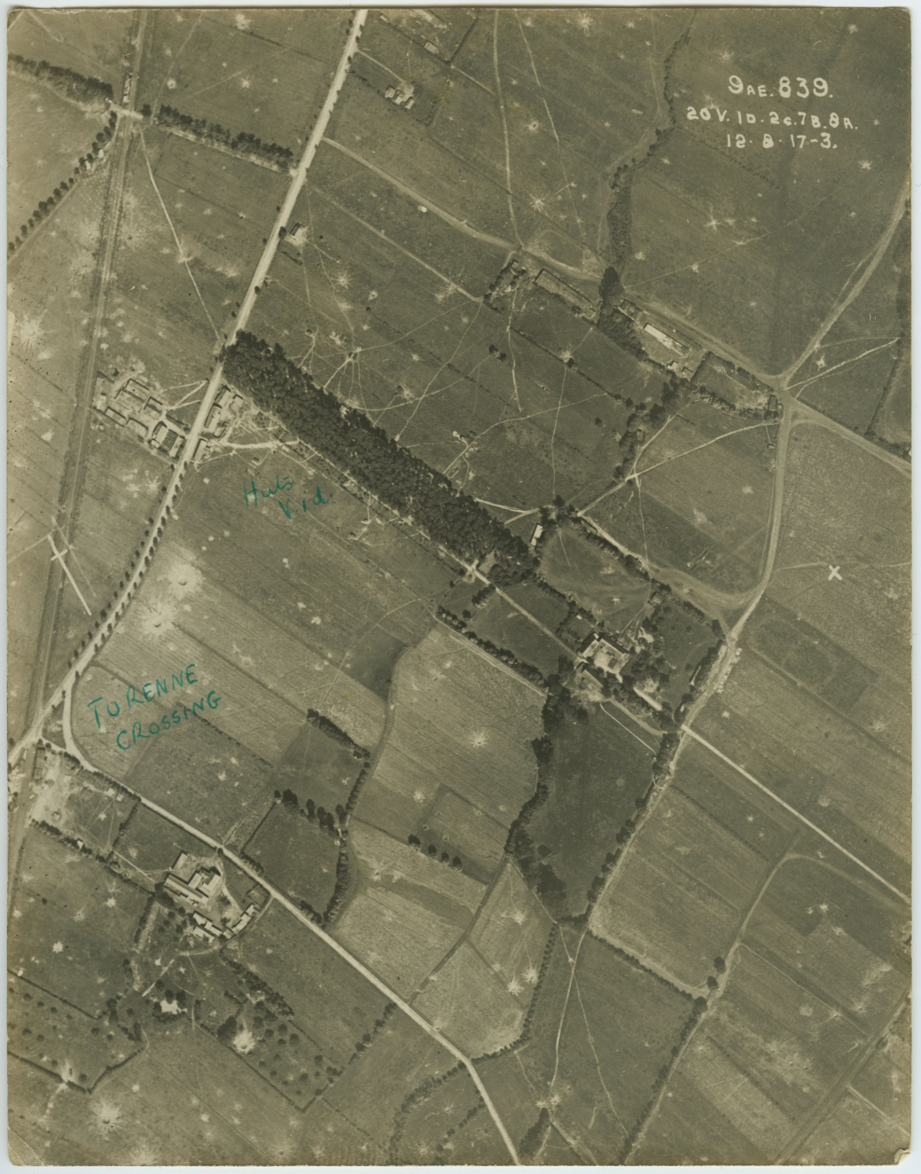
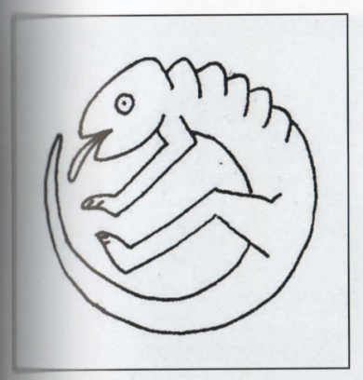

Camouflage Detection
German Huts Hidden in Woods
WWI Stereoscope (Finnegan, 2006)
Chameleon Insignia for French Camouflage Unit (Finnegan, 2006)
Digital Archive #5096
Notes:
SLIDE 6: Camouflage Detection
[stereoscopic photos]

Slide 7
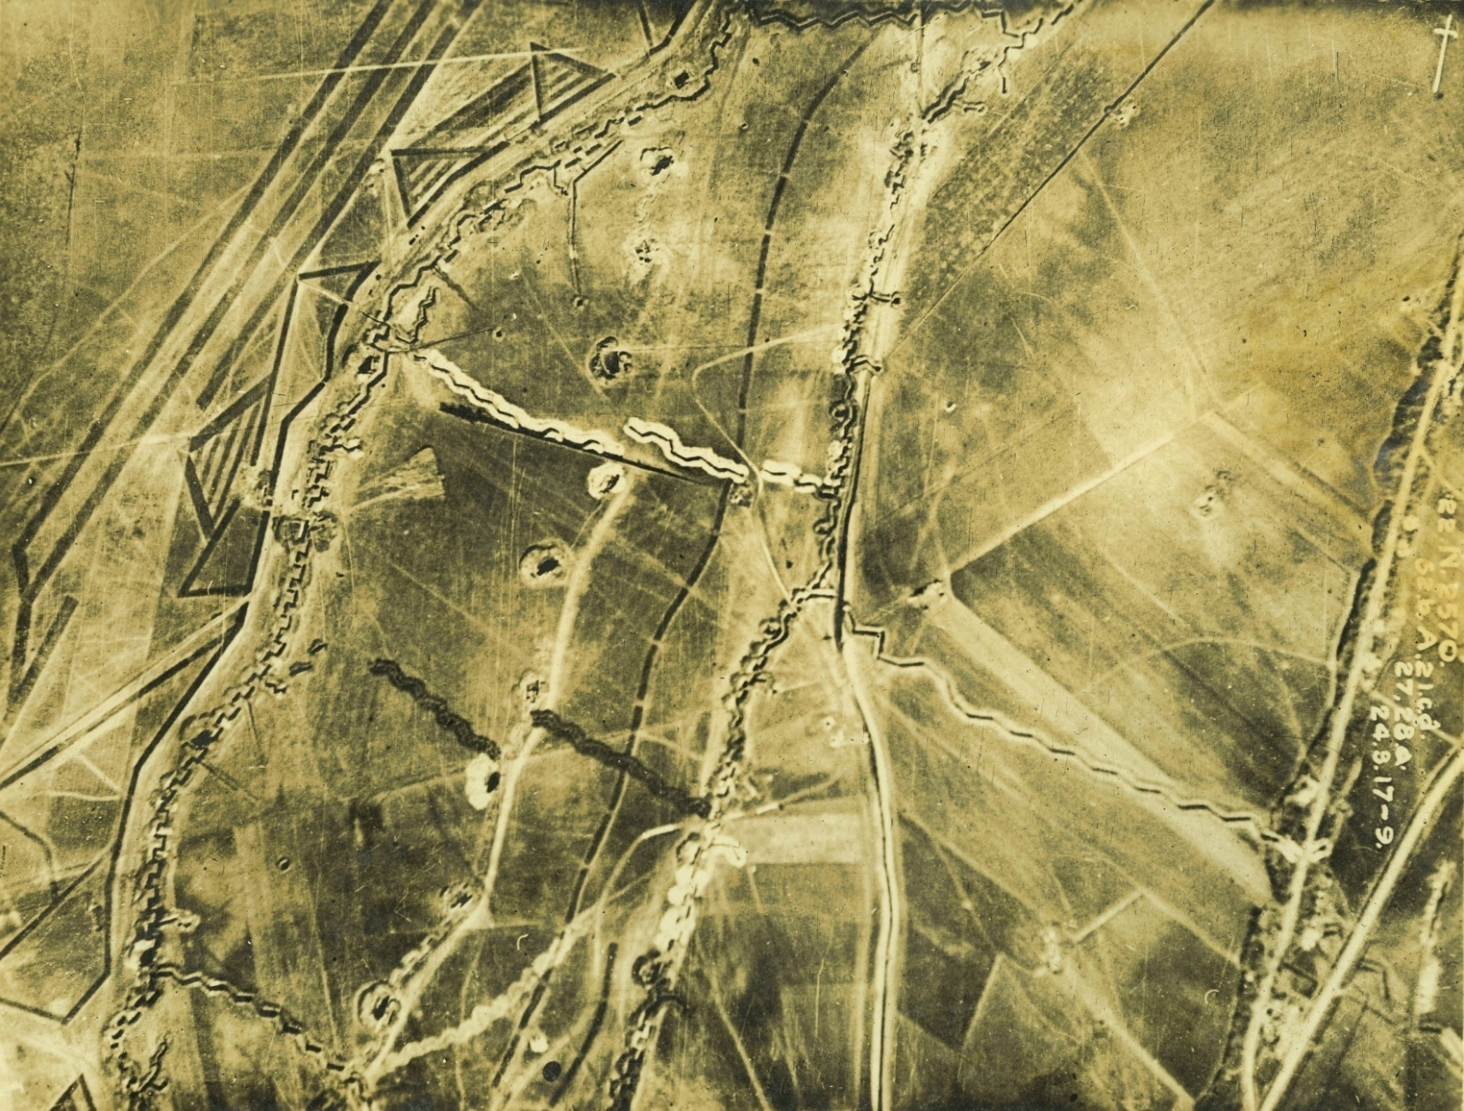
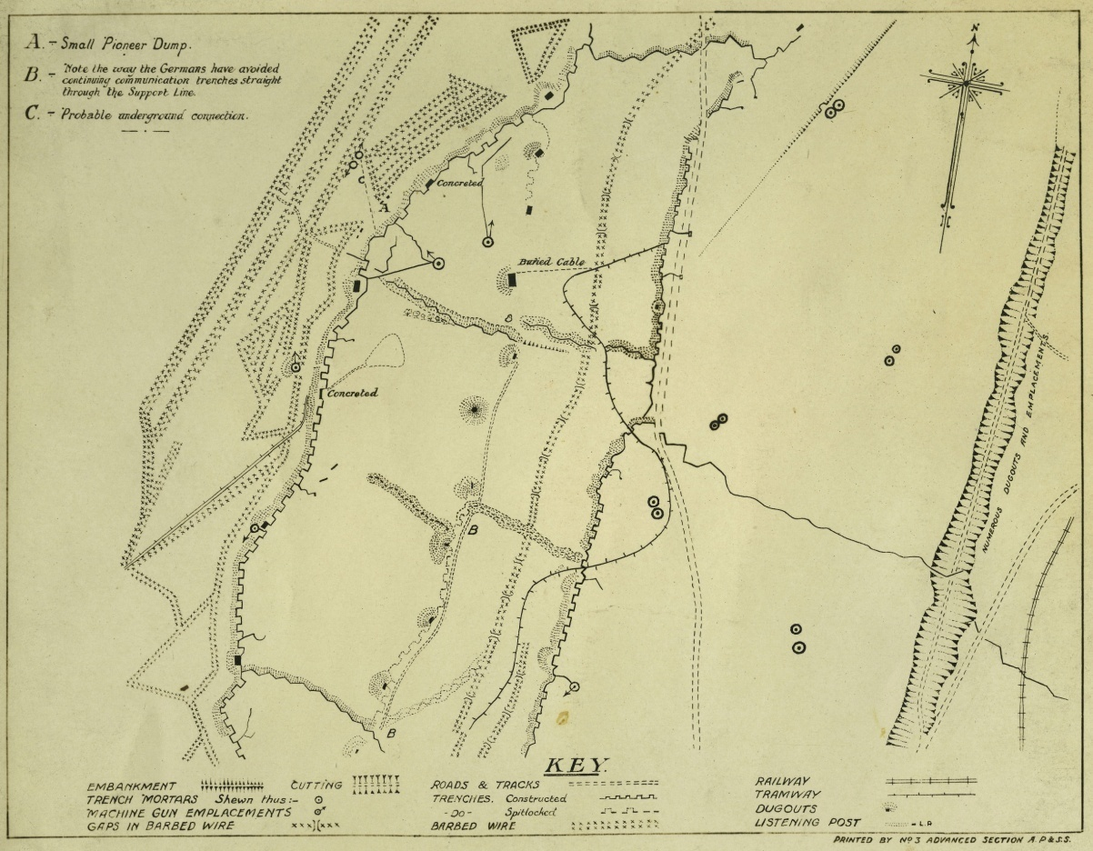

Attack and Defence Planning
Digital Archives #4698
Digital Archives #4864
Notes:
SLIDE 7: Attack and Defence Planning
[air photo and diagram of Canal du Nord]

Slide 8
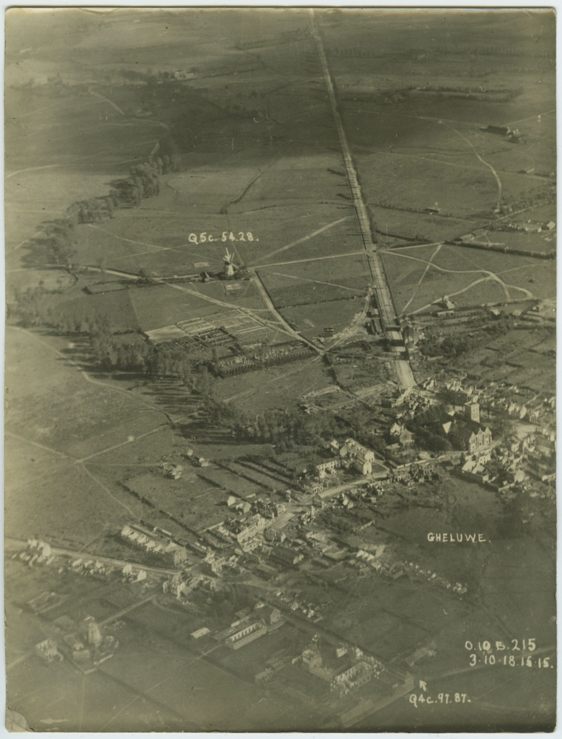
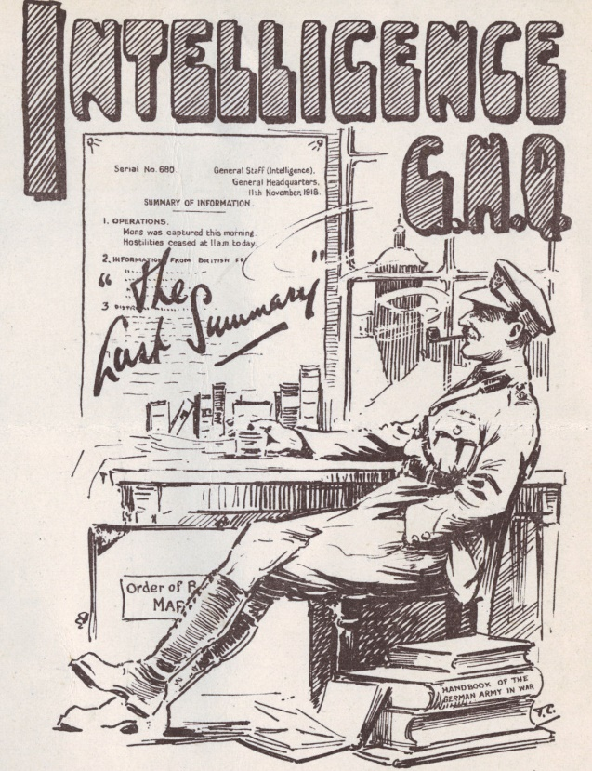

Psychological
Analysis of the Enemy
German field hospital
and military cemetery
Casualties Up
Morale Down
Digital Archives #4668
Notes:
SLIDE 8: Psychological Analysis of the Enemy
[Gheluwe German field hospital and cemetery]

Slide 9
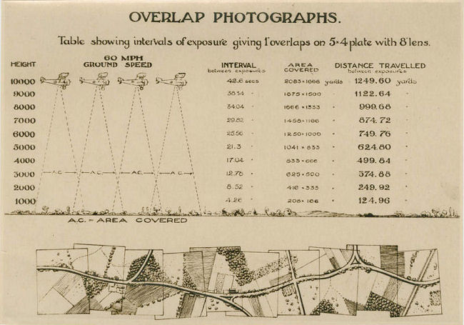
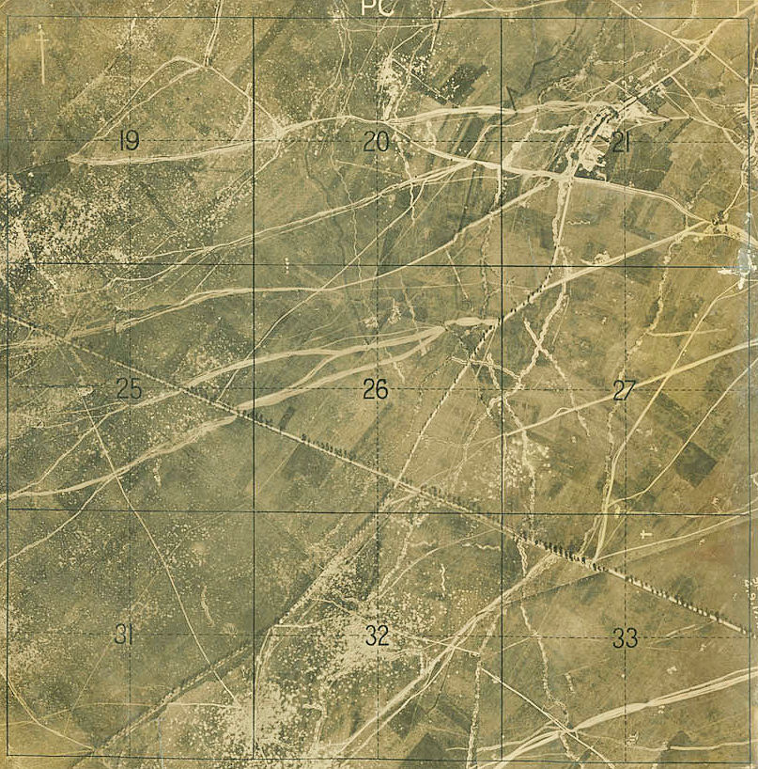
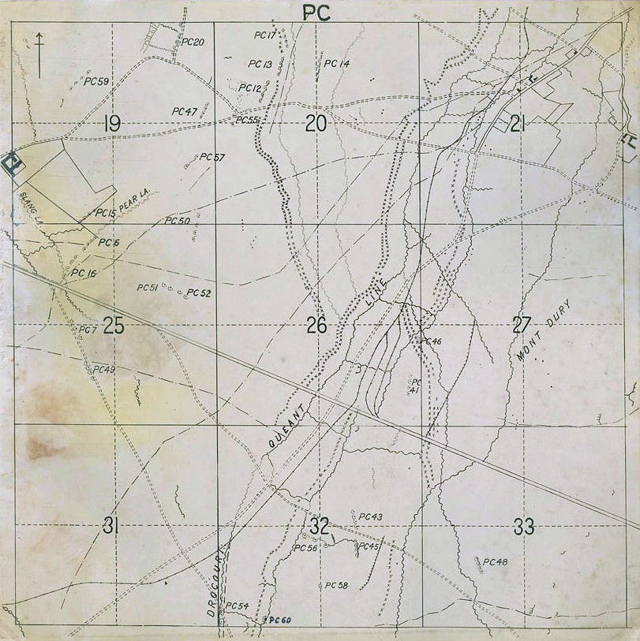
Data Collection for Mapping
Map from Aerial Photo
Digital Archives Lieut. G.R.E. Hayter
Digital Archives Lieut. G.R.E. Hayter
Notes:
SLIDE 9: Data Collection for Mapping
[Pages from Lieut. Hayter's book]

Slide 10
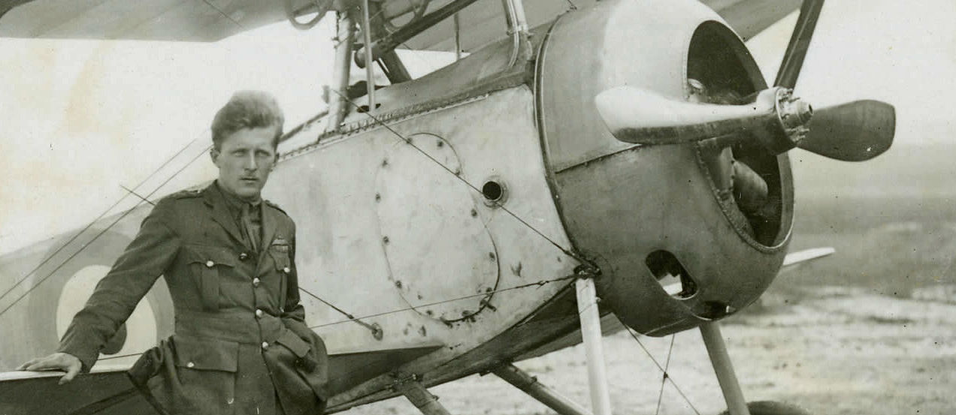
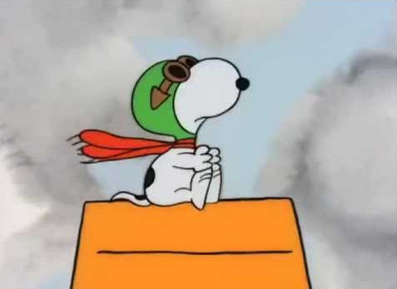
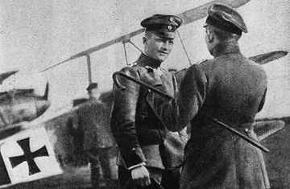
“War of the Lenses” leads to GIS, GPS & Google Earth
“Photographic Reconnaissance is a most difficult and ungrateful part of aerial observation. It gets more recognition and credit from the enemy than any one else.”
Major E. Steichen, U.S. Air Service (1917)
Billy Bishop
“The public mind is more apt to be impressed by the fighting and bombing aspects of aerial warfare.” (Ives, 1920)
That American “Dogfighter” Snoopy
The principle duties of aircraft are reconnaissance and the prevention of enemy reconnaissance and hostile interference with our aircraft.
RFC training manual 1914
Manfred von Richthofen, “the Red Baron”
Notes:
SLIDE 10: War of the Lenses
These were the main uses of aerial photography in the Great War. Literally millions of photographs were taken for these purposes during the four-year conflict, yet today very little is remembered about the reconnaissance crews who took them. Instead when we think of the Great War, especially the war in the air, we are more likely to remember those famous fighter pilots like the Canadian Billy Bishop or the German ‘Ace’ Manfred von Richthofen (a.k.a. the Red Baron) or even the famous American ‘dogfighter,’ Snoopy.
But fighter pilots were only a means to an end and that end was to clear the skies so that reconnaissance crews could go to work gathering the vital information needed for the military purposes just outlined. In many ways reconnaissance duties were more dangerous. In order to carry the heavy photographic equipment without reducing their range and elevation, they often had to fly without weaponry. Their planes were slower and less manoeuvrable. In order to get accurate, detailed photos they were often required to fly low over enemy territory in a straight line and at a slow, constant speed, just like ducks in a shooting gallery, while being shot at not just from below but above as well. Each reconnaissance plane, on average, required an escort of 5 fighter planes.
We owe them a tremendous debt. The technology that was developed as a result of their efforts gave birth to such scientific fields as remote sensing and photogrammetry and became the basis for our modern methods of mapping. In fact, today's mainstream tech like GIS, GPS, Google Maps and Google Earth which we consider to be both essential and ubiquitous can trace their lineage directly back to their origins in WWI.
But in order to fully understand what a truly revolutionary innovation aerial photography was and to appreciate the enormous impact its inception has had on our lives, we need to go back in time and paint a brief picture of what the state of photographic and aeronautic technology was before the outbreak of the Great War in 1914.

Slide 11
Obstacles to Aerial Photography (Prior to WWI)
(1) Long exposure times (2) plate preparation, developing & portable dark rooms (3) plate & camera sizes
Chronology
1839 Photography first becomes widely accessible (Daguerreotype: copper-backed silver plate)
1851 Frederick Archer: Collodion Wet-Plate. Few seconds exposure time. Glass plate.
1858 “Nadar:” 1st air photo taken from balloon over Paris. Laussedat experiments with Photogrammetry.
1860 Tintype: iron plate. Faster developing and drying time.
1871 Richard Maddox: Dry-Plate. under a second exposure time, no mobile dark room.
1889 First transparent, plastic, roll film called “nitrate film.” Extremely flammable.
1889 First Sherlock Holmes mystery is published. (This will make sense later)
1903 First motorized, piloted flight of an aeroplane.
1909 First aerial photograph from an aeroplane.
1914 - 1918 World War I.
Notes:
SLIDE 11: Obstacles to Aerial Photography
Widespread use of photography only became possible with the invention of the Daguerreotype process in 1839. Louis Daguerre traded his invention for a royal pension and the French Crown gave it freely to the people making the technology accessible worldwide. In order to be of any practical use in the air, however, the photographic process had to overcome certain obstacles like long exposure times. I'm sure you've seen movies set in the 1800s where the people have to stand absolutely still in front of a camera for several minutes. You can imagine how impractical this would be for aerial photography especially during wartime. Exposure times would have to be shortened.
Another obstacle was the preparation of the photographic plates. Whether they were made of glass, tin or any other material, the plates had to be prepared with chemicals just before the picture was to be taken and then immediately developed after the exposure. This was called the "wet-plate" process and meant that if the photos were not taken in a studio, the photographer would also have to have some portable type of dark room near at hand. Plates and cameras were also large and heavy.

Slide 12
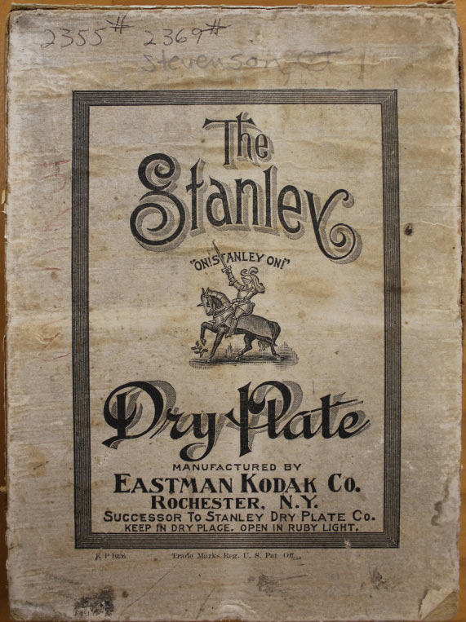
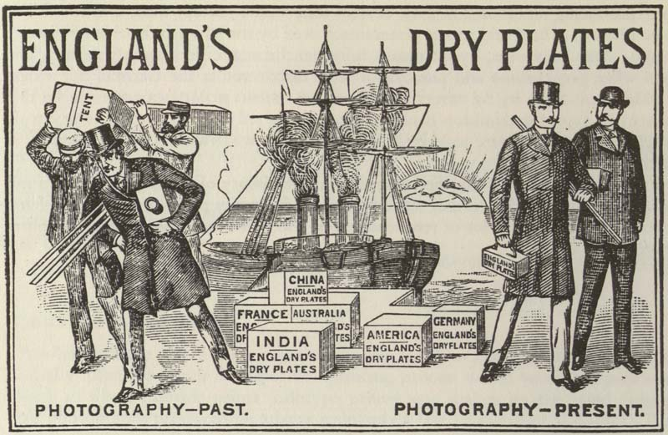
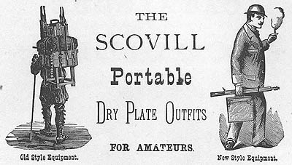
Glass ‘Dry-Plates’
1871, Richard Maddox
less than a second exposure time
prepped and stored
no portable dark room
smaller, lightweight plates
smaller cameras
Notes:
SLIDE 12: Glass Dry-Plates
Much of this was solved with Richard Maddox's ‘dry-plate’ process which sealed the chemicals onto the plate with a thin layer of gelatin. This meant multiple plates could be prepped and sealed beforehand and did not have to be developed directly after exposure, removing the need for a portable dark room. Exposure times were also reduced to less than a minute and his glass plates were smaller and lighter which resulted in a reduced camera size. These were huge forward strides in the area of portability as we can see by the reduced size and amount of equipment portrayed in these ads for glass dry plates.

Slide 13
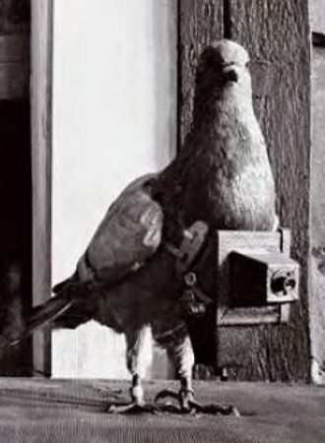
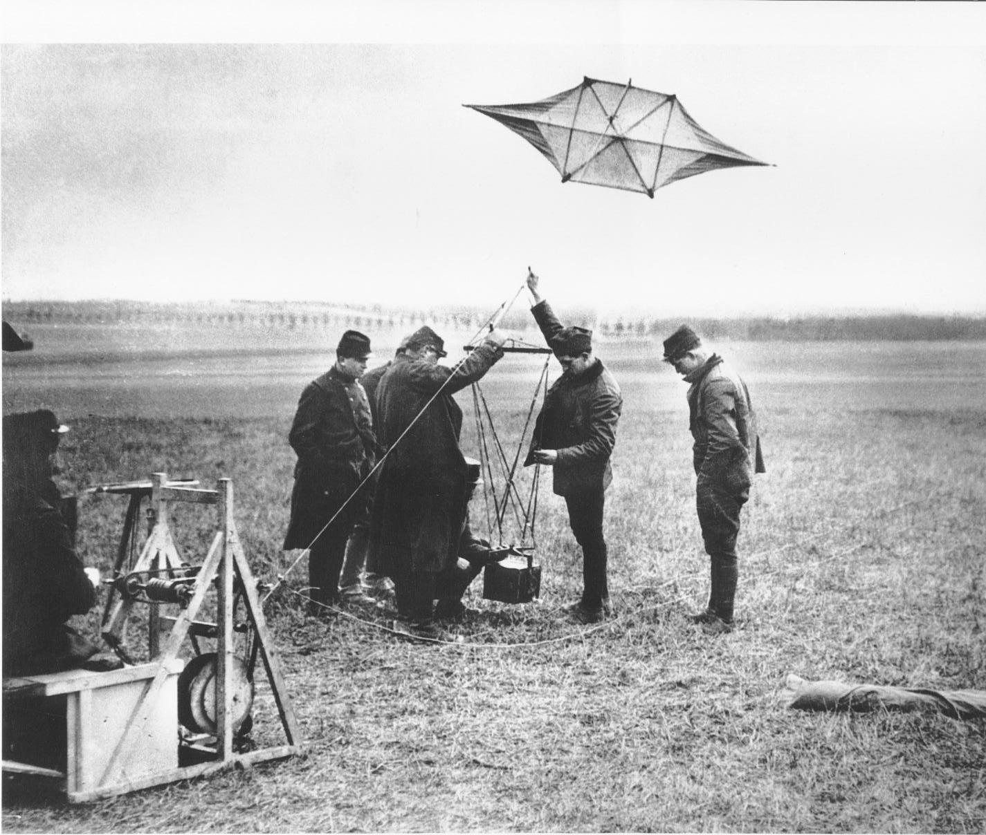
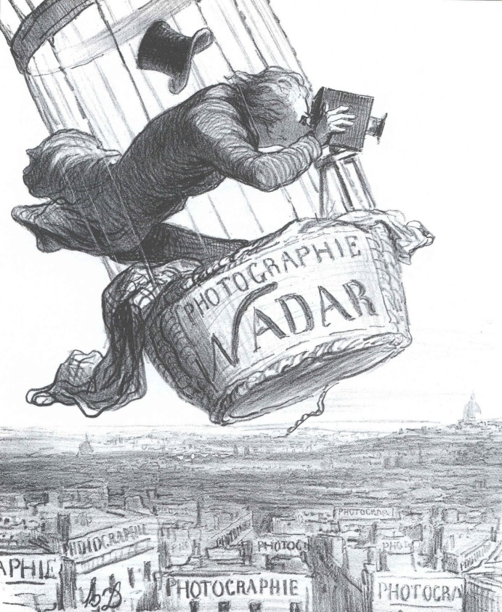
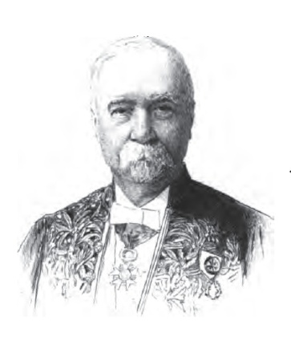
Finding the Right Platform
“It is quite natural to see birds becoming photographers at a time when men are beginning to become birds.”
From a leading French magazine (1909) quoted in Skyview Canada (1976)
1858
“Wet-Plate” Process
Balloons
Kites
Rockets
Pigeons
Felix Tournachon
Laussedat’s map of Paris (1876)
Aimé Laussedat
Notes:
SLIDE 13: Finding the Right Platform
At the same time, others were trying to solve the problem of finding the right vehicle or platform from which to take aerial photos. When the French photographer, Felix-Gaspard Tournachon, known by the pseudonym "Nadar," took the first aerial photograph from a balloon over Paris in 1858 he had to do so using the ‘wet-plate’ process of the time, requiring him to mix those chemicals in the air and create a dark room in the balloon gondola by wrapping a curtain around it. The balloon was not ideal for photography as you can see from this cartoon of Nadar balancing precariously in his basket.
A clever French Colonel of Army Engineers named Aimé Laussedat did use unmanned balloons and kites to successfully produce a map of Paris from air photos in 1876. But the process was far from ideal. It was indeed a monumental innovation and gave birth to the field of Photogrammetry, which simply means, the science of taking accurate measurements from photos but the process required taking numerous oblique angled overlapping photos and then rectifying them to vertical angle. This was a very slow and complicated process and kites and balloons were awkward and unstable platforms.
Subsequently, many different vehicles were experimented with in addition to kites and balloons such as rockets, and yes, even pigeons—but It wasn’t until the invention of the aeroplane in 1903 and the first photograph taken from one in 1909 (just 5 years before the war) that the ideal, stable and manoeuvrable platform for aerial photography was found.

Slide 14
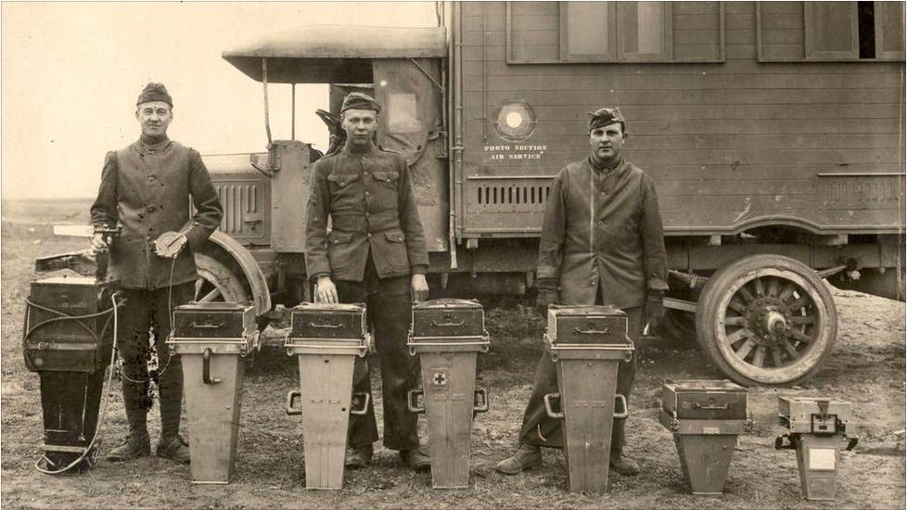
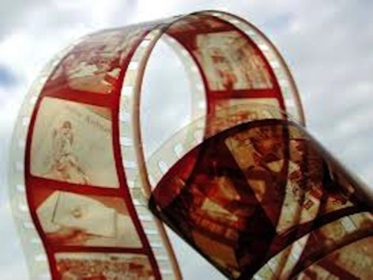
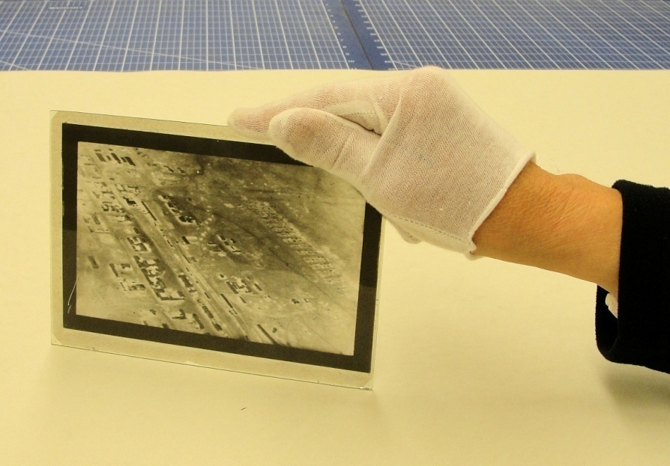
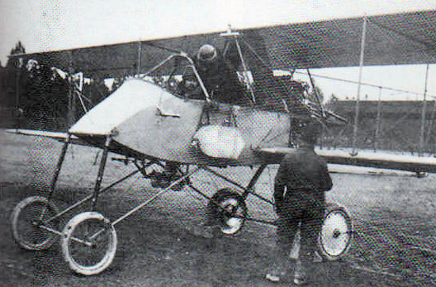

Film vs Glass
1889
early film was extremely flammable
shrink, deform (processing, environment)
early emulsions worked better on glass
quality of resolution and tonal range
problems with static discharges
problems keeping film flat (pressure and suction)
limited focal range & vibration of pre-war cameras
development of auto magazines for glass plates
French cameras, 50cm in focal length at left to 26cm at right
(Finnegan, 2006)
WWI glass, dry-plate negative
Most taken at 10,000 feet with 8” focal length (covered 1 sq mile).
1918: photos could be taken at altitudes as high as 15,000-18,000 feet with a 120cm focal length camera and 18 x 24cm plates.
Swiss Douhet-Zollinger film camera
(Finnegan, 2006)
Notes:
SLIDE 14: Film vs Glass
At the outbreak of the war the photographic medium of choice of the British Royal Flying Corps was the 4 inch x 5 inch glass ‘dry-plate.’ Although flexible, plastic roll film had been invented in 1889 it was not adopted by the Germans until 1916 and never totally adopted by the Allies. The Allies experimented with film in 1915 and had good results for artillery spotting with a pre-war, Swiss Douhet-Zollinger camera but it was limited in focal length. As anti-aircraft fire improved and increased, planes had to fly higher resulting in this camera being abandoned in favour of the more sturdy glass plate cameras they were developing which could withstand the vibration of the plane and take detailed photographs of the ground at much greater altitudes.
Early roll film was also highly flammable and could shrink or deform during processing or under environmental changes. The early emulsions spread better on glass than film and, as a result, the quality of resolution and tone for detailed air photo interpretation was better on glass plates. There were also problems with static discharges caused by the movement of the film and the Allies wrestled with ways for keeping large-format film flat during exposure. Each solution (glass pressure plate, pressure curtain, venturi tube suction) they came up with opened the door to potential scratching of the film, reduced light or some distortion of the image. For these reasons, plates remained in use with the Allies for the rest of the war as these were also less susceptible to the vibration of the plane and draught from the propeller. A major disadvantage, however, of that decision was the cumbersome method of changing plates in order to take multiple shots in rapid succession. Camera magazines had to be designed that could hold multiple plates (usually up to 18) and by the later stages of the war, a mechanism had been developed to automatically change plates by utilizing the power of a miniature windmill mounted externally on the aircraft.

Slide 15


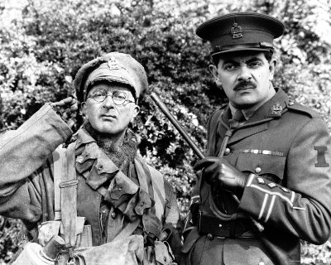
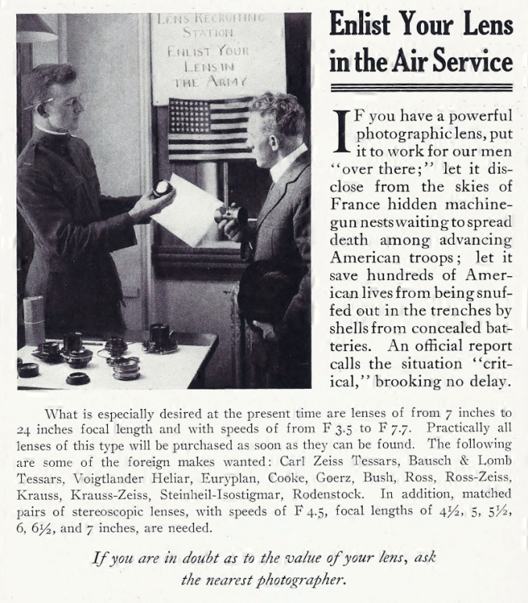

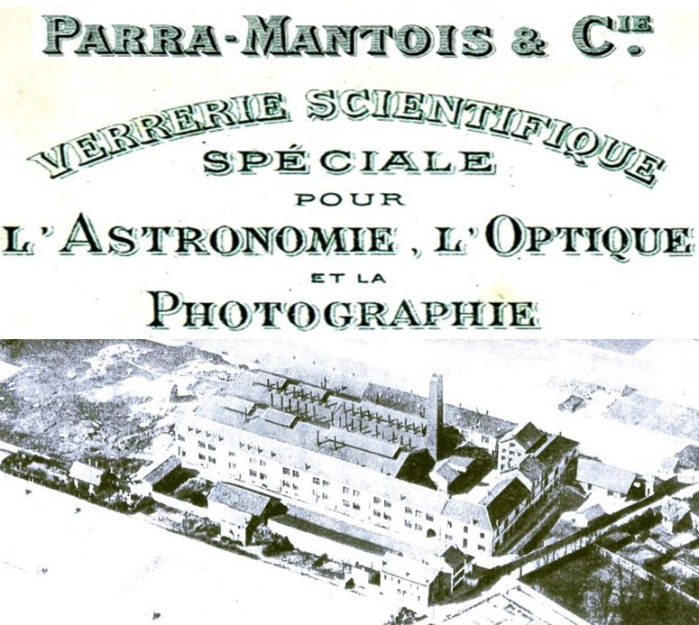

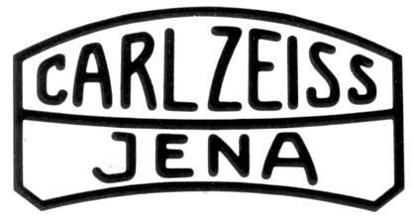
Lenses
Britain:
I have a
cunning
plan...
U.S.:
Private Baldrick’s lenses
(Blackadder Goes Forth, BBC, 1989)
France:
Advert placed in National Geographic (1918)
Germany:
Notes:
SLIDE 15: Lenses
As far as camera equipment went, the Germans had a definite advantage with the best cameras and lenses provided by the Carl Zeiss Company. The French had Parra-Mantois as a supplier but the British, Belgians and Americans were severely lacking in lens making capability. In fact, the British only had one factory in their entire empire. As a result, they relied on their French ally to supply them but the French could not meet the demand alone so, the Allies had to appeal to their civilian populations to donate their lenses from cameras, telescopes, binoculars or anything else they could get their hands on.

Slide 16
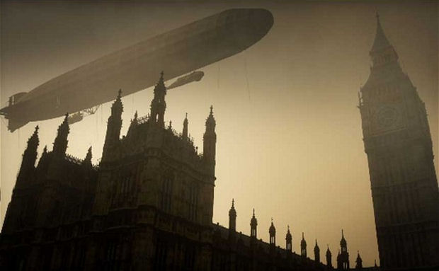
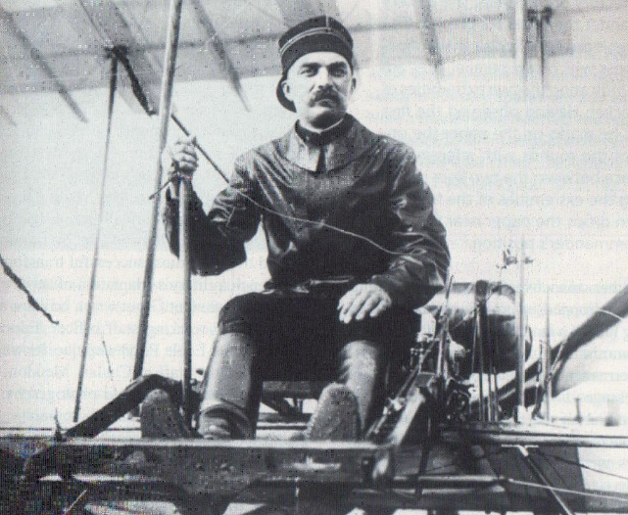
Aviation
France
no European country embraced aviation more enthusiastically
pioneers in air photography, interpretation & photogrammetry
l’Aéronautique Militaire had 141 planes at the outbreak of war
M.Farman was standard Allied training plane until late 1917
French practices adopted in RFC’s 1st training manual
Germany
Capitaine Bellenger, French Aviation Pioneer
(Finnegan, 2006)
more interest in airships (“Zeppelins”)
Dutch manufacturer, Fokker, located in Germany
roughly equivalent size air force to France but more dirigibles
What about…
Great Britain?
Notes:
SLIDE 16: Aviation, French & German
No European country embraced aviation more readily than France. As we have already seen, they were pioneers in aerial photography and photogrammetry. They were early practitioners of air photo interpretation and, in the early days, supplied their allies with numerous, French-made Blériot and Farman aircraft. In fact, The Maurice Farman remained the official Allied trainer until the end of 1917.

Slide 17
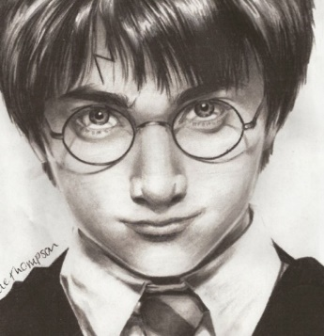
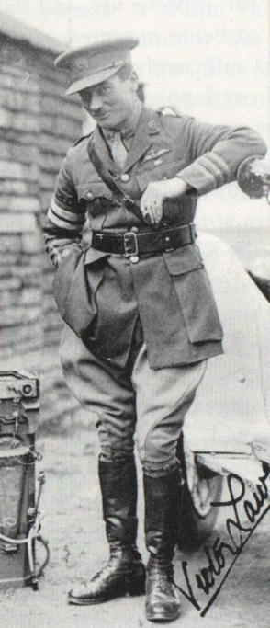
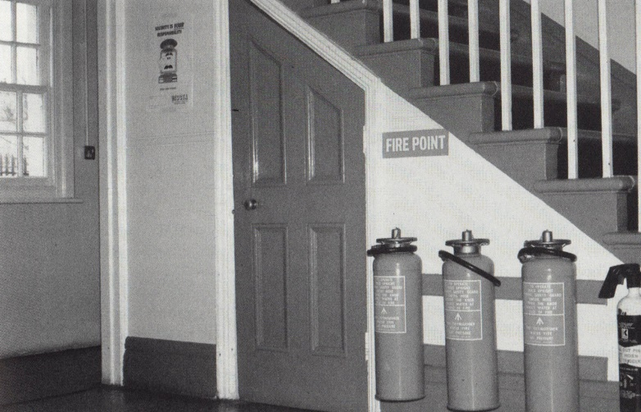


Aviation
Sergeant (later Captain) F.C. Victor Laws
Known as the “Father of RAF Photography.”
(Nesbit, 1997)
Harry Potter
The cupboard under the stairs, RFC HQ, Farnborough.
The RFC’s first air photo laboratory 1913 (Nesbit, 1997)
Great Britain
Britain lagged behind in aviation, air photography & interpretation
Spying on the enemy from the air was “unsportsmanlike.”
Cavalry afraid their role in reconnaissance would be usurped
1909 Louis Blériot crosses English Channel, RFC formed in 1912
no large-scale aircraft or aero-engine industry (Sopwith & Avro)
RFC 5 Squadrons totalled 63 aeroplanes (100 Squadrons in 1918)
Almost all were French-made Blériots, Maurice and Henri Farmans
prior to WWI, used French flying schools to train their pilots
Focussed on naval power (RNAS had 71 planes and 7 dirigibles)
Notes:
SLIDE 17: Aviation, Great Britain
But what about Great Britain? Let me start off by asking, “What do Harry Potter and Victor Laws of the RFC have in common?” Answer: “they both spent a lot of time in the cupboard under the stairs.” This, ladies and gentlemen, was the RFC’s first air photo laboratory and represents the extent of their progression in that discipline as late as 1913. Victor Laws was a great pioneer for the British and went on to become recognized as the “Father of RAF Photography” for his camera designs and innovations but these are the resources and conditions he was working under at the beginning of the war.
Other obstacles to progress in the field included the British High Command’s perception of aerial reconnaissance as “unsportsmanlike” and breaking the chivalric code. The use of Cavalry had been the traditional and gentlemanly method for procuring reconnaissance and the Cavalry guarded this role jealously. It wasn’t until Louis Blériot’s crossing of the English Channel from Calais to Dover in 1909 that widespread support swung in favour of the creation of an air force but it was still 3 more years until the formation of the Royal Flying Corps in 1912. Even then, Britain being a sea power, split its air force in two with the majority of planes going to the Royal Naval Air Service for protection of the navy and surveillance of the English Channel and the North Sea.

Slide 18
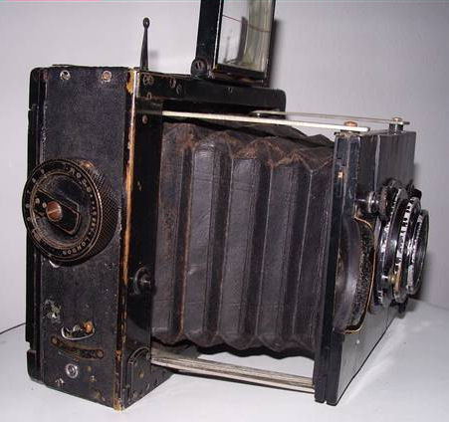
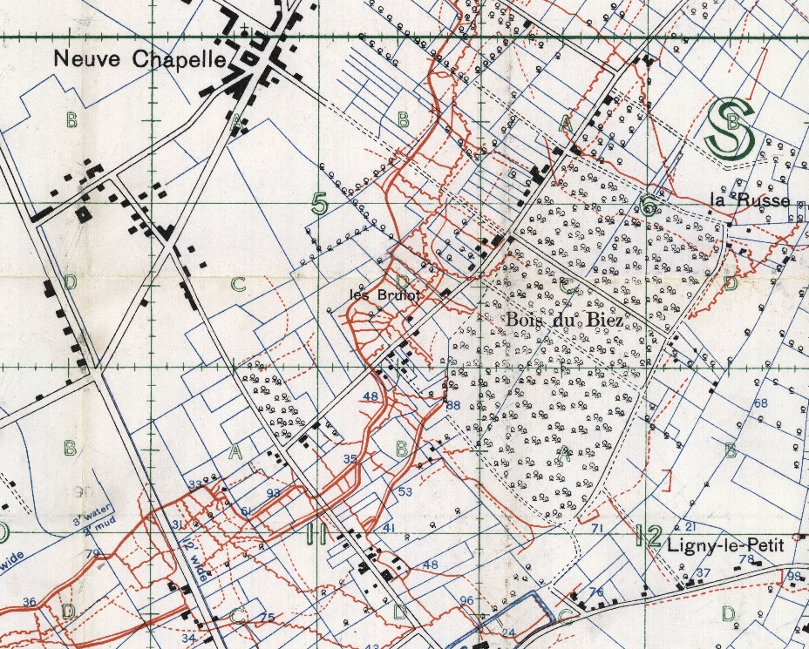
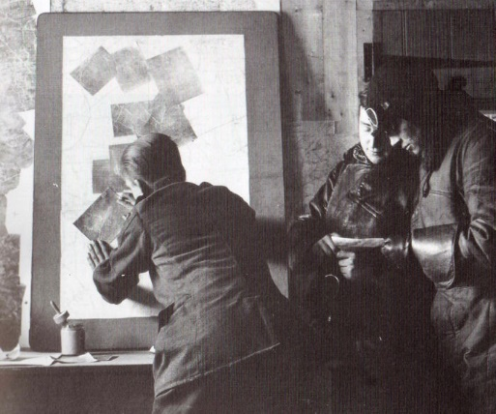
Neuve Chapelle, March 1915
“Flying, you must understand, is merely a sport like any other, from the military point of view it has no value whatever.” Général Ferdinand Foch, French Army
Taking the Initiative:
C.C. Darley, V. Laws, J.T.C Moore-Brabazon & C.D.M. Campbell
Vindication for Aerial Photos: Lt. Charles Darley’s Mosaic Map
Civilian, Pan-Ross (4”x5” plates)
1915: 80,000 prints
1918: 6,000,000 prints
Each sector photographed
once ever two weeks.
…and photo-mosaics issued
down to the platoon level
Trench map of Neuve Chapelle area, July 1915.
German trenches shown in red, British trenches not shown.
Digital Archives #67496
Notes:
SLIDE 18: Neuve Chapelle, March 1915
Even the French High Command still had its doubts about the value of aerial photography and remained very skeptical of the intelligence obtained from this source. For this reason, in 1914 and 1915 with no real official support for aerial photography, young, visionary and innovative British pilots had to take the initiative into their own hands. Some purchased civilian cameras from photo shops when on leave back in London. They took hand-held shots over the sides of the plane or through holes cut in the floor, while cradling the cameras between their legs to reduce the vibration from the engine. They invented camera mounts for the sides of the planes utilizing 4 tennis balls to negate the vibration of the plane and draught from the propeller. But it wasn't until the Battle of Neuve Chapelle in 1915 that aerial photography was finally recognized as being essential to all military planning.
One of these young, British innovators, Lieutenant Charles Darley of 3 Squadron, purchased his own photographic chemicals and set up a dark room in the stables of a chateau where the squadron was billeted. He meticulously acquired photographic coverage of the entire German front in his sector and created a photo mosaic annotated with all points of interest to military intelligence. He presented this to the commanding officers planning the Battle of Neuve Chapelle and by doing so, they were surprised to discover newly constructed German trenches that they had been totally unaware of. This knowledge altered their plan of attack and turned what might have been a disaster into a victory. This was the turning point in attitudes amongst the top brass toward the value of aerial photography. From this point on it was considered to be essential and resources in the form of equipment and personal poured in.

Slide 19
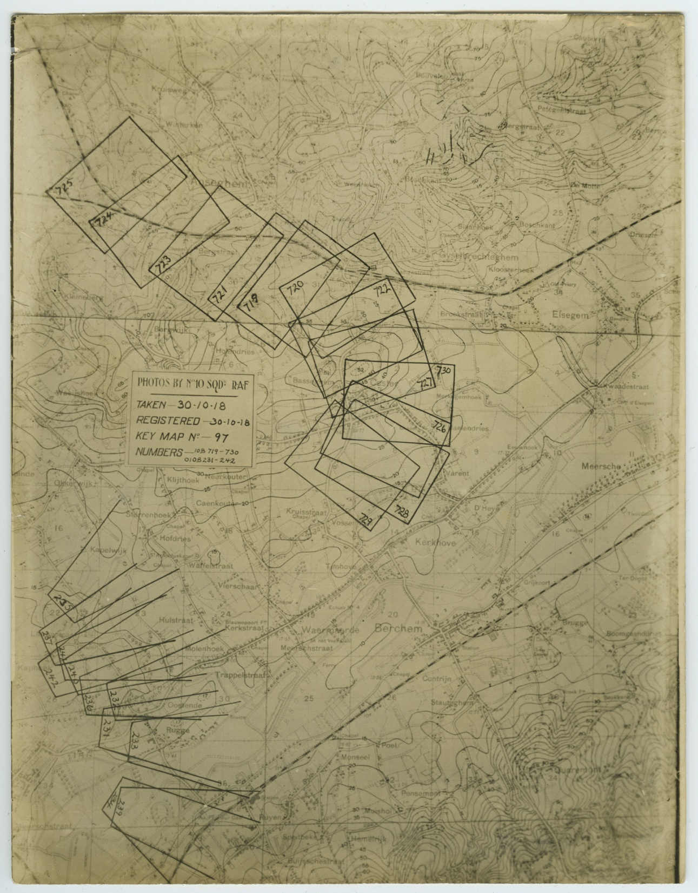

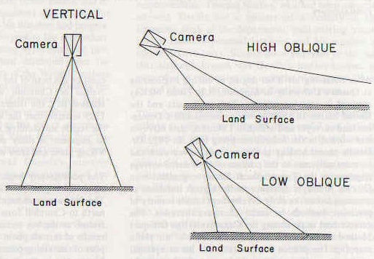
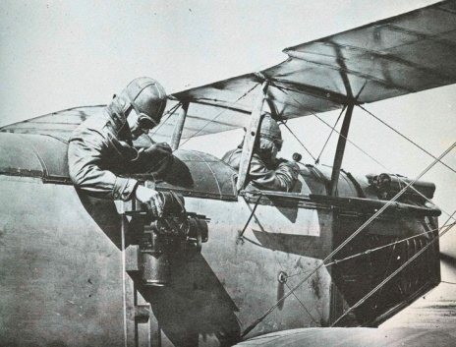
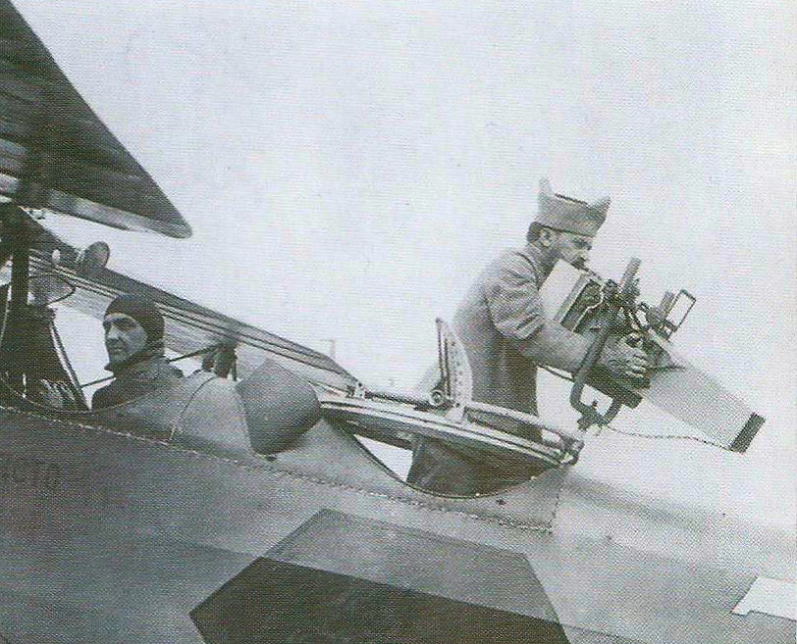
Camera Angles
Digital Archives #5155
Key Map Showing Coverage of Photos
Vertical Photos
Vertical mount
(Heiman, 1972)
Vertical
higher altitude
hard to interpret
2D image
good for maps
(Ives, 1920)
Oblique mount
Oblique Photos
High
low altitude
panoramas
easy to interpret
Low
higher altitude
detect elevations
hidden objects
larger area
(Finnegan, 2006)
Notes:
SLIDE 19: Camera Angles
As things evolved it was discovered that photographs from three basic camera angles would be necessary for compiling the information needed for all branches of military intelligence: high and low oblique and vertical.
Both high and low angle obliques could be taken by a camera mounted to the machine gun ring or turret of the plane. Vertical angle cameras were usually mounted on the side of the plane or sometimes through the bottom. The terms "high" and "low" can be confusing as they do not refer to the altitude but the angle. High oblique means the photo is taken at a low altitude but a high angle of divergence from the vertical. It was often referred to as a panorama shot because multiple, overlapping high obliques could be joined together to form one. These photos are very easy for the lay person to interpret as they represent a view of the surrounding landscape that is familiar to our eyes, only slightly elevated to show more area. As a matter of fact, these photos were usually only taken a couple of hundred feet above the ground making this a very dangerous assignment. Cameras with high shutter speeds had to be used for these panorama shots, otherwise, objects in the foreground like trees may be blurred even though objects in the background are not.
A low oblique was taken at a higher altitude but a lower angle of divergence from the vertical. These obliques were very useful to detect changes in elevation and aspects of terrain. They also revealed objects that may be hidden behind trees and buildings in panorama shots. These hidden objects could be important obstacles to an attack like walls enclosing fields and embankments. Because they were taken at a higher altitude the photo covers a larger area of ground but the oblique angle means the scale of the photo is not constant. Features in the foreground are at a different scale than features in the background. For this reason they are unsuitable for taking accurate measurements for map-making and, as it turned out, accurate mapping proved to be a crucial factor in winning the war.

Slide 20
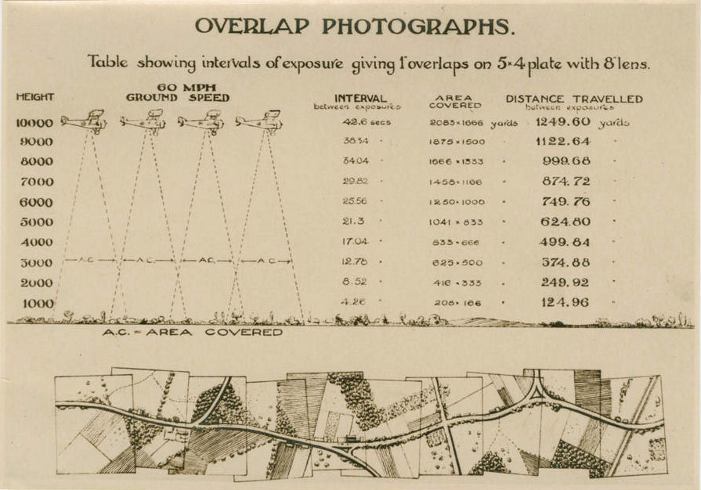
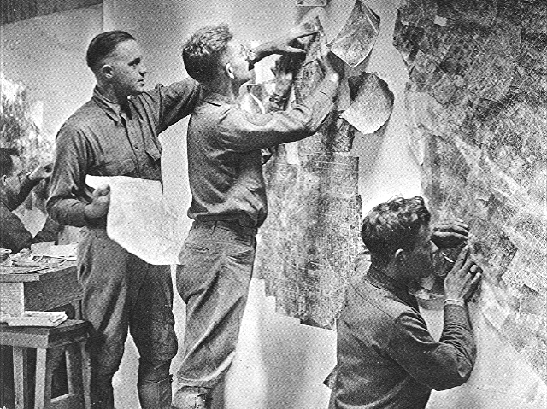
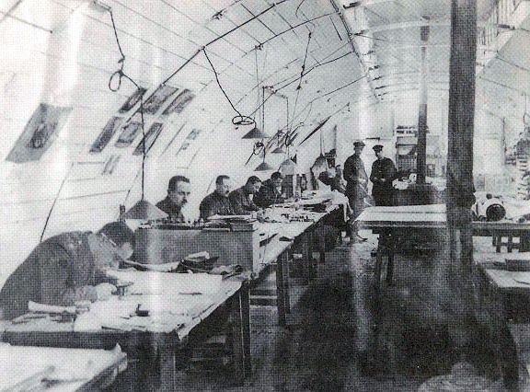
Aerial Photographs for Map Creation
Verticals
scale is constant (photogrammetry)
no object hidden from view
distortion at edges leads to overlap
2D view causes interpretation problems
see everything but in 2-D
features can be misinterpreted
clearly defined shadows needed
Photo Mosaic
Drawing the Base Map
(Heiman, 1972)
(Chasseaud, 1999)
Notes:
SLIDE 20: Aerial Photos for Map Creation
Completely vertical angle photos are used for mapping because measurements of objects or distances between objects will be accurate because the scale will be constant. In other words, photogrammetry will be possible. Another advantage of the vertical angle photo is that nothing is hidden from view. No object is hidden behind another.
There is some distortion, however, in every photo as you move from the centre to the edges. This is caused by the curvature of the lens, and in high altitude shots, the curvature of the earth itself.
For this reason, it became necessary to take overlapping photos so that only the most accurate, central portion of each photo would have to be used.
A disadvantage to the vertical shot is that it is still a relatively new perspective for us. For thousands of years people have only been able to look down on objects at an oblique angle from mountainsides or tall buildings. This overhead perspective of the world is still somewhat alien and some find it hard to interpret what they are seeing. Think of Google maps or satellite view. Even though they make this vertical perspective commonplace today, we still find it extremely useful to have Google streetview as well so that we can see the side or profile of objects in order to confirm their identity. Vertical images are two-dimensional. We only see length and width not height. Unless the shadows are well defined, hills and depressions are hard to detect. Obstacles to an attack plan like walls may appear as only narrow white lines which may be misinterpreted as roads or pathways. A dangerous mistake to make.

Slide 21




Stereoscopic Photos
L. Tom Perry Special Collections, MSS P 72, Brigham Young University
Beginning in mid 1915
increase overlap to 60-75%
stereos become 3-D images
not a new concept
enables placement of contours
enables camouflage detection
Chameleon Insignia for French Camouflage Unit (Finnegan, 2006)
Punch Magazine, 1856
Notes:
SLIDE 21: Stereoscopic Photos
A solution to this problem with verticals can be found by increasing the overlap.
Photos that overlap as much as 60 to 75 percent are called stereoscopic. When viewing two such overlapping photos under a stereoscope, all features that appear on both photos will appear in 3D.
This occurs because the angle of objects taken in the two pictures will be slightly different on each photo and if aligned and spaced correctly under the stereoscope to mimic the distance between our eyes the images will merge into one three-dimensional form.
This was not an entirely new concept as stereo photos had been used for decades during the Victorian era as a form of entertainment similar to the View-Master which was a toy many of us may remember from our childhood. The difference is that this was the first time it had ever been employed in a military application for the purpose of determining elevations in order to place contour lines on maps.
This ability to change two-dimensional objects from photos into 3D objects is also the reason that the stereoscope became known as camouflage’s worst enemy.
Bridges painted to match the water below may have gone unnoticed on flat, two-dimensional vertical air photos but when viewed in stereo the bridge jumps up in elevation above the surrounding river.
Buildings and military emplacements in camouflage paint suddenly stand out in relief against their surroundings.

Slide 22


Other Aids for Interpretation
Spotting enemy activity and camouflage
temporal coverage detects appearance, disappearance, or change
monthly, weekly, daily, hourly
turn-around time 30 minutes
August 12, 1917
December 26, 1917
Digital Archives #5096
Digital Archives #5114
Notes:
SLIDE 22: Other Aids for Interpretation
In addition to stereoscopic coverage, another indispensable tool for photo interpretation is something called ‘temporal coverage.’ In other words, multiple photos of the same area taken at different times.
After all, It is not always the object in a photo that is suspicious but rather the appearance, disappearance or change of objects from one photo to the next.
As the war progressed and aerial reconnaissance became streamlined and more prolific, coverage went from monthly to weekly, daily, or even hourly if needed.
And the turn-around time from the moment a crew left the ground to the time it submitted photos to Intelligence HQ to view could be as little as 30 minutes.

Slide 23


Aerial Photographs for
Offensive & Defensive Planning
assess the strengths and weakness of enemy's defences
but also your own.
detect enemy camouflage and success of your own
track progress of maintenance work on both sides
detect preparations for an attack.
(increase in enemy troops, new trenches, roads, rail, & airfields)
Digital Archives #4952
Hours Before Battle
assess success of preliminary bombardment
(destruction of enemy trenches, wire & guns)
identify surviving enemy guns
(to concentrate all your artillery power on them)
spot gaps in wire
(to exploit them for new attack routes)
During Battle
assess damage, new supply routes & gun positions
After Battle
identify all new positions to update maps
Digital Archives #4980
Notes:
SLIDE 23: Offensive & Defensive Planning
Interpretation was required for many aspects of offensive and defensive planning during WWI:
to assess the strengths and weakness of not only your enemy's defences but your own as well. This includes trench, communication and supply networks
to detect enemy camouflage and assess the success of your own
to track the progress of maintenance work on both sides
to detect preparations for an attack. Specifically, the increase in number of troops at the front or the new construction of "jump off" trenches, roads, railways and airfields.
Hours Before Battle
to assess the success of preliminary artillery bombardments in the destruction of enemy trenches, barbed wire and guns.
Surviving enemy guns can then be identified and more artillery power can be concentrated on the remaining ones. Attack routes can be altered to exploit gaps in enemy wire.
During Battle
to assess damage, new supply routes and gun positions
After Battle
to identify all newly assumed positions and update maps as soon as possible.

Slide 24



Origin of Air Photo Interpretation
Deductive Reasoning and the Influence of Sherlock Holmes:
“the small scale of the photographs, in which a machine gun shows as a mere pin point, adds to the uncertainty [of identification], with the net result of making interpretation a task of minute study and deduction worthy of Sherlock Holmes.” Herbert Eugene Ives (1920)
1887-1927
Benedict Cumberbatch
Sherlock, 2010-2017
Basil Rathbone
The Hound of the Baskervilles, 1939
Jeremy Brett
The Adventures of Sherlock Holmes, 1984-1994
Notes:
SLIDE 24: Origin of Air Photo Interpretation
The deductive methods used in air photo interpretation are very much like those used in a Sherlock Holmes novel or short story. In fact, Conan Doyle may have had a direct influence on the field of interpretation as the first Sherlock Holmes stories were written as early as 1887 and continued to be written through the First World War to as late as 1927. They have already been proven to have influenced changes in methods used in criminal investigation and Herbert Eugene Ives in his book, Airplane Photography published just after the war in 1920, stated that “the small scale of the photographs, in which a machine gun shows as a mere pin point, adds to the uncertainty [of identification], with the net result of making interpretation a task of minute study and deduction worthy of Sherlock Holmes.” And, just like Holmes, air photo interpreters—as you may already be beginning to guess—could pull a litany of details out of a single scrap of paper.

Slide 25






Aerial Photograph
Interpretation 101
A game of misdirection?
direction of north
direction of shadows
Game of Shadows
North
Incorrect: shadows away
(Ives, 1920)
Correct: shadows toward
North
Digital Archive #5120
http://digitalarchive.mcmaster.ca/islandora/object/macrepo:5120
Notes:
SLIDE 25: Interpretation 101, Game of Shadows
So now, if your are willing, I would like to give you all a brief, crash-course in ‘WWI air photo interpretation.’
Let’s start with the ‘north arrow.’ It is annotated on most photos primarily so that that the photo can be oriented the same way as a map covering the same area. This allows you to be able to make direct comparisons between the two.
Reconnaissance crews annotated the date and time the photo was taken on a corner of the photo but the interpreter would have to determine the direction of north based on this information in conjunction with the direction of the shadows caused by the sun. To do this they would use this very difficult looking—but actually rather simple to read—dial. Imagine the centre of the dial is the sun and the lines emanating from it are the directions of the shadows. Select the Roman numeral (a.m.) or Arabic numeral (p.m.) that represents the time of day the photo was taken and then use the line between it and the centre of the dial representing the sun to align with the shadows on the photo. Once you have that line parallel to the shadows on the photo, the letter ‘N’ on the dial designates the general direction of north somewhere between the two arrows. You can further increase the accuracy of this calculation by using the small Roman numerals between the arrows which indicate the months of the year. Draw a line from the centre of the dial through the small Roman numeral between the two arrows indicating the month the photo was taken and you will have a truer direction for north.
However, when not using the photo in conjunction with a map, but instead viewing a photo for interpretation purposes, you should not automatically rotate the image so that north is at the top. You should instead rotate the image so that the shadows from objects fall toward you the viewer. The reason for this is that we are not accustomed—at ground level—to see shadows that fall behind objects as they are blocked from our view by the object itself. We only see those shadows that fall toward us. But on vertical photos we do see these shadows. If we orient the shadows away from us it confuses our brain and we tend to flip the image seeing depressions where there are hills and hills where there are depressions.

Slide 26





Aerial Photograph
Interpretation 101
examine entire photo in detail
compare photos from different angles
compare photos from different dates
compare with maps of same area to determine scale or use FL + Al
angle of sun and shadow lengths can determine height of objects
the Adventure of the Musgrave Ritual, BBC (1986)
“Where was the Sun?
Over the Oak.
Where was the Shadow?
Under the Elm.”
Riddle from the Adventure of the Musgrave Ritual (1893)
Notes:
SLIDE 26: Interpretation 101, the Musgrave Ritual
1. Next, every inch of the entire air photo was examined in a slow, methodical fashion with a magnifying glass.
2. It was then compared to photos taken at different angles to help identify features.
3. It was then compared to photos of the area taken on different dates to check for the appearance, disappearance or change to any object.
4. Terrain in the photo was compared to a topographic map of the area which made it possible to ascertain the scale of the photo. The focal length and altitude of the photo could also accomplish this.
5. Once the scale was determined, the length of shadows could be used in conjunction with the angle of the sun (based on the date and time of day) to determine the height of objects using trigonometry.

Slide 27



Aerial Photograph
Interpretation 101
Uncovering the True Nature of Objects
Tone & Texture: Vegetation
light bounces, absorbs, transmits
camouflage paint
cut branches
bands of barbed wire
German artillery position camouflaged with cut vegetation.
Band of barbed wire
Agricultural fields
Notes:
SLIDE 27: Interpretation 101, Tone & Texture
Tone and texture in a photo are two more tools an interpreter can use to uncover the true nature of objects.
A concrete bunker painted to blend in with vegetation may fool a pilot’s eye but not the eye of the camera. Light will bounce off its hard surface and reflect back at the camera recording a brighter tone just as black asphalt roadways appear white in B & W photos. Branches and foliage cut from trees to use as camouflage will appear as a different shade or tone in photos from the surrounding foliage as the vegetation begins to dry out. Colour-filter lenses were also used to differentiate things like real vegetation from imposters. In WWII they took this a step farther as they had invented infrared lenses by then. Since the chlorophyll in plants absorbs red light, live, healthy vegetation would appear as a bright red colour in an infrared photo, while cut, dying vegetation would appear as a dark brown colour. On the other hand, bands of barbed wire that had been out in the field for some time and have weathered and rusted often appeared as fields of dormant vegetation. This could be a deadly mistake for an interpreter to make and it did occur in WWI. Usually, however, these bands were laid in triangular or other geometric shapes to force attackers into killing zones so these distinctive shapes gave them away.

Slide 28


Aerial Photograph
Interpretation 101
Shape & Pattern Recognition (Signatures)
Shape
railways vs roads
dumps and guns
battery size
battery direction
Signatures
dumps
barracks
factories
batteries
Fingerprints
Plumes
melted snow
Artillery battery
Digital Archive #4977
Notes:
SLIDE 28: Interpretation 101, Shapes & Signatures
So shape also played a very important role in interpretation. Railways could be differentiated from roads due to their characteristic switches, sidings and especially by their large, gentle curves with no sharp 90 degree turns. They were important to make note of because they usually passed by important enemy targets like supply and ammunition dumps and terminated at strategic points like large gun emplacements. A task of primary importance during the war was the location of enemy gun batteries. The shape and size of emplacement could identify what type of guns were there. The direction they were facing was important to ascertain what they might be targeting or to determine what Allied units might be within their range and field of fire.
Patterns created by the location of certain man-made objects in proximity to each other created what became known as "signatures" which could identify their function. For instance, several buildings adjacent to a road or rail network with large, stacked objects evenly spaced and surrounded by a fence would probably indicate a supply depot. If the stacks were spaced further apart with barriers around them it was probably an ammunition depot. Barracks were easily identified because of the intense movement of ground troops and by the large number of rectangular buildings in a regular layout, usually appearing light in tone in the photos because they were all made of wood. They were even able to identify different types of factories and power facilities just by the type and arrangement of buildings.
The signature of an artillery battery was usually 4 to 6 horseshoe-shaped earthworks side-by-side as we see here in this photo taken during the winter months.
But there is something strange about this particular battery. Human activity is very hard to hide in aerial photographs—especially in the winter. It leaves many fingerprints—or should I say footprints? For example, It is clear that this battery is either deserted or a dummy as there are no dark patches on the snow in front from the muzzle blasts of the guns as in the battery to the right. Melted patches of snow could also mean heating and cooking fires below in underground dugouts used as barracks for troops manning the guns.

Slide 29


Aerial Photograph Interpretation 101
Fingerprints and Footprints:
Camouflage Discipline
Digital Archive #5096
Digital Archive #4732
Notes:
SLIDE 29: Interpretation 101, Fingerprints or Footprints
In order to leave no fingerprints something called camouflage discipline was adopted. This meant that soldiers were expected to take a long, indirect route to any camouflaged position, usually entering by a concealed entrance.
Even though this photo was taken later during the war in 1917 when camouflage discipline would have been in place, the German soldiers going to-and-from the bunkers hidden in this long, rectangular woodlot have disregarded it. We can see many fine, light lines indicating absent vegetation due to men beating paths back and forth. These paths all lead to the woodlot sending up a ‘red flag’ for any Allied photo interpreter. Maybe they felt they were far enough behind the front line to be safe from any danger, or maybe they simply got careless. Either way, we can see the results this carelessness in this enlargement—or quite literally, a blow-up—of the same area taken at a later date. Even though the trees all now appear as broken toothpicks surrounded by a pockmarked landscape we can still see the remnants of some of the bunkers that were hidden there.

Slide 30

Aerial Photograph Interpretation 101
Putting Them on the Couch
Stage 1:
5-7 graves per row
Symmetrical design
Landscaped with crosses
…and looking at the bigger picture.
Psychological Analysis
Stage 2:
5-7 graves in straight rows
Less attention to landscaping
Stage 3:
Doubles existing size
Up to 15 graves per row
No crosses or landscaping
Access road added
Stage 4:
Not in use yet
Size cleared indicates expectation of more casualties
morale down
resources down
casualties up
(Stichelbaut, 2013)
Notes:
SLIDE 30: Interpretation 101, Putting Them on the Couch
Another branch of air photo interpretation involved looking at the bigger picture (no pun intended). Rather than trying to determine the identification of individual topographic or tactical features, the interpreter or analyst would take a much broader overview of the human activities in the photo and attempt to gauge the enemy’s mindset by reading between the lines.
To illustrate what I mean, let me share with you an example taken from Stichelbaut’s book, "The Great War Seen from the Air.“ In his book he presents us with a photo of a German field hospital beside a windmill at the edge of the Belgian town of Gheluwe, and tells us to pay close attention to the adjoining cemetery. On close inspection we can see that the German military cemetery is separate from the town’s civilian cemetery and seems to have been built in four stages. The original section is located furthest from the road and is very meticulously laid out and adorned with shrubs and plants. All the graves have individual white crosses and the whole layout was carefully planned with attention to symmetry. The second phase was constructed toward the road and graves were grouped in rows of 5 to 7 soldiers. The next phase doubled the size of the cemetery and added an access road. The third phase shows rows of up to 15 graves. The space allotted to each grave is smaller and they no longer have individual white crosses. The fourth and newest phase is not in use yet but by the size of the land which has been cleared and prepared; it appears they expect many more deaths. The lack of time, resources and attention being devoted to the more recent burials, could be interpreted to be a sign that enemy moral is decreasing while the casualties they are suffering are increasing.

Slide 31






Legacy
Continuing Influence
Ledegem Station in 2017 and in 1918
archaeologists and engineers using our maps and photos to determine where to employ ground-penetrating radar.
(France and Belgium)
Notes:
SLIDE 31: Legacy
So, this has been a very short and superficial introduction to what is a very vast and complex subject. I hope you now have a deeper comprehension of the lasting influence that aerial photography has had in shaping our modern world.
As for the legacy of these photos shot during the war, in some cases, they may be the only accurate record left to us of geography that has been forever altered by the devastation known to us as the Great War. Today, they are valued and consulted not only by those who wish to preserve the past but also by those who wish to construct our future on these landscapes of past conflict.

Slide 32
Gord Beck
Map Specialist
Lloyd Reeds Map Collection
Mills Memorial Library
beckg@mcmaster.ca
References:
Beach, J. (2013). Haig's intelligence: GHQ and the German Army, 1916-1918. Cambridge: Cambridge University Press.
Collier, P. (January 01, 2002). The Impact on Topographic Mapping of Developments in Land and Air Survey: 1900-1939. Cartography and Geographic Information Science, 29,3, 155-174.
Dye, P. (Spring, 2009). France and the Development of British Military Aviation. Royal Air Force: Air Power Review, 12, 1, 14-26.
Finnegan, T. J., & Center for Strategic Intelligence Research (U.S.). (2006). Shooting the front: Allied aerial reconnaissance and photographic interpretation on the Western Front--World War I. [Washington, D.C.]: Center for Strategic Intelligence Research, National Defense Intelligence College.
Heiman, Grover. (1972). Aerial Photography: the story of aerial mapping and reconnaissance. New York: The Macmillan Company Ltd.
Ives, H. E. (1920). Airplane Photography. Philadelphia: Lippincott.
Mead, Peter. (1983). The Eye in the Air: history of air observation and reconnaissance for the army, 1745-1945. London: H.M.S.O.
Nesbit, Roy Conyers. (1997). Eyes of the RAF: a history of photo-reconnaissance. Godalming, Surrey: Bramley Books.
Sinclair, J.C. (2008). One Hundred Years of Canadian Military Mapping, 1903-2003. Ottawa: Baico Publishing Inc.
Stichelbaut, B., Chielens, P., In Flanders Fields Museum., Imperial War Museum (Great Britain), & Musée royal de l'Armée et d'histoire militaire. (2013). The Great War seen from the air in Flanders fields, 1914-1918. Brussels: Mercatorfonds.
Thomson, D. W. (1975). Skyview Canada: A story of aerial photography in Canada. Ottawa: Dept. of Energy, Mines and Resources.
Notes:
SLIDE 32: Sources of Information and Recommended Reading

