Slide 1
Do More With Digital Scholarship: Visualization
Matthew Davis
January 26th, 2018

Slide 2
What are we doing here?
Defining what visualization is for our purposes.
Looking at some methods to capture three-dimensional objects for digital display and analysis, with the idea of allowing drill-down in the real world.
Considering what the underlying data of a visualization might be and how much data is necessary.
Determining what elements are necessary, at a minimum, to make a visualization useful to others.
Thinking about different purposes for visualization.
Discussing how to critique visualizations.

Slide 3
What is visualization?
When people talk about visualization, they are often referring to data visualizations. This is not the only kind available, however.
Notes:
Cut to examples

Slide 4
What is visualization?
When people talk about visualization, they are often referring to data visualizations. These are not the only kind available, however.
A visualization is anything that uses images, diagrams, or animations to communicate a message.
Notes:
Cut to examples

Slide 5
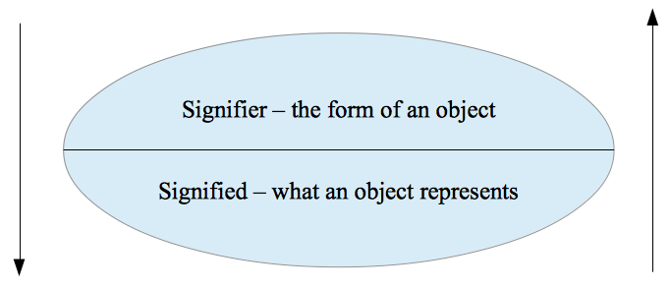
Visualization – Yea or Nay?

Slide 6
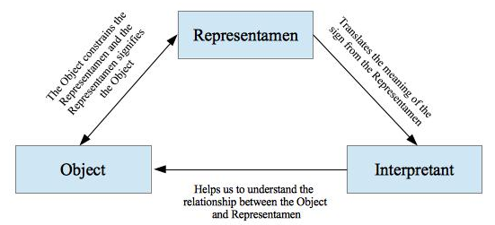
Visualization – Yea or Nay?

Slide 7
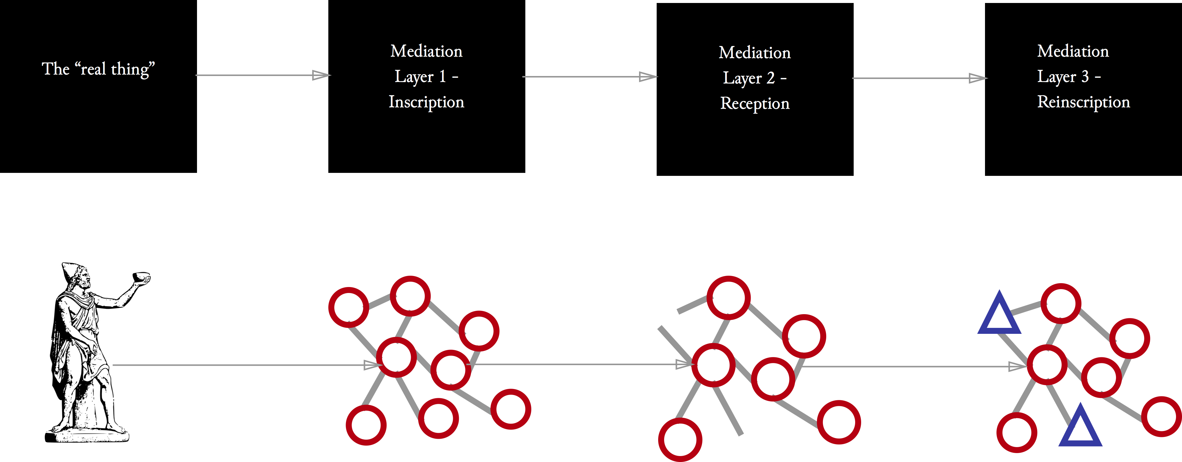
Visualization – Yea or Nay?

Slide 8
Visualization – Yea or Nay?

Slide 9
Visualization – Yea or Nay?

Slide 10
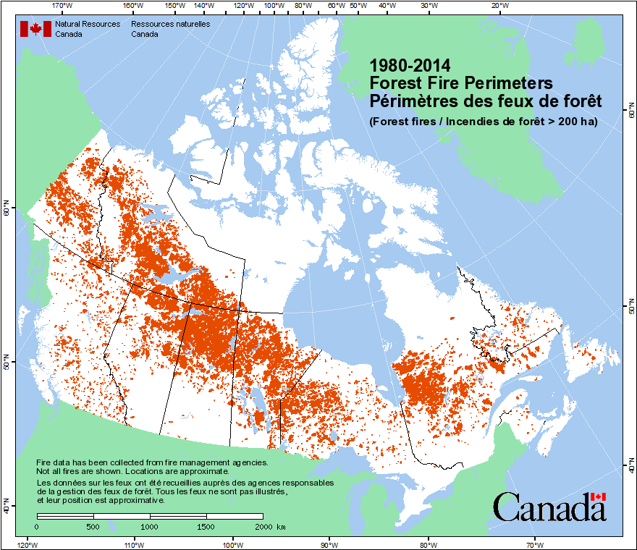
What is visualization?
When people talk about visualization, they are often referring to data visualizations.
Maps

Slide 11
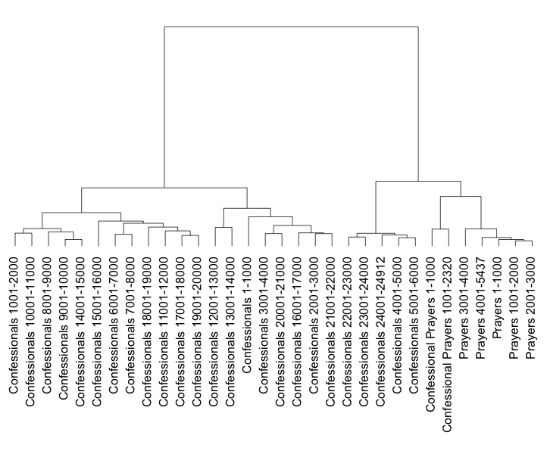
What is visualization?
When people talk about visualization, they are often referring to data visualizations
Maps
Charts

Slide 12
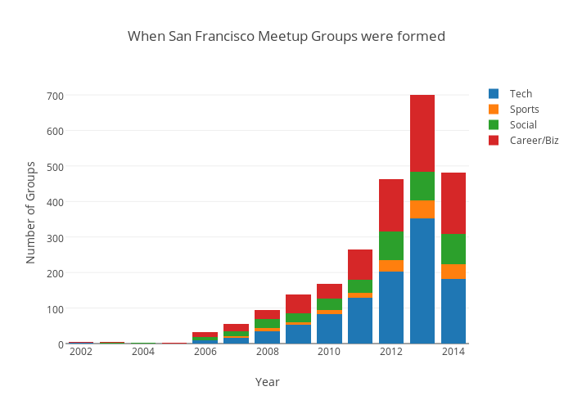
What is visualization?
When people talk about visualization, they are often referring to data visualizations
Maps
Charts
Graphs

Slide 13
What’s the Difference?

Slide 14
What’s the Difference?
Really, there isn’t one.
Notes:
All these are are ways to represent data visually in a way that makes sense to people

Slide 15
Charts, Maps, and Graphs are…
Ways to graphically represent complex data in a way that is hopefully immediately intuitive and understandable by a person.

Slide 16
Charts, Maps, and Graphs are…
Ways to graphically represent complex data in a way that is hopefully immediately intuitive and understandable by a person.
Fundamentally bound by the organizational structure of the data that the visualization is drawn from.

Slide 17
Charts, Maps, and Graphs are…
Example: Comparing play structures
Example: The Lydgate Corpora

Slide 18
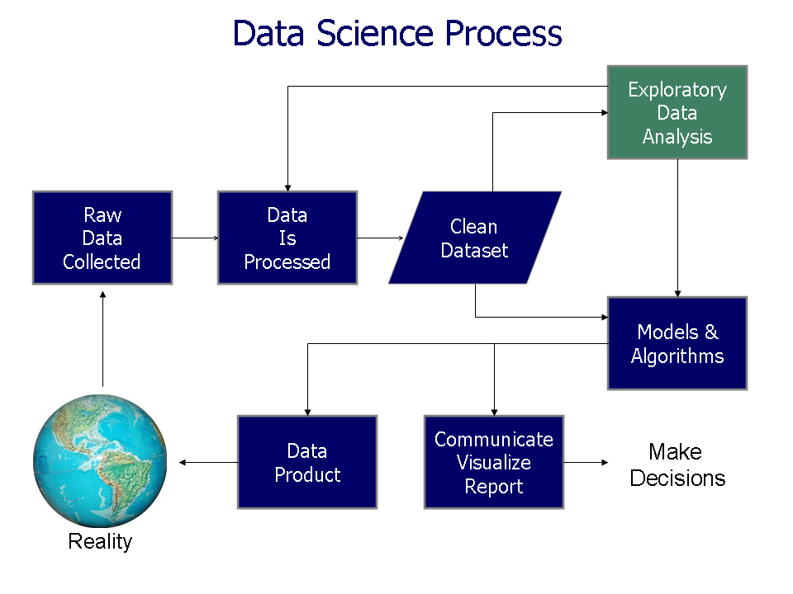
Data Science According to Popular Conception

Slide 19
Explanatory versus Exploratory Graphs
An Exploratory Visualization is:
A way to get familiar with the data you’re working with.
Often drawn from a series of set graphical techniques.
A slow process – looking at the data in order to find the one or two things that are interesting.
An Explanatory Visualization is:
Showing those one or two interesting things about the data.
The process of using data in order to tell a story or to reinforce a narrative you have already determined based on your other research.
The primary type of data visualization we interact with both inside and outside of the academy beyond our own work.
These two are not mutually exclusive. Sometimes the process of expanding upon or modifying an explanatory visualization created for another purpose can yield interesting results.
Notes:
Examples - http://bl.ocks.org/robschmuecker/7880033
http://mbostock.github.io/d3/talk/20111018/tree.html
https://bost.ocks.org/mike/hive/
http://mbostock.github.io/d3/talk/20111018/cluster.html
http://bl.ocks.org/mbostock/4063550
http://bl.ocks.org/mbostock/4063582
http://mbostock.github.io/d3/talk/20111018/partition.html

Slide 20
Tools for analysis (by no means complete!)
Data refining
Microsoft Excel
OpenRefine (http://openrefine.org)
OxyGen (https://www.oxygenxml.com)
Realistically, if the data set is in an open format any tool able to import that format will work for you. Do not use proprietary tools with their own data formats unless they have an export option!
Visualization
Microsoft Excel
R (https://cran.r-project.org)
Rattle Gui (http://rattle.togaware.com)
Weka (http://www.cs.waikato.ac.nz/ml/weka/)
Gephi (https://gephi.org)
D3.js (https://d3js.org)
Tableau (http://www.tableau.com)

Slide 21
Good visualizations…
Readily convey some aspect of the data in a clear, concise, and easily understood manner.
Provide information and contextualization that cannot easily be conveyed by another means. Don’t make a visualization for the sake of making a visualization!
Provide ready access to the underlying data so that interested people can take your work to the next level or check your analysis.

Slide 22
Three-dimensional models
Sometimes the relationships between things don’t work quite right in the two-dimensional context of a screen.
3D models can help to make the relationships between things more accessible.

Slide 23
LIDAR scanning

Slide 24
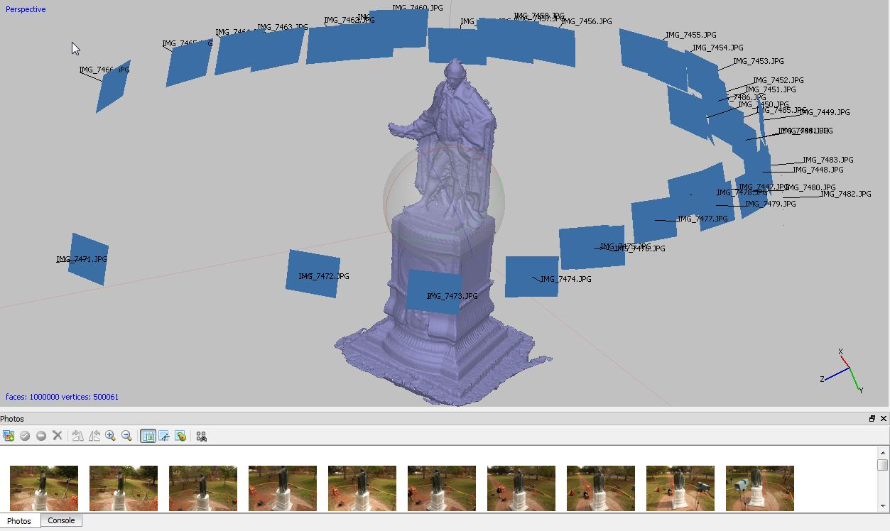
Photogrammetry

Slide 25
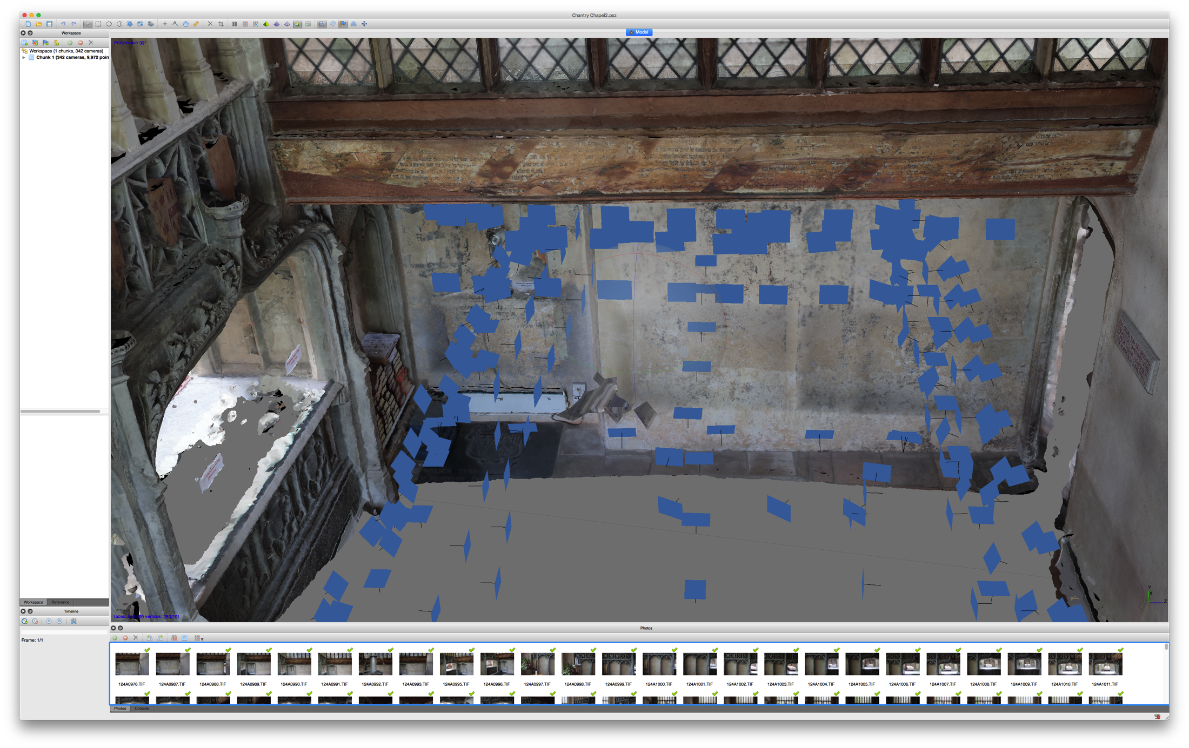
Visualization: Yea or Nay?

Slide 26
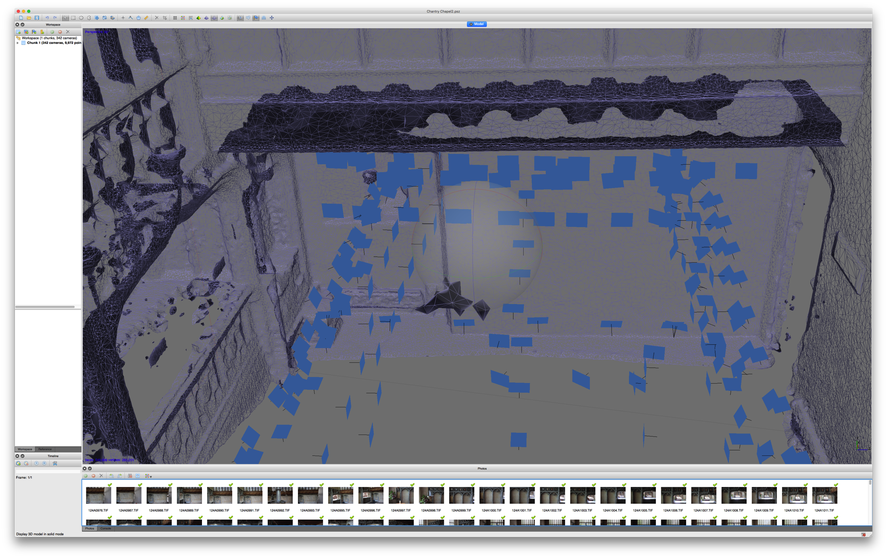
Visualization: Yea or Nay?

Slide 27
Exercise: Good or Bad Visualization?
http://www.bloomberg.com/graphics/2015-whats-warming-the-world/
http://xkcd.com/980/huge/#x=-6416&y=-7232&z=3
http://cs.colby.edu/courses/S14/cs251/LectureNotes/figures/developer_skills.jpg
https://www.good.is/infographics/issue-38-celebrity-activism#open
What would make these better?

Slide 28
Examples of Possible Visualizations
https://github.com/d3/d3/wiki/Gallery

