Slide 1
Do More with Digital Scholarship: XML-Based Metadata
September 26th, 2017
Matthew Evan Davis
Postdoctoral Fellow, Sherman Centre for Digital Scholarship
davism17@mcmaster.ca
@medievalmatt

Slide 2
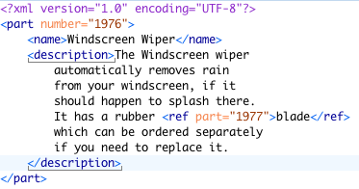
So what does XML-Based Metadata mean?
XML – eXtensible Markup Language (https://www.w3.org/standards/xml/core)
A set of rules for encoding a document in a format that both humans and machines can read.
These rules are meant for annotating documents, but can also be used to store data.
Very similar in appearance to HTML, but both more flexible and stricter in implementation.

Slide 3
So what does XML-Based Metadata mean?
XML – eXtensible Markup Language (https://www.w3.org/standards/xml/core)
Metadata – data that gives information about other data (how meta!). It falls into three types:
Descriptive metadata is information, such as a title, abstract, author information, or keywords that might help find and identify the underlying data
Structural metadata is metadata about how the underlying data is put together – chapters in a book, songs on an album, or other aspects of the types, versions and relationships of materials
Administrative metadata is information, such as a creation date, that helps to manage the underlying data.

Slide 4
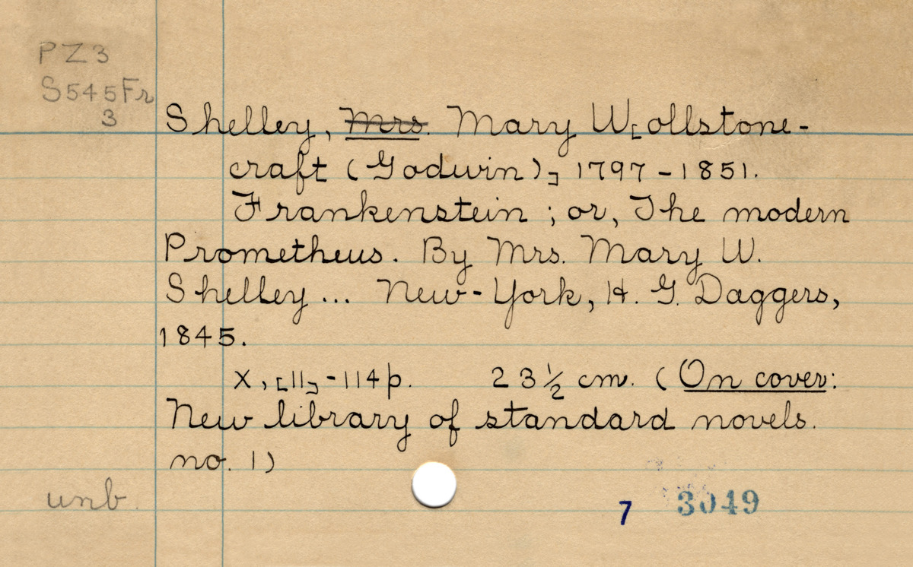
What’s What?

Slide 5
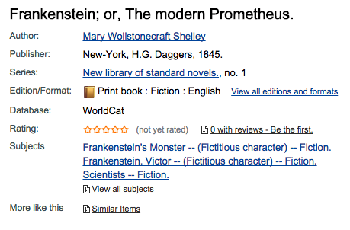
What’s What?

Slide 6
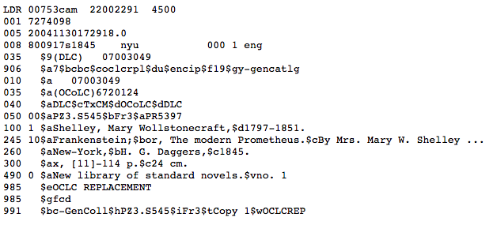
What’s what?

Slide 7
So what does this do for me?
Because XML-based metadata schemes allow you to encode both information about at text and the content of that text, you can do various things with the information despite only having encoded it once.
So what? Why not just put your transcription into an excel sheet, a word file, or something else and be done with it? How is this useful?

Slide 8
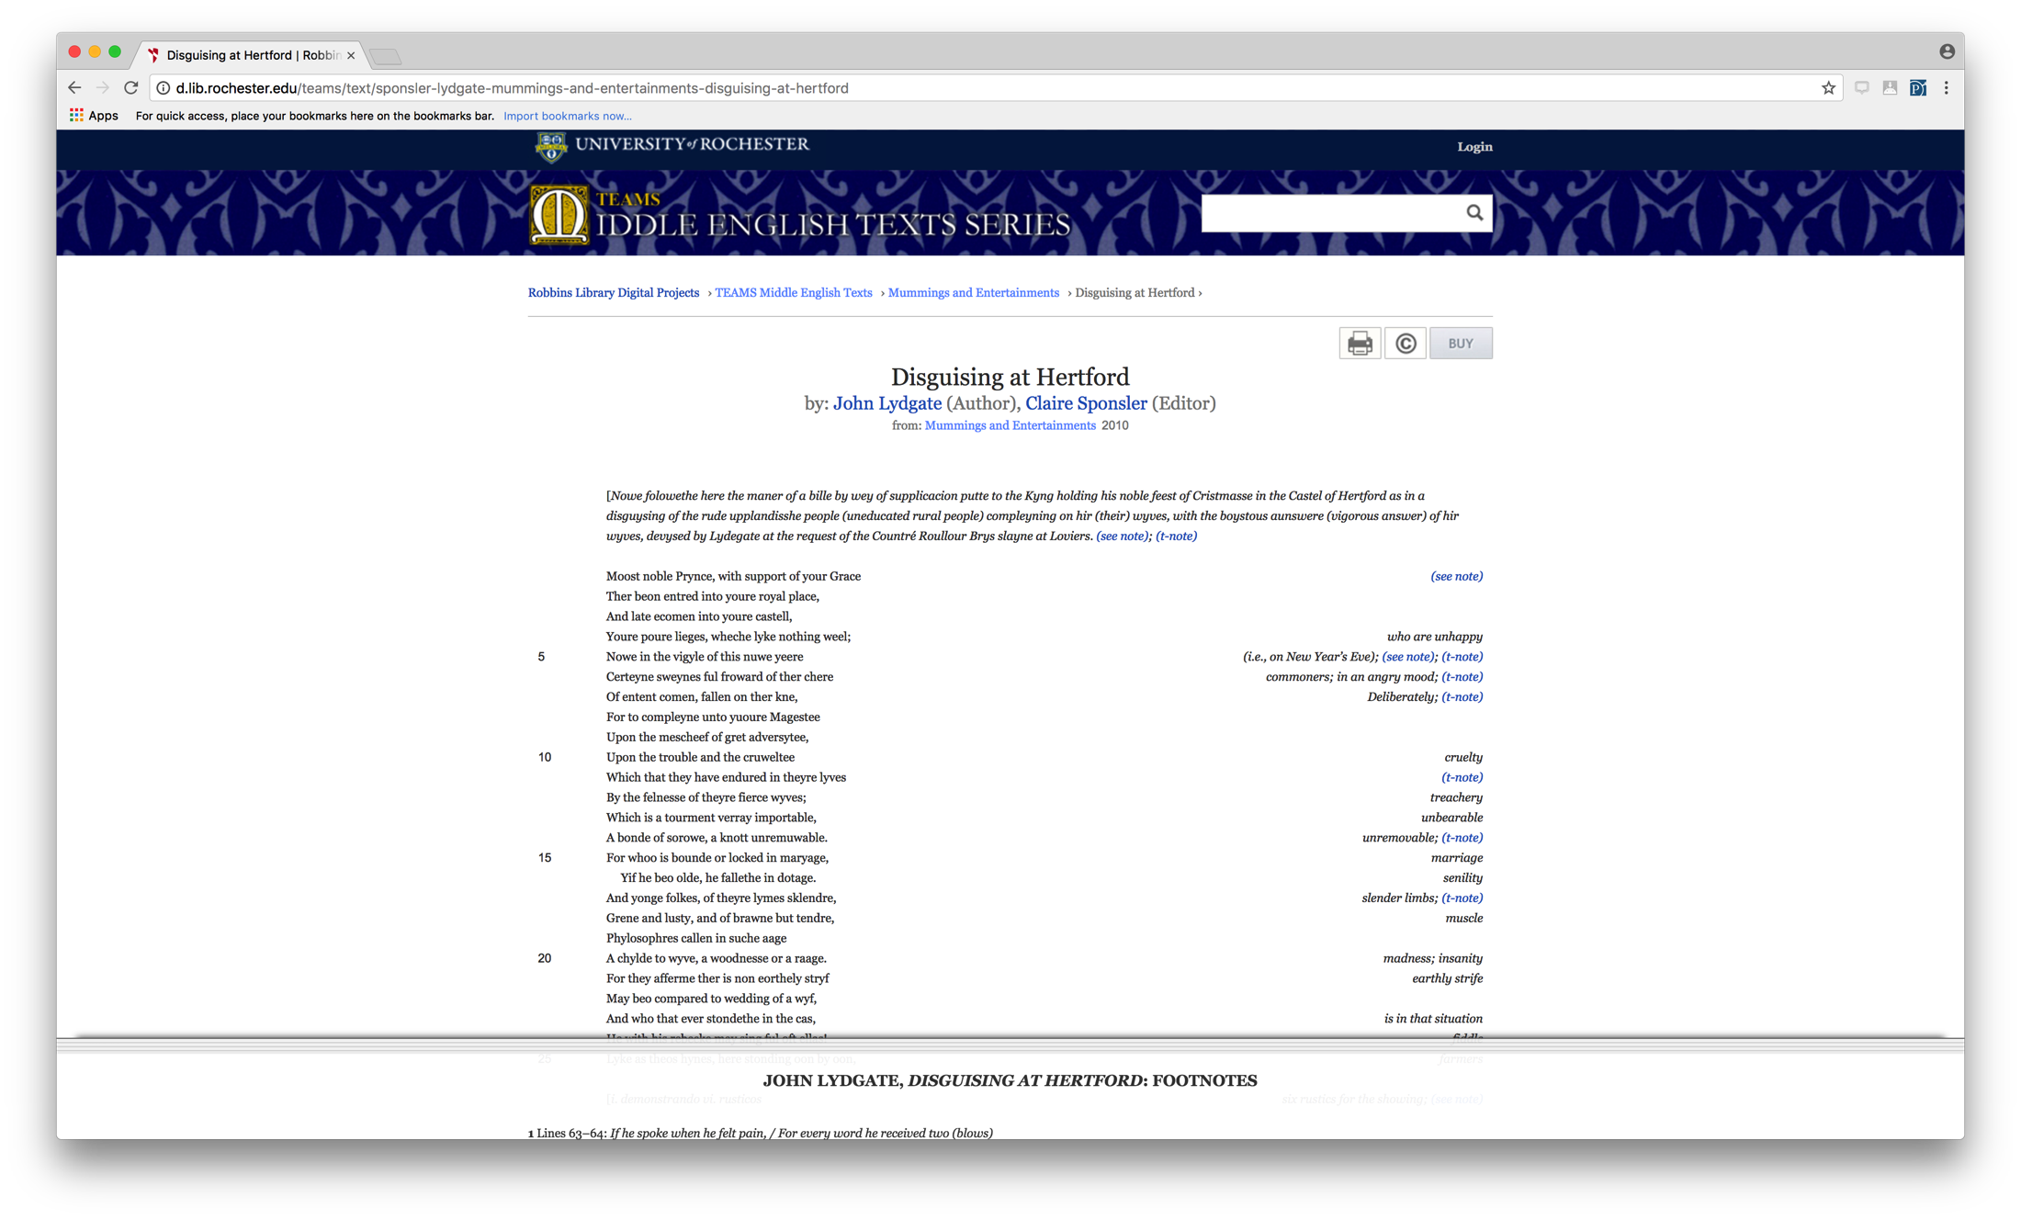
So what?
.pdf files, text files, and html, once created, can generally only be used in the original contexts they were created for.

Slide 9
So what?
An XML-based file, on the other hand, can be converted to any of the formats mentioned, can be utilized in whole or in part by other projects, and can be searched on across multiple documents easily.

Slide 10
How does XML do this?
Generally speaking, XML comes in various ”flavors,” called standards, that set out rules to lay over the top of the general XML framework, but are specific to the project in question.
The example on the previous page was written using the TEI, or Text Encoding Initiative, standard for XML, and that standard can be found at http://www.tei-c.org/Guidelines/P5/.
There are a number of other XML standards for metadata, and a good sampling of them (with links to the standards for each) can be found at the Getty’s Metadata Standards Crosswalk page: https://www.getty.edu/research/publications/electronic_publications/intrometadata/crosswalks.html.
A crosswalk is a piece of code that is used to translate from one metadata standard to another. You can also have multiple standards on a single XML page, and if you’re interested in this we can talk about it at the workshop on Friday.
No matter the standard, though, there are certain aspects that remain the same because they’re part of the underlying XML framework.

Slide 11
Terminology
XML, much like HTML, is built on the concepts of start tags, end tags, and empty elements:
<p>The quick brown fox jumped over the lazy dog</p>
<p/>
The element is the information contained by the angle brackets, and the slash indicates whether it is at the beginning of the element, the end of the element, or an empty element.

Slide 12
Terminology
The example given in the last slide consists entirely of elements:
<p>The quick brown fox jumped over the lazy dog</p>
<p/>
If you want to add additional information to an XML element that is meant to be machine readable, but not readable by humans, you can include what is called an attribute:
<p rend=“align(center) case(allcaps)”>The quick brown fox jumped over the lazy dog</p>
<p/>
The description of each element in the TEI guidelines not only tells you what the intended purpose of the element is, but what attributes can be attached to that element. For the attributes that can attach to the element <p>, browse to http://www.tei-c.org/release/doc/tei-p5-doc/en/html/ref-p.html.

Slide 13
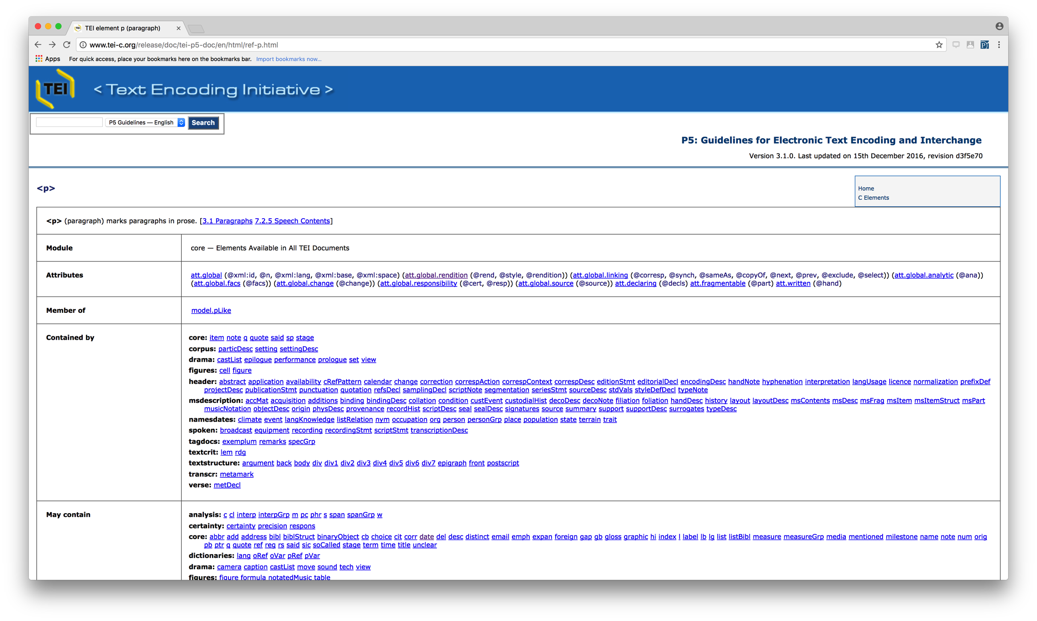
Terminology

Slide 14
How do I actually build a document?
This is the smallest TEI document possible:
<TEI version="5.0" xmlns="http://www.tei-c.org/ns/1.0">
<teiHeader>
<fileDesc>
<titleStmt>
<title>The shortest TEI Document Imaginable</title>
</titleStmt>
<publicationStmt>
<p>First published as part of TEI P2, this is the P5 version using a name space.</p>
</publicationStmt>
<sourceDesc>
<p>No source: this is an original work.</p>
</sourceDesc>
</fileDesc>
</teiHeader>
<text>
<body>
<p>This is about the shortest TEI document imaginable.</p>
</body>
</text>
</TEI>
A TEI document consists of two parts – the metadata about the document, which is contained in a tree under the <teiHeader>, and the actual document itself, which is contained either under a <text> or a <sourceDoc> element..

Slide 15
How do I actually build a document?
Everything else you do is a process of checking the guidelines, determining what element matches with what you are trying to transcribe, and applying it accordingly.
The underlying structure of the TEI Header can be found at http://www.tei-c.org/Vault/P5/3.1.0/doc/tei-p5-doc/en/html/HD.html, while the underlying structure for a default text can be found at http://www.tei-c.org/Vault/P5/3.1.0/doc/tei-p5-doc/en/html/DS.html.
Note that the default text structure does not handle every situation that is likely to come up! The Table of Contents for the full Guidelines (at http://www.tei-c.org/Vault/P5/3.1.0/doc/tei-p5-doc/en/html/) can be useful for ferreting out the various ways that your document fits (and doesn’t fit!) TEI as it is written.

Slide 16
Editorial Tools
Anything that can edit text can be used to create an XML document. XML-specific tools simply allow you to validate the XML for correctness against the schema, run various programmatic transformations against the document, or autocomplete certain elements.
Possible examples (a fuller list comparing features can be found on Wikipedia: https://en.wikipedia.org/wiki/Comparison_of_XML_editors):
OxyGen (https://www.oxygenxml.com/): academic license (US$99)
Xeditor (http://www.xeditor.com/portal): web-based, pricing by enquiry.
Adobe Framemaker (http://www.adobe.com/products/framemaker.html): commerical license (US$999)

Slide 17
Online Tools
TAPAS (http://tapasproject.org/): designed to “Visualize, Store, and Share Your TEI.”
CWRC-Writer (http://www.cwrc.ca/projects/infrastructure-projects/technical-projects/cwrc-writer/). Based on a modified version of TEI Lite (http://www.tei-c.org/Guidelines/Customization/Lite/)
http://apps.testing.cwrc.ca/editor/dev/index.htm
Username: cwrc
Password: cwrcy

Slide 18
Displaying, Searching and Working With an XML Text
There are two languages that will let you manipulate the document you’ve just created: XSLT and XQuery.
XSLT stands for eXtensible Stylesheet Langauge Transformations. It is a language designed to transform XML documents into other formats – other versions of XML, Word Documents, plain text, etc.
XQuery is a programming language that can both query and transform collections of data, including TEI documents.
XSLT and XQuery are similar to, but significantly different in structure to XML, and idiosyncratic enough that it’s easier to talk about them with an example of your encoded data to work with.

Slide 19
Thank you!
Matthew Evan Davis
davism17@mcmaster.ca
@medievalmatt

