Slide 1
Demystifying Digital Scholarship: The Command Line
Matt Davis
John Fink
Matt McCollow
November 3rd, 2016

Slide 2
What are we doing here?
Give a brief explanation of what the command line is and what it can do for you.
What the shell/terminal is, and why you should get familiar with it.
How to log into a computer (remotely or locally) using the command line.
Some basic syntax.
Creating directories and files.
Text editing via the command line.
Moving things around.
Changing permissions
Logging out.
http://explainshell.com

Slide 3
What is the command line and what can it do for us?
Command line computing is not programming.
Programming is the ability to create entirely new applications, with control over everything the computer does and each step of the process.
Examples: C++, C#, Java, Python

Slide 4
What is the command line and what can it do for us?
Command line computing is not programming.
Command line computing is not scripting.
Scripting is the automation of commands that could be handled one at a time by a user, usually with some logic attached. It’s generally attached to a existing application.
Examples: bash scripting, Visual Basic for Office, ifTTT

Slide 5
What is the command line and what can it do for us?
Command line computing is not programming.
Command line computing is not scripting.
Command line computing is making the computer do things by typing in information rather than clicking on an icon with a mouse.
Notes:
Abilit

Slide 6
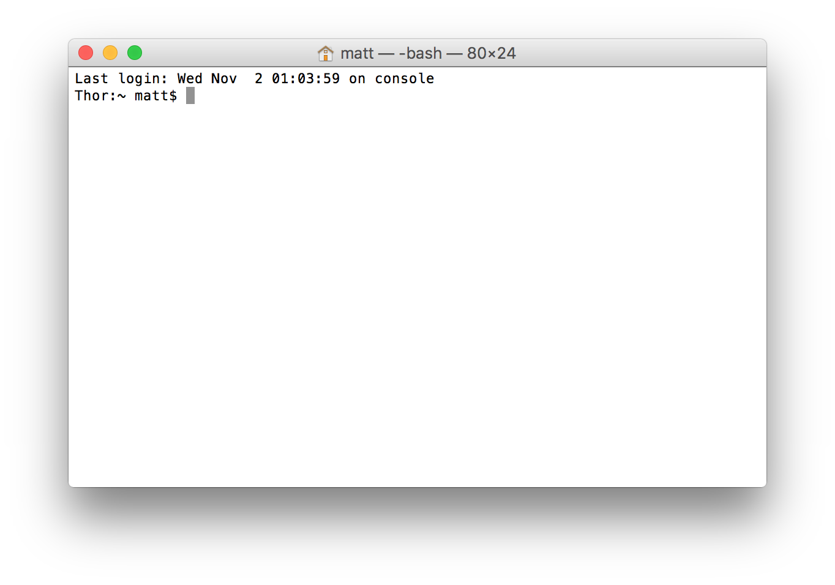
The Shell
A shell is a program that accepts your input, via the keyboard, and runs commands from the operating system.

Slide 7
The Shell
Various shell clients:
Windows: PuTTY
Mac OS: Terminal
Linux: xterm
SSH <LINK>

Slide 8
Basic Syntax
sometext:~$ grep -i “textstring” filename
Command prompt
Program
Flag/option
arguments
Type “grep -i “textstring” filename” into explainshell

Slide 9
Basic Commands
pwd – print working directory
ld – user and group memberships
cd – change directory
ls – directory listing
whoami – make sure are currently logged in as who you think you are
file – information on a particular file
Type: file “XXXXX”

Slide 10
Moving around in the filesystem
cd: go home
cd ..: move up a level
cd ../../../: move up multiple levels
cd ../../folder/subfolder/: move up a number of levels, then down into subfolders off a different branch of the tree.
cd -: go to the most recent directory.

Slide 11
Listing information
ls: shows files in the current directory.
ls -al: shows all the files, including hidden files, and puts them in a vertical list with details.
ls -al | more: lists the number of items that fit the screen, then allows you to page through the list with the up and down arrow keys.
Notes:
Most configuration programs are hidden (.XXX) files so you don’t accidentally make changes.

Slide 12
Pipes!
The “|”, or pipe, lets you send the output of one command to another
ls -al | more takes the output of the list and sends it to the “more” command.
This also works for commands like “grep” and “sort,” or potentially anything that can be run from the command line.
Notes:
Most configuration programs are hidden (.XXX) files so you don’t accidentally make changes.

Slide 13
Getting help
If you come across a program that you want, the “man” command will give you further information.
Example: man ls
Note that this is exactly what explainshell does for individual commands, but in the command line.
Notes:
Most configuration programs are hidden (.XXX) files so you don’t accidentally make changes.

Slide 14
Making directories
Example: mkdir “name”
Type: cd ~
Type: mkdir hello
Type: mkdir “hello dolly”

Slide 15
Accessing web content: curl and wget
curl
Type: curl http://scds.ca
Content can be saved using > - example: “curl http://scds.ca > filename”
wget
Saves the target url to a file
Example: “wget http://scds.ca”
curl is useful for testing without filling up your hard drive for files.
wget is useful for things like creating a local version of a website as it appears to you online.

Slide 16
Text editing
A text editor is a tool that lets you edit text.
Many possible text editors: vi, emacs, pico/nano…even notepad or textedit are text editors, just accessed through the GUI.
Today concentrating on nano.
Notes:
For today we’re going to talk about nano, but it’s useful to know about the other editors as well, especially VI

Slide 17
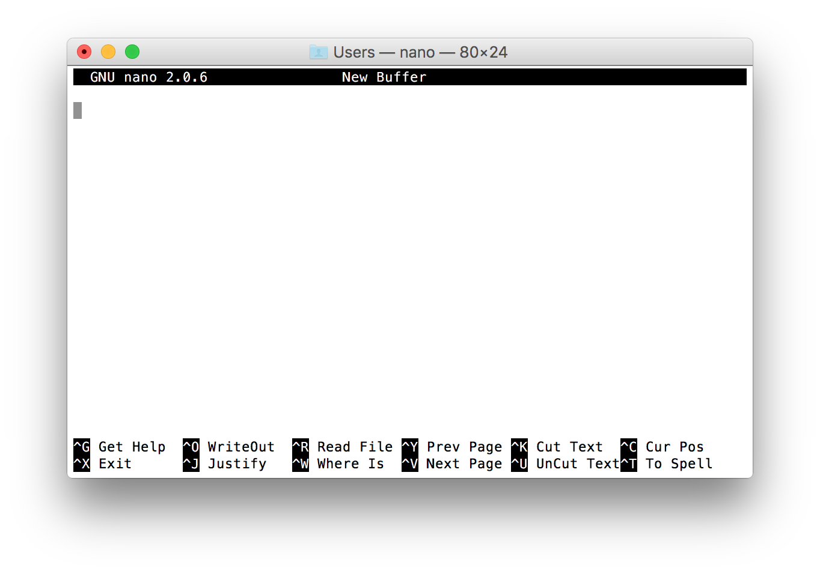
Text editing
From the shell, type “nano” and add some text.
Notes:
For today we’re going to talk about nano, but it’s useful to know about the other editors as well, especially VI

Slide 18
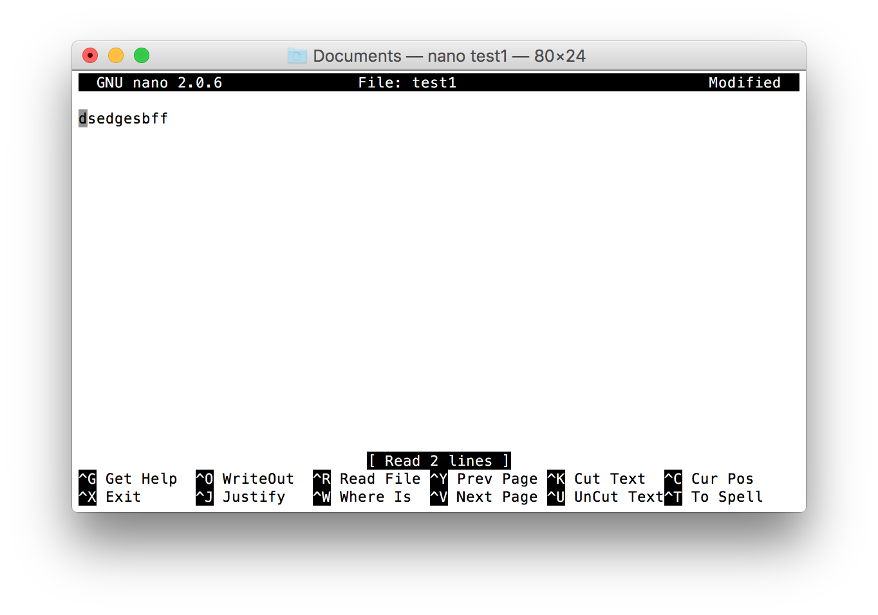
Text editing
To open a saved file, type “nano <filename>”

Slide 19
Permissions
If you type “ls -al” you will see the permissions of a file to the left, eg:
-rwxrwxr-x 1 owner group 4096 Nov 20 15:39 filename
These letter combinations represent the three types that could use the file:
-rwxrwxr-x = user group world
r = read
w= write
x= execute

Slide 20
Changing Permissions
The “chmod” command is used to change the permissions on a file, using symbolic or octal arguments
Symbolic:
“chmod u=rwx” allows a user to read, write, and
execute a file.
Octal:
“chmod 775” changes the permission to
rwxrwxr-x
4, 2, 1 are read, write, and execute, respectively. What bits
you want to put on something are simply a matter of
adding the bits up.

Slide 21
File Permission Tips
Don’t make files world writable or executable unless you mean it.
Files are usually 664, which is rw-rw-r--
Scripts and programs need to be executable
Permissions can be changed recursively with the “-r” flag: chmod -r 775 name
Chmod will allow the use of wildcards like *.* or *.html

Slide 22
Miscellaneous Tips
The up arrow key allows you to see previous commands.
The tab key will give you a list of all the commands containing a particular letter string, or complete a file or directory name.
Control-c to stop a running program or to clear out the command line.

Slide 23
Cleaning up: rm and rmdir
rm – remove a file
rmdir – remove an (empty!) directory
These have the potential of wiping out your entire system, so read the manual before attaching any flags and know where you are in the file structure.
Example: type “rm -rf” into explainshell.

Slide 24
Logging out:
Type exit or logout at the prompt to log out of the shell

