Slide 1
Community Safety Committee Research Presentation
Yi Shi Sun¹, Margaret Secord², Joanne Gibbons³, Julie Michal³
¹ Bachelor of Health Sciences (Honours), McMaster University, Hamilton, ON, Canada
² McMaster University, Hamilton, ON, Canada
³ Co-Chairs of Community Safety Committee, Hamilton, ON, Canada
Notes:
Welcome everyone and thank you for taking the time today to hear the results of the research.
Community Safety Committee originated in the GALA Neighbourhood last summer, recognizing and responding to the needs of the community, when started looking at community safety issues holistically. Around this time there were a number of shootings in Hamilton, the community safety team broadened their participation to include anyone in Hamilton. Participation was positive however, meetings became a sounding stage for issues without sound resolutions.
We, reached out to neighbouring hubs and community members to identify the need for the following project and collaborated with a McMaster University Student Researcher, Yishi Sun, with supervision by Ms. Margaret Secord.

Slide 2
Research Question
What is the spectrum of community participation and engagement initiatives that contribute to an increase in neighbourhood safety in an urban residential setting?
Definition of Terms
Spectrum: used to describe that there is a diverse range of focuses within the topic. For example, in the spectrum of community participation and engagement, there are informal activities such as socializing with neighbours, more formalized approaches such as neighbourhood watch, and everything in between.
Initiative: A plan, strategy, or approach that can be used to improve a situation. For example, a community participation and engagement initiative is a plan, strategy, or approach with the focus on improving the community.
Notes:
To start, the research question that was initially brainstormed and eventually refined to is: What is the spectrum of community participation and engagement initiatives that contribute to an increase in neighbourhood safety in an urban residential setting?
To make sure we are all on the same page, It is helpful to define some of the terms before we get started.
Spectrum being the diverse range of focuses within a topic such as within community participation and engagement: informal activities such as socializing with neighbours, more formalized approaches such as neighbourhood watch, and everything in between
Initiative: being any sort of community participation and engagement initiative that is a part of a plan, strategy, or approach with the focus on improving the safety of the community

Slide 3
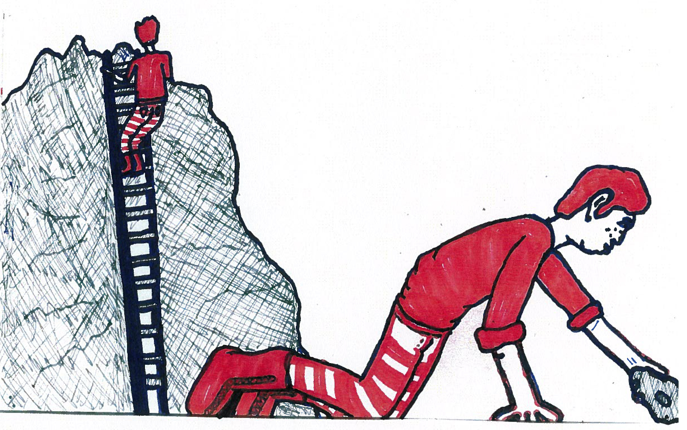
Search Strategy
https://www.google.ca/search?q=search+pics&espv=2&biw=2046&bih=1107&tbm=isch&tbo=u&source=univ&sa=X&ved=0ahUKEwjjmt6C3aPOAhWp7IMKHbojBu0QsAQIMQ&dpr=0.9#tbm=isch&q=searching+high+and+low+pics&imgrc=wIqQEJyi0oMfuM%3A
Notes:
We sent him on a mission looking high and low, finally diving into the literature to explore the topics of community engagement in relationship to community safety required an extensive search into not only the academic databases, but also the grey literature as well.
You can connect with us for further information on this and other components of this presentation through our email which will be given at the end of the presentation.

Slide 4
Significance of Community Engagement
“The most successful crime prevention initiatives are comprehensive. The causes of crime are very complex and there are no simple solutions. Rather than relying on a single program or strategy, you should use several different programs that are targeted at different aspects of the problem”
Programs using a collaborative approach and addressing root problems have been very successful.
Delivering local solutions to local problems that have been identified by local people.
Focus on prevention, crisis intervention, and long-term solutions.
Premier's Advisory Council on Crime and Community Safety: Final Report (2015)
Making Cities Safer Action Briefs for Municipal Stakeholders (2009)
Notes:
The Significance of Community Engagement
“The most successful crime prevention initiatives are comprehensive. The causes of crime are very complex and there are no simple solutions. Rather than relying on a single program or strategy, you should use several different programs that are targeted at different aspects of the problem”e most successful crime prevention initiatives are comprehensive. The causes of crime are very complex and there are no simple solutions. Rather than relying on a single program or strategy, you should use several different programs that are targeted at different aspects of the problem”
Further elaborated on in the Premier’s Advisory Council on Crime and Community Safety: Final Report (2015) and really portrays the significance of community engagement are:
Programs using a collaborative approach and addressing root problems have been very successful.
Delivering local solutions to local problems that have been identified by local people.
Focus on prevention, crisis intervention, and long-term solutions.

Slide 5
Challenges to Community Engagement
Not enough volunteers
Leading to other community volunteers becoming burned out
Perceived increased liability, risk and high stress levels in volunteer roles
Community buy in through education and awareness
No coordination within communities about what types of programs are being offered by whom
Organizations working in silos
Lack of system support, core funding, and staff
Need to build community capacity
Developing train-the-trainer programs and providing support for volunteers
Premier's Advisory Council on Crime and Community Safety Final Report (2015)
Notes:
However, challenges faced in community engagement are common place and many of you may have already experienced this in the past
The first is simply not enough volunteers participating or engaging with the initiative and this will lead to the secondary challenge of causing other community volunteers to become burned out. In other words, the same 10 ppl running around the community attempting to do everything… is not sustainable.
Also there may be perceived increased liability, risk and high stress levels in volunteer roles.
Community buy in and support will oftentimes be a challenge and this will be counteracted by actions of education and awareness to community members.
Another challenge faced when working in community engagement is that there is no coordination within communities about what types of programs are being offered by whom with organizations working in silos
Yishi found the work that this Community Safety Committee is doing is actually in fact addressing this challenge by connecting various communities together so that they do not have to work in silos
Further challenges faced in community engagement is sometimes the lack of system support, core funding, and staff
To counteract this, communities can build community capacity through programs such as train-the-trainer programs and providing support for volunteers, or Helping us Helping you :)

Slide 6
Different Strategies Researched in the Literature
Situation Table
Social Cohesion
Sustaining Volunteer Engagement
Neighbourhood Watch
Surveillance
Lighting
Crime Prevention Through Environmental Design (CPTED)
Activity Support
CPTED
Access Control
CPTED
Image and Maintenance
CPTED
Target Hardening
CPTED
Territoriality
CPTED
Notes:
The strategies that were researched and discussed?
Situation Table, Social Cohesion, Sustaining Volunteer Engagement, Neighbourhood Watch, Surveillance, Lighting, Crime Prevention Through Environmental design (CPTED) - which includes Activity Support, Access Control ,Image and Maintenance, Target Hardening and Territoriality

Slide 7
Situation Table

Slide 8
Situation Table
Regular held meeting with police, representatives from different community organizations, and community members to discuss risk situations in a timely matter
By addressing situations with acutely elevated risk and/or individuals at imminent risk of harm and victimization, the Situation Table can work together to intervene
Relatively new program and as of March 2015, there are currently 8 pilot Situation Tables operating across Ontario with 6 more planned
A study detailing the results of the pilots has yet to be released
Presented by the Minister of Community Safety and Correctional Services at the summit on Economics of Policing Community Safety
Reported that the North Bay Gateway Hub Situation Table has 200 cases brought forward in a year’s time with 290 individuals supported
"Public Safety Canada - 2Nd Summit On The Economics Of Policing & Community Safety - March 2, 2015 - Ottawa". news.ontario.ca. N.p., 2015. Web. 21 Apr. 2016.
"Situation Table Helps Those In Need". Beacon Herald. N.p., 2016. Web. 21 Apr. 2016.
"Situation Table Training, Centre For Public Safety And Well-Being | Wilfrid Laurier University". Wlu.ca. N.p., 2016. Web. 21 Apr. 2016.
Notes:
Something new and exciting found in the research was the Situation Table (known as Crisis Tables in some implementations)
They are regular held meeting with police, representatives from different community organizations, and community members to discuss risk situations in a timely matter
The theory behind it is that by addressing situations with acutely elevated risk and/or individuals at imminent risk of harm and victimization, the Situation Table can work together to intervene
It is a relatively new program and as of March 2015, there are currently 50 pilot Situation Tables in the process of being developed or operating across Ontario.
A study detailing the results of the pilots has yet to be released
However it has been presented by the Minister of Community Safety and Correctional Services, Yasir Naqvi, at the summit on Economics of Policing Community Safety
In his presentation and in news articles, it has been reported that the North Bay Gateway Hub Situation Table, one of the longest running pilot programs, has 200 cases brought forward in a year’s time with 290 individuals supported

Slide 9
Evaluation of Situation Tables in Cambridge and Kitchener
25 members representing local services and organizations
Alternate members to stand-in when primary representative was unavailable
Most common risk factors: mental health, criminal involvement, and substance use
Key factor to successful implementation: recruitment and engagement of members with the ability to act quickly with flexibility and autonomy in their home organizations in response to situations
An Evaluation of the Connectivity Situation Tables in Waterloo Region Addressing Risk Through System Collaboration (2015)
Notes:
In both situation tables, there were 25 members representing local services and organizations
Additional alternate members to stand-in when the primary representative was unable to attend
Representation from education, police and justice services, primary health care, community health and hospital services, community mental health and addictions, child protection services, housing and homelessness support services, sexual assault and victim support services.
Most common risk factors: mental health, criminal involvement, and substance use
Key factor in the successful implementation of the Situation Tables has been the recruitment and engagement of members who are perceived as “leaders” and “decision-makers” in their home organizations
Allows members to act quickly with some flexibility and autonomy in order to respond to the situations with acutely elevated risk

Slide 10
Evaluation of Situation Tables in Cambridge and Kitchener
Connect individuals/families in situations with services in 76% of situations
When comparing police linked calls in 90 days prior to 90 days after the situation has been closed by the Situation Table
74% reduction in police linked calls associated with individuals involved in the situation
The Situation Table has assisted local services to reach vulnerable populations that they have had difficulty connecting with
Positive impact on local services as well as the relationships between services and organizations involved in the Situation Table
Community Safety Committee- Situation Table in Process
An Evaluation of the Connectivity Situation Tables in Waterloo Region Addressing Risk Through System Collaboration (2015)
Notes:
The situation tables have been able to connect individuals and families in situations of acutely elevated risk with services in 76% of the situations
74% reduction in police linked calls associated with individuals involved in the situation table.
In other areas, Situation Tables has assisted local services to reach vulnerable populations that they have had difficulty connecting with
The evaluation found a positive impact on the work done by these local services
Service providers reported that the new relationships with other service providers developed through the work of the Situation Table have enabled them to work more collaboratively, effectively, and efficiently
We are very excited to announce that The Community safety Committee is in the process of forming a situation table. So far Julie and Joanne have finished the training component.

Slide 11
Social Cohesion
https://docs.google.com/presentation/d/1Og2OXbxbkdDZ320YgboSMs7Uj5VNMA6jixtnHCxmeiw/edit#slide=id.p26

Slide 12
Social Cohesion
Domains
Local Policies to Enhance the Domains
Empowerment
Giving local people voice, Giving local people a role in policy processes
Participation
Establishing and supporting local activities, organisations, and events
Common purpose
Cooperating with one another, developing and supporting networks
Supporting networks
Expectation that help would be given to or received from others when needed
Collective norms and values
Ethos which residents recognise and accept, promoting community interests
Trust
Encouraging trust in residents in their relationships, bringing conflicting groups together
Safety
Involvement in local crime prevention, providing visible evidence of security measures
Belonging
Boosting the identity of a place via design, street furnishings, naming
Social cohesion, social capital and the neighbourhood (2001)
Notes:
The first area of focus we will discuss is social cohesion and it is actually something that came upon time and time again in the research so it makes sense to address it first
Social cohesion plays a big role, but what factors contribute into whether a community is cohesive or not?
In the literature the following areas of social cohesion have been described along with the local policies that support them:
Empowerment: Giving local people voice, Giving local people a role in policy processes
Participation
Common purpose
Supporting networks
Collective norms and values
Trust
Safety: Involvement in local crime prevention, providing visible evidence of security measures
Belonging: Boosting the identity of a place via design, street furnishings, naming

Slide 13
Social Cohesion (cont.)
Important for neighborhood development
Contributes a sense of individual and group empowerment that helps neighbors to collectively act to meet their shared needs
Social cohesion can be a significant predictor of actual involvement in crime prevention efforts by local community-based organizations
Sense of community in the urban environment A catalyst for participation and community development (1990)
An Examination of Citizen Involvement in Crime Prevention in High-Risk Versus Low- to Moderate-Risk Neighborhoods (2006)
Extent to which neighbors share values
Can rely on each other for support
Act in ways that protect the safety of their communities
Notes:
So what is the significance of social cohesion?
Social cohesion contributes to the extent to which neighbors share values, which in turn can rely on each other for support, and thus act in ways that protect the safety of their communities
It’s important for neighborhood development because by contributing to a sense of individual and group empowerment, it helps neighbors to collectively act to meet their shared needs
Research has found that social cohesion can be a significant predictor of actual involvement in crime prevention efforts by local community-based organizations

Slide 14
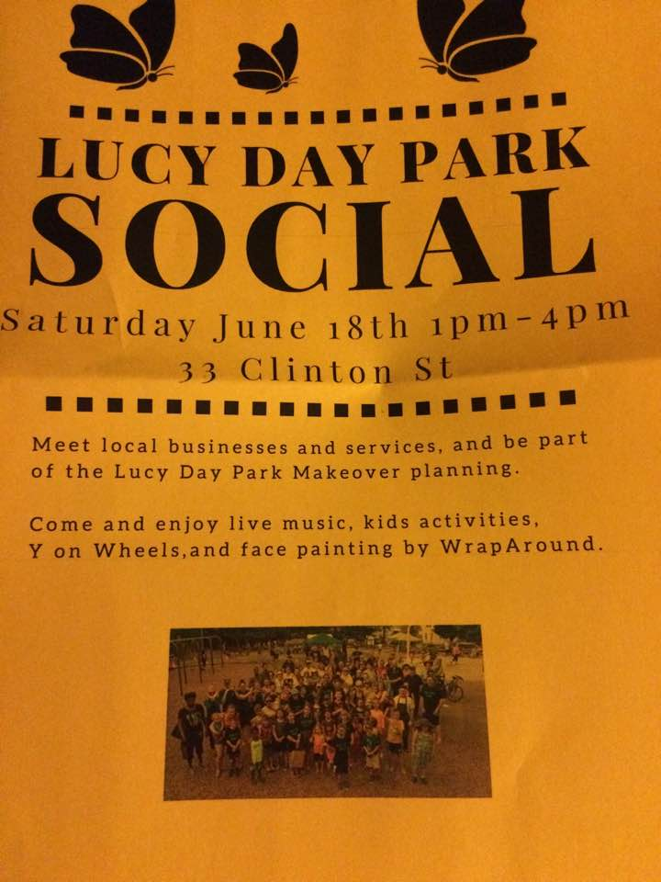
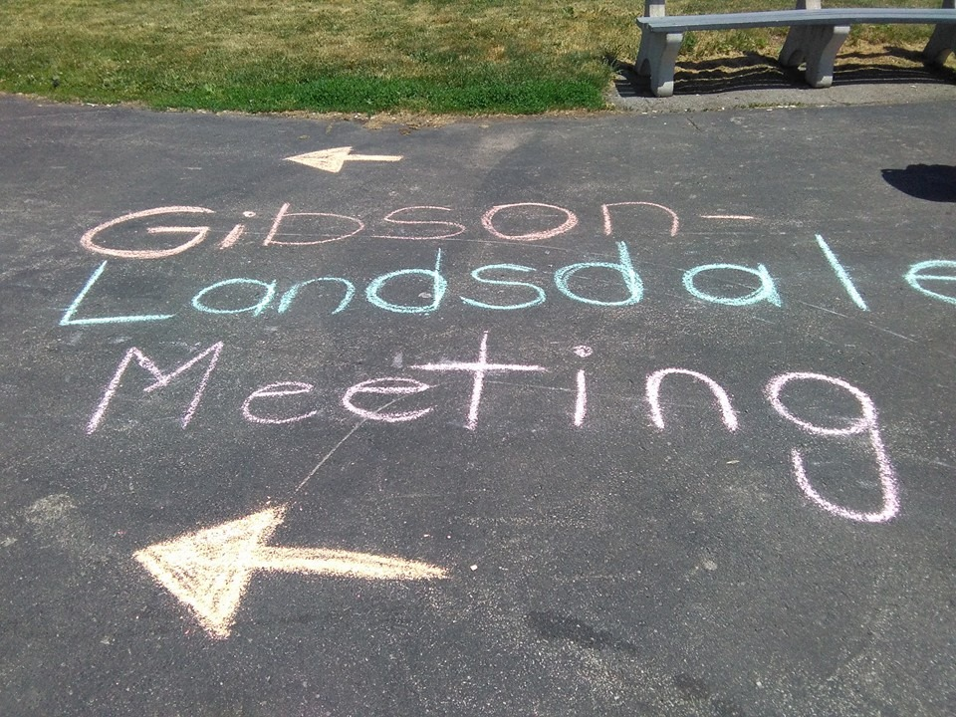
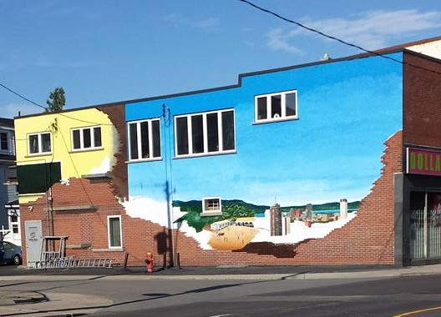
How to Build on Domains of Social Cohesion?
Initiatives and programs varies by neighbourhood
No “one model fits all” approach
Examples:(Some of which are already occurring in our neighbourhoods here in Hamilton)
https://www.facebook.com/photo.php?fbid=516231461899578&set=pcb.1065953676813030&type=3&theater
Notes:
Talking about all this social cohesion naturally brings up the question of how to build on these areas of social cohesion? The start is that the initiatives and programs will vary by neighbourhood as there is no “one model fits all” approach”
In the literature, there hasn’t been research determining what initiatives have concretely led to increases of social cohesion partly due to the how relative it is to the neighbourhood
The examples listed are what other communities and neighbourhoods have attempted and have seen successes with: Some of which are already occurring in our neighbourhoods here in Hamilton.
Hold focus groups/consultations with residents, stakeholders, vulnerable populations to identify needs within a community and develop a strategy to address those needs (housing, safety, etc)
Work with local business associations to develop strategies that match jobs to existing residents’ skills and employment needs
Community mapping exercise to identify safe common meeting locations in the community
Increased recreation, cultural and community-based programming in public areas such as parks
There are also the more widely known locally led street/block parties and community festivals that celebrate the community’s diversity
As well community based methods of support such as babysitting clubs, walking groups, and food cooperatives
Again these are examples of what has worked in other neighbourhoods but what is right for our neighbourhood may be different

Slide 15
Social Cohesion (cont.)
Social cohesion was the strongest predictor of involvement in both high-risk and low- to moderate-risk neighborhoods
In high-risk neighborhoods, the following three factors emerged as significant predictors of citizen involvement:
Residents who felt like part of the neighborhood (versus just a place to live)
Minority residents were more likely to be involved
Residents who believed that police get to know residents
Social cohesion a robust predictor of lower rates of violence
An Examination of Citizen Involvement in Crime Prevention in High-Risk Versus Low- to Moderate-Risk Neighborhoods (2006)
Neighborhoods and violent crime: A multilevel study of collective efficacy (1997)
Notes:
Research has found that social cohesion was the strongest predictor of residents’ involvement in both high-risk and low- to moderate-risk neighborhoods.
In high-risk neighborhoods, the following three factors emerged as significant predictors of citizen involvement:
Residents who felt like part of the neighborhood versus just a place to live
Minority residents were more likely to be involved
Residents who believed that police get to know residents
Involvement in crime prevention activities has less to do with the public’s perception of the effectiveness and more to do with the development of personal relationships between the police and residents.
Social cohesion was also found to be a robust predictor of lower rates of violence in a community.

Slide 16
Sustaining Volunteer Engagement
http://placevision.net/engagement/

Slide 17
Capacity of an Organization
Role Specification
How clearly is the role defined?
Dissemination
How is information of the role provided to the public?
Role Availability
How available are these opportunities?
Role Flexibility
How adjustable are the demands of the role?
Cash Compensation
Are participants being paid for work in cash?
Engaging older adults in volunteering: Conceptualizing and measuring institutional capacity (2008)
Notes:
Many of the community participation and engagement initiatives will require volunteers and sustaining their engagement will be important for ensuring sustainable initiatives.
Research into the institutional capacity (or the ability of an organization) to provide volunteer roles can be broken down into a framework of 10 categories to consider
Every organization is unique in their target population of volunteers, recruitment and retention strategies, but the framework sets for 10 categories that each organization can look into and see how suitable/appropriate they are
1-Role Specification: How clearly is the role defined?
Aspects of the role: requirements, responsibilities, boundaries, costs, benefits
Ways of defining: job description, code of conduct, volunteer contract, confidentiality statement
2-Dissemination: How is information of the role provided to the public?
Forms of advertising: newsletter, website
3-Role Availability: How available are these opportunities?
Aspects: number of roles, frequency of new openings
4-Role Flexibility: How adjustable are the demands of the role?
Aspects: accommodate for variability in volunteers’ capacity and availability.
5-Cash Compensation: Are participants being paid for work in cash?
Example: stipends, repay volunteers for meal and transportation expenses

Slide 18
Capacity of an Organization
In Kind Compensation
Are participants being repaid for work in services or goods?
What kind of opportunities are participants given to develop skills and personal growth?
Skill Development
Recognition
How are participants applauded for their service?
How can the organization support to better fit the participant?
Accommodation
How are participants connected and be apart of the organization?
Integration
Engaging older adults in volunteering: Conceptualizing and measuring institutional capacity (2008)
Notes:
6-In Kind Compensation: Are participants being repaid for work in services or goods?
Example: parking, gifts, or access to a facility
7-Skill Development: What kind of opportunities are participants given to develop skills and personal growth?
8-Recognition: How are participants applauded for their service?
Example: special events, media coverage
9-Accommodation: How can the organization support to better fit the participants especially in face of changes
Organizational actions taken and resources applied
10-Integration: How are participants connected and be apart of the organization?

Slide 19
Volunteer Retention in Charities
In research with charity organizations, increasing retention of volunteers centre on enriching their experience:
Recognizing volunteers
Providing training and professional development
Matching volunteers to tasks
Welcoming culture to volunteers
Resources to support volunteers
Having volunteers assist in recruiting other volunteers
Though supervision and communication are necessary for many organizations, excessive use have negative effects
Volunteer Management Practices and Retention of Volunteers (2004)
Notes:
In research with charity organizations, increasing retention of volunteers centre on enriching the volunteer’s experience and the following methods has shown to have positive correlations with volunteer experience:
Recognizing volunteers for their contributions and efforts
Providing training and professional development as opportunities for personal growth
Matching volunteers to tasks so that they are more likely to enjoy the experience
Welcoming culture to volunteers
Allocating resources to support volunteers
Having volunteers assist in recruiting other volunteers
Though supervision and communication are necessary for many organizations, excessive use may have negative consequences on volunteer retention
The idea is that it may begin to feel like the grind of their daily jobs instead of an enjoyable time
In turn diminishing their experience and reducing their desire to continue volunteering

Slide 20
Focus on Pride and Respect
In research with volunteer organizations, there is a direct and positive association between commitment in volunteers and their sense of pride and respect
Providing volunteers the opportunity to hear from the organization’s beneficiaries
Showing volunteers the importance of their work
Communication that emphasizes the appreciation for the volunteer’s time and efforts
Pride and respect in volunteers' organizational commitment (2008)
Notes:
Building on the volunteer retention aspect, in research with volunteer organizations, there is a direct and positive association between the commitment in volunteers and their sense of pride and respect for their efforts
The pride and respect can be developed through actions of the organization including:
Providing volunteers the opportunity to hear from the organization’s beneficiaries
Showing volunteers the importance of their work
Communication that emphasizes the appreciation for the volunteer’s time and efforts
Newsletters, emails, in-person

Slide 21
Neighbourhood Watch
https://www.google.ca/search?q=neighbourhood+watch&espv=2&biw=2046&bih=1107&tbm=isch&tbo=u&source=univ&sa=X&ved=0ahUKEwj6tJ28kaHOAhUJzoMKHUo4DOgQsAQITQ&dpr=0.9#imgrc=9B1DHK2dbUd22M%3A
Notes:
Neighbourhood Watch is a community initiative that has been implemented in a wide variety of communities around the world
Though not all Neighbourhood Watch implementation are the same, there are common themes including:
residents operating as the ‘eyes and ears’ of the police
residents reporting suspicious behavior to the police or neighborhood coordinator
residents interacting and working together to solve problems
After implementation of Neighbourhood Watch, there are different goals in different neighbourhoods and they can include reducing fear of crime, increasing informal neighbourhood control of minor crimes, and increasing public confidence in police
The purpose of Neighbourhood Watch is NOT to make citizen’s arrests, nor take any action that might jeopardize volunteers’ safety or that of the public

Slide 22
Neighbourhood Watch (cont.)
Visible surveillance
Deterrent effect on the perceptions and decision making of potential offenders
Creation of signs of occupancy
Perceptions of potential offenders in terms of their likelihood of getting caught
Enhance community cohesion
Generation of acceptable norms of behavior and by direct involvement of residents
Increase the flow of useful information from the public to the police
Greater number of arrests and convictions
Does neighborhood watch reduce crime A systematic review and meta-analysis (2006)
Notes:
How does Neighbourhood Watch implementations work to reduce crime?
The first is through visible surveillance in that it creates a deterrent effect on the perceptions and decision making of potential offenders
Through the creation of signs of occupancy, it may affect perceptions of potential offenders in terms of their likelihood of getting caught
Signs of occupancy include removing newspapers and mail from outside neighbors’ homes when they are away, mowing the lawn, and filling up trash cans
Another aspect is enhancing community cohesion (what we mentioned in the last section) and generation of acceptable norms of behavior and by direct involvement of residents
In theory, it would also increase the flow of useful information from the public to the police and potentially lead to a greater number of arrests and convictions
Even though there is evidence supporting Neighbourhood Watch reducing crime in neighbourhoods, there are some considerations:
There is a lack of data and inconclusive research on community participation levels within Neighbourhood Watch so how many residents are actually engaging in neighbourhood surveillance, social interaction, and all the other aspects that make the implementation work effectively
There is a possibility that Neighbourhood Watch activities may increase fear of crimes and racial prejudice and this is especially a concern in diversified populations
As with most aspects with social cohesion, social-control processes have little influence over outsiders who feel no pressure to conform and residents have little leverage to regulate or change the social perceptions and behaviors of outsiders

Slide 23
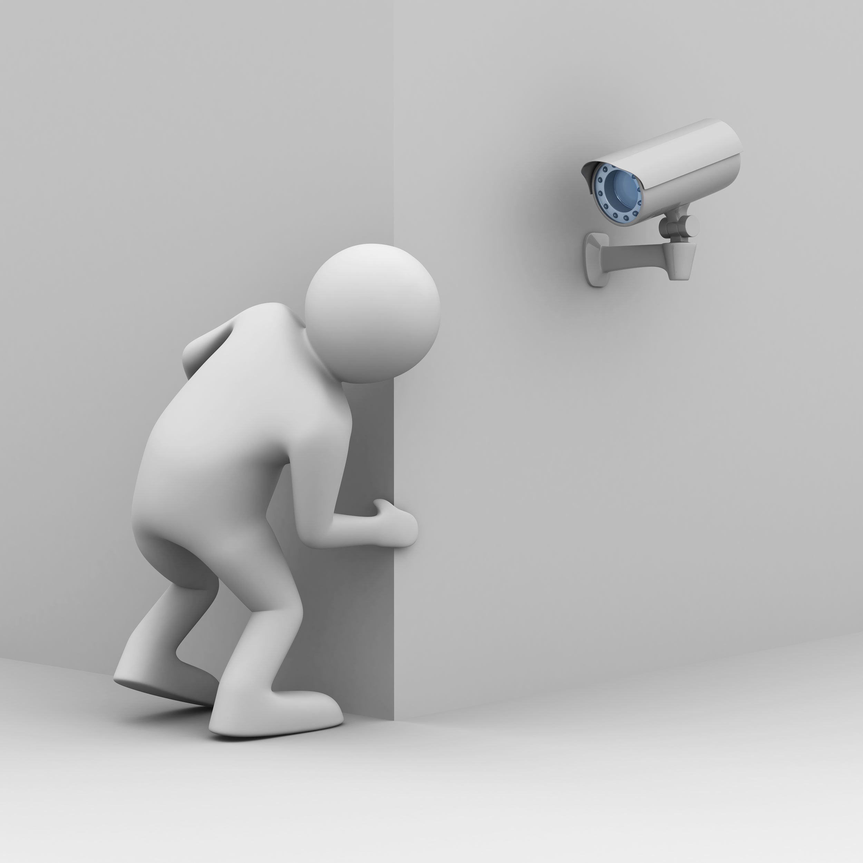
Surveillance
https://www.google.ca/search?q=surveillance+images&espv=2&biw=2046&bih=1107&tbm=isch&tbo=u&source=univ&sa=X&ved=0ahUKEwjFuaX-k6HOAhVk1oMKHSYtCOoQsAQIKg&dpr=0.9#imgrc=MIdJjwUEMR1MEM%3A
Notes:
The next topic area is surveillance which is how the physical design can promote informal or natural surveillance opportunities for residents
The theory is that if offenders perceive that they can be observed, they may be less likely to commit the offense
There are multiple ways to create this increased potential for intervention, apprehension, and prosecution by residents
First is natural surveillance which are residents’ self-surveillance opportunities such as windows from which to observe the neighbourhood ( neighbours making the best spys)
Second is organized surveillance in the form of security guards or patrols
Third is mechanical surveillance such as closed circuit television

Slide 24
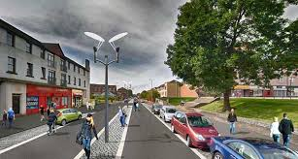
Surveillance
Burglars avoid targets that are readily observed by neighbours
Concealment opportunities for burglars
Properties with low levels of lighting
High walls and fences
Thick foliage
Linear integrated spaces
Examples: Suburban Vancouver, London, and Burnley, United Kingdom
Preventing auto theft in suburban Vancouver commuter lots: effects of a bike patrol (1996) --- Understanding Car Parks, Crime and CCTV: Evaluation Lessons from Safer Cities (1993) ---- An Evaluation of Secured by Design Housing Schemes Throughout the West Yorkshire Area (1999) ---- Burglary of Single-Family Houses (2002) ---- A place for every crime and every crime in its place: an alternative perspective on crime displacement (1992)--- https://www.google.ca/search?q=linear+integrated+neighbourhood+pics&espv=2&biw=2046&bih=1107&source=lnms&tbm=isch&sa=X&ved=0ahUKEwil1r25-KPOAhUj44MKHYzUC34Q_AUIBigB&dpr=0.9#imgrc=qTeSDtmPLIjPPM%3A
Notes:
In the literature, it is hypothesised that burglars avoid targets that are readily observed by neighbours
Example of concealment opportunities for burglars include properties with low levels of lighting, high walls and fences, and thick foliage particularly when close to points of access such as windows and doors
(As well linear integrated spaces with strong intervisibility of good numbers of entrances provide more surveillance opportunities)
In other words the space functions cooperatively, and an un-obstructed vision with an unaided eye (the pic is a great example this)
However a key point of consideration…. the existence of natural surveillance opportunities does not mean that surveillance is taking place.

Slide 25
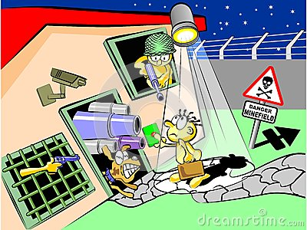
Lighting
https://www.google.ca/search?q=surveillance+images&espv=2&biw=2046&bih=1107&tbm=isch&tbo=u&source=univ&sa=X&ved=0ahUKEwjFuaX-k6HOAhVk1oMKHSYtCOoQsAQIKg&dpr=0.9#tbm=isch&q=survelnce+lights+images&imgrc=SyfLXnWbVPegFM%3A
Notes:
Def com 5 is never the answer…. However lighting lets us see who are friends are.

Slide 26
Lighting
Two theories on why improved street lighting may cause reduction in crime
Effects of improved street lighting on crime a systematic review (2002)
Increased surveillance of potential offenders
improving visibility and by increasing the number of people on the street
predicts decreases in crime especially during the night-time
Increased community investment in the area
increased community pride, community cohesiveness and informal social control
decreases in crime during both day-time and night-time
Notes:
Improved street lighting has been seen in the literature to cause reductions in crime, but there has been 2 prevailing theories as to how it may cause these reductions
The first is based on the theory that improved street lighting will increase surveillance of potential offenders through improving visibility and by increasing the number of people on the street
If this theory is more dominant, it should hypothetically predict decreases in crime especially during the night-time
The second theory is based on increased community investment in the area which in theory leads to increased community pride, community cohesiveness and informal social control
This theory would predict decreases in crime during both day-time and night-time
These two theories are likely not mutually exclusive, but one may have a greater impact than the other

Slide 27
Lighting (cont.)
DAY VS NIGHT
http://wiccanmoonsong.blogspot.ca/2012/08/nighttime-vs-daytime-when-working-spells.html
Effects of improved street lighting on crime a systematic review (2002)
Notes:
Researchers found that improved lighting led to reductions in crime by 20%
The measure of crime used in the studies were property and violent crimes
They examined if there was a difference between night-time and day-time crime, they did not find that night-time crime decreased more than day-time crime
This supports that the more dominant theory is improved street lighting reducing crime because of its role in increasing community pride and community investment
Though there was the overall reduction by 20% crime in the 13 studies, researches did make note that it was most effective in reducing crime in stable non-diversified communities

Slide 28
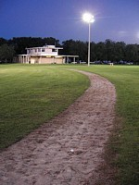
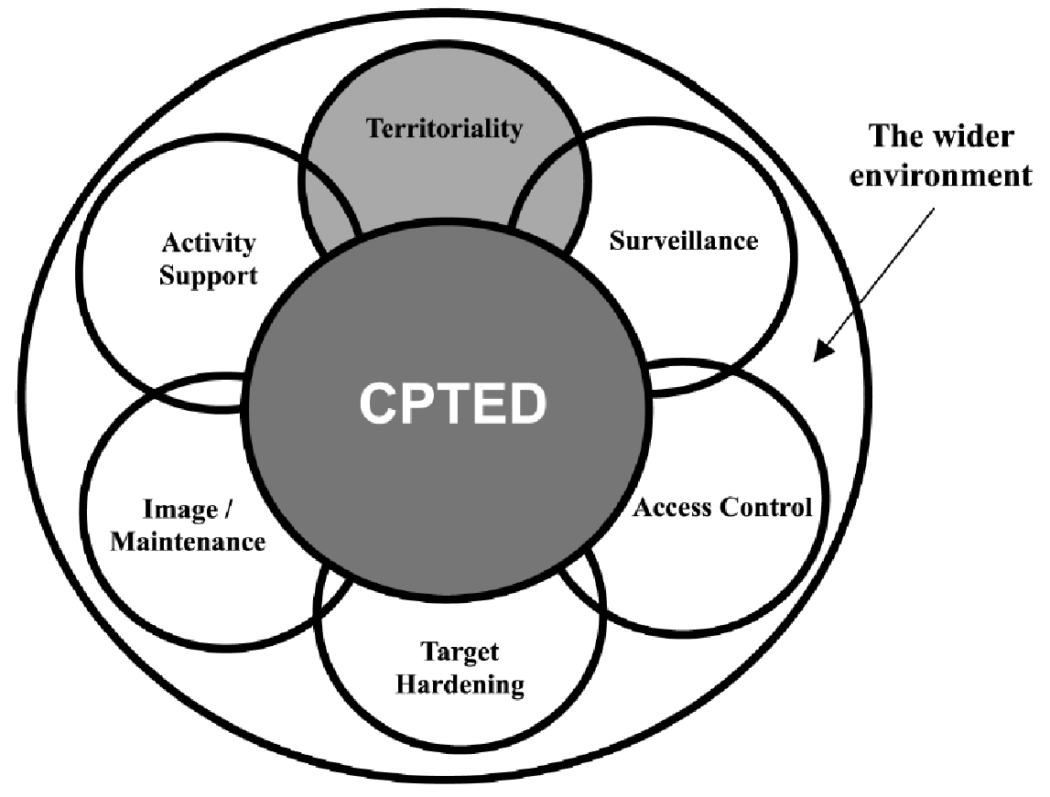
Crime Prevention Through Environmental Design (CPTED)
https://www.google.ca/search?q=cpted+images&espv=2&biw=2046&bih=1107&tbm=isch&tbo=u&source=univ&sa=X&ved=0ahUKEwigmJ-GmKHOAhXL5oMKHbznBesQsAQIGg&dpr=0.9#imgrc=48z_avG0ojlOKM%3A
Notes:
CPTED Crime prevention through Environmental Design focuses on Territoriality, Surveillance, Access Control, Target Hardening, Image/Maintenance and Activity Support.
The Hamilton Police are already utilizing this model as such we will be providing an overview of each category before collectively bringing it back to discuss the merits of CPTED as a whole.
For an assessment or more information contact your local police department.

Slide 29
Territoriality (CPTED con’t)
Reinforcing “sense of ownership” in legitimate users of space
Reducing opportunities for offending by discouraging illegitimate users
Design that differentiates between private property and public spaces
Yard/driveway/walkway VS street/sidewalk
Methods of differentiation: shrubbery, bushes, alternate paving stone colour
Residential burglars judge risk The role of territoriality (1993)
"Crime Prevention Through Environmental Design - Royal Canadian Mounted Police". Rcmp-grc.gc.ca. N.p., 2011. Web. 21 Apr. 2016.
Notes:
Territoriality is the concept of reinforcing “sense of ownership” in legitimate users of space
This can be done through reducing opportunities for offenders by discouraging illegitimate users
This can be in the form of design that differentiates between private property and public spaces
For example the yard, driveway, or walkway can be considered private space while the street and sidewalk is oftentimes considered public space
Though territoriality has shown to be most effective at the local level, there are often difficulties associated with definition, interpretation and measurement

Slide 30
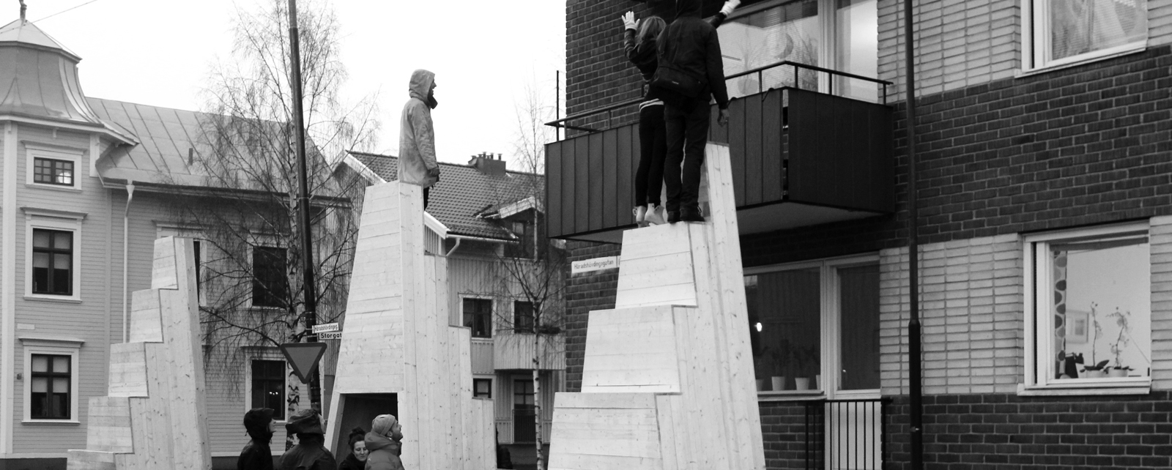
Access Control (CPTED con’t)
Focused on reducing opportunities for crime by:
denying access to potential targets
creating a heightened perception of risk in offenders
Can comprise many forms:
Informal and natural: spatial definition
Formal and organised: security personnel
Mechanical strategies: locks and bolts
Areas with unregulated access have more crime than areas with street layouts with more restricted access
Defensible Space: People and Design in the Violent City (1971)
Preventing Crime: What Works, What Doesn’t, What’s Promising (1997)
http://www.arch.umu.se/en/education/master-studies/laboratory-of-immediate-architectural-intervention/
Notes:
Access control is focused on reducing opportunities for crime by denying access to potential targets and creating a heightened perception of risk in offenders.
There are many forms:
Informal and natural access control such as spatial definition as discussed before
Formal and organised access control such as security personnel or patrolmen
Mechanical strategies such as locks and bolts

Slide 31
Support and Target Hardening (CPTED con’t)
Increases the efforts that offenders must expend for a crime
Long-established and traditional approach to crime prevention
Denying or limiting access to a crime target through the use of physical barriers (fences, gates, locks, electronic alarms, and security patrols)
UK public housing estates: target-hardening strategies resulted in reductions in burglaries (control group used in comparison)
Burglary Reduction: Findings From Safer Cities Schemes (1994)
Residential security: containment and displacement of burglary (1984)
Notes:
The next area of focus in CPTED is support and target hardening
The theory behind it is to increase the efforts that offenders must expend for a crime and is the long-established and traditional approach to crime prevention
For example denying or limiting access to a crime target through the use of physical barriers such as fences, gates, locks, electronic alarms, and security patrols
An example is in the United Kingdom public housing estates where target-hardening strategies resulted in reductions in burglaries

Slide 32
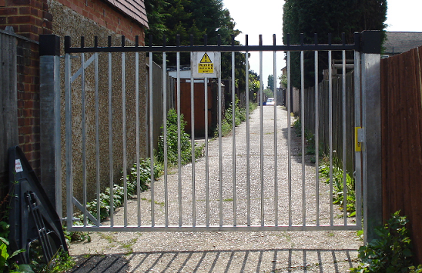
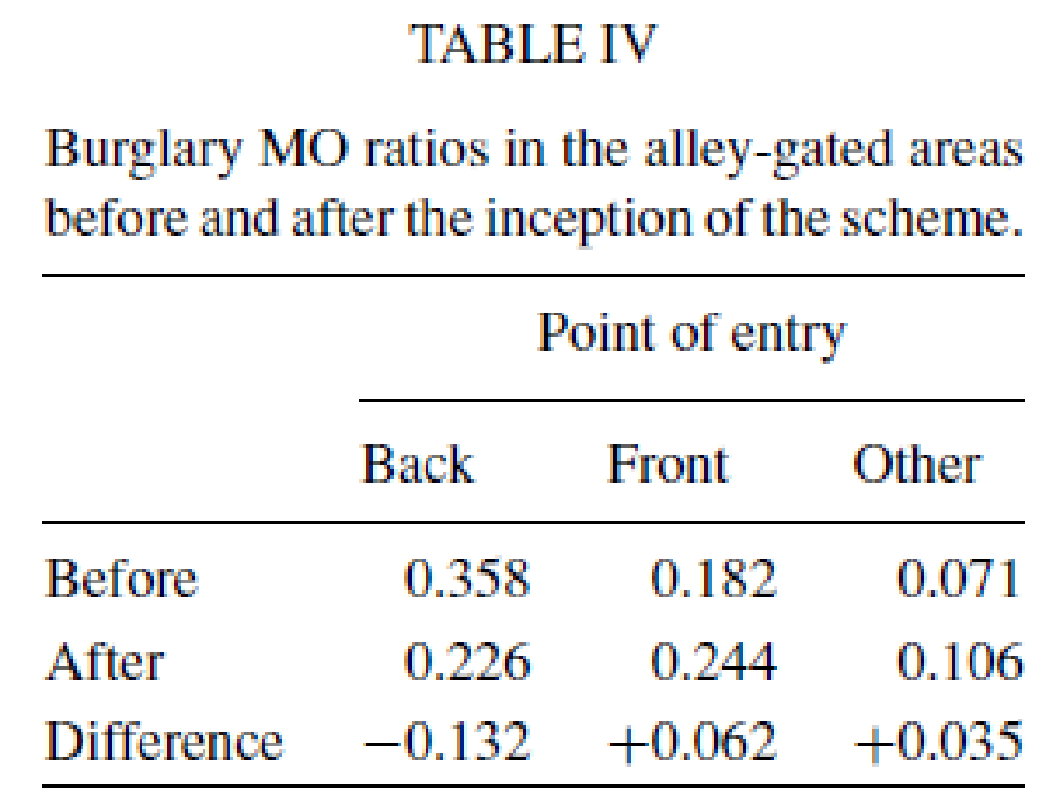
Alley-gating (CPTED con’t)
Installation of lockable gates across the alleyways on the rear of properties
Situational crime prevention with widespread popularity in the UK
Keys to the gates provided only to residents who live in the houses secured by the gates
Critics have compared it to gated neighbourhoods
Alley-gating does not physically create a closed-off ‘community’ within gates, since only the alleys to the back are enclosed
Before (Jan 1998 - Dec 1999)
After (Jan 2000 - June 2003)
Total of 3178 gates were installed
Closing off opportunities for crime: An evaluation of alley-gating (2005)
Alley-gating and neighbourhood gating are they two sides of the same face (2003)
Notes:
Alley-gating is one form of target hardening strategy and situational crime prevention with widespread popularity in the United Kingdom
It involves the installation of lockable gates across the alleyways on the rear of properties
Critics of alley-gating have compared it to gated neighbourhoods and suggest that it may create a similar defensive or fortress mentality with the residents of the community
Supporters of alley-gating has suggested that it does not physically create a closed-off ‘community’ within gates, since only the alleys to the back are enclosed, but no research has been done so far into the mindset of residents in alley-gating versus gated neighbourhood communities

Slide 33
Support and Target Hardening (CPTED con’t)
Excessive use of target hardening tactics can create a “fortress mentality”
Second-generation CPTED in schools (1997)
Self-policing capacity of the built environment is damaged
Imagery whereby residents withdraw behind physical barriers
Notes:
There are pros and cons to everything -- An excessive use of target hardening tactics can create a “fortress mentality” within the residents of a community
This can in turn cause residents to withdraw behind physical barriers to feel safe
A reduction in the self-policing capacity may result as residents may be inclined to be more withdrawn
In other words, could compromise other key components community safety, such as, community residents’ buy in, or marginalized members of the community become “other-ed”

Slide 34
Image and Maintenance (CPTED con’t)
“Broken windows theory”: demoralizing effect that abandoned buildings, graffiti, and general decay have on neighbourhoods
Promoting a positive image and routinely maintaining the built environment
Management of private rental housing can reduce drug related crime
Routine maintenance of the urban environment will significantly assist in reducing crime
New York Port Authority Bus Terminal: goal to reduce disorder and crime
62 tactics used including focus on renovations, visibility, surveillance, and flow
Reductions in order complaints and robbery and assault offenses
Preventing Crime at Places: Why Places Are Important (1997)
From Broken Windows to Busy Streets: A Community Empowerment Perspective (2015)
Redesigning Hell: Preventing Crime and Disorder at the Port Authority Bus Terminal (1996)
Notes:
The last section of CPTED is image and maintenance
As some of you may be familiar with, the “broken windows theory” is the demoralizing effect that abandoned buildings, graffiti, and general decay have on neighbourhoods
To combat this, image and maintenance strategy revolves around promoting a positive image and routinely maintaining the built environment
Researchers have suggested that management of private rental housing can reduce drug related crime and that routine maintenance of the urban environment may significantly assist in strategies to reducing crime

Slide 35
Crime prevention through environmental design
RCMP: “Research has shown that the proper design and effective use of the built environment can lead to a reduction in both the opportunity for crime and fear of crime”
Incorporation into local crime prevention plans of Toronto and Edmonton
Application in the design of neighbourhoods, parks, public housing, etc in Erin Mills, Vancouver, Lethbridge, Brampton, Kitchener
"Crime Prevention Through Environmental Design - Royal Canadian Mounted Police". Rcmp-grc.gc.ca. N.p., 2011. Web. 21 Apr. 2016.
Notes:
All the previous sections mention are all a part of Crime Prevention Through Environmental Design (CPTED) and has already been used in crime reduction strategies across Canada
The RCMP’s views on CPTED include “Research has shown that the proper design and effective use of the built environment can lead to a reduction in both the opportunity for crime and fear of crime”
Limitations of CPTED include Irrational offenders (such as those who are intoxicated) are less likely to be deterred by these strategies

Slide 36
Discussions and Questions
Connect with us
bartonandking@gmail.com
Situation Table
Social Cohesion
Sustaining Volunteer Engagement
Neighbourhood Watch
Surveillance
Lighting
Crime prevention through environmental design (CPTED)
Activity Support
CPTED
Access Control
CPTED
Image and Maintenance
CPTED
Target Hardening
CPTED
Territoriality
CPTED

