Slide 1
Community Safety Committee Research Presentation
Yi Shi Sun¹, Margaret Secord², Joanne ³, Julie Michal³
¹ Bachelor of Health Sciences (Honours), McMaster University, Hamilton, ON, Canada
² McMaster University, Hamilton, ON, Canada
³ Co-Chairs of Community Safety Committee, Hamilton, ON, Canada
Notes:
Welcome everyone and thank you for taking the time tonight to see some of the research in the literature about community engagement and community safety

Slide 2
Research Question
What is the spectrum of community participation and engagement initiatives that contribute to an increase in neighbourhood safety in an urban residential setting?
Definition of Terms
Spectrum: used to describe that there is a diverse range of focuses within the topic. For example, in the spectrum of community participation and engagement, there are informal activities such as socializing with neighbours, more formalized approaches such as neighbourhood watch, and everything in between.
Initiative: A plan, strategy, or approach that can be used to improve a situation. For example, a community participation and engagement initiative is a plan, strategy, or approach with the focus on improving the community.
Notes:
To start, the research question that was initially brainstormed and eventually refined to is: What is the spectrum of community participation and engagement initiatives that contribute to an increase in neighbourhood safety in an urban residential setting?
Definition of the terms used in this research question include:
Spectrum being the diverse range of focuses within a topic such as within community participation and engagement: informal activities such as socializing with neighbours, more formalized approaches such as neighbourhood watch, and everything in between
Initiative: being any sort of community participation and engagement initiative that is a part of a plan, strategy, or approach with the focus on improving the safety of the community

Slide 3
Timeline so far
Month | Activity
August | Community Safety Meeting (Aug 12, 2015), Brainstorming on Research Question
September | Community Safety Meeting (Sep 9, 2015), Creating the Research Question together and finishing paperwork
October | Community Safety Meeting (Oct 14, 2015), Creating Learning Contract/Action Agreement, Starting to explore the literature
November | Continued Research, Community Safety Meeting (Nov 11, 2015)
December | Continued Research, Progress Meeting with Ms. Margaret Secord (Dec 18, 2015)
Notes:
Just to recap how we got here in terms of the timeline of this project, our first meeting as part of the Community Safety Committee was in August where we started brainstorming together on the research question
In September, we progressed on creating the research question and finishing paperwork and in October, research into the literature began

Slide 4
Timeline so far (cont.)
Month | Activity
January | Continued research, Meeting with Ms. Julie Michal on status of the Community Safety Committee (Jan 7, 2016)
February | Continued research, Community Safety Meeting at SPRC (Feb 23, 2016)
March | Continued research, McMaster BHSc Poster Day (Mar 30, 2016)
April | Presentation with Community Safety Committee at SPRC (April 21, 2016)
May and Onwards | Continued research and support of Community Safety Committee
Notes:
In the new yea we had our Community Safety Committee meeting here at SPRC on Feb 23 which set the stage for today’s presentation to the committee
And in the months after April, continued research and support of the Community Safety Committee depending on what direction the committee wants to go following the presentation

Slide 5
Search Strategy
Academic databases:
Google Scholar
Journals @ Scholars Portal
Social Science Abstracts
Sociological Abstracts
JSTOR (Journal Storage)
Grey literature:
Canadian Public Policy Collection
LexisNexis
Canadian Federal Website
Various Municipal and Provincial Websites
Notes:
Diving into the literature to explore the topics of community engagement in relationship to community safety required an extensive search into not only the academic databases, but also the grey literature as well.
For the academic databases, a wide variety were used to be able to access academic journals and articles from a range of topic areas
For the grey literature, the Canadian Public Policy Collection was a great resource to find policy papers published across Canada, LexisNexis had an extensive database of newspaper articles from around the world, and the Canadian federal website along with various municipal and provincial websites were explored as well

Slide 6
Items to Consider Throughout
Coherence
How does this initiative relate to other things that are going on in the community?
Deliberateness
What are the initiative’s specific objectives?
Inclusiveness
How well does the initiative address all components of the problem it is designed to solve?
Theoretical Comprehension
What background research has gone into the design of this initiative?
Notes:
Something that I came across in the research that will really set the stage for this presentation was the “Gaining Momentum Multi-Sector Community Safety and Well-being in Ontario” policy paper
It laid out various items for communities to consider as they explore various community engagement and initiative opportunities and deem which ones are more appropriate and suitable for their community
Coherence: How does this initiative relate to other things that are going on in the community? Are there other programs, activities, projects in the community that are designed to deal with these same problems or issues?
Deliberateness: How was this initiative planned in the first place? What are its specific objectives?
Inclusiveness: How well does the initiative address all components of the problem it is designed to solve? Does it include all the partners that are needed to make it work well?
Theoretical Comprehension: Are all partners aware of the theory that underlies this initiative? What background research has gone into the design of this initiative?

Slide 7
Items to Consider Throughout (cont.)
Adequacy of Scope and Rigour
How well does this initiative affect all the factors that are contributing to the problem?
Measurability
How will you know if the initiative is achieving the desired results?
Sustainability
Where will the interest, energy, and resources come from to sustain the initiative?
How easy will it be to keep the initiative going?
Gaining Momentum Multi-Sector Community Safety and Well-being in Ontario (2015)
Notes:
Adequacy of Scope and Rigour: How well does this initiative affect all the factors that are contributing to the problem? What controls are in place to ensure that the initiative achieves its desired results?
Measurability: How will you know if the initiative is achieving the desired results? Can you measure progress in the outcomes?
Sustainability: How easy will it be to keep the initiative going? Where will the interest, energy and resources come from to sustain the initiative?

Slide 8
Significance of Community Engagement
“The most successful crime prevention initiatives are comprehensive. The causes of crime are very complex and there are no simple solutions. Rather than relying on a single program or strategy, you should use several different programs that are targeted at different aspects of the problem”
Programs using a collaborative approach and addressing root problems have been very successful.
Delivering local solutions to local problems that have been identified by local people.
Focus on prevention, crisis intervention, and long-term solutions.
Premier's Advisory Council on Crime and Community Safety: Final Report (2015)
Making Cities Safer Action Briefs for Municipal Stakeholders (2009)
Notes:
Here is a quote from the Making Cities Safer Action Briefs for Municipal Stakeholders (2009) report on what contributes to a successful action plan: “The most successful crime prevention initiatives are comprehensive. The causes of crime are very complex and there are no simple solutions. Rather than relying on a single program or strategy, you should use several different programs that are targeted at different aspects of the problem”
Further elaborated on in the Premier’s Advisory Council on Crime and Community Safety: Final Report (2015) and really portrays the significance of community engagement are:
Programs using a collaborative approach and addressing root problems have been very successful.
Delivering local solutions to local problems that have been identified by local people.
Focus on prevention, crisis intervention, and long-term solutions.

Slide 9
Challenges to Community Engagement
Not enough volunteers
Leading to other community volunteers becoming burned out
Perceived increased liability, risk and high stress levels in volunteer roles
Community buy in through education and awareness
No coordination within communities about what types of programs are being offered by whom
Organizations working in silos
Lack of system support, core funding, and staff
Need to build community capacity
Developing train-the-trainer programs and providing support for volunteers
Notes Premier's Advisory Council on Crime and Community Safety Final Report (2015)
Notes:
However, challenges faced in community engagement are common place and many of you may have already experienced this in the past
The first is simply not enough volunteers participating or engaging with the initiative and this will lead to the secondary challenge of causing other community volunteers to become burned out
Also there may be perceived increased liability, risk and high stress levels in volunteer roles.
Community buy in and support will oftentimes be a challenge and this will be counteracted by actions of education and awareness to community members.
Another challenge faced when working in community engagement is that there is no coordination within communities about what types of programs are being offered by whom with organizations working in silos
The work that this Community Safety Committee is doing is actually in fact addressing this challenge by connecting various communities together so that they do not have to work in silos
Further challenges faced in community engagement is sometimes the lack of system support, core funding, and staff
To counteract this, communities can build community capacity through programs such as train-the-trainer programs and providing support for volunteers

Slide 10
Different Strategies Researched in the Literature
Social Cohesion
Neighbourhood Watch
Surveillance
Lighting
Territoriality
Activity Support
Access Control
Image and Maintenance
Target Hardening
Crime prevention through environmental design (CPTED)
Situation Table
Sustaining Volunteer Engagement
Notes:
Now that was a bit into the introduction of what the research focused on, but what areas or strategies were actually researched into the literature?
The following initiatives, ideas, and strategies will be gone through in detail and explored one by one:
Social Cohesion, Neighbourhood Watch, Surveillance, Lighting, Territoriality, Activity Support, Access Control, Image and Maintenance, Target Hardening, Crime prevention through environmental design (CPTED), Situation Table, and Sustaining Volunteer Engagement

Slide 11
Social Cohesion

Slide 12
Social Cohesion
Domains
Local Policies to Enhance the Domains
Empowerment
Giving local people voice, Giving local people a role in policy processes
Participation
Establishing and supporting local activities, organisations, and events
Common purpose
Cooperating with one another, developing and supporting networks
Supporting networks
Expectation that help would be given to or received from others when needed
Collective norms and values
Ethos which residents recognise and accept, promoting community interests
Trust
Encouraging trust in residents in their relationships, bringing conflicting groups together
Safety
Involvement in local crime prevention, providing visible evidence of security measures
Belonging
Boosting the identity of a place via design, street furnishings, naming
Social cohesion, social capital and the neighbourhood (2001)
Notes:
The first area of focus we will discuss is social cohesion and it is actually something that came upon time and time again in the research so it makes sense to address it first
Social cohesion plays a big role, but what factors contribute into whether a community is cohesive or not?
In the literature the following domains of social cohesion have been described along with the local policies to enhancing these domains:
Empowerment: Giving local people voice, Giving local people a role in policy processes
Participation: Establishing and supporting local activities, organisations, and events
Common purpose: Cooperating with one another, developing and supporting networks
Supporting networks: Expectation that help would be given to or received from others when needed
Collective norms and values: Ethos which residents recognise and accept, promoting community interests
Trust: Encouraging trust in residents in their relationships, bringing conflicting groups together
Safety: Involvement in local crime prevention, providing visible evidence of security measures
Belonging: Boosting the identity of a place via design, street furnishings, naming

Slide 13
Social Cohesion (cont.)
Important for neighborhood development
Contributes a sense of individual and group empowerment that helps neighbors to collectively act to meet their shared needs
Social cohesion can be a significant predictor of actual involvement in crime prevention efforts by local community-based organizations
Sense of community in the urban environment A catalyst for participation and community development (1990)
An Examination of Citizen Involvement in Crime Prevention in High-Risk Versus Low- to Moderate-Risk Neighborhoods (2006)
Extent to which neighbors share values
Can rely on each other for support
Act in ways that protect the safety of their communities
Notes:
After touching on what contributes to the domains of social cohesion, next is its significance
Social cohesion contributes to the extent to which neighbors share values, which in turn can rely on each other for support, and thus act in ways that protect the safety of their communities
It’s important for neighborhood development because by contributing to a sense of individual and group empowerment, it helps neighbors to collectively act to meet their shared needs
Research has found that social cohesion can be a significant predictor of actual involvement in crime prevention efforts by local community-based organizations

Slide 14
How to Build on Domains of Social Cohesion?
Initiatives and programs varies by neighbourhood
No “one model fits all” approach
Examples:
Hold focus groups/consultations with residents, stakeholders, vulnerable populations to identify needs within a community and develop a strategy to address those needs (housing, safety, etc)
Work with local business associations to develop strategies that match jobs to existing residents’ skills and employment needs
Community mapping exercise to identify safe common meeting locations in the community
Increased recreation, cultural and community-based programming in public areas such as parks
Notes:
Talking about all this social cohesion naturally brings up the question of how to build on these domains of social cohesion? The start is that the initiatives and programs will vary by neighbourhood as there is no “one model fits all” approach”
In the literature, there hasn’t been research determining what initiatives have concretely led to increases of social cohesion partly due to the how relative it is to the neighbourhood
The examples listed are what other communities and neighbourhoods have attempted and have seen successes with:
Hold focus groups/consultations with residents, stakeholders, vulnerable populations to identify needs within a community and develop a strategy to address those needs (housing, safety, etc)
Work with local business associations to develop strategies that match jobs to existing residents’ skills and employment needs
Community mapping exercise to identify safe common meeting locations in the community
Increased recreation, cultural and community-based programming in public areas such as parks

Slide 15
How to Build on Domains of Social Cohesion?
Examples:
Locally led street/block parties and community festivals that celebrate the community’s diversity
Community based methods of support: babysitting clubs, walking groups, food cooperatives
Victoria, Australia local government action guides - Increasing social connections (2012)
Simcoe Muskoka District Community Design Social Cohesion & Well-being (2015)
Notes:
There are also the more widely known locally led street/block parties and community festivals that celebrate the community’s diversity
As well community based methods of support such as babysitting clubs, walking groups, and food cooperatives
Again these are examples of what has worked in other neighbourhoods but what is right for your neighbourhood may be different

Slide 16
Social Cohesion (cont.)
Social cohesion was the strongest predictor of involvement in both high-risk and low- to moderate-risk neighborhoods
In high-risk neighborhoods, the following three factors emerged as significant predictors of citizen involvement:
Residents who felt like part of the neighborhood (versus just a place to live)
Minority residents were more likely to be involved
Residents who believed that police get to know residents
Social cohesion a robust predictor of lower rates of violence
An Examination of Citizen Involvement in Crime Prevention in High-Risk Versus Low- to Moderate-Risk Neighborhoods (2006)
Neighborhoods and violent crime: A multilevel study of collective efficacy (1997)
Notes:
Research has found that social cohesion was the strongest predictor of residents’ involvement in both high-risk and low- to moderate-risk neighborhoods.
In high-risk neighborhoods, the following three factors emerged as significant predictors of citizen involvement:
Residents who felt like part of the neighborhood versus just a place to live
Minority residents were more likely to be involved
Residents who believed that police get to know residents
Involvement in crime prevention activities has less to do with the public’s perception of the effectiveness and more to do with the development of personal relationships between the police and residents.
Social cohesion was also found to be a robust predictor of lower rates of violence in a community.

Slide 17
Neighbourhood Watch

Slide 18
Neighbourhood Watch
Not standardized, varies among implementation
Common themes:
a) residents operating as the ‘eyes and ears’ of the police
b) residents reporting suspicious behavior to the police or neighborhood coordinator
c) residents interacting and working together to solve problems
Different goals in different neighbourhoods: reduce fear of crime, increase informal neighbourhood control of minor crimes, increase public confidence in police
NOT to make citizen’s arrests, nor take any action that might jeopardize volunteers’ safety or that of the public
The Effectiveness of Neighborhood Watch A Systematic Review (2008)
Notes:
Neighbourhood Watch is a community initiative that has been implemented in wide variety of communities around the world
Though not all Neighbourhood Watch implementation is the same, there are common themes including:
residents operating as the ‘eyes and ears’ of the police
residents reporting suspicious behavior to the police or neighborhood coordinator
residents interacting and working together to solve problems
After implementation of Neighbourhood Watch, there are different goals in different neighbourhoods and they can include reducing fear of crime, increasing informal neighbourhood control of minor crimes, and increasing public confidence in police
The purpose of Neighbourhood Watch is NOT to make citizen’s arrests, nor take any action that might jeopardize volunteers’ safety or that of the public

Slide 19
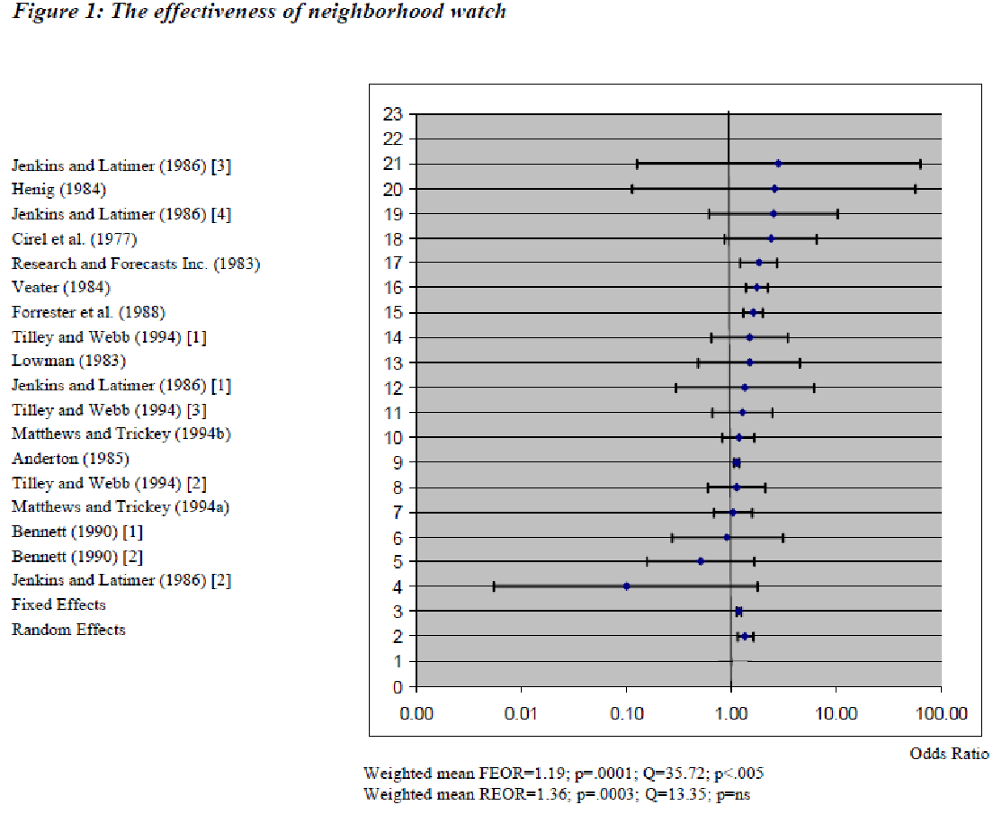
Neighbourhood Watch (cont.)
The results of the narrative review show that 19 of the 24 evaluations included in the analysis found that neighborhood watch was associated with a reduction in crime.
The Effectiveness of Neighborhood Watch A Systematic Review (2008)
Notes:
A systematic review was conducted in 2008 which looked at 24 evaluations of Neighbourhood Watch implementations in the US and the UK. In each evaluation, the studies had a comparison control neighbourhood to compare and measure an associated reduction in crime. The results from the systematic reviewed showed that 19 of the 24 evaluations found an associated reduction in crime. The other 5 evaluations either showed no reductions or an increase in crime when comparing the community with Neighbourhood Watch implementation to the control community.

Slide 20
Neighbourhood Watch (cont.)
Visible surveillance
Deterrent effect on the perceptions and decision making of potential offenders
Creation of signs of occupancy
Perceptions of potential offenders in terms of their likelihood of getting caught
Enhance community cohesion
Generation of acceptable norms of behavior and by direct involvement of residents
Increase the flow of useful information from the public to the police
Greater number of arrests and convictions
Does neighborhood watch reduce crime A systematic review and meta-analysis (2006)
Notes:
How does Neighbourhood Watch implementations work to reduce crime?
The first is through visible surveillance in that it creates a deterrent effect on the perceptions and decision making of potential offenders
Through the creation of signs of occupancy, it may affect perceptions of potential offenders in terms of their likelihood of getting caught
Signs of occupancy include removing newspapers and milk from outside neighbors’ homes when they are away, mowing the lawn, and filling up trash cans
Another aspect is enhancing community cohesion (what we mentioned in the last section) and generation of acceptable norms of behavior and by direct involvement of residents
In theory, it would also increase the flow of useful information from the public to the police and potentially lead to a greater number of arrests and convictions

Slide 21
Neighbourhood Watch (cont.)
Lack of data and inconclusive research on community participation levels within Neighbourhood Watch
engaging in neighbourhood surveillance, social interaction, etc
Possibility that Neighbourhood Watch activities may increase fear of crimes and racial prejudice
Especially in non-homogenous populations
Social-control processes have little influence over outsiders who feel no pressure to conform
Residents have little leverage to regulate or change the social perceptions and behaviors of outsiders
The theory and research behind neighborhood watch Is it a sound fear and crime reduction strategy (1987)
Notes:
Even though there is evidence supporting Neighbourhood Watch reducing crime in neighbourhoods, there are some considerations:
There is a lack of data and inconclusive research on community participation levels within Neighbourhood Watch so how many residents are actually engaging in neighbourhood surveillance, social interaction, and all the other aspects that make the implementation work effectively
There is a possibility that Neighbourhood Watch activities may increase fear of crimes and racial prejudice and this is especially a concern in non-homogenous populations
As with most aspects with social cohesion, social-control processes have little influence over outsiders who feel no pressure to conform and residents have little leverage to regulate or change the social perceptions and behaviors of outsiders

Slide 22
Surveillance

Slide 23
Surveillance
Physical design can promote informal or natural surveillance opportunities for residents
If offenders perceive that they can be observed, they may be less likely to commit the offense
Increased potential for intervention, apprehension, and prosecution
Natural: residents’ self-surveillance opportunities, windows
Organized: security guards, patrols
Mechanical: closed circuit television surveillance
Crime prevention through environmental design (CPTED) a review and modern bibliography (2005)
Notes:
The next topic area is surveillance which is how the physical design can promote informal or natural surveillance opportunities for residents
The theory is that if offenders perceive that they can be observed, they may be less likely to commit the offense
There are multiple ways to create this increased potential for intervention, apprehension, and prosecution by residents
First is natural surveillance which are residents’ self-surveillance opportunities such as windows from which to observe the neighbourhood
Second is organized surveillance in the form of security guards or patrols
Third is mechanical surveillance such as closed circuit television surveillance

Slide 24
Surveillance (cont.)
Burglars avoid targets that are readily observed by neighbours
Concealment opportunities for burglars
Properties with low levels of lighting
High walls and fences
Thick foliage
Linear integrated spaces with strong intervisibility of good numbers of entrances provide more surveillance opportunities
Existence of natural surveillance opportunities does not mean surveillance is taking place or any direct action by citizens is guaranteed
Burglary of Single-Family Houses (2002)
A place for every crime and every crime in its place: an alternative perspective on crime displacement (1992)
Notes:
In the literature, it is hypothesised that burglars avoid targets that are readily observed by neighbours
Example of concealment opportunities for burglars include properties with low levels of lighting, high walls and fences, and thick foliage particularly when close to points of access such as windows and doors
As well linear integrated spaces with strong intervisibility of good numbers of entrances provide more surveillance opportunities
However a key point of consideration as we go through surveillance is that existence of natural surveillance opportunities does not mean that surveillance is taking place or any direct action by citizens is guaranteed

Slide 25
Surveillance (cont.)
Suburban Vancouver: Increased formal bike patrols at parking lots and garages have demonstrated reductions in car-related crime
London Underground: Reduced robberies and car-related crime with closed circuit television security compared with a control group in parking lots
Burnley, United Kingdom: implementation of closed circuit television security significantly decreased all recorded property crime
Burglary, car crime, criminal damage, and stolen goods
Preventing auto theft in suburban Vancouver commuter lots: effects of a bike patrol (1996)
Understanding Car Parks, Crime and CCTV: Evaluation Lessons from Safer Cities (1993)
An Evaluation of Secured by Design Housing Schemes Throughout the West Yorkshire Area (1999)
Notes:
Examples of where communities implemented surveillance opportunities include suburban Vancouver where increased formal bike patrols at parking lots and garages have demonstrated reductions in car-related crime
In the London Underground, when they compared an implementation of closed circuit television security with a control group without it, reduced robberies and car-related crime were observed in parking lots
In Burnley, United Kingdom following the implementation of closed circuit television security, it significantly decreased all recorded property crimes which includes burglary, car crime, criminal damage, and stolen goods

Slide 26
Lighting

Slide 27
Lighting
Two theories on why improved street lighting may cause reduction in crime
Effects of improved street lighting on crime a systematic review (2002)
Increased surveillance of potential offenders
improving visibility and by increasing the number of people on the street
predicts decreases in crime especially during the night-time
Increased community investment in the area
increased community pride, community cohesiveness and informal social control
decreases in crime during both day-time and night-time
Notes:
Improved street lighting has been seen in the literature to cause reductions in crime, but there has been 2 prevailing theories as to how it may cause these reductions
The first is based on the theory that improved street lighting will increase surveillance of potential offenders through improving visibility and by increasing the number of people on the street
If this theory is more dominant, it should hypothetically predict decreases in crime especially during the night-time
The second theory is based on increased community investment in the area which in theory leads to increased community pride, community cohesiveness and informal social control
This theory would predict decreases in crime during both day-time and night-time
These two theories are likely not mutually exclusive, but one may have a greater impact than the other

Slide 28
Lighting (cont.)
Meta-analysis of 13 studies (8 American, 5 United Kingdom) showed that improved lighting led to reductions in crime
Overall reduction in crime after improved lighting was 20%
Did not find that night-time crime decreased more than day-time crime
Supports theory of improved street lighting reducing crime because of its role in increasing community pride and community investment
Most effective in reducing crime in stable homogeneous communities
Effects of improved street lighting on crime a systematic review (2002)
Notes:
In a meta-analysis of 13 studies (8 from the US and 5 from the UK), researchers found that improved lighting led to reductions in crime
The overall reduction in crime after improved lighting was 20%
The measure of crime used in the studies were property and violent crimes
When they examined if there was a difference between night-time and day-time crime, they did not find that night-time crime decreased more than day-time crime
This supports that the more dominant theory is improved street lighting reducing crime because of its role in increasing community pride and community investment
Though there was the overall reduction by 20% crime in the 13 studies, researches did make note that it was most effective in reducing crime in stable homogeneous communities

Slide 29
Crime Prevention Through Environmental Design (CPTED)

Slide 30
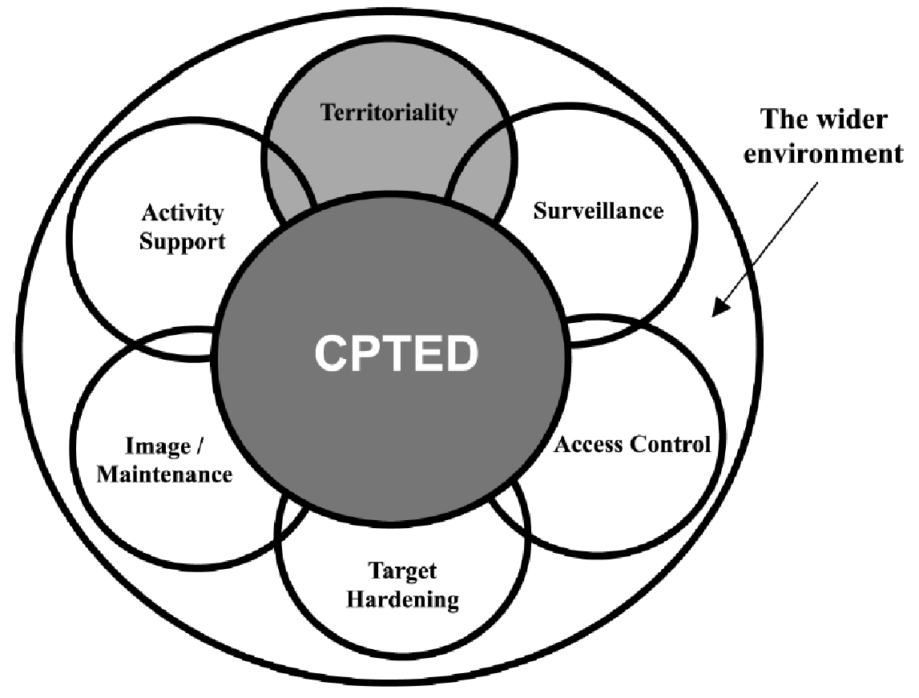
Crime Prevention Through Environmental Design (CPTED)
Notes:
Crime Prevention Through Environmental Design or CPTED (pronounced cep-ted) is a concept that embodies a couple different areas in the environment that a community can engage with to improve community safety
We’ve already talked a bit about surveillance, but we will go through each of the other areas before collectively bringing it back to discuss the merits of CPTED as a whole

Slide 31
Territoriality
Reinforcing “sense of ownership” in legitimate users of space
Reducing opportunities for offending by discouraging illegitimate users
Design that differentiates between private property and public spaces
Yard/driveway/walkway VS street/sidewalk
Methods of differentiation: shrubbery, bushes, alternate paving stone colour
Residential burglars judge risk The role of territoriality (1993)
"Crime Prevention Through Environmental Design - Royal Canadian Mounted Police". Rcmp-grc.gc.ca. N.p., 2011. Web. 21 Apr. 2016.
Notes:
Territoriality is the concept of reinforcing “sense of ownership” in legitimate users of space
This can be done through reducing opportunities for offenders by discouraging illegitimate users
This can be in the form of design that differentiates between private property and public spaces
For example the yard, driveway, or walkway can be considered private space while the street and sidewalk is oftentimes considered public space
Methods of differentiation between these spaces can be done through shrubbery, bushes, or alternate paving stone colour (just a couple of examples)

Slide 32
Territoriality (cont.)
In study with 72 incarcerated burglars, most burglars factored territorial concerns, neighbor reactivity, and difficult entry into their judgments that a house was burglarized or not burglarized
Though territoriality has shown to be most effective at the local level
Difficulties associated with definition, interpretation and measurement
Varies between cultures, neighbourhoods, and individual groups
Residential burglars judge risk The role of territoriality (1993)
Defensible space undefended: social factors in crime prevention through environmental design (1981)
Suburb Boundaries and Residential Burglars (2003)
Notes:
In a study with 72 incarcerated burglars from the US, researchers found that most burglars factored territorial concerns, neighbor reactivity, and difficult entry into their judgments of whether a house was burglarized or not burglarized
Though territoriality has shown to be most effective at the local level, there are often difficulties associated with definition, interpretation and measurement
Part of this is because the designs that differentiate between public and private space is based a lot on perceptions and will vary between cultures, neighbourhoods, and individual groups

Slide 33
Activity Support
The use of design and signage to encourage intended patterns of usage of public space
Encourage residents’ use and presence in local parks, paths, and alleyways
Increased numbers of pedestrians may provide surveillance and potentially discourage some offences
May encourage other targets for crime (i.e. pick-pocketing)
Crime Prevention Through Environmental Design: Applications of Architectural Design and Space Management Concepts, 2nd ed.
Notes:
With territoriality being able to distinguish between private and public space, activity support is similar in that it is the use of design and signage to encourage intended patterns of usage of public space
In theory it works through encouraging residents’ use and presence in public spaces such as local parks, paths, and alleyways
The increased numbers of pedestrians may provide surveillance and potentially discourage some offences
However, there is the potential with more pedestrians in public spaces that, there may be encouragement for other targets for crime such as pick-pocketing

Slide 34
Access Control
Focused on reducing opportunities for crime by:
denying access to potential targets
creating a heightened perception of risk in offenders
Can comprise many forms:
Informal and natural: spatial definition
Formal and organised: security personnel
Mechanical strategies: locks and bolts
Areas with unregulated access have more crime than areas with street layouts with more restricted access
Defensible Space: People and Design in the Violent City (1971)
Preventing Crime: What Works, What Doesn’t, What’s Promising (1997)
Notes:
Access control is focused on reducing opportunities for crime by denying access to potential targets and creating a heightened perception of risk in offenders.
It can comprise of many forms:
Informal and natural access control such as spatial definition and the layout/organization of a neighbourhood
Formal and organised access control such as security personnel or patrolmen
Mechanical strategies such as locks and bolts
Research has also shown that areas with unregulated access have more crime than areas with street layouts with more restricted access

Slide 35
Access Control (cont.)
New York’s Bronx district: routes through the public housing complex were reduced in number, lighting and surface appearance of the buildings was improved
Significant reduction in crime (54%) was reported (no control group)
Creating Defensible Space (1996)
Notes:
An example of where access control strategies were used was the New York’s Bronx district
Routes through the public housing complex were reduced in number, lighting and surface appearance of the buildings was improved
This resulted in a significant reduction in overall crime (54%) being reported which includes burglary, robbery, assault, and felonies
However in this study, there was no control group/neighbourhood as it just compared before to after implementation

Slide 36
Support and Target Hardening
Increases the efforts that offenders must expend for a crime
Long-established and traditional approach to crime prevention
Denying or limiting access to a crime target through the use of physical barriers (fences, gates, locks, electronic alarms, and security patrols)
UK public housing estates: target-hardening strategies resulted in reductions in burglaries (control group used in comparison)
Burglary Reduction: Findings From Safer Cities Schemes (1994)
Residential security: containment and displacement of burglary (1984)
Notes:
The next area of focus in CPTED is support and target hardening
The theory behind it is to increase the efforts that offenders must expend for a crime and is the long-established and traditional approach to crime prevention
For example denying or limiting access to a crime target through the use of physical barriers such as fences, gates, locks, electronic alarms, and security patrols
An example is in the United Kingdom public housing estates where target-hardening strategies resulted in reductions in burglaries
Target-hardening strategies include securing all ground floor points of entry against burglary and installation of security devices
In this study a control estate/neighbourhood was used to compare the reductions in burglaries

Slide 37
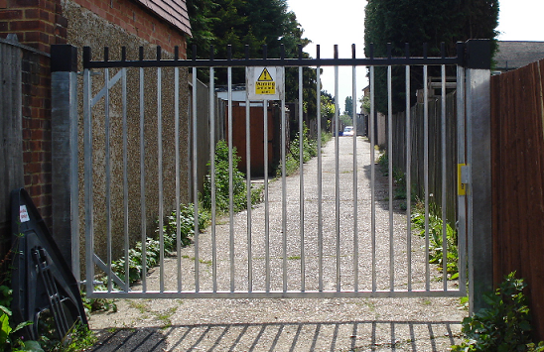
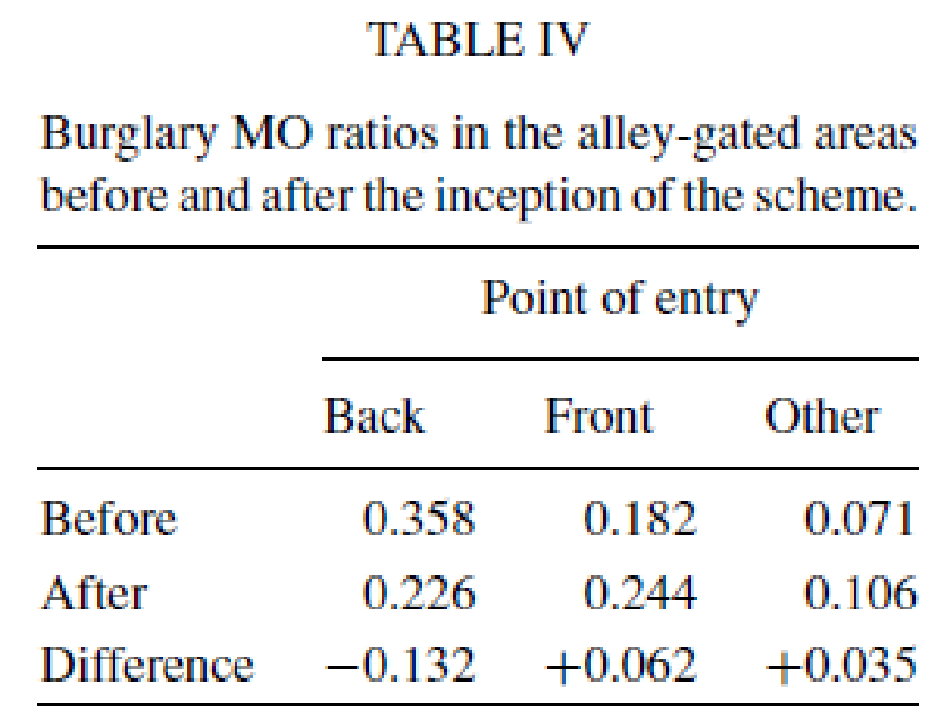
Alley-gating
Installation of lockable gates across the alleyways on the rear of properties
Situational crime prevention with widespread popularity in the UK
Keys to the gates provided only to residents who live in the houses secured by the gates
Critics have compared it to gated neighbourhoods
Alley-gating does not physically create a closed-off ‘community’ within gates, since only the alleys to the back are enclosed
Before (Jan 1998 - Dec 1999)
After (Jan 2000 - June 2003)
Total of 3178 gates were installed
Closing off opportunities for crime: An evaluation of alley-gating (2005)
Alley-gating and neighbourhood gating are they two sides of the same face (2003)
Notes:
Alley-gating is one form of target hardening strategy and situational crime prevention with widespread popularity in the United Kingdom
It involves the installation of lockable gates across the alleyways on the rear of properties
Keys to the gates provided only to residents who live in the houses secured by the gates
The results of the alley gating study showed a statistically significant reduction in burglary rates by 37% relative to a comparison neighbourhood
When breaking down the burglary rates by point of entry, there was a decrease in burglary when point of entry was the back while for point of entry at the front or other, there were increases
Because the decrease in back point of entry were greater than the increases in front and other point of entry, the net result was a reduction in burglary rates by 37%
Burglary MO ratio was calculated by the number of burglaries in the alley-gated areas divided by those in the comparison area
Critics of alley-gating have compared it to gated neighbourhoods and suggest that it may create a similar defensive or fortress mentality with the residents of the community
Supporters of alley-gating has suggested that it does not physically create a closed-off ‘community’ within gates, since only the alleys to the back are enclosed, but no research has been done so far into the mindset of residents in alley-gating versus gated neighbourhood communities

Slide 38
Support and Target Hardening (cont.)
Excessive use of target hardening tactics can create a “fortress mentality”
Second-generation CPTED in schools (1997)
Self-policing capacity of the built environment is damaged
Imagery whereby residents withdraw behind physical barriers
Notes:
The idea of a fortress mentality is one of the biggest critiques of support and target hardening strategies in reducing crime shown in the literature
As excessive use of target hardening tactics can create a “fortress mentality” within the residents of a community
This can in turn build the imagery and perception where residents need to withdraw behind physical barriers to feel safe
This may cause the self-policing capacity of the built environment and community to be damaged as residents may be inclined to be more withdrawn
This can possibly lead to a positive feedback loop where residents feel more and more inclined to withdraw and have the “fortress mentality”

Slide 39
Image and Maintenance
“Broken windows theory”: demoralizing effect that abandoned buildings, graffiti, and general decay have on neighbourhoods
Promoting a positive image and routinely maintaining the built environment
Management of private rental housing can reduce drug related crime
Routine maintenance of the urban environment will significantly assist in reducing crime
New York Port Authority Bus Terminal: goal to reduce disorder and crime
62 tactics used including focus on renovations, visibility, surveillance, and flow
Reductions in order complaints and robbery and assault offenses
Preventing Crime at Places: Why Places Are Important (1997)
From Broken Windows to Busy Streets: A Community Empowerment Perspective (2015)
Redesigning Hell: Preventing Crime and Disorder at the Port Authority Bus Terminal (1996)
Notes:
The last section of CPTED is image and maintenance
As some of you may be familiar with, the “broken windows theory” is the demoralizing effect that abandoned buildings, graffiti, and general decay have on neighbourhoods
To combat this, image and maintenance strategy revolves around promoting a positive image and routinely maintaining the built environment
Researchers have suggested that management of private rental housing can reduce drug related crime and that routine maintenance of the urban environment may significantly assist in strategies to reducing crime
An example of the image and maintenance strategy was in the New York Port Authority Bus Terminal where the goal was to reduce disorder and crime in the bus terminal
62 tactics were used and implemented and included a focus on renovations, visibility, surveillance, and flow
The results were reductions in order complaints (as a measure of disorder) and robbery and assault offenses (as a measure of crime)
No control bus terminal was used for comparison of reductions in disorder and crime

Slide 40
Crime prevention through environmental design
RCMP: “Research has shown that the proper design and effective use of the built environment can lead to a reduction in both the opportunity for crime and fear of crime”
Incorporation into local crime prevention plans of Toronto and Edmonton
Application in the design of neighbourhoods, parks, public housing, etc in Erin Mills, Vancouver, Lethbridge, Brampton, Kitchener
"Crime Prevention Through Environmental Design - Royal Canadian Mounted Police". Rcmp-grc.gc.ca. N.p., 2011. Web. 21 Apr. 2016.
Notes:
All the previous sections mention are all a part of Crime Prevention Through Environmental Design (CPTED) and has already been used in crime reduction strategies across Canada
The RCMP’s views on CPTED include “Research has shown that the proper design and effective use of the built environment can lead to a reduction in both the opportunity for crime and fear of crime”
It has been incorporation into local crime prevention plans of Toronto and Edmonton
As well it has been applied in the design of neighbourhoods, parks, and public housing in Canadian cities and neighbourhoods such as Erin Mills, Vancouver, Lethbridge, Brampton, Kitchener

Slide 41
Crime prevention through environmental design (cont.)
Five Oaks project in Ohio: reported a 26% decrease in recorded crime after a range of CPTED interventions
multiple interventions obscure the detailed understanding of what each intervention contributed
Britain and North America: analysis of 45 cases of environmental design and improvement: 24 with evidence of crime reduction and another 12 with positive findings
Focus on lighting, fencing, improving surveillance, neighbourhood cleanup, and physical improvements to housing
Creating Defensible Space (1996)
What Works in Crime Prevention: An Overview of Evaluations (1993)
Notes:
One of the more referenced and famous CPTED implementations is the Five Oaks project in Ohio
Reported a 26% decrease in overall recorded crime and 50% in violent crime after a range of CPTED interventions
The comparison is that in the city of Dayton (Five Oaks is a neighbourhood within Dayton), overall crime increased by 1%
Multiple interventions obscure the detailed understanding of what each intervention contributed
Another example was in a study on crime reduction strategies from the Britain and North America
An analysis of 45 cases of environmental design and improvement had results that 24 of these cases had evidence of crime reduction with another 12 having positive findings in terms of crime reduction
In these 45 cases, the range of focus varied, but were primarily on lighting, fencing, improving surveillance, neighbourhood cleanup, and physical improvements to housing

Slide 42
Crime prevention through environmental design (cont.)
Most successful in cases when residents are made aware of and educated upon the design strategies that have been implemented and their role in maximising the potential of these strategies
More positive cases included:
Lighting, fencing, improved surveillance, clean up of neighbourhoods
Street changes, wider market gangways
What works in crime prevention: an overview of evaluations (1993)
Planning For Crime Prevention: A Transatlantic Perspective (2002)
Notes:
In the literature, most successful implementations of CPTED were in cases when residents are made aware of and educated upon the design strategies that have been implemented and their role in maximising the potential of these strategies
Many of the positive cases included the following in their strategies:
Lighting, fencing, improved surveillance, clean up of neighbourhoods, street changes, wider market gangways

Slide 43
Crime prevention through environmental design (cont.)
Irrational offenders (i.e. intoxicated) are less likely to be deterred
Social conditions may nurture fear, reduce inclination to intervene, and result in withdrawal of residents into their home
Implementation of crime prevention measures in one area can displace existing crime to another location, target, type of crimes
Fortress mentality can result
Citizens and neighbourhoods withdraw behind walls, fences, and fortified homes
Marginalized members of the community are “other-ed”
An introduction to 2nd Generation CPTED (2003), Crime Spillover (1981)
Notes:
Limitations of CPTED include Irrational offenders (such as those who are intoxicated) are less likely to be deterred by these strategies
With implementation of CPTED strategies, there is a possibility that the social conditions may nurture fear in the community and in turn may reduce inclination to intervene, and result in withdrawal of residents into their home
It is possible that implementation of crime prevention measures in one area can displace existing crime to another location, target, or type of crime
May cause the “fortress mentality” and lose community residents’ buy in
Citizens and neighbourhoods withdraw behind walls, fences, and fortified homes
Marginalized members of the community are “other-ed”

Slide 44
Situation Table

Slide 45
Situation Table
Regular held meeting with police, representatives from different community organizations, and community members to discuss risk situations in a timely matter
By addressing situations with acutely elevated risk and/or individuals at imminent risk of harm and victimization, the Situation Table can work together to intervene
Relatively new program and as of March 2015, there are currently 8 pilot Situation Tables operating across Ontario with 6 more planned
A study detailing the results of the pilots has yet to be released
Presented by the Minister of Community Safety and Correctional Services at the summit on Economics of Policing Community Safety
Reported that the North Bay Gateway Hub Situation Table has 200 cases brought forward in a year’s time with 290 individuals supported
"Public Safety Canada - 2Nd Summit On The Economics Of Policing & Community Safety - March 2, 2015 - Ottawa". news.ontario.ca. N.p., 2015. Web. 21 Apr. 2016.
"Situation Table Helps Those In Need". Beacon Herald. N.p., 2016. Web. 21 Apr. 2016.
"Situation Table Training, Centre For Public Safety And Well-Being | Wilfrid Laurier University". Wlu.ca. N.p., 2016. Web. 21 Apr. 2016.
Notes:
Something new and exciting found in my research was the Situation Table (known as Crisis Tables in some implementations)
They are regular held meeting with police, representatives from different community organizations, and community members to discuss risk situations in a timely matter
The theory behind it is that by addressing situations with acutely elevated risk and/or individuals at imminent risk of harm and victimization, the Situation Table can work together to intervene
It is a relatively new program and as of March 2015, there are currently 8 pilot Situation Tables operating across Ontario with 6 more planned
A study detailing the results of the pilots has yet to be released
However it has been presented by the Minister of Community Safety and Correctional Services, Yasir Naqvi, at the summit on Economics of Policing Community Safety
In his presentation and in news articles, it has been reported that the North Bay Gateway Hub Situation Table, one of the longest running pilot programs, has 200 cases brought forward in a year’s time with 290 individuals supported

Slide 46
Evaluation of Situation Tables in Cambridge and Kitchener
Cambridge: first 13 months, 105 situations discussed
Kitchener: first 5 months, 35 situations discussed
25 members representing local services and organizations
Alternate members to stand-in when primary representative was unavailable
Most common risk factors: mental health, criminal involvement, and substance use
Key factor to successful implementation: recruitment and engagement of members with the ability to act quickly with flexibility and autonomy in their home organizations in response to situations
An Evaluation of the Connectivity Situation Tables in Waterloo Region Addressing Risk Through System Collaboration (2015)
Notes:
In the Cambridge Situation Table: first 13 months, 122 situations were brought forward, 17 were rejected as not appropriate resulting in 105 situations discussed
In the Kitchener Situation Table: first 5 months, 39 situations were brought forward, 4 were rejected as not appropriate resulting in 35 situations discussed
There was an average of 6 risks in each situation discussed
In both situation tables, there were 25 members representing local services and organizations
Additional alternate members to stand-in when the primary representative was unable to attend
Representation from education, police and justice services, primary health care, community health and hospital services, community mental health and addictions, child protection services, housing and homelessness support services, sexual assault and victim support services.
Most common risk factors: mental health, criminal involvement, and substance use
Key factor in the successful implementation of the Situation Tables has been the recruitment and engagement of members who are perceived as “leaders” and “decision-makers” in their home organizations
Allows members to act quickly with some flexibility and autonomy in order to respond to the situations with acutely elevated risk

Slide 47
Evaluation of Situation Tables in Cambridge and Kitchener
Connect individuals/families in situations with services in 76% of situations
When comparing police linked calls in 90 days prior to 90 days after the situation has been closed by the Situation Table
74% reduction in police linked calls associated with individuals involved in the situation
The Situation Table has assisted local services to reach vulnerable populations that they have had difficulty connecting with
Positive impact on local services as well as the relationships between services and organizations involved in the Situation Table
An Evaluation of the Connectivity Situation Tables in Waterloo Region Addressing Risk Through System Collaboration (2015)
Notes:
The situation tales have been able to connect individuals and families in situations of acutely elevated risk with services in 76% of the situations
When comparing police linked calls in the 90 days prior to the situation closed by the Situation Table and 90 days after the situation has been closed, 74% reduction in police linked calls associated with individuals involved in the situation
Situation Tables has assisted local services to reach vulnerable populations that they have had difficulty connecting with
The evaluation found a positive impact on the work done by these local services
Service providers reported that the new relationships with other service providers developed through the work of the Situation Table have enabled them to work more collaboratively, effectively, and efficiently

Slide 48
How to move forward?
Online Situation Table Training
“Centre for Public Safety and Well-Being is proud to present this Situation Table learning package designed for police services and community partners who are considering risk-driven collaborative interventions to increase community safety and well-being.”
Includes: Training Modules, Videos, Manual, and Other Resources
https://www.wlu.ca/academics/faculties/faculty-of-human-and-social-sciences/centre-for-public-safety-and-well-being/situation-table.html
2016-18 Safer and Vital Communities Grant
Though the deadline for applications has passed, Fionne Yip from the Ministry of Community Safety and Correctional Services may be a resource to contact for additional opportunities and to connect to other developing Community Safety programs
http://www.mcscs.jus.gov.on.ca/english/Policing/ProgramDevelopment/SVC201618.html
Notes:
There are 2 possible opportunities to move forward with the Situation Table including:
Online Situation Table Training
From their website, this is described as: “Centre for Public Safety and Well-Being is proud to present this Situation Table learning package designed for police services and community partners who are considering risk-driven collaborative interventions to increase community safety and well-being.”
From the website, the online training appears to include: Training Modules, Videos to support the content, Situation Table Manual, and Other Resources
It can be accessed at the following link: https://www.wlu.ca/academics/faculties/faculty-of-human-and-social-sciences/centre-for-public-safety-and-well-being/situation-table.html
2016-18 Safer and Vital Communities Grant
As mentioned previously, the Ministry of Community Safety and Correctional Services, Yasir Naqvi, had presented on the Situation Table in 2015
The Ministry of Community Safety and Correctional Services website has many resources for community safety organizations including the 2016-18 Safer and Vital Communities Grant
Though the deadline for applications has passed, Fionne Yip from the Ministry of Community Safety and Correctional Services may be a resource to contact for additional opportunities and to connect to other developing Community Safety programs
The contact information as well as additional details can be accessed in the following link: http://www.mcscs.jus.gov.on.ca/english/Policing/ProgramDevelopment/SVC201618.html

Slide 49
Sustaining Volunteer Engagement

Slide 50
Capacity of an Organization
Role Specification
How clearly is the role defined?
Dissemination
How is information of the role provided to the public?
Role Availability
How available are these opportunities?
Role Flexibility
How adjustable are the demands of the role?
Cash Compensation
Are participants being paid for work in cash?
Engaging older adults in volunteering: Conceptualizing and measuring institutional capacity (2008)
Notes:
Many of the community participation and engagement initiatives will require volunteers and sustaining their engagement will be important for ensuring sustainable initiatives.
Research into the institutional capacity (or the ability of an organization) to provide volunteer roles can be broken down into a framework of 10 categories to consider
Every organization is unique in their target population of volunteers, recruitment and retention strategies, but the framework sets for 10 categories that each organization can look into and see how suitable/appropriate they are
Role Specification: How clearly is the role defined?
Aspects of the role: requirements, responsibilities, boundaries, costs, benefits
Ways of defining: job description, code of conduct, volunteer contract, confidentiality statement
Dissemination: How is information of the role provided to the public?
Forms of advertising: newsletter, website
Role Availability: How available are these opportunities?
Aspects: number of roles, frequency of new openings
Role Flexibility: How adjustable are the demands of the role?
Aspects: accommodate for variability in volunteers’ capacity and availability.
Cash Compensation: Are participants being paid for work in cash?
Example: stipends, repay volunteers for meal and transportation expenses

Slide 51
Capacity of an Organization
In Kind Compensation
Are participants being repaid for work in services or goods?
What kind of opportunities are participants given to develop skills and personal growth?
Skill Development
Recognition
How are participants applauded for their service?
How can the organization support to better fit the participant?
Accommodation
How are participants connected and be apart of the organization?
Integration
Engaging older adults in volunteering: Conceptualizing and measuring institutional capacity (2008)
Notes:
In Kind Compensation: Are participants being repaid for work in services or goods?
Example: parking, gifts, or access to a facility
Skill Development: What kind of opportunities are participants given to develop skills and personal growth?
Recognition: How are participants applauded for their service?
Example: special events, media coverage
Accommodation: How can the organization support to better fit the participants especially in face of changes
Organizational actions taken and resources applied
Integration: How are participants connected and be apart of the organization?

Slide 52
Volunteer Retention in Charities
In research with charity organizations, increasing retention of volunteers centre on enriching their experience:
Recognizing volunteers
Providing training and professional development
Matching volunteers to tasks
Welcoming culture to volunteers
Resources to support volunteers
Having volunteers assist in recruiting other volunteers
Though supervision and communication are necessary for many organizations, excessive use have negative effects
Notes:
In research with charity organizations, increasing retention of volunteers centre on enriching the volunteer’s experience and the following methods has shown to have positive correlations with volunteer experience:
Recognizing volunteers for their contributions and efforts
Providing training and professional development as opportunities for personal growth
Matching volunteers to tasks so that they are more likely to enjoy the experience
Welcoming culture to volunteers
Allocating resources to support volunteers
Having volunteers assist in recruiting other volunteers
Though supervision and communication are necessary for many organizations, excessive use may have negative consequences on volunteer retention
The idea is that it may begin to feel like the grind of their daily jobs instead of an enjoyable time
In turn diminishing their experience and reducing their desire to continue volunteering

Slide 53
Focus on Pride and Respect
In research with volunteer organizations, there is a direct and positive association between commitment in volunteers and their sense of pride and respect
Providing volunteers the opportunity to hear from the organization’s beneficiaries
Showing volunteers the importance of their work
Communication that emphasizes the appreciation for the volunteer’s time and efforts
Notes:
Building on the volunteer retention aspect, in research with volunteer organizations, there is a direct and positive association between the commitment in volunteers and their sense of pride and respect for their efforts
The pride and respect can be developed through actions of the organization including:
Providing volunteers the opportunity to hear from the organization’s beneficiaries
Showing volunteers the importance of their work
Communication that emphasizes the appreciation for the volunteer’s time and efforts
Newsletters, emails, in-person

Slide 54
Discussions and Questions

